Slide 1
Expansion of African Trade
Africa starts to make a BIG statement

Slide 2
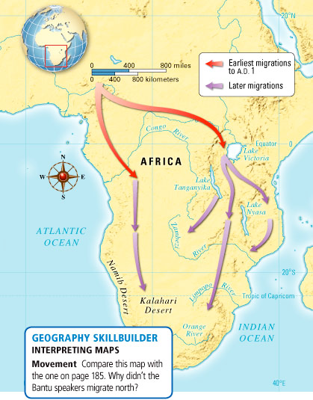
Migrations of Bantu-Speakers
Spread their agricultural skills, built canoes, diseases like Malaria, and assimilated people into their culture
By 400 C.E. they arrived in South Africa, ending the migration

Slide 3
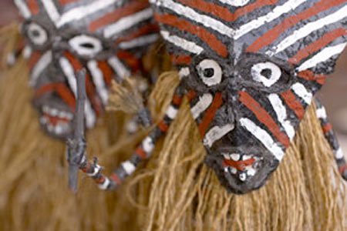
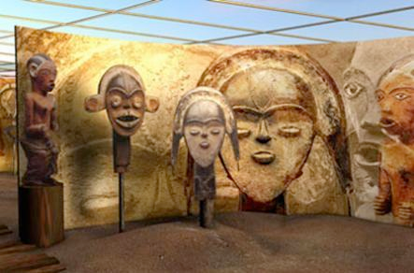
More on the Bantu
Were close-knit communities where they would trace their ancestry through their mothers, not their fathers
Believed in many spirits inhabiting the world, but one god
Story-telling people who created masks and sculpted figures to represent dead ancestors

Slide 4
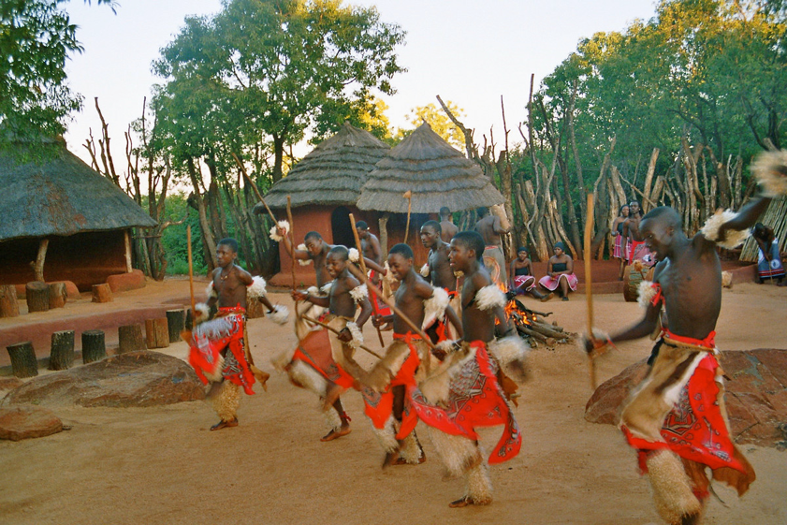
Political Structures of Inland Africa
Did not have one dominant figure or a strong central government, instead families governed themselves
As population grew, so did competition between tribes

Slide 5
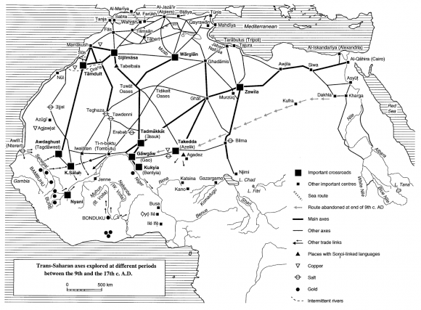
Trans-Saharan Trade

Slide 6
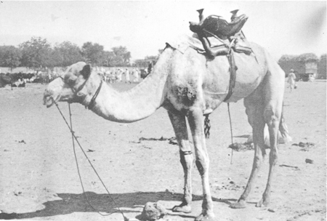
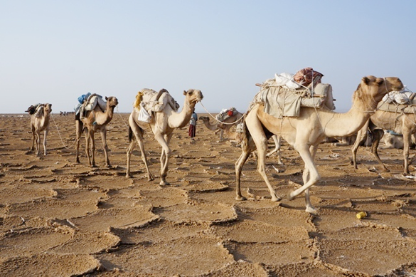
Camels and Trade
Replaced horses and donkeys as the main vehicles of trade
Developed multiple types of saddles based on the need for battles (sitting on top) trade (carrying loads) or front or back for better control
Gold, Ivory, Slaves, traded from Africa for Salt, textiles, and horses

Slide 7
Indian Ocean Trade
Islamic Merchants rejuvenated maritime trade in the 8th century
Swahili city-states (which means coasters) were major centers of trade on the East African coast
Brought the cities wealth and rich merchants homes were built of stone or coral, instead of trade

Slide 8
the Kingdoms of Ghana and Mali
Ghana had a strong-centralized government with an army equipped with iron weapons, traded gold and ivory
In Mali, Timbuktu and Gao accumulated the most wealth, with the kingdom founded by Sundiata, called the “Lion Prince”

Slide 9
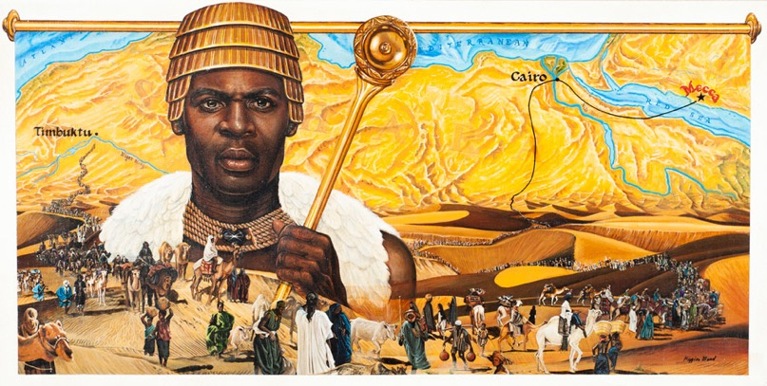
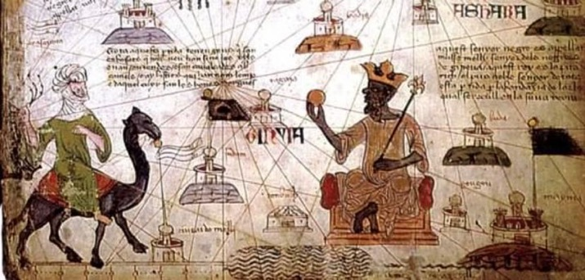
Mansa Musa
Known for his religious leadership more than his political or economic stuff
In 1324 he took a pilgrimage to Mecca, consisting of 100 camels, thousands of slaves and soldiers, and gold to distribute as he went
He was the richest man in the world and brought down the value of gold in Mecca because of the amount he brought, he helped Islam spread in Africa

Slide 10
Social Structures
Women’s Roles: communities were patriarchal, but women were still major players
Even with the introduction of Islam, women didn’t wear the hijab, since it may have been considered a cultural tradition in the Middle East, and not a religious requirement

Slide 11
Slavery in Sub-Sahara Africa
Private property did not exist, so the accusation of slaves showed social status
Arab traders preferred women over men, and put them to work as servants or concubines, male slaves were used in the military or agricultural
The Kanji Rebellion (around 870), led by Ali bin Muhammad was successful for 10 years in modern-day Iraq capturing the city of Basra, but was squashed 10 years later

Slide 12
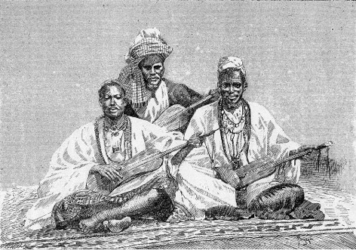
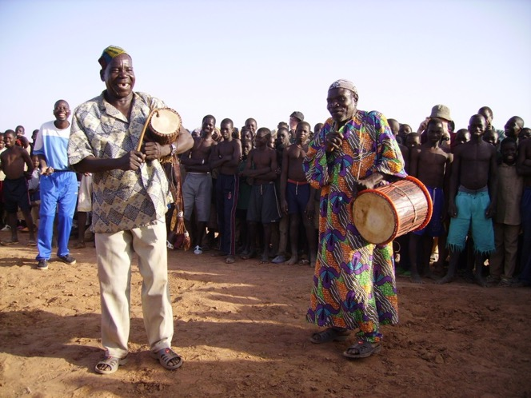
Sub-Saharan Culture
The Griots, were storytellers who possessed encyclopedic knowledge of family lineages and other info
Both venerated and feared, said could sing to your successes, or sing your downfall
This position was held both by men and women

Slide 13
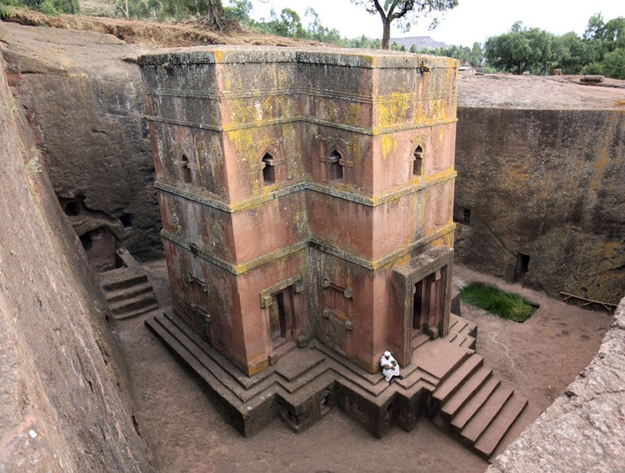
Last slide on Culture
Bantu language melded with Arabic to form Swahili
Ethiopian kingdom, known as Axum, kept Christianity up and practiced the old form of worship, isolated from the rest of the world
11 rock churches which are still used today, carved out of solid bedrock

