Slide 1
The First River Valley Civilizations
3500 BCE - 1500 BCE

Slide 2
Civilization
Your book lists the following requirements of a civilization:
Cities serve as administrative centers
Political system is based on the control of a defined territory
Specialization of labor (non-food-producing)
Status distinction (based on wealthy elites)
Monument building
Record keeping system
Long distance trade
Advances in arts/science

Slide 3
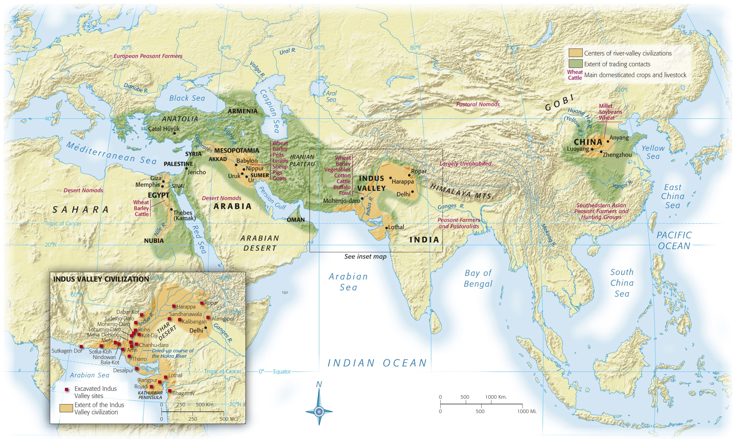
Notes:
Map 2.1: River-Valley Civilizations, 3500–1500 B.C.E.
The earliest complex societies arose in the floodplains of large rivers: in the fourth millennium B.C.E. in the valley of the Tigris and Euphrates Rivers in Mesopotamia (modern Iraq) and the Nile River in Egypt, in the third millennium B.C.E. in the valley of the Indus River in Pakistan, and in the second millennium B.C.E. in the valley of the Yellow River in China.

Slide 4
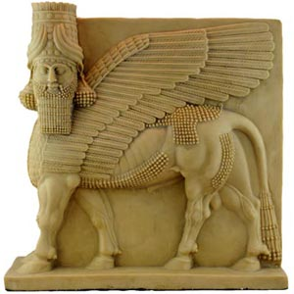
MESOPOTAMIA

Slide 5
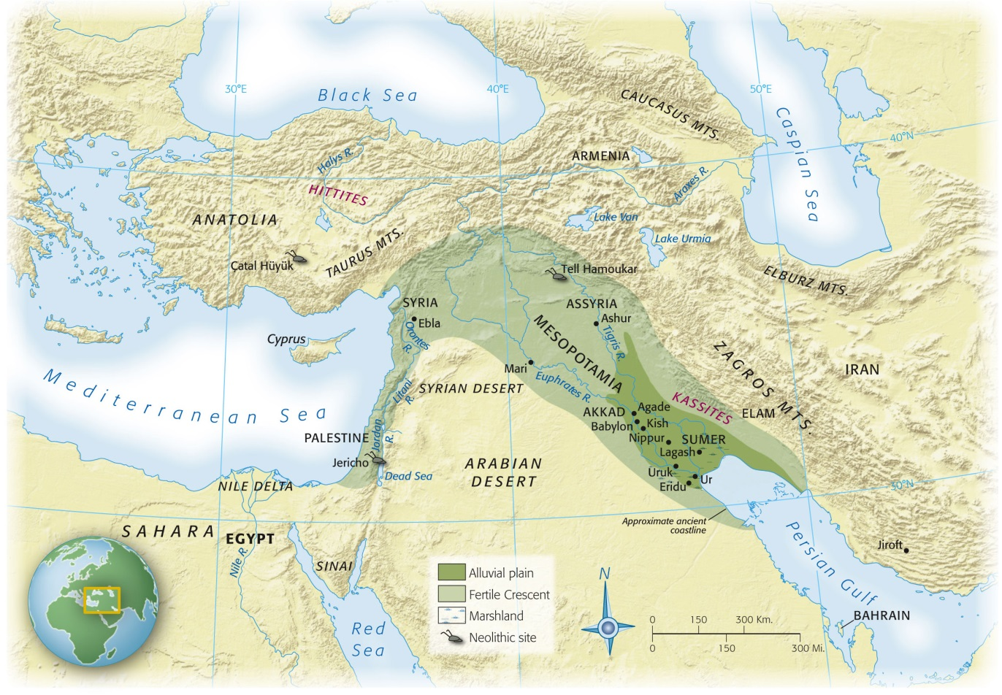
Mesopotamia
“Land between the rivers” (Tigris and Euphrates)
Modern day Iraq
Agriculture reached Mesopotamia c. 5,000 BCE
Not enough annual rainfall
Dependent on irrigation and canals
4,000 BCE use of ox drawn plows appear
First united by Sargon of Akkad in 2350 BCE

Slide 6
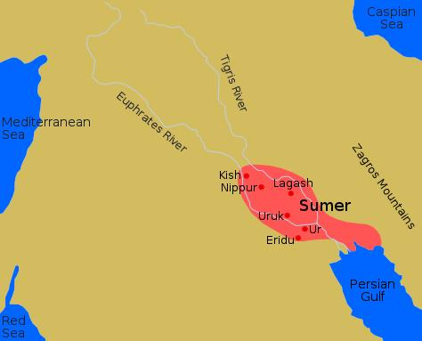
Sumerians
Laid the framework for Mesopotamian culture and civilization beginning in 5,000 BCE
Spoke Semitic language
Hebrew, Aramaic, Phoenician, Arabic
3400 Year Old Song
(Click to listen)

Slide 7
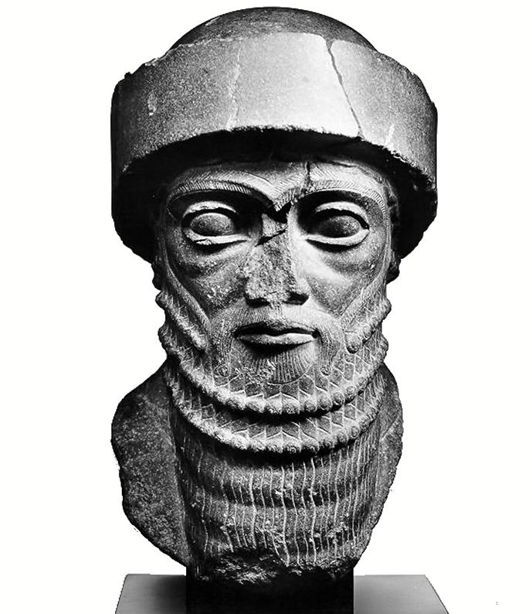
Babylon
Persians conquered Sumer and moved capital to Babylon
Adopted many Sumerian traditions
Patriarchal society
Women did have more rights than under Sumerians
Arranged marriages
Hammurabi

Slide 8
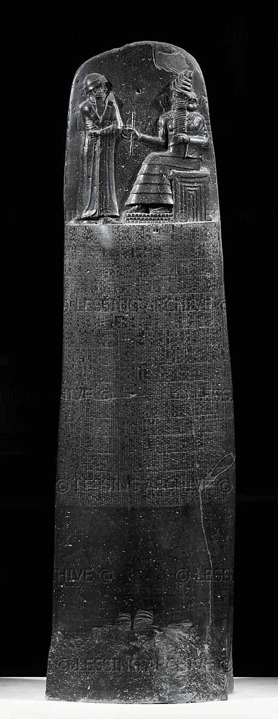
Hammurabi
Greatest Babylonian king
Established “order” through taxes, administration, laws
Laws replaced vengeance with court system
Created stability and justice
Code of Hammurabi
282 laws published on black stone pillars
Allowed ALL citizens to see laws
Illustrative examples for judges to use in legal cases
“eye for an eye”
Many severe punishments
Punishments dependent on social class of defendant

Slide 9
Politics and Society
Politics
Society
City-state organization
Urban center and the surrounding rural areas
Most worked fields, some specialized labor
Pottery, artwork, clothing, weapons, tools
Specialists depended on the food surplus created by rural workers
3 classes
Free, land owners
Royalty, officials, warriors, priests, merchants
Those dependent on farmers/artisans
Rural work force
Slaves
Identified by haircut
Women
Child bearing and care
Could own property
Could engage in trade
Decline in status after 2nd millennium BCE

Slide 10
Religion
Centrally located temples dedicated to the deity/deities within cities
Temple = residence of the god(s)
Polytheistic
Gods embodied nature
Used gods to explain natural disasters
anthropomorphic
Ziggurat
Priests
Owned land
Prominent in politics/economy
Amulets
Charms that protect the wearer from evil
Proof of widespread belief in magic

Slide 11
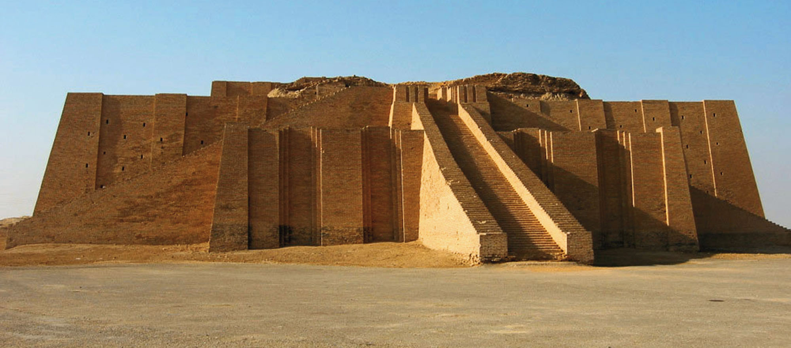
p. 34
Notes:
Ziggurat of Ur-Nammu, ca. 2100 B.C.E.
Built at Ur by King Ur-Nammu for the Sumerian moon-god, Nanna, an exterior made of fine bricks baked in a kiln encloses a sun-dried mudbrick core. Three ramps on the first level converge to form a stairway to the second level. The function of ziggurats is not known.

Slide 12
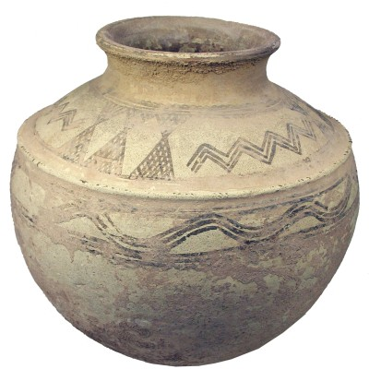
Technology
Canals, dams, dikes for irrigation
Cuneiform
Wedge-shaped writing
Reed stylus push shapes into clay
Clay
Storage/dishware
Potter’s wheel, 4,000BCE
Bronze
Tools, weapons
Sharper than stone
Did not break as easily as stone
Easier to repair than stone
Military
Horse drawn chariot
Paid, full-time army
Mathematics
System based on 60
60 seconds in a minute, etc
Astronomy

Slide 13
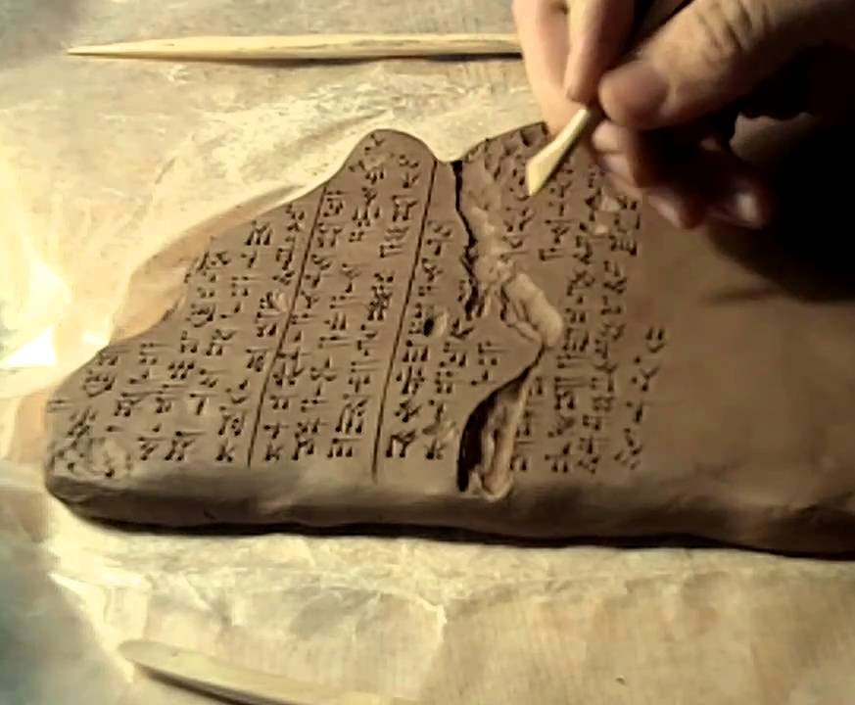

Slide 14
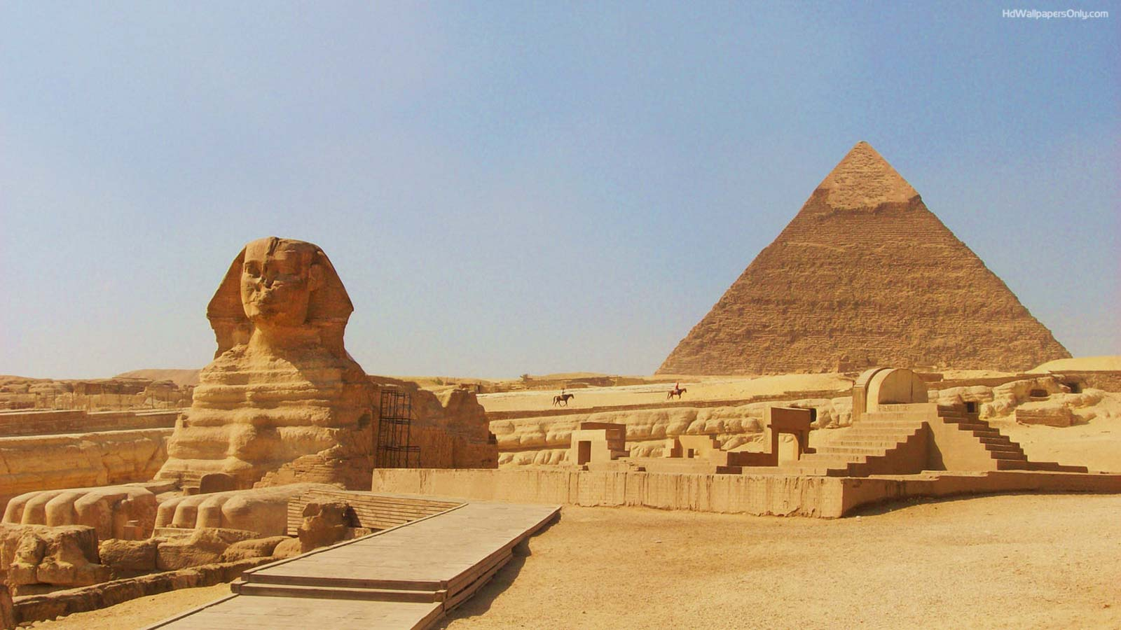
EGYPT

Slide 15
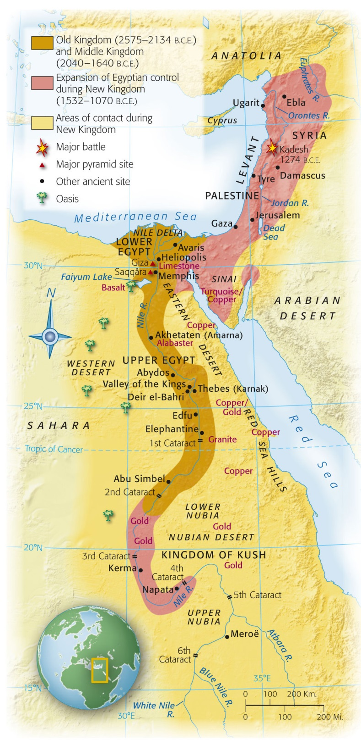
Notes:
Map 2.3: Ancient Egypt.
The Nile River, flowing south to north, carved out of the surrounding desert a narrow green valley that became heavily settled in antiquity.

Slide 16
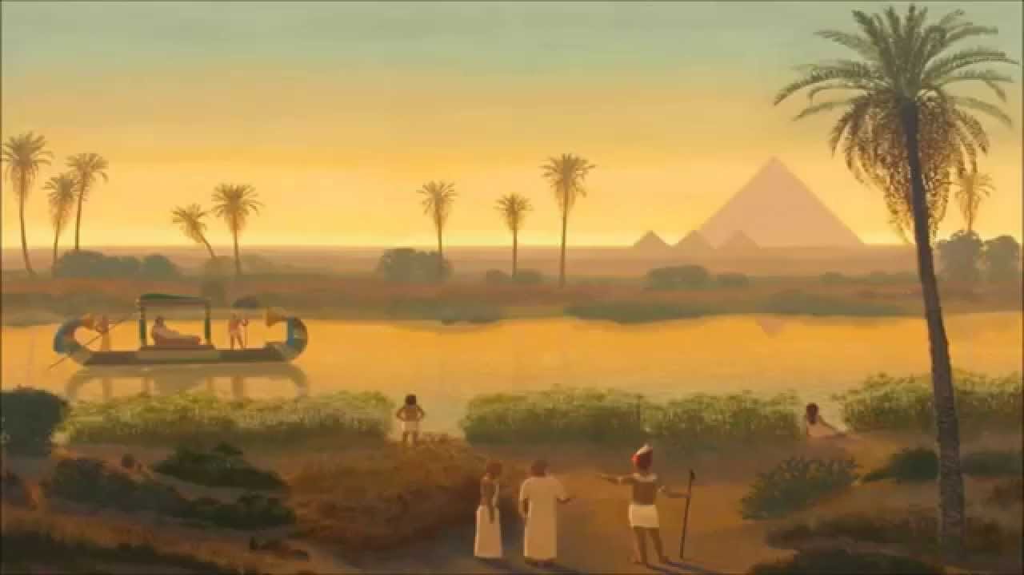
Egypt
Natural isolation from other parts of the world
Self-sufficient (unlike Mesopotamia who depended on imports)
The Nile
World’s longest river / flows from south to north
Egypt called “the Gift of the Nile” by Herodotus (Greek traveler)
Majority of Egyptian population lived on the banks of the lush Nile
Agriculture dependent on the predictable Nile floods

Slide 17
Religion
Natural world is a place of cycles
Re (sun god)
Made his way across the sky by day
Went to the Underworld at night to return the next morning
Osiris (king of Underworld)
Horus-associated with the pharaoh
Cults of gods would form in cities/villages
Prominence of a god(s) depended on the ruler (see ch 4)

Slide 18
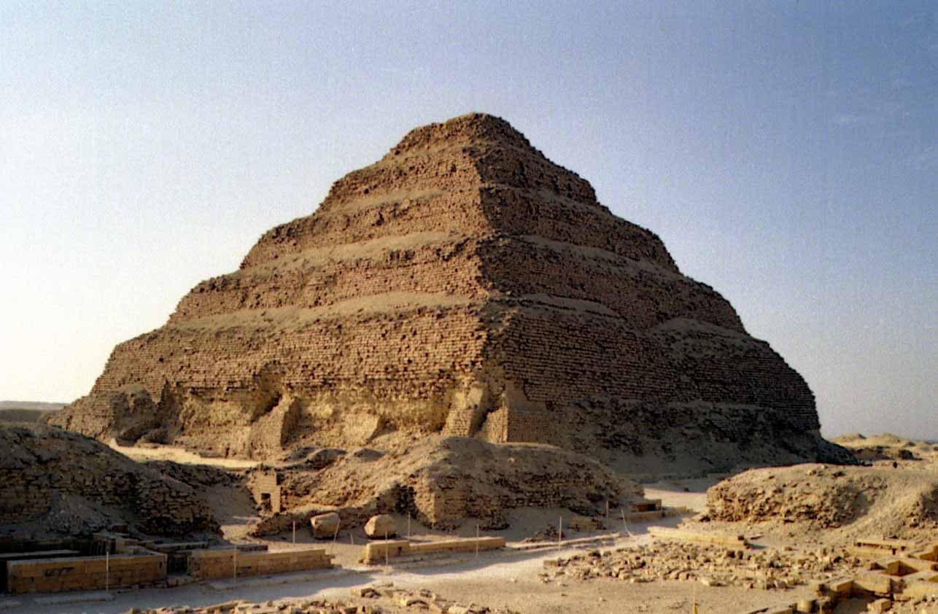
Politics and Religion
Pharaoh: Egyptian king
Considered to be a god sent to maintain ma’at (order of the universe)
Death= journey that returned the pharaoh to the gods
Pyramids
Tombs of pharaohs
Simple tools and MASSIVE amounts of human labor
Saqqara
Step pyramids of Djoser
Near Memphis
Giza
Menkaure, Khafre, Khufu

Slide 19
Death and the Afterlife
Book of the Dead
Rituals/spells to protect the spirit on journey to afterlife
Weighing of the deceased heart in the Underworld
Determines if s/he had a good life and deserves rewards
Tomb reflected status and wealth of the deceased
Poor/common people: graves or simple mud-brick tombs
Elite/kings: elaborate tombs/pyramids

Slide 20
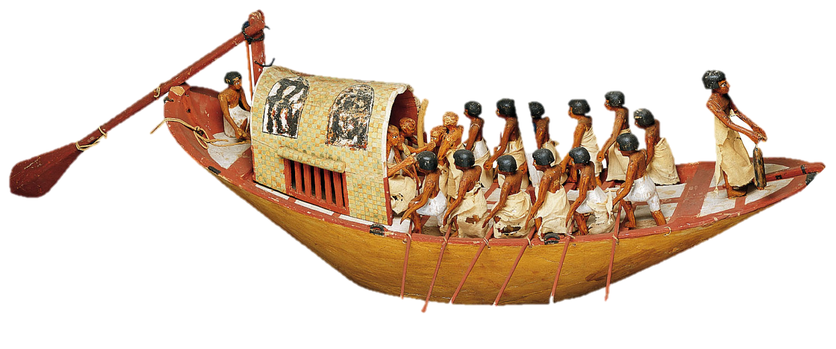
Notes:
Model of Egyptian Riverboat, ca. 1985 B.C.E.
This model was buried in the tomb of a Middle Kingdom official, Meketre, who is shown in the cabin being entertained by musicians. The captain stands in front of the cabin, the helmsman on the left steers the boat with the rudder, while the lookout on the right lets out a weighted line to determine the river’s depth. Lightweight ships equipped with sails and oars were well suited for travel on the peaceful Nile and sometimes were used for voyages on the Mediterranean and Red Seas.

Slide 21
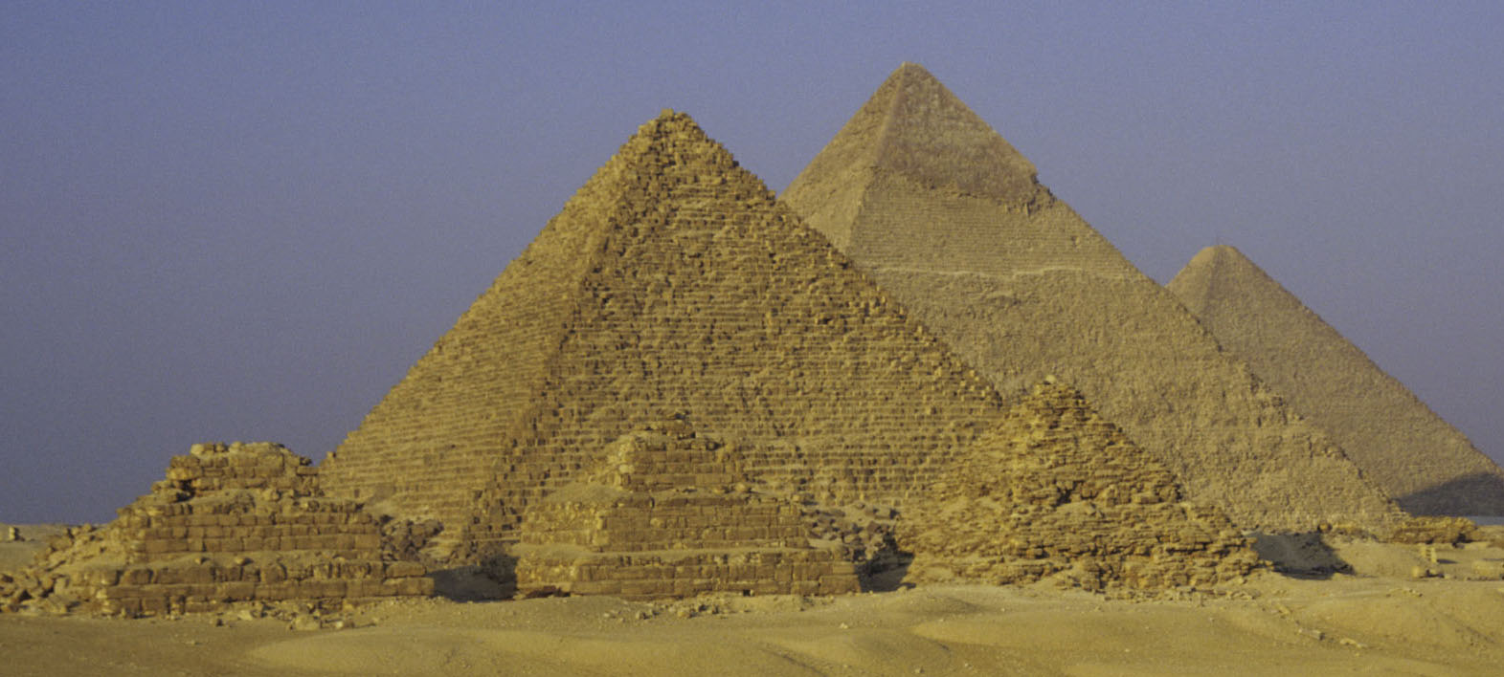
Notes:
Pyramids of Menkaure, Khafre, and Khufu at Giza, ca. 2500 B.C.E.
With a width of 755 feet (230 meters) and a height of 480 feet (146 meters), the Great Pyramid of Khufu is the largest stone structure ever built. The construction of these massive edifices depended on relatively simple techniques of stonecutting, transport (the stones were floated downriver on boats and rolled to the site on sledges), and lifting (the stones were dragged up the face of the pyramid on mud-brick ramps). However, the surveying and engineering skills required to level the platform, lay out the measurements, and securely position the blocks were very sophisticated and have withstood the test of time.

Slide 22
Politics
Upper and Lower Egypt united by Menes
Dynasties
Period of rule by pharaohs of a certain family line
History divided into Old, Middle, New Kingdoms
Memphis: capital of Old Kingdom
Thebes: capital of Middle/New Kingdoms
Administrative system
Extensive bureaucrats
At times positions became hereditary
Taxes
Monopoly of economy/trade
Literate administrative class

Slide 23
Technology
Hieroglyphics
Picture symbols representing words, sounds, syllables
Eventually evolved into a cursive form
Scribes copied texts onto papyrus scrolls
Made from a papyrus reed
Exported papyrus (along with grain and gold) to the Levant (Israel, Palestine, Lebanon, Syria)
Science and Math
Knowledge of anatomy due to mummification
Most accurate calendar in the world through celestial observations
Engineering: pyramids, etc

Slide 24
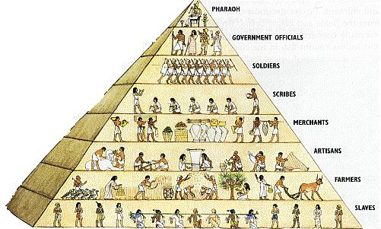
Society

Slide 25
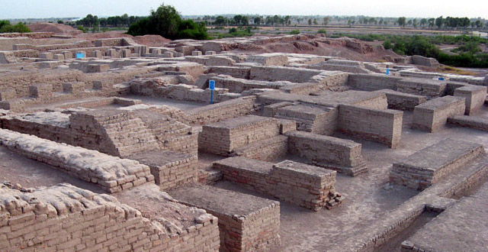
INDUS RIVER VALLEY

Slide 26
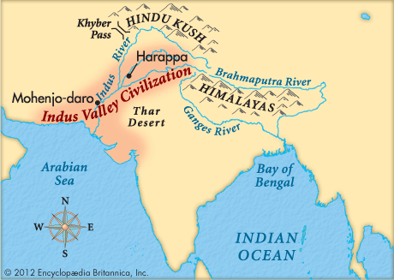

Slide 27
Indus River Valley
Modern day Pakistan
Floods and monsoon rains allow for agriculture
Great access to metals
More of the general population had access to metal tools, etc than in Mesopotamia and Egypt
Pottery
Skilled in pottery making
Large buildings dedicated to kilns/pottery
Trade
Evidence of widespread trading
Iran, Afghanistan, India, Mesopotamia
Cities abandoned after 1900 BCE
Natural disasters, ecological changes
Loss of fertile soil

Slide 28
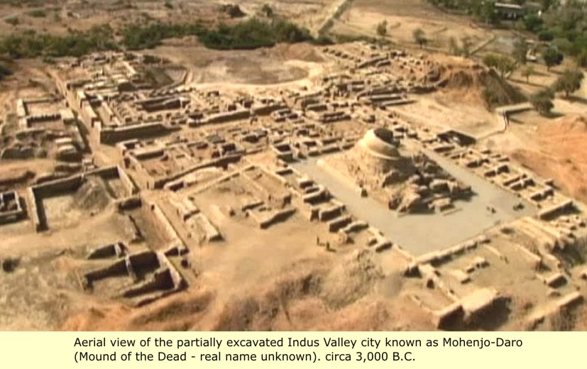
Harappa and Mohenjo-Daro
Mohenjo-Daro was larger than Harappa
Uniformity in city layout
Thick wall surrounded both cities
Rectangular grid pattern of streets
“Sewage system” had covered drains that carried waste away from the city

Slide 29
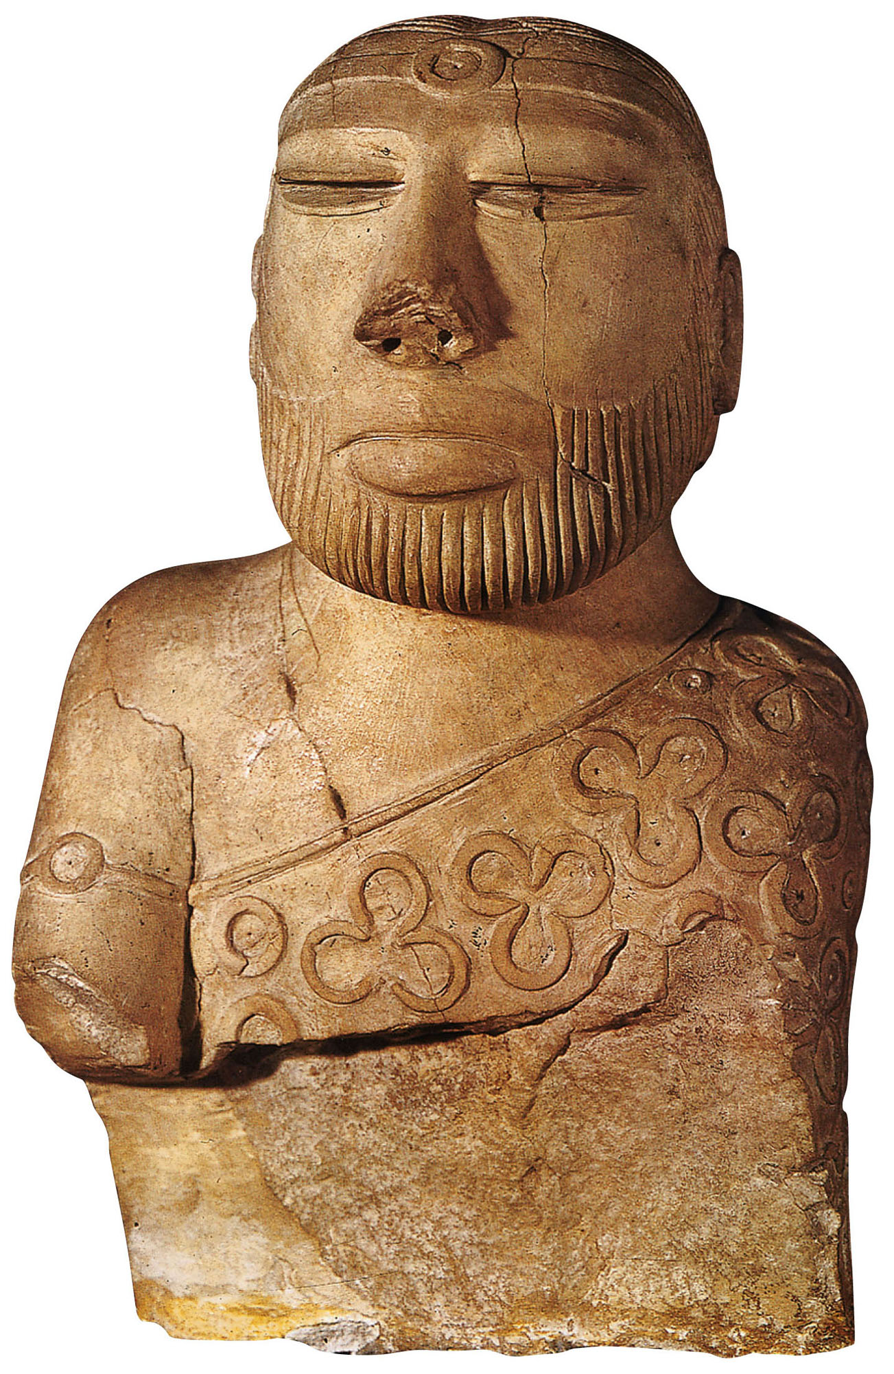
p. 47
Notes:
Man from Mohenjo-Daro, ca. 2600–1900 B.C.E.
This statue of a seated man wearing a cloak and headband was carved from a soft stone called steatite. It is often called the “Priest-King” because some scholars believe it may represent someone with religious and secular authority, but the true identity and status of this person are unknown.

Slide 30
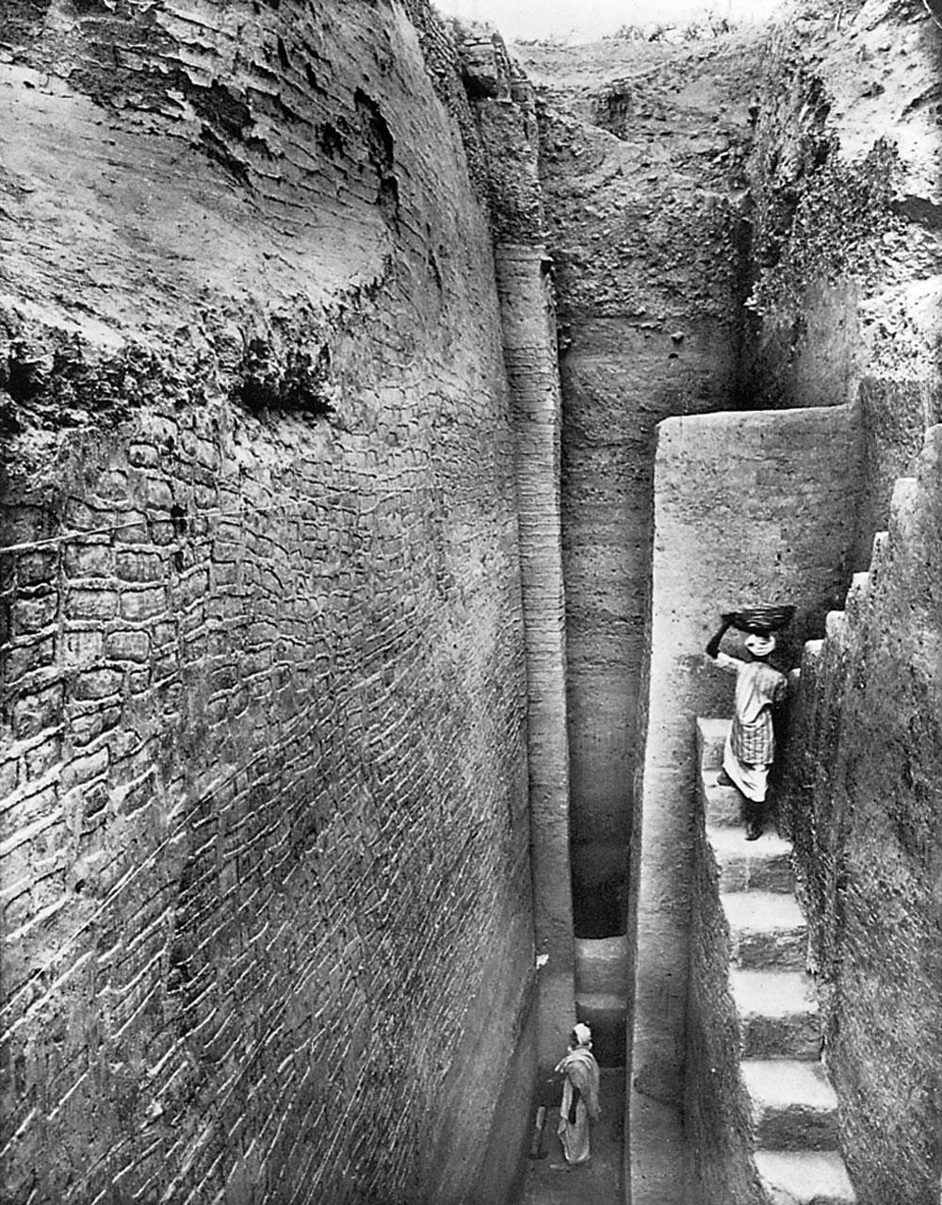
p. 48
Notes:
Mud-Brick Fortification Wall of the Citadel at Harappa.
Built upon a high platform, this massive construction required large numbers of bricks and enormous man-hours of labor.

Slide 31
p. 29

Slide 32
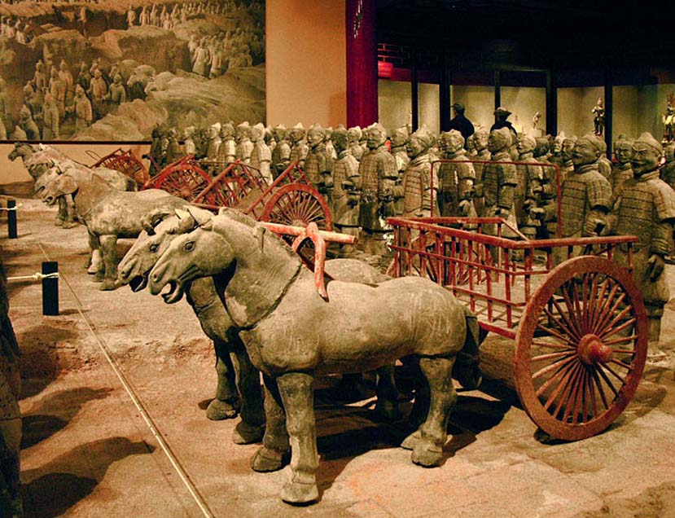
China

Slide 33
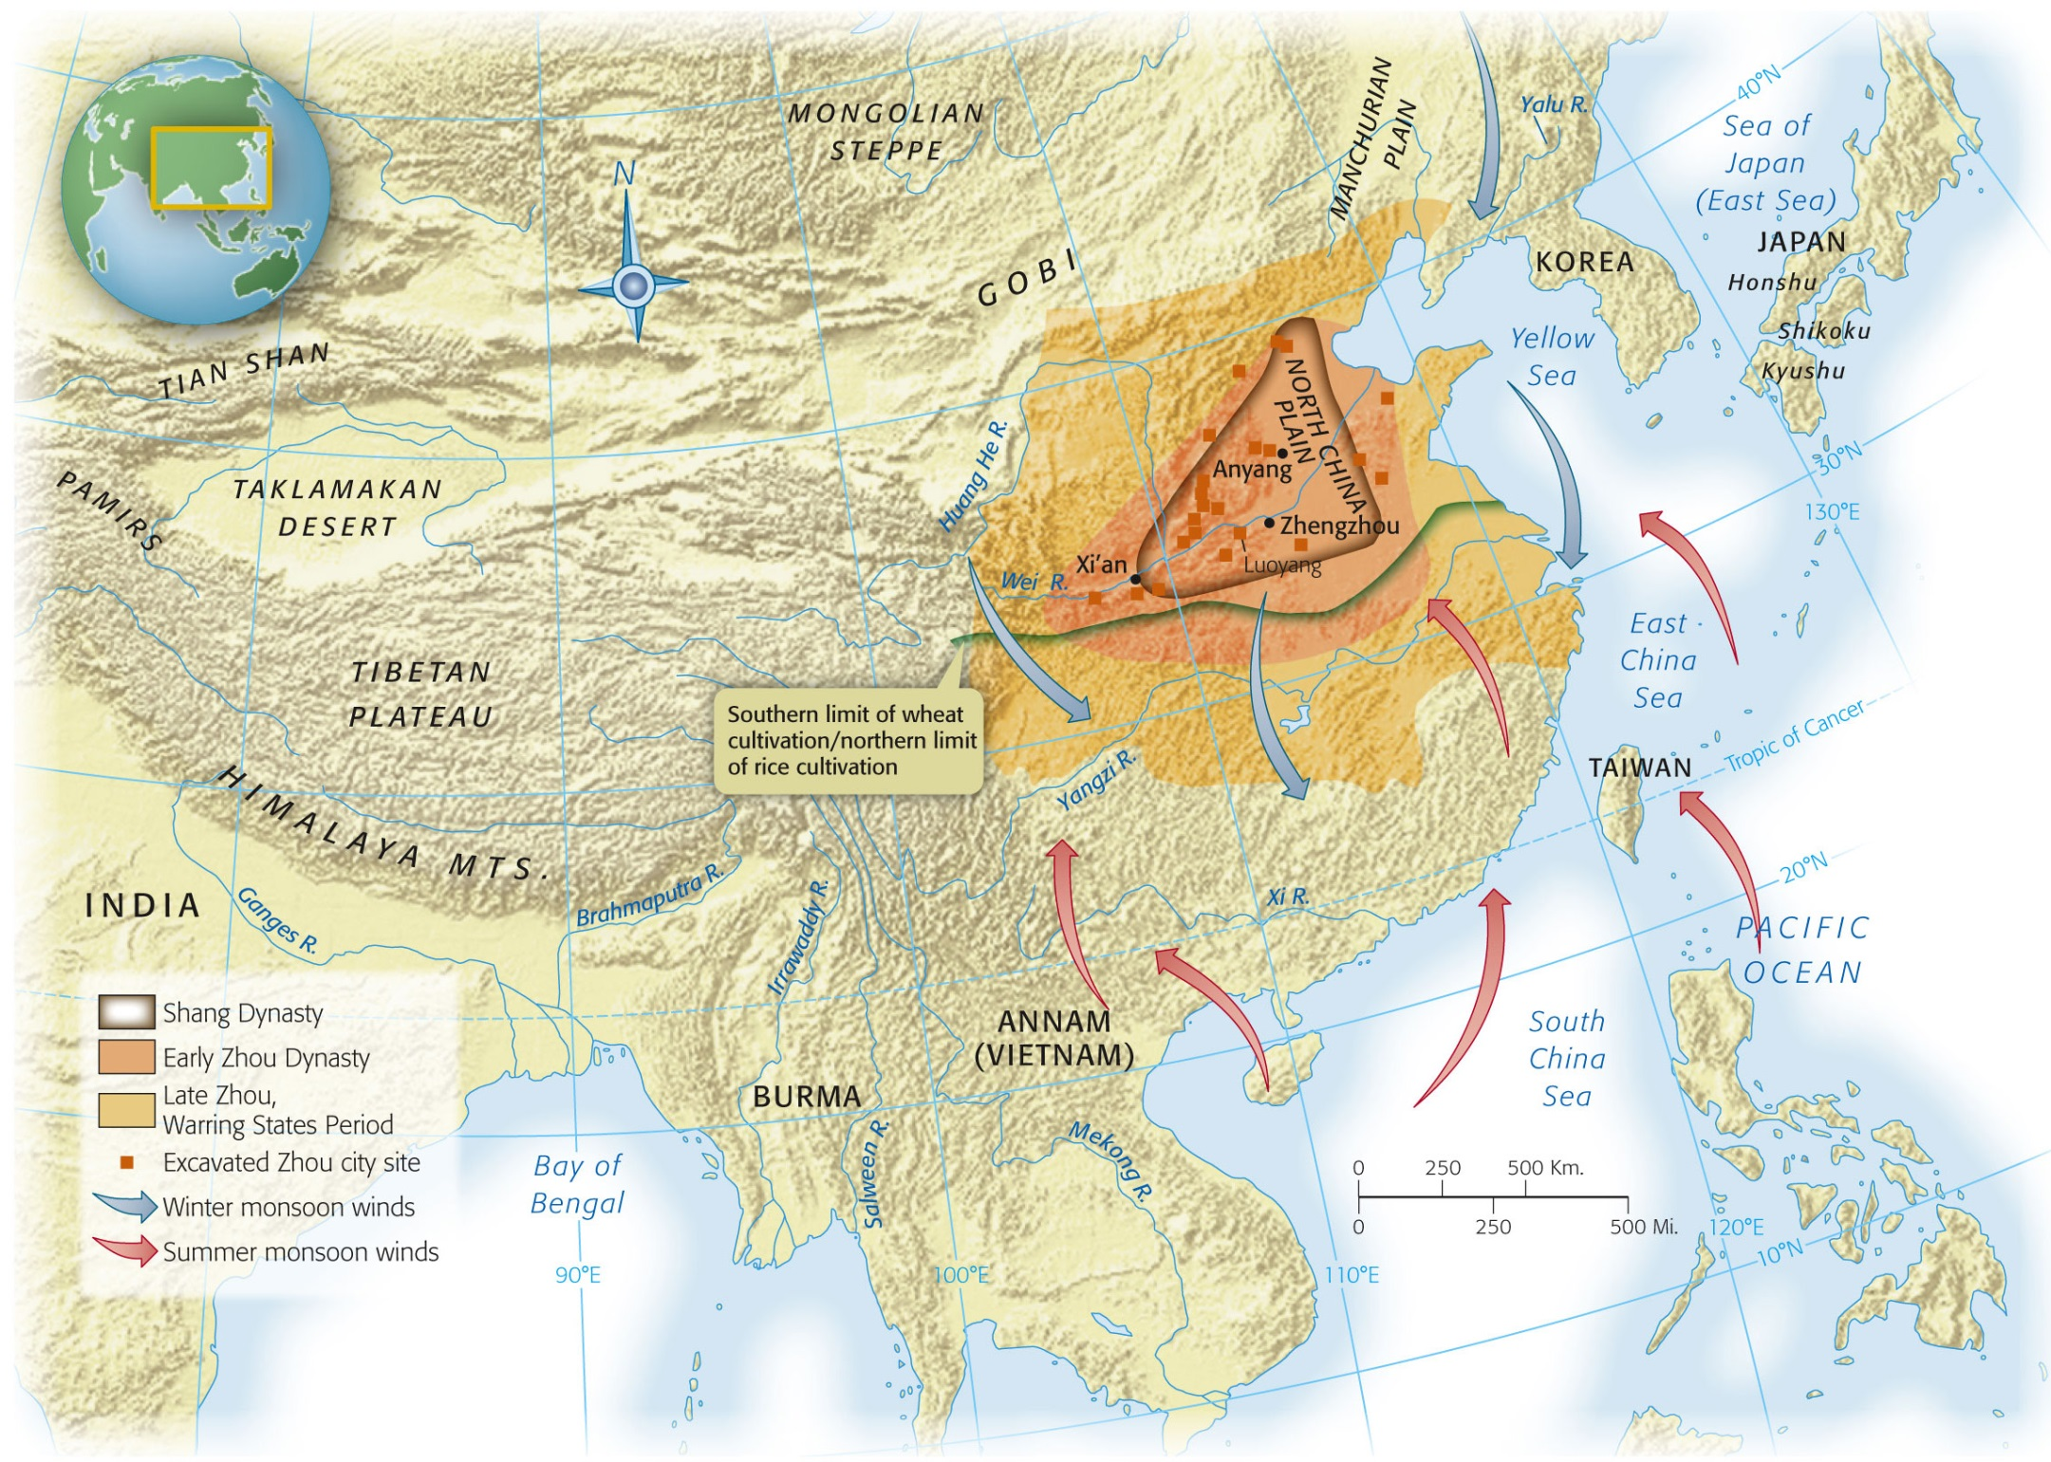
Map 3-1, p. 57
Notes:
Map 3.1: China in the Shang and Zhou Periods, 1750–221 B.C.E.
The Shang dynasty arose in the second millennium B.C.E. in the floodplain of the Yellow River. While southern China benefits from the monsoon rains, northern China depends on irrigation. As population increased, the Han Chinese migrated from their eastern homeland to other parts of China, carrying with them their technologies and cultural practices. Other ethnic groups predominated in more outlying regions, and the nomadic peoples of the northwest constantly challenged Chinese authority.

Slide 34
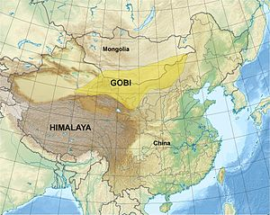
Geography
“Isolation”
Mountain ranges
Deserts
Mongolian steppe
Pacific Ocean
Evidence of trade with India/Central Asia

Slide 35
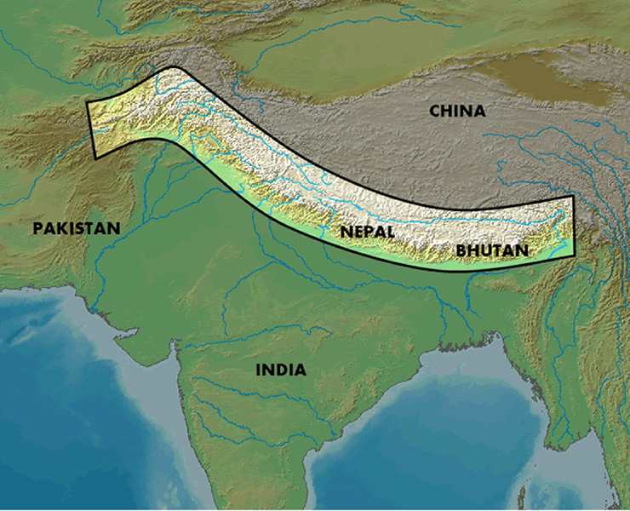
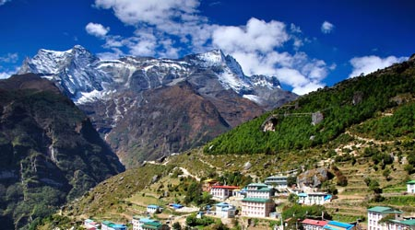
Himalayas

Slide 36
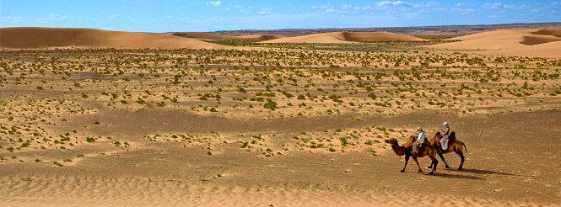
Gobi Desert

Slide 37
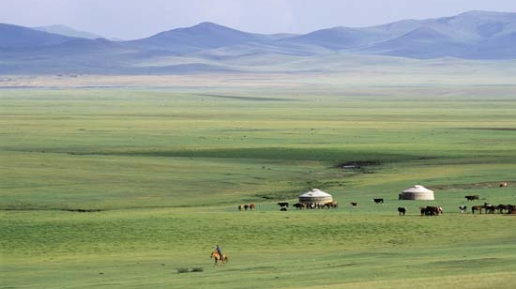
Mongolian Steppe

Slide 38
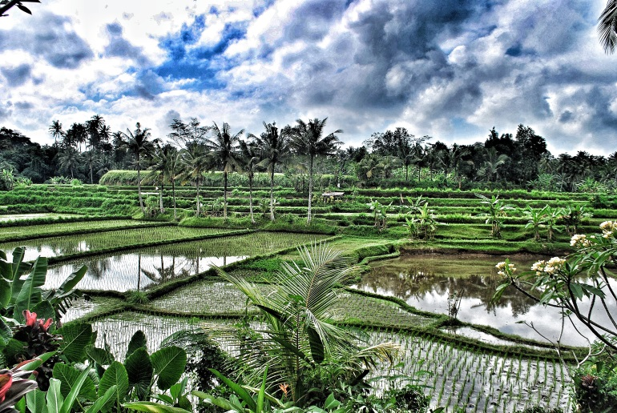
Agriculture
Northern China
Southern China
Deforestation
Retaining walls
Millet and wheat
Monsoons allow for agriculture
Rice
Rice paddies
Flooding of fields
Feeds more people per acre
More populous than the north

Slide 39
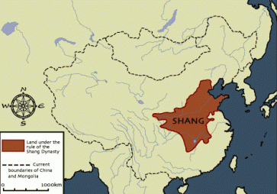

Slide 40
History of China
Follows the Xia Dynasty
Xia is not historically confirmed
China’s history begins with the Shang
Oracle Bones
Where we get our info about the Shang
Animal bones/shells
Used to contact “ancestral spirits”
Gives info on king, court, religion, society

Slide 41
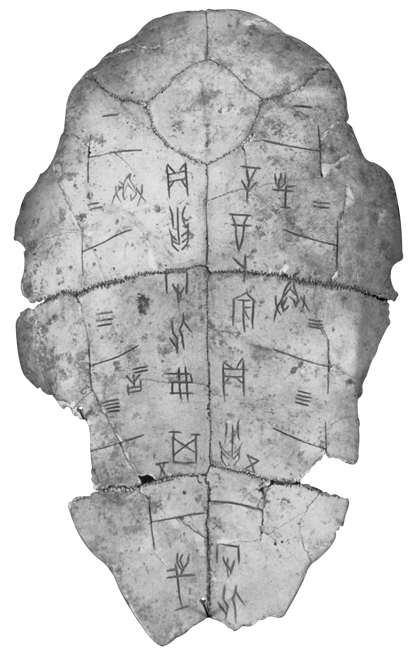
Notes:
Chinese Divination Shell.
After inscribing questions on a bone or shell, the diviner applied a red-hot point and interpreted the resulting cracks as a divine response.

Slide 42
Religion and Afterlife
Supreme god (Di) resides in the sky
Responsible for storms
Distant from humans
Death
Spirits reside with Di
Ancestral spirits can intervene on behalf of family members
Ruler has direct contact with ancestors who can intercede with Di
Ancestor veneration and ruler contact with ancestors is effective rationale for rule
Tombs of elite class
Ornate vessels used to contact ancestral spirits
Buried with family members and servants

Slide 43
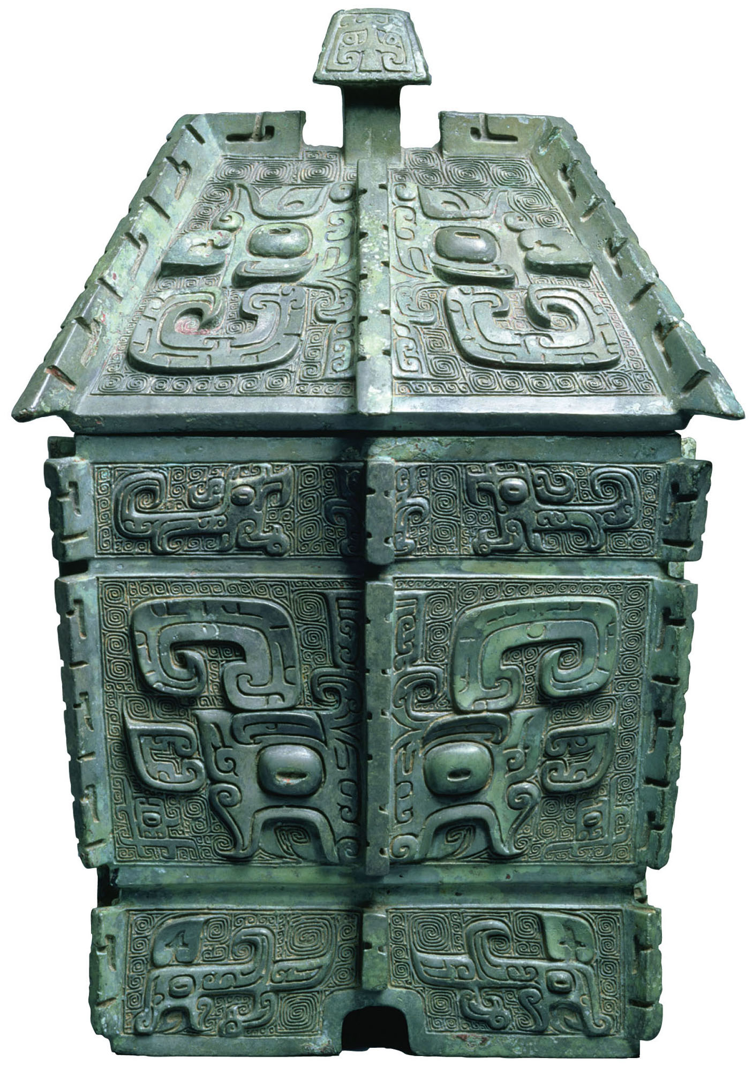
p. 56
Notes:
Shang Period Bronze Vessel.
Vessels such as this large wine jar were used in rituals by the Shang ruling class to make contact with their ancestors. As both the source and the proof of the elite’s authority, these vessels were often buried in Shang tombs. The complex shapes and elaborate decorations testify to the artisans’ skill.

Slide 44
Technology
Writing system
100s of characters
Used in court
Bronze weapons
Horse drawn chariots
Originated in W. Asia

