Slide 1
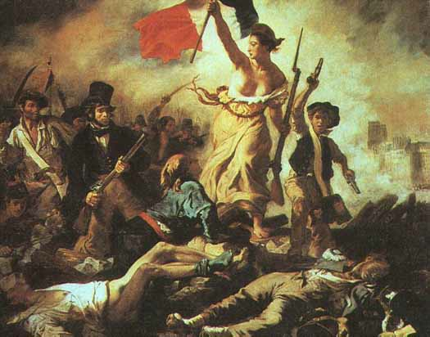
The French Revolution
Background:
A. In the 1770s, France made up of three large social classes
called estates.
1. The First Estate = The Roman Catholic higher and lower
clergy
a. Made up 1% of the population
b. Owned 10% of the land
c. Only contributed about 2% of its income to the
government
d. Scorned Enlightenment ideas

Slide 2
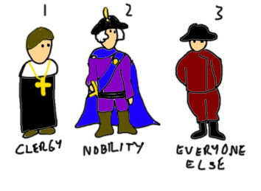
2. The Second Estate = rich nobles: Held highest offices in
government
a. Made up 2% of population
b. Owned about 25% of land
c. Basically did NOT pay taxes
d. Scorned Enlightenment ideas
3. The Third Estate = Bourgeoisie, urban lower class and peasant
farmers
a. Made up about 97% of population
b. Paid about 50% of income to government in taxes
c. Owned about 40% of the land
d. Had no power to influence government
e. Resented wealthy First and Second Estates
f. Embraced Enlightenment ideas
Question: Why might the First and Second Estates be opposed to change?

Slide 3
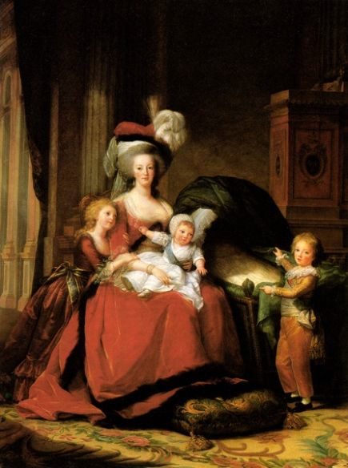
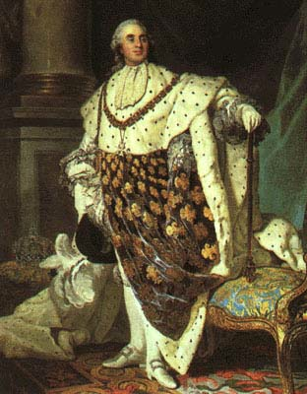
Notes:
http://www.thefashionhistorian.com/2012/03/chemise-la-reine.html

Slide 4
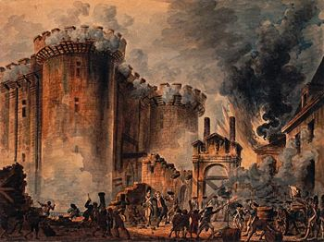
The Third Estate wanted rights and this led to the storming of the Bastille in Paris… the people went to get weapons at the Paris prison July 14, 1789.

Slide 5
II. Causes of the French Revolution
A. Political
3rd Estate wanted greater representation
Louis XVI was a weak leader
Wife unpopular
Inspired by American Revolution
B. Economic
Debt caused by war & royal extravagance & debt from financing of American Revolution
Inflation, famine
Peasants made little $$ but paid high taxes
C. Social
3rd Estate resented 1st and 2nd Estate privileges
Enlightenment ideas of liberty and equality spread

Slide 6
III. Effects of the French Revolution
A. Political
Succession of types of governmental rule = monarchy to republic to dictatorship, and finally to a restored monarchy
Expectations for freedom, equality
Sparked later revolutions
B. Economic
Economy falls because of war and revolution
C. Social
French feudal system abolished

Slide 7
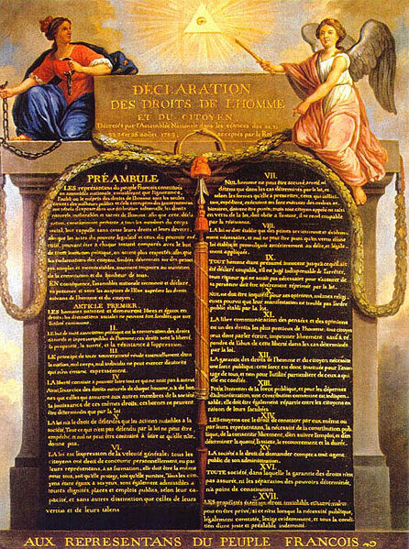
IV. The French Revolution
A. End of Old Order
1. August 4, 1789:
National Assembly voted
a. all male citizens could
hold government, army
or church office
b. nobles gave up feudal
dues & agreed to be
taxed
c. Composed Declaration
of the Rights of Man
Notes:
Under the old system each Estate met separately and had one vote. The Third Estate demanded they all meet together and each delegate have one vote. This Third Estate had as many delegates as the First & Second Estates combined. The nobles didn’t like this so the king ordered them to follow the old rules. The Third Estate didn’t give up. They met and on June 17 they named themselves the National Assembly. They broke into an indoor tennis court and pledged to stay until they wrote a new constitution.

Slide 8
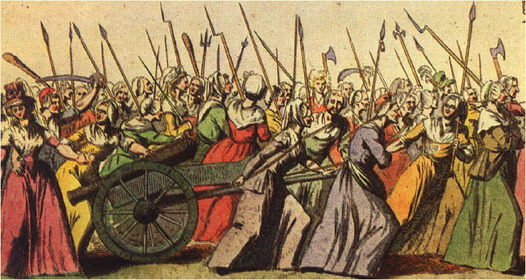
B. The Declaration of the Rights of Man and of the Citizen (Aug. 1789)
Stated all men equal, free
“liberty, property, security, & resistance to oppression”
Freedom of speech, press, religion
Right to vote (had to
pay minimum tax)
October 1789, thousands of Parisian women rioted over rising bread prices
How did the women’s march mark a turning point in the relationship between
The king and the people?

Slide 9
C. Limited Monarchy - 1791
1. Legislative Assembly established
2. Government controlled by wealthy middle class
D. War
Other European countries feared spread of ideas
France declared war 1792; men & women in army
Paris went crazy; 1,000s killed
Notes:
The National Assembly seizes Church property and sells it to pay off French national debt. This upset the peasantry which was predominantly Catholic.
Still struggling with food shortages & debt. The radicals sat on the left, the moderates in the middle & conservatives on the right. That’s where we get the terminology.

Slide 10
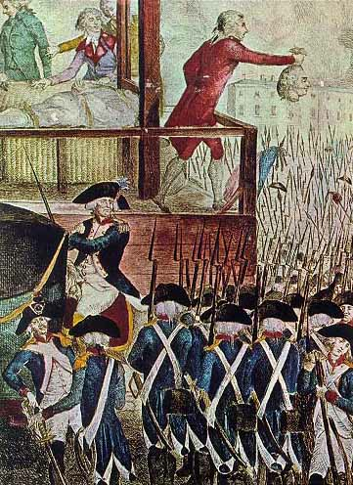
Imprisoned royal family August 1792
Republic formed September 1792… “liberty, equality,
and fraternity”; vote extended to all males regardless of property (Women left out!)
6. Jacobins – club that supported republic
7. Tried Louis XVI for treason - guillotined
The guillotine was created by
Dr. Joseph Guillotine as a more humane way to execute people

Slide 11
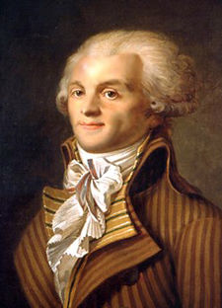
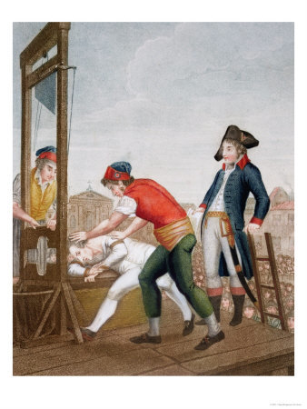
V. Reign of Terror
Robespierre - Jacobin leader of Committee of Public Safety - became dictator
New calendar
To protect revolution from enemies of revolution
Enemies tried in morning, guillotined in afternoon
40,000 killed
Ended 1794 - Robespierre guillotined

Slide 12
VI. New government = Republic
Two house legislature
Directory - 5 men have executive power
Power with middle class

Slide 13
Quick Review:
1. Who made up each of the Estates?
2. Which of the Estates had the greatest population and paid the
most taxes?
3. What were the Economic causes of the French Revolution?
4. What were the Social causes of the French Revolution?
5. What were the Political effects of the French Revolution?
6. What was the Social effect of the French Revolution?
7. What role did the ideas of the Enlightenment play in the
French Revolution?

Slide 14
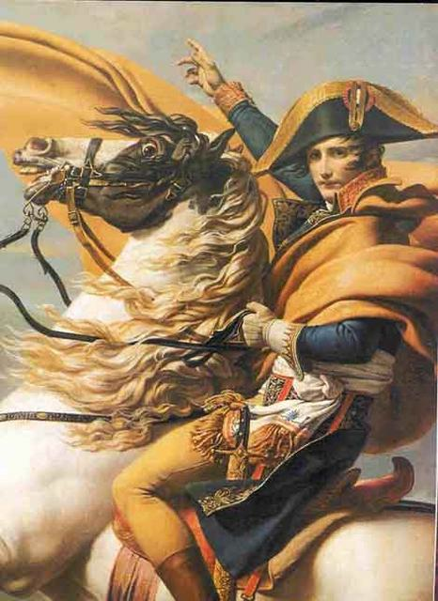
Napoleon Bonaparte
Military genius!

Slide 15
I. Napoleon’s Rise to Power
1789 - French Revolution
1795 - Napoleon defends against royalists
1796 – As general has victories in Italy against Austria & Sardinia
1799 - coup d'état brings him to power – he becomes a dictator (coup d'état means “quick seizure of power”)
1800 - plebiscites give him total power
1802- peace agreement w/ Britain, Austria and Russia
1804 - Napoleon crowned himself emperor
Notes:
1795 - On October 5, 1795, mobs of Parisians joined national guardsmen bent on toppling the Republic, and the government called on Bonaparte to repel the attack. Pbs.org
Napoleon leads successful campaigns in both Italy and Egypt. He conquers Cairo. In

Slide 16
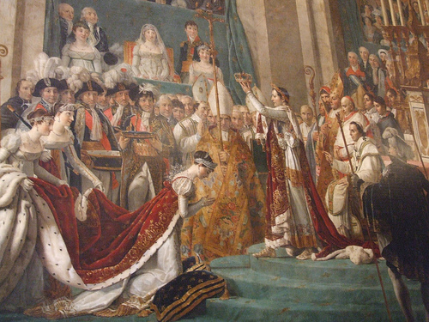
Crowned himself and wife Josephine: would not take orders from Pope

Slide 17
II. Napoleon Restores Order
Established Banking system
Efficient Tax system
Concordat - agreement w/ Pope Pius VII - church has influence but cannot control national affairs
Napoleonic Code - uniform set of laws
1. No freedom of speech, press
2. Slavery permitted & restored in French colonies in
Caribbean
Expanded empire to greatest extent 1807-1812
Notes:
Tried to end gov’t corruption. Dismissed corrupt officials, created lycees, gov’t run schools. People promoted based on merit rather than family connections.
Concord w Pope Pius VII – to repair the relationship with the church.
In the agreement the First Consul (Napoleon) was given the right to nominate bishops; the bishoprics and parishes were redistributed; and the erection of seminaries was allowed. The Pope (Pius VII) condoned the actions of those who had acquired church property, and by way of compensation the government engaged to give the bishops and curés suitable salaries. Britannica online

Slide 18
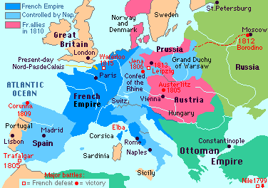

Slide 19
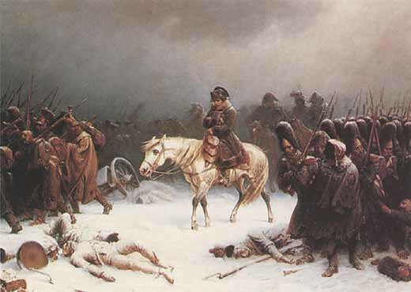
III. Causes of Napoleon’s defeat
Mistake | Effect
Continental System Blockade = Blockade against Great Britain | GB and other Europeans smuggled goods; GB responded with her own blockade
Peninsular War = Invasion of Spain | Spanish used Guerrilla warfare & defeated Napoleon; Nationalism turned conquered people against French
Invasion of Russia – Geography played a role in defeating Napoleon… he stayed until October… troops got caught in snow! | French defeated - ruined army Alex I - destroyed Moscow (scorched earth policy) rather than let Napoleon have it Napoleon forced to surrender, exiled to Elba

Slide 20
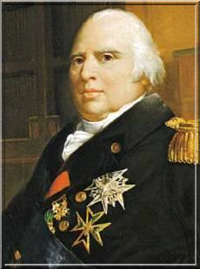
IV. Monarchy restored
Monarchy restored - Louis XVIII (Louis XVI’s brother) took throne
People feared he would undo revolutionary reforms
1. Napoleon took this as a
sign he should regain
power

Slide 21
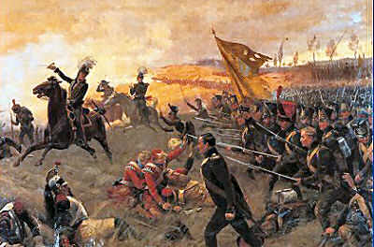
V. Hundred Days
Napoleon escaped from Elba in
1815
1. Welcomed by Paris crowds
2. W/in days emperor again
B. Hundred days - Napoleon’s last bid
for power
C. Europe - went to war
1. England led forces against
Napoleon
2. The Battle of Waterloo, Belgium – Napoleon’s final
defeat on June 18, 1815
D. Napoleon sent into exile on island of St. Helena
1. Died 1821

Slide 22
Quick Review:
Which country used guerrilla warfare tactics to defeat Napoleon?
In what way did geography help to defeat Napoleon in Russia?
What did Alexander I do that helped to defeat Napoleon in Russia?
When and where did Napoleon meet his final defeat?
What role did the Continental System play in Napoleon’s defeat?
What was the governmental secession during the French Revolution?

Slide 23
Napoleon: Far Reaching Consequences for Europe
“He was as great a man can be without virtue.” Alexis de Tocqueville

Slide 24
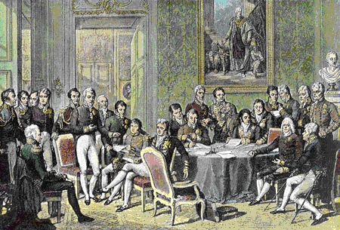
I. Congress of Vienna: Nov. 1814 – June 1815
Meeting for security and stability in Europe
Three goals:
1. Surround France with strong countries
2. Restore balance of power
3. Restore Europe’s royal families to thrones they had before
Napoleon
C. 1st time nations cooperated for peace; did not seek revenge on France; no war for 40 years

Slide 25
II. Further Consequences
Monarchies continue in Europe;
1. GB and France have constitutional monarchies
2. Central and Eastern Europe have absolute monarchies and create Holy Alliance to combat forces of Revolution - Russia, Austria, Prussia
B. Concert of Europe - alliance against future revolutions
C. Latin American independence
D. Nationalism would lead to creation of new nations
E. Democracy gains in popularity

Slide 26
The End!

