Slide 1
Nationalism and Political Identities in Asia, Africa, and Latin America
©2011, The McGraw-Hill Companies, Inc. All Rights Reserved.
*
Notes:
*

Slide 2
India’s Quest for Home Rule
Indian National Congress founded 1885, to promote self-rule
Initial support from both Hindus and Muslims
Original position in favor of collaboration with British, after World War I moved to opposition
British encouraged development of Muslim League (1906) to blunt Congress
Woodrow Wilson, Lenin inspirations to movement
©2011, The McGraw-Hill Companies, Inc. All Rights Reserved.
*
Notes:
*

Slide 3
Mohandas K. Gandhi (1869-1948)
Hindu, studied law in London, practiced in South Africa
Opposed apartheid
Returned to India 1915, made Indian National Congress into a mass movement
Titled Mahatma: “great soul”
Opposed caste system
©2011, The McGraw-Hill Companies, Inc. All Rights Reserved.
*
Notes:
*

Slide 4
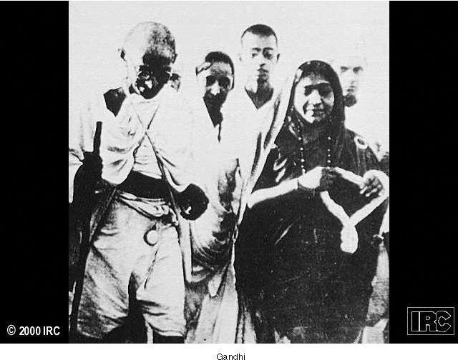
Gandhi
©2011, The McGraw-Hill Companies, Inc. All Rights Reserved.
*
Notes:
*

Slide 5
Gandhi’s Passive Resistance
Ahimsa: nonviolence
Satyagraha: passive resistance (“truth and firmness”)
Non-Cooperation Movement (1920-1922)
Civil Disobedience Movement (1930)
Boycott of British institutions
Amritsar Massacre (1919)
©2011, The McGraw-Hill Companies, Inc. All Rights Reserved.
*
Notes:
*

Slide 6
The Government of India Act (1937)
Creation of autonomous legislature
600 nominally sovereign princes refuse to cooperate
Muslim fears of Hindu dominance
Traditional economic divide
Especially severe with Great Depression
Muhammad Ali Jinnah (1876-1948) proposes partition, creation of the state of Pakistan
©2011, The McGraw-Hill Companies, Inc. All Rights Reserved.
*
Notes:
*

Slide 7
The Republic of China
Revolution in 1911 forces Emperor Puyi to abdicate
Sun Yatsen (1866-1925) proclaims Republic of China in 1912
Political anarchy follows
Independent warlords exercise local control
©2011, The McGraw-Hill Companies, Inc. All Rights Reserved.
*
Notes:
*

Slide 8
Chinese Nationalism
May Fourth Movement
Students, urban intellectuals protest foreign interference
Especially Japanese interference
Marxism increases in popularity
Chinese Communist Party founded in Shanghai (1921)
Leader: Mao Zedong (1893-1976)
©2011, The McGraw-Hill Companies, Inc. All Rights Reserved.
*
Notes:
*

Slide 9
Sun Yatsen (1866-1925)
Created Nationalist People’s Party (Guomindang)
Accepts support from Soviet Union
Members of the Chinese Communist Party also join Guomindang
©2011, The McGraw-Hill Companies, Inc. All Rights Reserved.
*
Notes:
*

Slide 10
Civil War
Jiang Jieshi (Chiang Kai-Shek, 1887-1975) takes over after death of Sun Yatsen
Launches military expedition to unify China, turns against communist allies
Communists flee 6,215 miles to northwest China, 1934: the Long March
Mao Zedong leads, elucidates Chinese communism (Maoism)
©2011, The McGraw-Hill Companies, Inc. All Rights Reserved.
*
Notes:
*

Slide 11
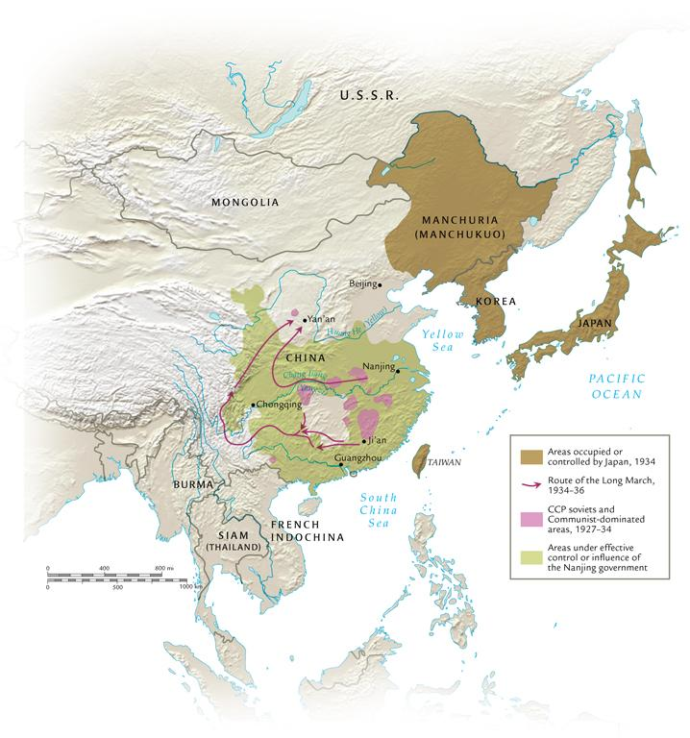
The Struggle for Control in China, 1927-1936
©2011, The McGraw-Hill Companies, Inc. All Rights Reserved.
*
Notes:
*

Slide 12
Imperialist Japan
Japan signs treaties under League of Nations to limit imperialist activity, 1922-1928
Political chaos in interwar Japan, assassinations
Militarist, imperialist circles advocate greater assertion of Japanese power in the region
China a soft target
©2011, The McGraw-Hill Companies, Inc. All Rights Reserved.
*
Notes:
*

Slide 13
The Mukden Incident (1931)
Japanese troops in Manchuria, China, secretly blow up small parts of the Japanese-built South Manchuria Railway as pretext for war
Over opposition of Japanese civilian government, military takes Manchuria, renames it Manchukuo, a puppet state
League of Nations censures Japan; Japan leaves the League of Nations
©2011, The McGraw-Hill Companies, Inc. All Rights Reserved.
*
Notes:
*

Slide 14
Africa and the Great War
African colonies participate in World War I
Allies invade German-controlled colonies
Africans encouraged to fight white soldiers
Many Europeans left to be deployed elsewhere
Encouraged local rebellions and challenges to European domination
©2011, The McGraw-Hill Companies, Inc. All Rights Reserved.
*
Notes:
*

Slide 15
Africa’s New Elite
Postwar class of elite
Often influenced by education, other experiences abroad
Jomo Kenyatta (1895-1978), Kenyan nationalist
Moved to create modern nation-states in Africa
Pan-Africanism promoted by Marcus Garvey (Jamaica, 1887-1940)
“Back to Africa”
©2011, The McGraw-Hill Companies, Inc. All Rights Reserved.
*
Notes:
*

Slide 16
Latin American Developments
Reaction against U.S. influence; protests by university students
Explore alternate political ideologies, especially Marxism
Fidel Castro (Cuba, 1926- )
José Carlos Mariátegui (Peru, 1895-1930)
Artist Diego Rivera (Mexico, 1886-1957)
©2011, The McGraw-Hill Companies, Inc. All Rights Reserved.
*
Notes:
*

Slide 17
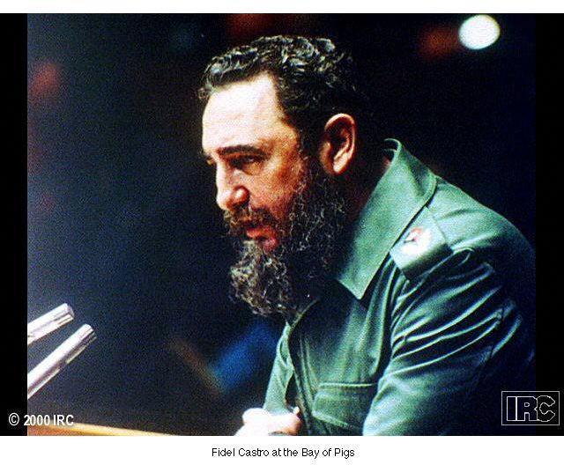
Fidel Castro (1926- )
©2011, The McGraw-Hill Companies, Inc. All Rights Reserved.
*
Notes:
*

Slide 18
United States Economic Domination
Great War ensures U.S. domination
Huge capital investment in Latin America; export of raw materials
U.S. economic neocolonialism under President William Howard Taft (1857-1931)
“Dollar diplomacy”
“Yankee imperialism”
©2011, The McGraw-Hill Companies, Inc. All Rights Reserved.
*
Notes:
*

Slide 19
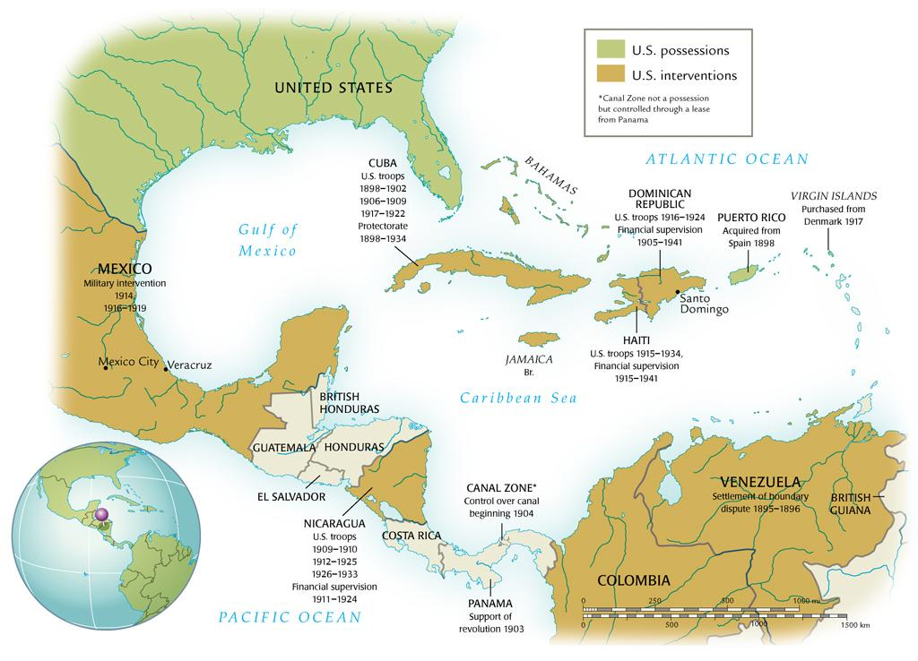
The United States in Latin America, 1895-1941
©2011, The McGraw-Hill Companies, Inc. All Rights Reserved.
*
Notes:
*

Slide 20
The “Good Neighbor Policy”
Franklin Delano Roosevelt (1882-1945)
Avoids direct intervention by supporting local leaders
U.S. Marines train local militias
©2011, The McGraw-Hill Companies, Inc. All Rights Reserved.
*
Notes:
*

Slide 21
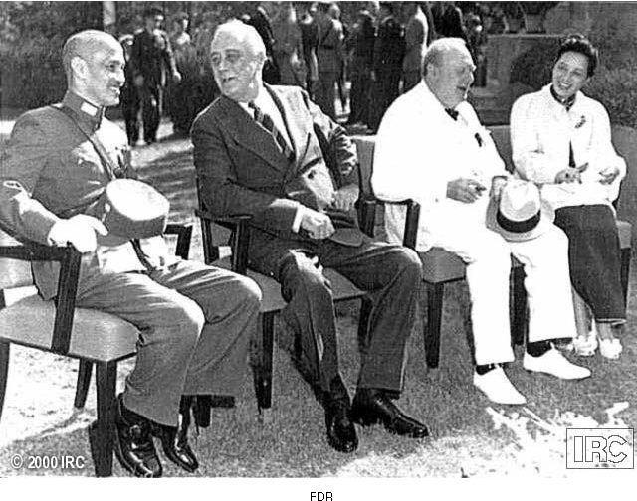
FDR
©2011, The McGraw-Hill Companies, Inc. All Rights Reserved.
*
Notes:
*

Slide 22
Nicaraguan Developments
Civil war in Nicaragua, 1920s
U.S. supports Anastacio Somoza Garcia (1896-1956)
Augusto César Sandino leads opposition to U.S. influence
Somoza assassinates Sandino in 1934
Maintains good relations with U.S.
©2011, The McGraw-Hill Companies, Inc. All Rights Reserved.
*
Notes:
*

Slide 23
Mexican Developments
Roosevelt formally renounces intervention as per Monroe Doctrine, 1933
Lázaro Cárdenas (1895-1970) nationalizes Mexican oil industry in 1938
Previously controlled by U.S., British interests
Roosevelt convinces U.S., British businesses to accept $24 million in compensation ($260 sought)
U.S. wants to retain support of Mexico with approaching war
Also, increasing dependence on Mexican immigrant labor
©2011, The McGraw-Hill Companies, Inc. All Rights Reserved.
*
Notes:
*

