Slide 1
New Civilizations in the Eastern and Western Hemispheres
2200-250 BCE
Nubia, Europe, Americas
(+ Migratory Bantu and Polynesians)

Slide 2
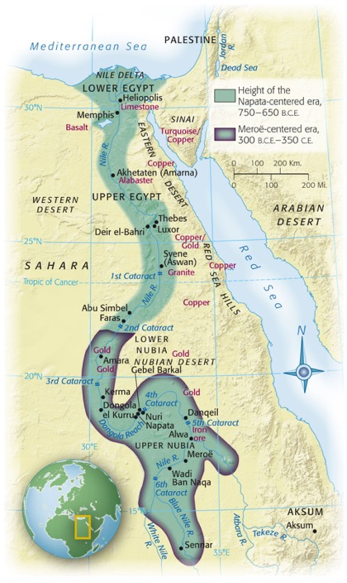
Nubia
Notes:
Map 3.2: Ancient Nubia.
The land route alongside the Nile River as it flows through Nubia has long served as a corridor connecting sub-Saharan Africa with North Africa. Centuries of Egyptian occupation, as well as time spent in Egypt by Nubian hostages, mercenaries, and merchants, led to a marked Egyptian cultural influence in Nubia. (Based on Map 15 from The Historical Atlas of Africa, ed. by J. F. Ade Ajayi and Michael Crowder. Reprinted by permission of Addison Wesley Longman Ltd.)

Slide 3
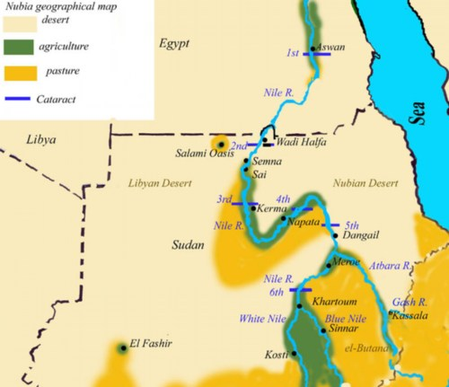
Nubia
Along Nile River
Between Modern Egypt and Sudan
Gold, Copper, Semiprecious stones

Slide 4
Egyptian Interaction
Old Kingdom (2300 BCE)
Egyptian trade missions
Gold, ebony, ivory, slaves, animals
Middle Kingdom (2040-1640 BCE)
Extension of fortifications further southward
Attempts to control gold mines in Nubia
New Kingdom
Destruction of Kush
Early urban area in Africa
Further Southern domination
Used Nubian gold to supply Middle Eastern markets
Egyptian domination for 500 years
Absorption of culture, politics, religion, culture into Nubia

Slide 5
25th Egyptian Dynasty
712-660 BCE: rule of Egypt by Nubian kings
Kept Nubian names
Ruled in Egyptian style and tradition
Capital: Memphis
701 BCE: attempt to help Palestine against Assyrian Empire
660 BCE: Assyrians drive Nubians back to the south
Meroë
Became center of Nubian kingdom by 4th cent BCE
Sub-saharan culture eventally replaces Egyptian influences
Collapse in the 4th cent CE due to invasion of nomads
Mobile due to camel domestication

Slide 6
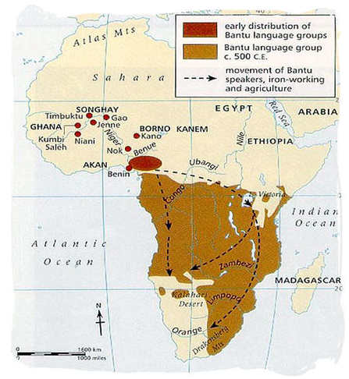
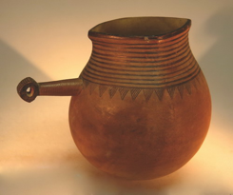
Bantu
People of the savanna region south of the Sahara
Farmers and nomadic herders, who were skilled in ironworking
1. used slash and burn farming techniques
2. land lost fertility requiring them to move
Bantu migration – the migration of the Bantu-speaking people from Cameroon and Eastern Nigeria into East, Central, and Southern Africa
Migration Map
C. Spread their ironworking skills and adapted their farming methods to suit the new lands
1. learned new customs
Notes:
Common Elements in African Societies
There were some similarities among many African societies. The migration of the Bantuspeaking
peoples provided a common linguistic base. Animistic religion and witchcraft
characterized many African societies. African peoples tended to believe in a creator deity who
operated through lesser spirits and the original settlers of the land. Ancestor worship was
common to much of African religion. Africa was more divided than united by geography.
Northern Africa was part of the wider Mediterranean world. The ecologies of sub-Saharan Africa
128
varied widely, but in many areas, agricultural societies supported market economies and
commercial activity. Participation in international trade with economies outside of Africa
precipitated political changes and stimulated the growth of African merchant groups but did not
result in rapid technological progress. It is possible that the African population numbered 30
million to 60 million by 1500.

Slide 8
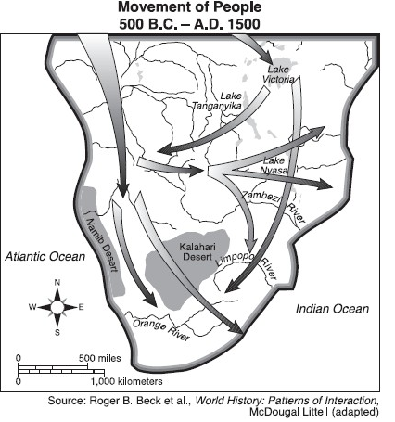
II. Bantu Migrations (3000BCE – CE 1100)
A. Cause of Migration
1. as populations increased, needed more land to
farm & graze
2. Needed hardwood for ironworking
B. Effect of Migration
1. Population distribution
2. Cultural blending through
contact and intermarriage
3. Increased pop. destiny
4. Shared technology
a. forging tools and
weapons from copper,
bronze, iron

Slide 9
III. The Dynamics of Bantu Expansion
The Bantu language originated in west Africa around 4000 B.C.E. The earliest speakers settled along rivers and cultivated yams and oil palms. With the ability to travel by canoe and a growing population due to successful agricultural practices, Bantu speakers began to spread across Africa and, by 1000 B.C.E., they inhabited most of the regions south of the equator. Their progress was not in mass migrations but rather incremental and intermittent spurts of migration. After 1000 B.C.E., iron metallurgy hastened the rate of migration because the Bantu had the increased technology to clear forests and prepare soil for agriculture. Today, the language itself has differentiated into more than five hundred distinct languages, each representing a different ethnic group.

Slide 10
Along with the language, Bantu methods of agriculture were spread into sub-Saharan Africa, bringing new crops and domesticated animals to wide regions of Africa.
Most Bantu speakers lived in agricultural communities of several hundred individuals ruled by chiefs. Within the society, there were also age sets, groups of individuals about the same age, who wielded considerable political and military power.
Bantu speakers believed in a creator god but primarily worshipped their ancestors and local spirits. It was necessary to keep these deities happy or disaster might occur. Bantu religious beliefs were quite flexible so when Bantus encountered different religious beliefs, components were incorporated into the belief system.

Slide 11
Polynesian Migrations
The rapid spread of the Asian peoples who colonies the Pacific islands after about 1500 BC is something of an enigma. Their motivation cannot have been solely an expanding population’s need to find new territories to settle, since only small founding populations remained – well below the numbers that the islands could have supported. They carried with them all the plants and animals they required in order to establish horticultural communities but marine resources also played an important role in their economies.

Slide 13
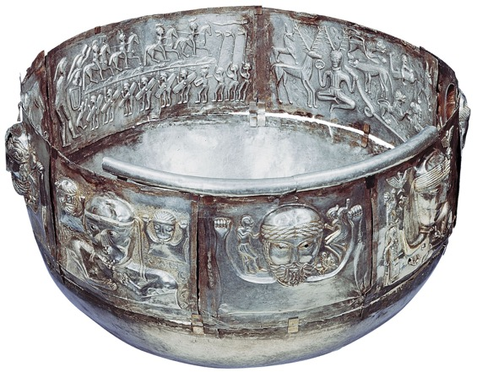
Celtic Europe
Notes:
The Gundestrup Cauldron.
This silver vessel was found in a peat bog in Denmark, but it must have come from elsewhere. It is usually dated to the second or first century B.C.E. On the inside left are Celtic warriors on horse and on foot, with lozenge-shaped shields and long battle-horns. On the inside right is a horned deity, possibly Cernunnos.

Slide 14
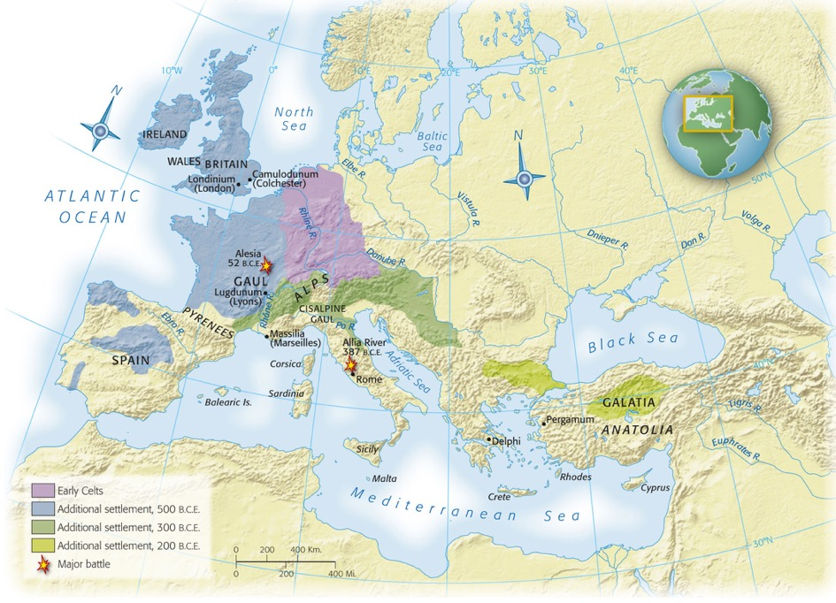
Map 3-3, p. 69
Notes:
Map 3.3: The Celtic Peoples.
Celtic civilization originated in central Europe in the early part of the first millennium B.C.E. Around 500 B.C.E. Celtic peoples began to migrate, making Celtic civilization the dominant cultural style in Europe north of the Alps. The Celts’ interactions with the peoples of the Mediterranean, including Greeks and Romans, involved both warfare and trade. (From Atlas of Classical History, Fifth Edition, by Michael Grant. Copyright © 1994 by Michael Grant. Used by permission of Oxford University Press, Inc.)

Slide 15
Celtic Europe
“Celtic” refers to Indo-European family language
First appears in Germany, Austria, Czech Rep.
Continental Europe
France, Germany, Switzerland, Austria, Czech Republic, Slovakia, Hungary, Poland, Romania
No unified Celtic nation
Divided into family groups
Elite warrior class
Wood and clay homes

Slide 16
Celtic Europe
Druids
Celtic priests
Gaul (France) and Britain
Religious and political
At times prevented warfare between rival clans
Religion
Halloween (Samhain) was a fertility festival (agriculture)
Worshipped in nature not man-built temples
Trade
Along rivers and with Mediterranean
Women
Children and food production
Partnership in marriage
More power/freedom than in Middle East, Rome, Greece
Conquest by Romans mostly ended Celtic tradition
Survives in parts of France, Scotland, Ireland, Wales

Slide 17
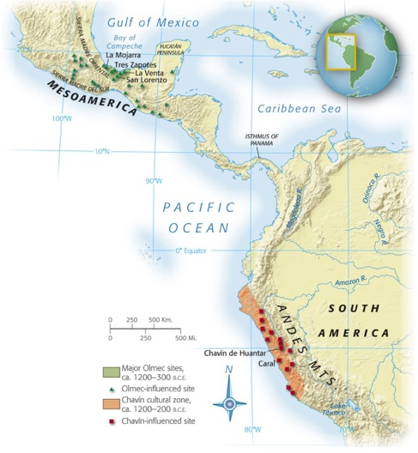
The Americas
Notes:
Map 3.4: Olmec and Chavín Civilizations.
The regions of Mesoamerica (most of modern Mexico and Central America) and the Andean highlands of South America have hosted impressive civilizations since early times. The civilizations of the Olmec and Chavín were the originating civilizations of these two regions, providing the foundations of architecture, city planning, and religion.

Slide 18
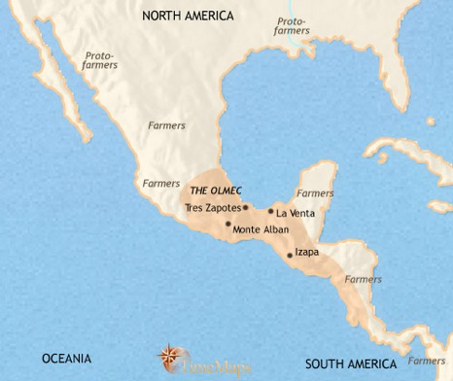
The Olmec
Mesoamerica
Meso = middle
Middle America (between N and S)
Most influential early Mesoamerican civilization
Modern Veracruz and Tabasco, Mexico

Slide 19
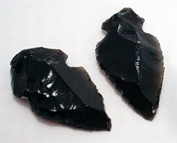
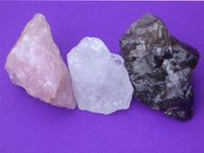
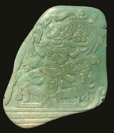
Resources
Obsidian, quartz, jade
Maize (corn), beans, fishing
Domesticated by 3500 BCE
Created specialization and social hierarchies
Led to urbanization

Slide 20
Urban Centers
San Lorenzo (1200-900 BCE)
La Venta (c 900-600 BCE)
Became important after the destruction/ abandonment of San Lorenzo
Tres Zapotes (c 600 BCE
Rose after the destruction/ abandonment of La Venta
Large platforms/mounds of dirt
Location of religious and political buildings
Most housing NOT in urban center
Some elite housing
Evidence of trading and merchant class
Each site eventually abandoned and buildings/monuments were destroyed

Slide 21
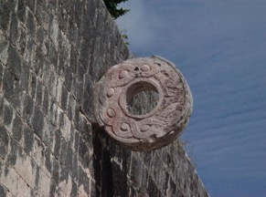
Politics and Religion
No evidence of Olmec empire
Olmec heads
Large carved heads of rulers
11 feet tall
Located near urban centers
Produced calendar
Origination (?) of the ritualistic Mesoamerican ball game

Slide 22
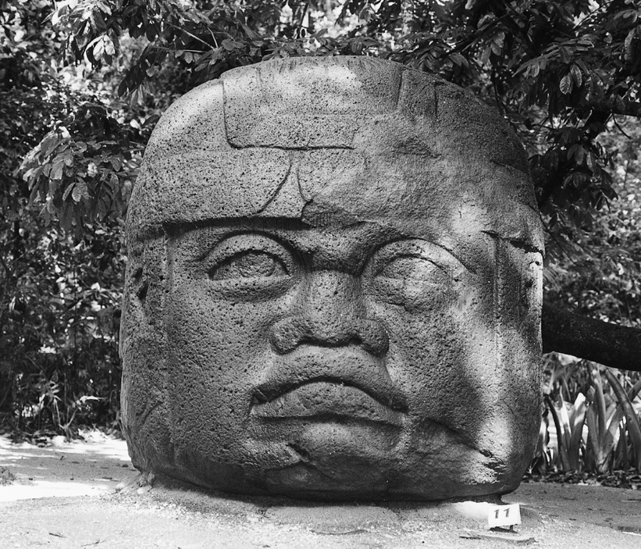
p. 74
Notes:
Olmec Head.
Giant heads sculpted from basalt are a widely recognized legacy of Olmec culture. Sixteen heads have been found, the largest approximately 11 feet (3.4 meters) tall. Experts in Olmec archaeology believe the heads are portraits of individual rulers, warriors, or ballplayers.

Slide 23
Andean Civilizations
South American coast
Urban centers first appeared in coastal areas
Fish, mollusks
Introduction of maize from Mesoamerica allowed for more urbanization
Caral
Precursor to Chavín
Included aspects of later Andean civilizations
Ceremonial plazas
Pyramids
irrigation

Slide 24
The Chavín
Modern day Peru
Capital of Chavín de Huantar was intersection of trade routes
Connected coast with inland farmers and llama herders
Trade relations allowed for work projects
Bridges, canals, roads, temples, etc
Western Hemisphere’s metallurgy evolved in Andean region
Later found in Mesoamerica
Further evidence of trade between the two

Slide 25
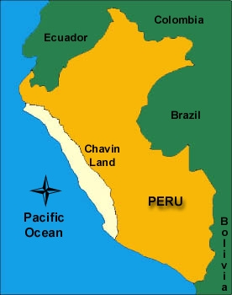

Slide 26
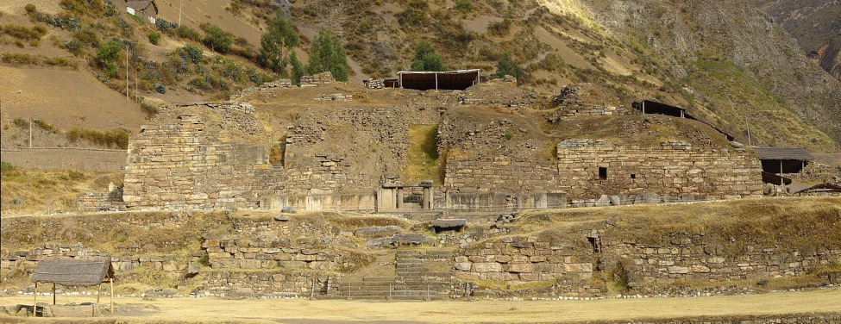
Chavín de Huantar

Slide 27
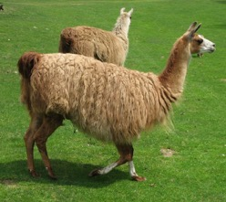
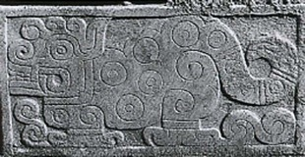
Animals
Llama
Only domesticated beast of burden in the Americas
Meat, wool, pack animal
Religion
Jaguar was most common

Slide 28
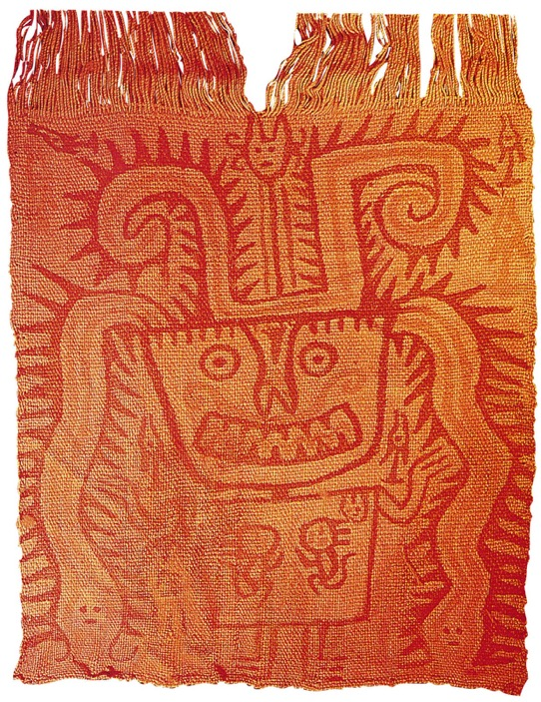
p. 104
Notes:
Ancient Peruvian Textiles.
The weaving of Chavín was famous for its color and symbolic imagery. Artisans both wove designs into the fabric and used paint or dyes to decorate plain fabric. This early Chavín painted fabric was used in a burial. Notice how the face suggests a jaguar and the headdress includes the image of a serpent.

