Slide 1
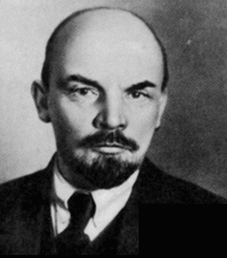
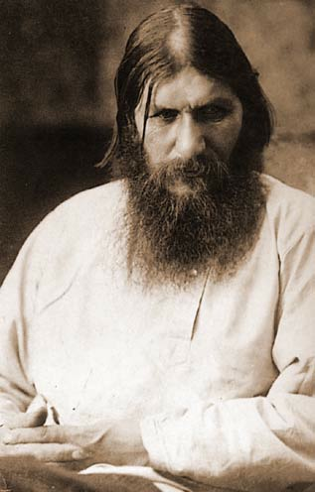
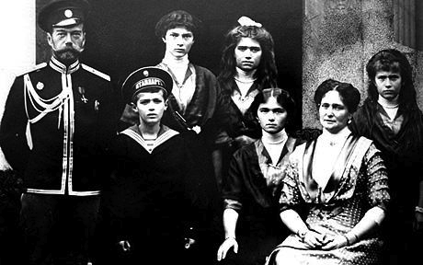
Revolutions in Russia

Slide 2
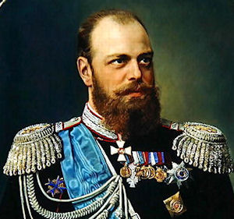
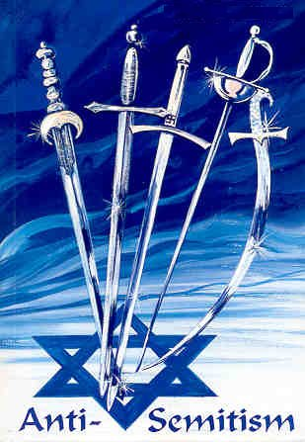
I.Czar Alexander III resists change(1881-1894)
A. Autocratic ruler
1. No reforms
2. Oppressed other nationalities
3. Used Terror
4. Anti - Semitic = hate for Jews
a. Pogroms = organized violence against Jews
b. homes, businesses, synagogues destroyed,
looted as police looked on
Notes:
Alex III was a younger son and didn’t become the heir until later in life. He did not receive the usual level of education that a tsar would have received. His father Alexander II had attempted to rapidly modernize Russia. He emancipated the serfs bringing feudalism to an end in Russia in 1861. He gave the serfs land hoping they would become self sufficient farmers. The serfs had to pay the gov’t for their land over a 49 yr time. He also began building railroad throughout the empire, incl the Trans-Siberian Railroad. He reformed the legal system and military. He was about to consent to a constitution but assassinated on the day the announcement was to be made.
Alex III was in many ways a foil or response to his father. He reacted to his father’s assassination by stopping all reforms, and not allowing any type of dissent. He used secret police to stop any dissent. His tutor had been a very conservative minister of religion this probably influenced Alex’s treatment of jews. He had a policy Russification for all those living in Russia and that would include orthodoxy.

Slide 3
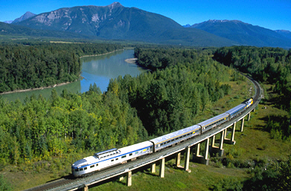
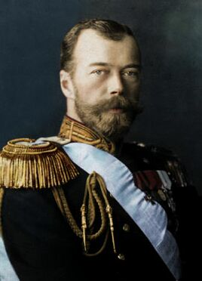
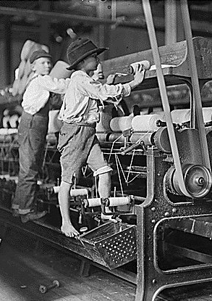
II. Nicholas II succeeds (1894)
A. Industrialization
1. Happens quickly
2. Trans-Siberian railway built
3. Poor working conditions
a. Low wages
b. Child labor
c. Unions outlawed
d. leads to rise of Bolsheviks
B. Autocrat
Notes:
Nicholas wasn’t groomed to be tsar by his father. He is compassionate towards the russian people but doesn’t quite grasp the way in which his world was changing.

Slide 4
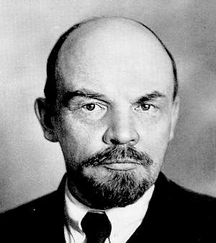
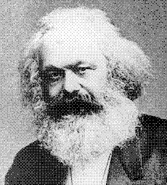
B. Revolution Begins during reign of Nicholas II
1. Marxist revolutionaries wanted workers to rule the country
a. Proletariat = workers
2. Marxists split 1903 due to differences over revolutionary tactics
a. Mensheviks – sought moderate broad base of support
b. Bolsheviks - radical, small group of committed revolutionaries to sacrifice all for change
Vladimir Lenin - leader
Fled to Europe to avoid arrest in early 1900s
Vladimir Lenin
Karl Marx
Notes:
Lenin, who was already unhappy with the Russian tars, was radicalized when his brother was hung for plotting against tsar Alex III in 1887. By 1900 he was plotting to over throw the gov’t. He was a ruthless leader and was lived in exile in Europe during the early 1900s.

Slide 5
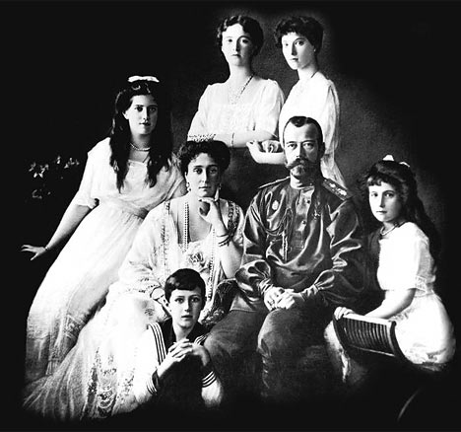
Timeline
1. 1904 - Russia falls to Japan - Russo- Japanese War (1st time a European country defeated by Asian nation in modern history)
2. January 22, 1905 - Bloody Sunday – workers petition for better working conditions, personal freedom, and elected national legislature
Soldiers fire on the workers = 1,000 killed, thousands wounded
Nicholas establishes Duma; dissolves it 10-weeks later!
3. 1914 – Russia enters WWI; not prepared militarily, economically
4. 1917 – March Revolution: Women textile workers strike - soldiers join
a. due to shortages of bread and fuel
5. 1917 - Czar stepped down, executed with his family in 1918
a. End of Romanov dynasty
b. Lenin returned
Notes:
Bloody Sunday led to strikes and demonstrations throughout Russia. The Duma was filled with moderates who wanted to lead Russia towards a constitutional monarchy. Nicholas II was hesitant to share his power.
In 1915 Nicholas goes to the front to help run the war. Alex runs things for him. She allows herself to be influenced by Rasputin and makes a series of bad decisions, ignoring Nicholas’ advisors. Rasputin is assassinated by the nobles.
Food and fuel shortages, as well as, inflation combined with the disasterous war effort to create an atmosphere for revolution.
Strikes led to riots.
The Duma doesn’t immediately pull out of the war. Germany helps Lenin return believing that he will pull russia out of the war.

Slide 6
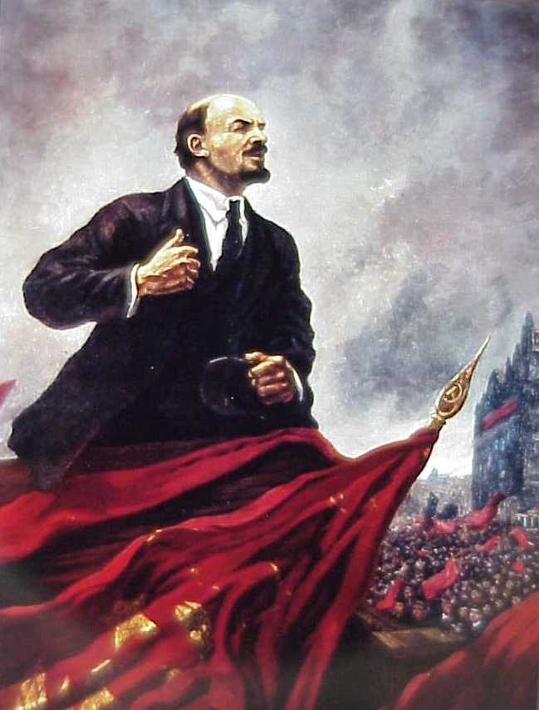
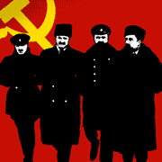
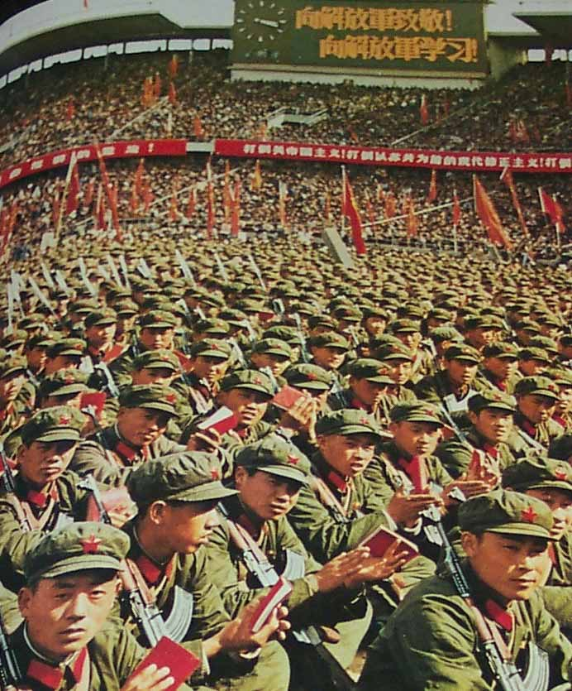
III. Bolshevik Revolution
A. Lead by Lenin in 1917
1. Slogan = “Peace, land, bread”
B. Bolsheviks Red Guards took over government
1. Redistributed land among peasants
2. Factories to workers

Slide 7
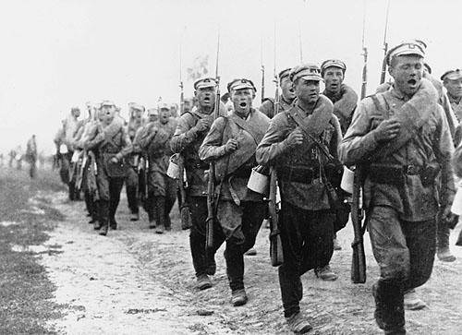
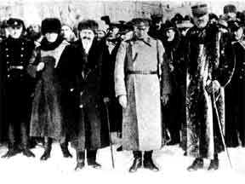
C. 1918 – Russia withdrew from WWI signed Treaty of Brest-
Litovsk - Russia gave territory to Germany
1. Angered Russians (many also upset with murder of royal
family)
D. Now civil war – Bolshevik Red Army vs. White Army
1. White Army divided; but united in wanting to defeat Red
2. Red army won
VS.
Reds
Whites
Notes:
Those that joined the White Army included the Cadets, who wished to continue the war against the Central Powers. Some Mensheviks and Socialist Revolutionaries that were opposed to the dictatorial powers of the new regime also joined the resistance. Others who joined included landowners who had lost their estates, factory owners who had their property nationalized, devout members of the Russian Orthodox Church who objected to the government's atheism and royalists who wanted to restore the monarchy.

Slide 8
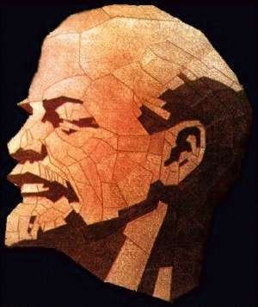
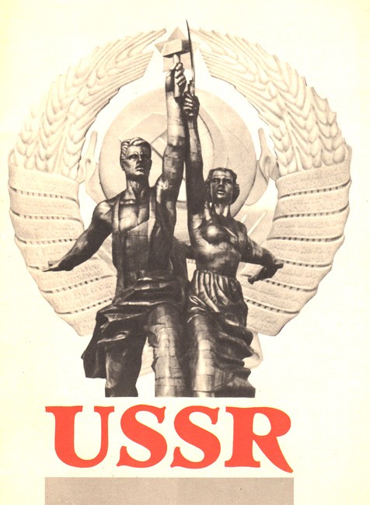
IV. Lenin Restores Order
A. War and revolution destroyed economy
B. 1921 - New Economic Policy
1. Against state-controlled economy
2. Small-scale version of capitalism
C. Against nationalism
1. Set up soviet republics
2. 1922 - Union of Soviet Socialist Republics (USSR)
Notes:
Vladimir Lenin came to the conclusion that "only by coming to an agreement with the peasants can we save the socialist revolution". In March, 1921, Vladimir Lenin announced details of his New Economic Policy (NEP). Farmers were now allowed to sell food on the open market and could employ people to work for them. Those farmers who expanded the size of their farms became known as kulaks.
Victor Serge recorded: "The New Economic Policy was, in the space of a few months, already giving marvellous results. From one week to the next, the famine and the speculation were diminishing perceptibly. Restaurants were opening again and, wonder of wonders, pastries which were actually edible were on sale as a rouble apiece. The public was beginning to recover its breath, and people were apt to talk about the return of capitalism, which was synonymous with prosperity.”
http://www.spartacus.schoolnet.co.uk/RUSnep.htm
Quote about NEP

Slide 9
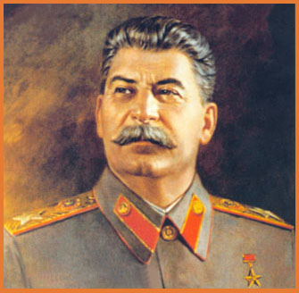
D. Bolsheviks named their party the Communist Party
1. Dictatorship of the Communist Party
2. Absolute power despite constitution promising
socialist and democratic principles
E. Stalin “man of Steel” becomes dictator 1928
1. Lenin died 1924
2. Prior to death wrote, “Comrade Stalin… has concentrated
enormous power in his hands, and I am not sure that he
always knows how to use that power with sufficient
caution.”
Notes:
http://www.rawstory.com/rs/2012/12/24/ongoing-preservation-of-lenins-body-stirs-debate-on-remains/
http://www.jewishworldreview.com/0304/lenin.asp

Slide 10
Causes and Results
Causes:
Weak czar
Horrid working
conditions
Low wages
Child labor
WWI
Famine
Results:
Social unrest
Labor strikes
Revolutionary activity
Czar abdicates
Bolshevik revolution
Communist Party and establishment of USSR

