Slide 1
The Rise of Fascism in Europe

Slide 2
I. Fascism
A political movement that promotes extreme forms of nationalism and militarism; includes denial of individual rights and dictatorial one-party rule.
Characteristics
Social – supported by middle class, aristocrats, industrialists & military
2. Cultural - censorship, secret police, indoctrination
3. Economic - control by state
4. Political - nationalist, racist, supreme leader, one party rule
C. Principles - authoritarian, state more important than individual, action oriented, charismatic leader
Notes:
There is no central theory like communism. Similar to communism in some aspects: 1. dictators w/one party rule, 2. no individual rights (obedience to the state & its leader was the most important), 3. state was supreme. Unlike communism they are going to supports classes believing that each class has a place and function. Fascists were nationalists while communists were internationalists wanting an international state of workers.
Fascism

Slide 3
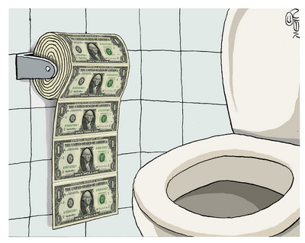
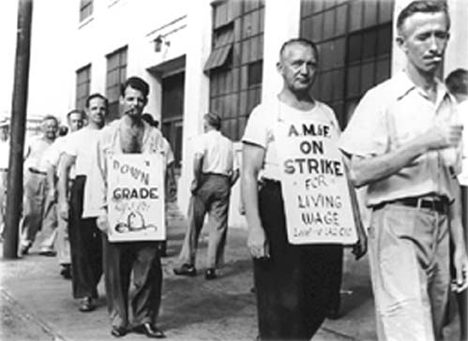
D. Reason for Rise of Fascism in Italy
1. Did not gain territory at Paris Peace conference after WWI & war debt
2. High prices (inflation) and low
wages, high taxes
3. Unemployment
4. Social unrest = strikes
5. Democracy not working – people looking for a strong leader
Notes:
The Italian economy was crippled by inflation and unemployment. There was widespread unrest due to the economic problems. The wanted a leader to take action.

Slide 4
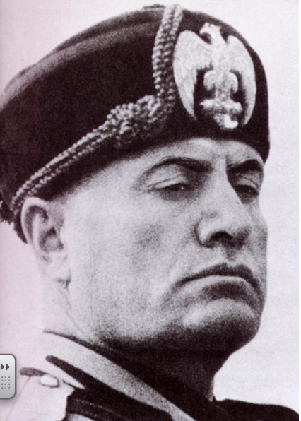
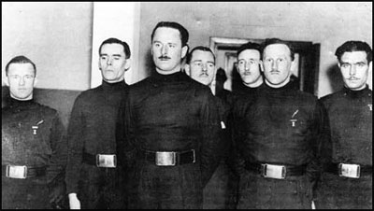
II. Benito Mussolini – “Il Duce” (the leader) came to power in 1922
A. Supported by King Victor Emmanuel II, industrialists, members of middle class
1. Pledged to help econ., make nation strong,
stamp out threat of communism, gain more
lands, outlaw rebellions among workers
B. Outlawed democracy and became a fascist dictator
1. followers called “Blackshirts”
2. established Secret police; no one allowed to
disagree
3. favored employers over workers– wages
fell
4. censored all media
Blackshirts
Notes:
Mussolini was a newspaper editor. He promised to revive the econ & rebuilding its armed forces.
One favoured way of making people conform was to tie a ‘troublemaker’ to a tree, force a pint or two of castor oil down the victim’s throat and force him to eat a live toad/frog etc. This punishment was enough to ensure people kept their thoughts to themselves.
When Mussolini said:
"Italy wants peace and quiet, work and calm. I will give these things with love if possible and with force if necessary.”
Many Italians, especially among the middle class, welcomed his authority. They were tired of strikes and riots, responsive to the flamboyant techniques and medieval trappings of fascism, and ready to submit to dictatorship, provided the national economy was stabilized and their country restored to its dignity. Mussolini seemed to them the one man capable of bringing order out of chaos. Soon a kind of order had been restored, and the Fascists inaugurated ambitious programs of public works. The costs of this order were, however, enormous. Italy’s fragile democratic system was abolished in favour of a one-party state. Opposition parties, trade unions, and the free press were outlawed. Free speech was crushed. A network of spies and secret policemen watched over the population. This repression hit moderate Liberals and Catholics as well as Socialists.
Benito Mussolini. (2013). In Encyclopædia Britannica. Retrieved from http://www.britannica.com/EBchecked/topic/399484/Benito-Mussolini

Slide 5
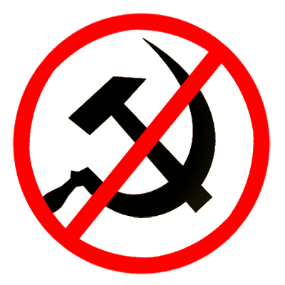
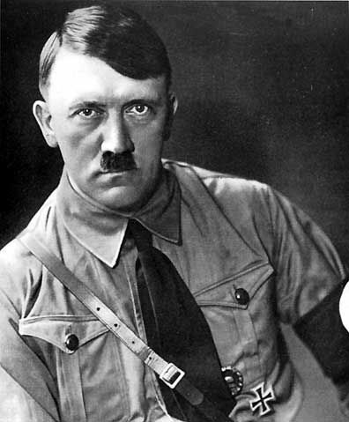
III. Rise of Fascism in Germany
Nazi party rose in German after WWI
1. Unhappy with conditions of Versailles Treaty
2. Anticommunist
3. Strongly nationalistic
4. Adolph Hitler became party leader in 1921

Slide 6
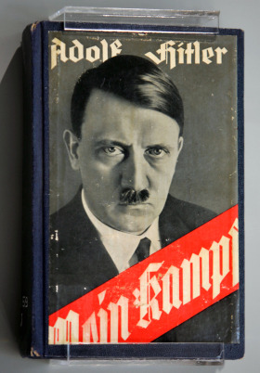
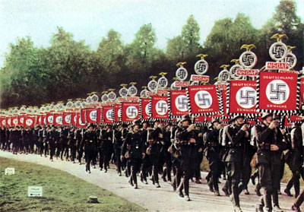
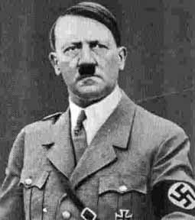
B. Weimar government had Hitler arrested for
trying to start a revolution
1. Hitler wrote Mein Kampf (My Struggle)
while in jail (1923-24)
a. wrote of hatred for democracy,
communism and Jews
C. Hitler rebuilt Nazi Party once he
was out of jail
1. Depression in Germany
2. 50% of population out of work
3. Hyperinflation
4. People looking for help
Notes:
By 1923 a loaf of bread cost 200 billion marks, it had cost less than 1 mark in 1918. Hitler only spent 9 months in prison even though he was sentenced to 5 yrs.

Slide 7
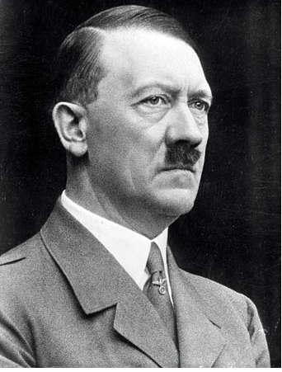
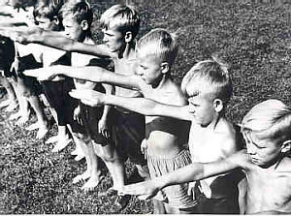
IV. Adolf Hitler “der Fuhrer” (leader)
A. Hitler elected chancellor 1933
B. Created totalitarian state
1. SS - army totally loyal to Hitler;
enemies of Reich were put in prisons
called concentration camps
2. Gestapo - secret police
3. Censored media
4. Only Nazi Party allowed
5. Hitler Youth = indoctrination
6. Free speech, assembly, press & religion ended
C. Began military buildup
1. Secretly began making weapons and ammunition
2. Provided jobs, which strengthened the economy!

Slide 8
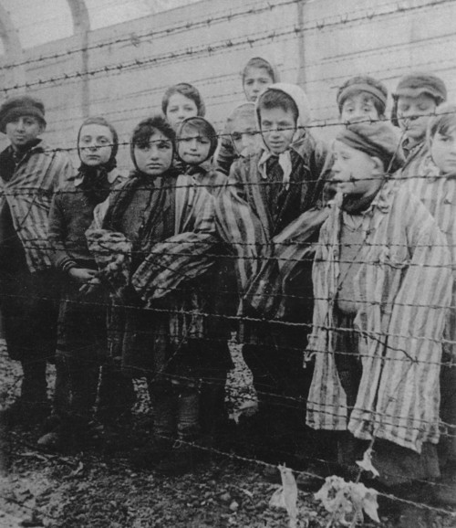
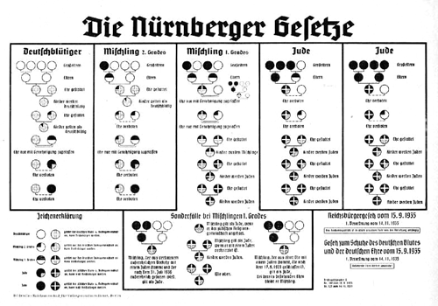
D. Hitler had a policy of persecution of Jews,
Communists, intellectuals, & Gypsies
1. Jews were national enemies & not true
Germans
2. German anti-Semitism had grown since late
1800s
3. Jews blamed for inflation and depression
4. Nuremberg Laws of 1935
5. Kristallnacht = Night of Broken Glass
6. Many people fled Germany
Nuremberg Laws

