Slide 1
Classical Mediterranean Empires
Persia, Greece, Rome
+ Phoenician Trading Empire

Slide 2
Ancient Iran (Persia)
1000-500 BCE

Slide 3
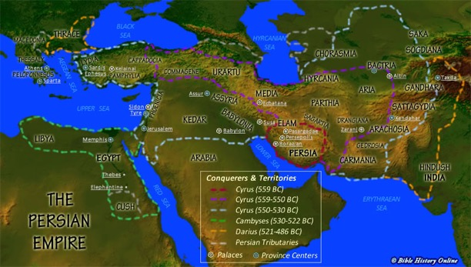
Land of the Aryans
Iran, Afghanistan, Pakistan, Turkmenistan
Link between western Asia and central/southern Asia
Majority of surviving historical accounts are Greek

Slide 4
Persian Empire
Medes
Western portion
First group to achieve complex political organization in the area
Persians
Southeastern portion
Achaemenids
The two groups intermarried to create the empire

Slide 5
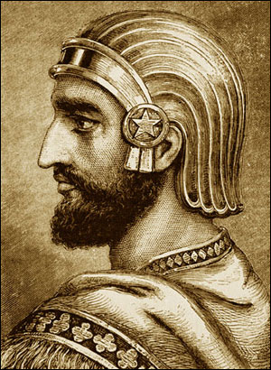
Cyrus
Persian father, Median mother
United Persian tribes and overthrew Median monarch
Placed both races in positions of authority
Kept Median traditions/government structure
Defeated Lydia, Anatolia, some Greek city-states, Neo-Babylonian dynasty

Slide 6
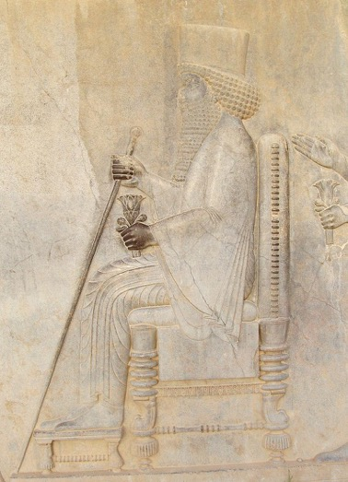
Darius I
Diminished the official role of the Medes
Second founder of the Persian Empire
Stretched empire from eastern Europe to Libya and Russia
New organizational structure that would continue until the end of the empire

Slide 7
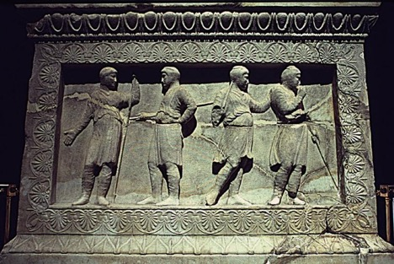
New Organizational Structure
Divided empire
20 provinces
Satrap: Persian “governor” in charge of a province
Collect taxes
Local court system
Hereditary (eventually)

Slide 8
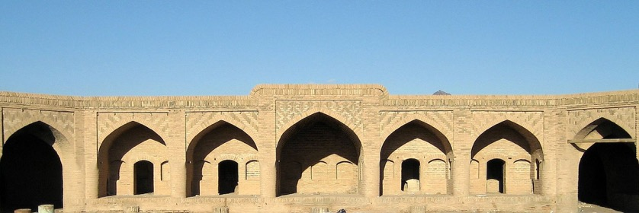
Persian Royal Road
1600 miles
Postal system
Royal messengers could travel across empire from modern Turkey to Iran within roughly a week
111 rest stops
Caravanserai
Guards at each stop

Slide 9
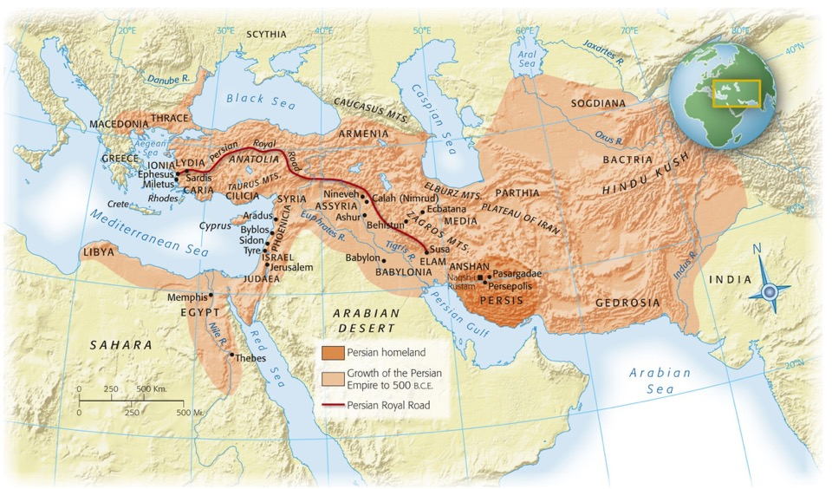
Persian Royal Road

Slide 10
Society
Patriarchal
Warriors
King
Landowning aristocracy
Women had political influence, could own property
Priests
AKA magi
Peasants
Labor units divided by men, women, children, etc
Officials distributed food and other necessities
Pregnant women/women with babies received extra
Skilled laborers received more than unskilled

Slide 11
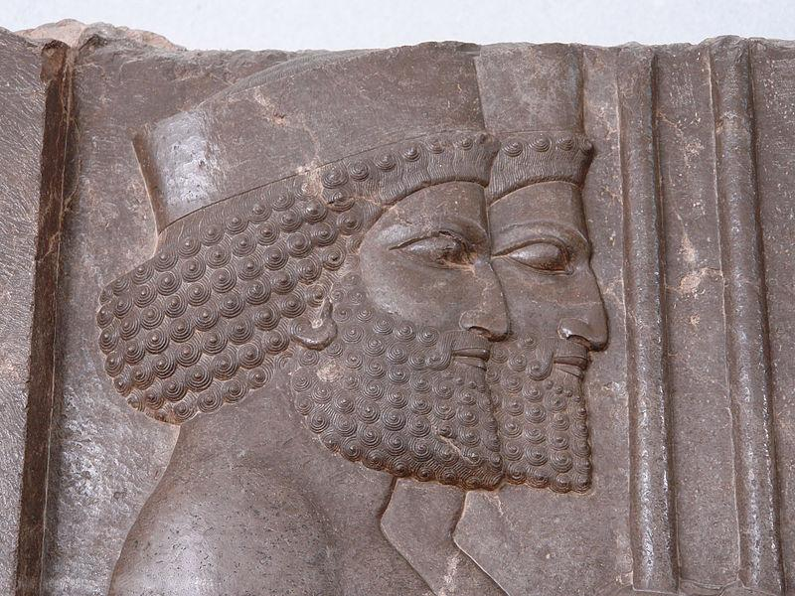
Decline of the Achaemenid Empire
Policy of toleration under Cyrus, Darius
Rebuilding of temple in Jerusalem
Xerxes (486-465 B.C.E.) harshly represses rebellions in Mesopotamia and Egypt
Increasing public discontent
©2011, The McGraw-Hill Companies, Inc. All Rights Reserved.
*
Notes:
*

Slide 12
Capital(s)
Susa
persepolis
Administrative center of empire
In geographical center
Elam/Mesopotamia
Near modern Iran/Iraq border
Location of the tomb of the prophet Daniel (?)
Ceremonial capital
Persian homeland
Symbol of power/wealth
Marriages, coronations, burials
Propaganda relief sculptures
Images of all classes all willingly cooperating together

Slide 13
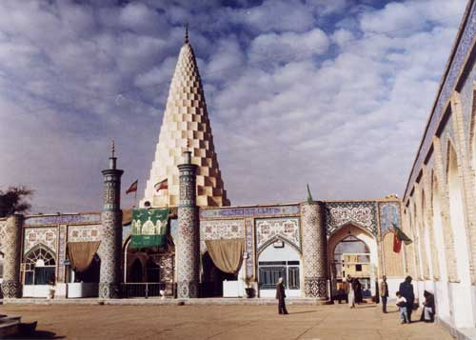
Susa
Notes:
Daniel’s tomb

Slide 14
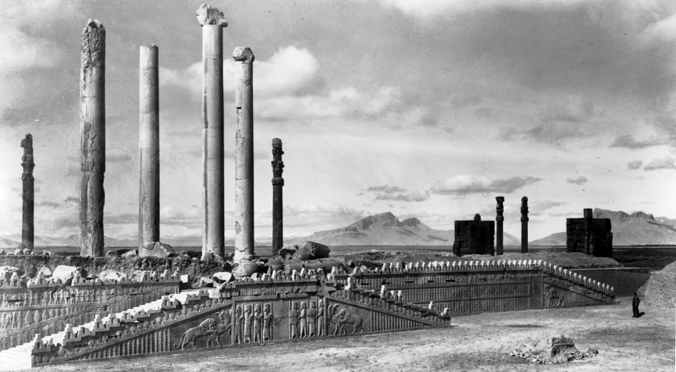
Persepolis
Notes:
View of the East Front of the Apadana (Audience Hall) at Persepolis, ca. 500 B.C.E.
Persepolis, in the Persian homeland, was built by Darius I and his son Xerxes, and it was used for ceremonies of special importance to the Persian king and people—coronations, royal weddings, funerals, and the New Year’s festival. The stone foundations, walls, and stairways of Persepolis are filled with sculpted images of members of the court and embassies bringing gifts, offering a vision of the grandeur and harmony of the Persian Empire.

Slide 15
Zoroastrianism
The Gathas: ancient Iranian hymn by Zoroaster
Ahuramazda (like the car ☺ ) – chief god
Created the world
World damaged by Angra Mainyu (hostile spirit)
Struggle between good and evil
Afterlife = reward/punishment depending on life lived
Darius tied his reign to religion by claiming to be appointed by Ahuramazda

Slide 16
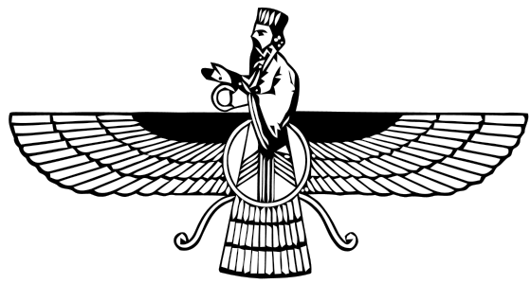
Zoroastrianism
Belief in one supreme deity
High ethical/moral standard for humans
Promised salvation
Influenced Judaism (?)

Slide 17
Ancient Greece
1000-500 BCE

Slide 18
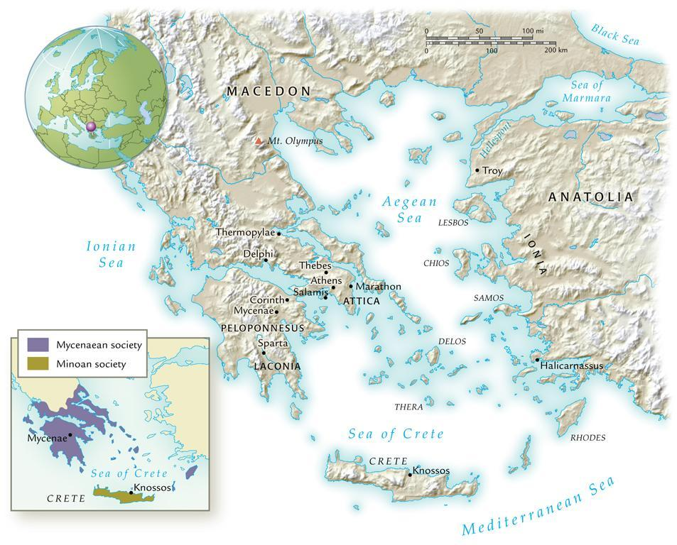
Classical Greece, 800-350 B.C.E.
©2011, The McGraw-Hill Companies, Inc. All Rights Reserved.
*
Notes:
*

Slide 19
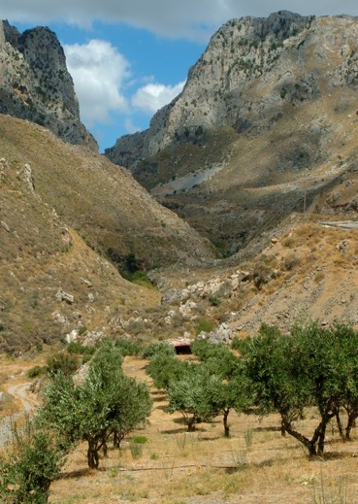
Geography/Resources
Limited fertile/arable land
Rocky, mountainous landscape
Grains, olive trees, sheep/goats
Dependence on the sea and trade
Geography made land transportation difficult
Could travel from Greece to Anatolia almost without losing sight of land

Slide 20
Dark Age
Archaic Period
150-800 BCE
Depopulation, poverty, disappearance from historical record
Following the destruction of Mycenaean civilization
Isolation from outer world
800-480 BCE
Dark Age ends with arrival of Phoenician ships to the Aegean
Writing system
Greeks added vowel sounds—the first true alphabet
Fewer symbols than cuneiform/hieroglyphics—easier for common people to learn
Population explosion
Shift to farming and diet change
Caused urban centers and specialization to develop

Slide 21
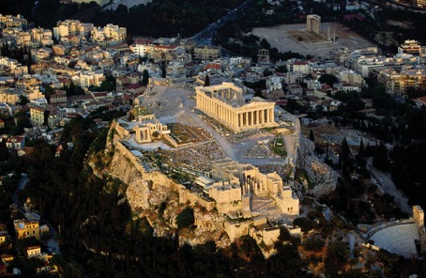
Polis
“City-state”
Greece made up of hundreds of polis due to geography
Hard to be unified
Acropolis: hilltop fortification
Agora: Large, open area / marketplace

Slide 22
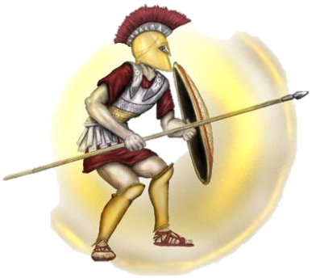
Hoplites and Colonization
Hoplite: heavily armored infantrymen
Army of private citizens
Usually farmers during “off season”
Excess population sent to colonies
Black Sea, North Africa, Italy
Greek culture spread with colonists
“Hellenes” described the Greek
“Barbaroi” described “barbarians”
Invention/use of coinage

Slide 23
Politics
Dark Ages: rule of kings
Eventually councils took the place of kings
Aristocracy
Tyrant
7th and 6th centuries BCE
Seizure of power and violation of traditional politics
Usually aristocrats supported by middle class
Eventually overthrown for either an oligarchy or democracy
Oligarchy
Rule by a few wealthy families
Democracy
Political power by all free adult males

Slide 24
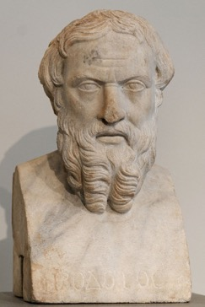
Culture
Religion
Zeus, Poseidon: gods that represented nature
Majority of gods were male
Epic poems (e.g. the Iliad and the Odyssey by Homer)gave the gods anthropomorphic characteristics
Sacrifice
Oracles: Apollo at Delphi
Intellect
Emphasis on the individual
Lyric poetry focusing on personal experience/
emotion
Rejection of traditional religious beliefs
Herodotus
First to write prose
Father of History

Slide 25
Athens vs. Sparta

Slide 26
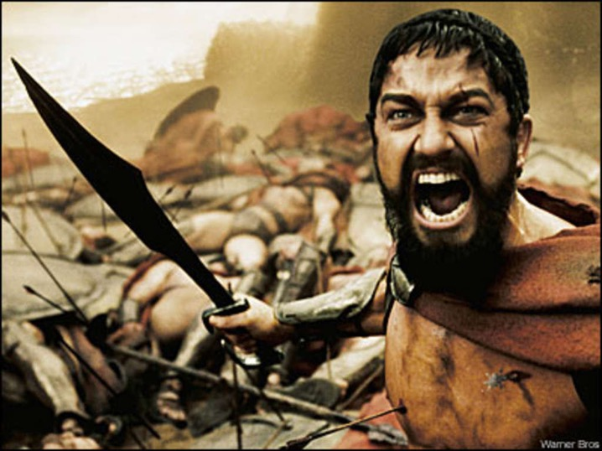
This. Is. Sparta!!!

Slide 27
Sparta (No, really)
7th century BCE
Shortage of farm land
Population increase
Invasion of Messenia (neighbor) INSTEAD of colonization
Native population became helots (state-owned serfs)
Spartans feared helot uprising
Military state
Permanently prepared for war
Best army in Greece
Boys sent to military school at 7
Peloponnesian League
System of alliances between Sparta
and other neighbor
Maintained peace in the region (for a while)

Slide 28
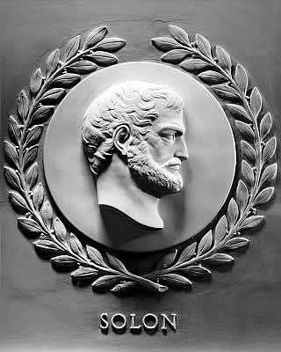
Athens
Larger in size and population than other polis
Fertile land, olive trees
Solon
Averted civil war in Athens
Divided Athens into 4 classes
Top 3 classes can hold office
Lowest class can still participate in meetings
Allowed for freedom of citizens
Pisistratus
Tyrant that created an Athenian “identity”
Monumental building projects, festivals
Pericles
460/450 BCE
All power to body of government
The Assembly
The Council of 500
The People’s Courts

Slide 29
Persian Wars
Ionian Revolt
Greeks in western Persia revolted against the Persians
Took the Persians 5 years to stop the rebellion
490 BCE
Darius sends troops to Eretria and Athens (both helped in the Ionian Revolt)
Eretria falls; survivors sent into exile in Iran
Athens: hoplites defeat Persians at the Battle of Marathon
480 BCE
Xerxes sends forces and takes over portions of southern Greece
Hellenic League (Sparta and allies)
300 Spartans die at Thermopylae
Persians sack Athens, then navy is destroyed at Salamis
Defeat of Persia leads to the creation of the Delian League
Alliance of city-states under the leadership of Athens
Athens eventually takes advantage of the League and becomes imperial power

Slide 30
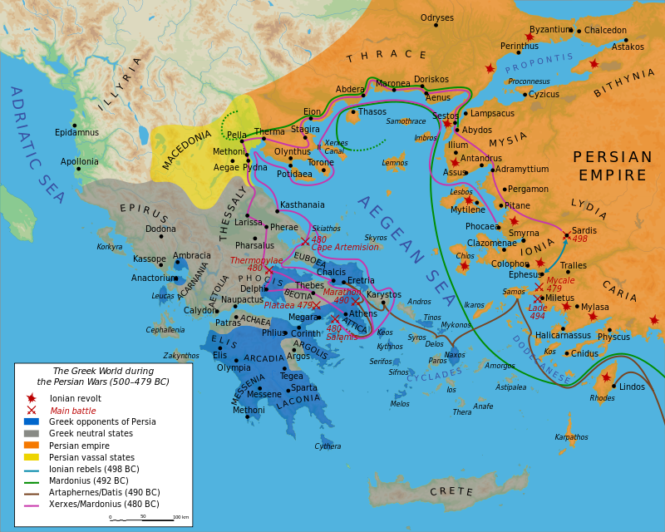

Slide 31
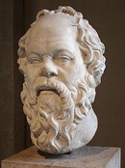
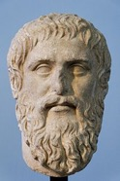
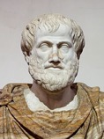
Philosophy
Socrates
Put on trial, convicted of “corrupting” Athenian youth
Forced suicide
Socratic method: questioning for deeper understanding
Plato
Founder of “the Academy”
Refused to write down thoughts/training
Aristotle
Student at the Academy
Founder of the Lyceum
Politics, philosophy, poetry, physics, psychology, etc
Tutor to Alexander the Great

Slide 32
Athenian “Equality”
Trireme
Warship with 170 rowers
Hoplites: now members of the middle/upper class
Rowers: lower class
Could demand equal rights b/c they were the backbone of the power
Only 10-15% of the population actually had a voice
Women, children, slaves excluded
Women
Athens
Arranged marriage
Relegated to the home
Bear/raise children (males)
Sparta
Expected to raise strong soldiers
Encouraged to exercise
Slavery rationalized
Most families owned 1 slave
Foreigners lacked the ability to reason/think for themselves

Slide 33
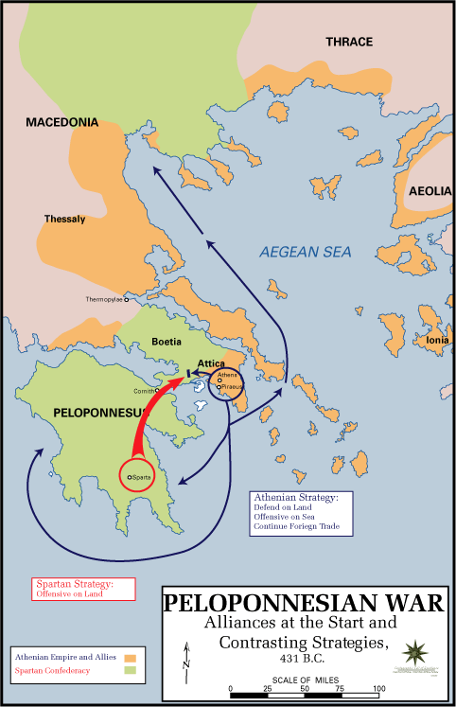
Peloponnesian War
Sparta vs. Athens
30 years of fighting
404 BCE: Defeat of Athenian navy
Sparta took over the Athenian “empire”
Same attitude toward others that Athens had
Internal fighting between other city states
Allowed the Persians to conquer lost lands

Slide 34
The Macedonians
Philip II
Alexander the Great
King of Macedonia
Created a military power in the Greek world
Hoplites
Spears
Horses/cavalry
Catapults
Corinth
Confederacy of states
Control of Greece
Defeated the Persian king, Darius III
Kept Persian style administration in conquered lands
Placed Macedonians in power
Eventually placed Persians in power/married Iranian women
Alexandria, Egypt
Died in 323 BCE

Slide 35
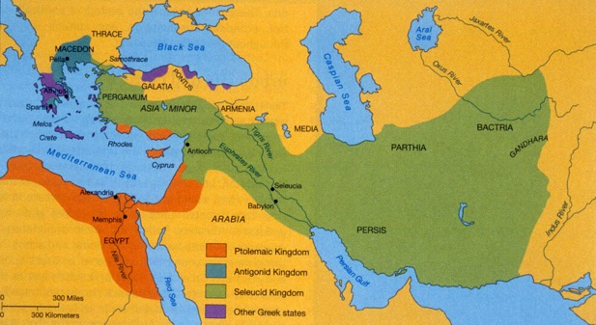
Hellenistic Age
Hellenistic Age
Spread and influence of Greek culture spread by Alexander’s empire
No clear successor to Alexander’s empire
50 years of unrest
Empire divided into 3 Hellenistic kingdoms
Seleucid (Persia)
Ptolemaic (Egypt)
Antigonid
(Greece/Macedonia)

Slide 36
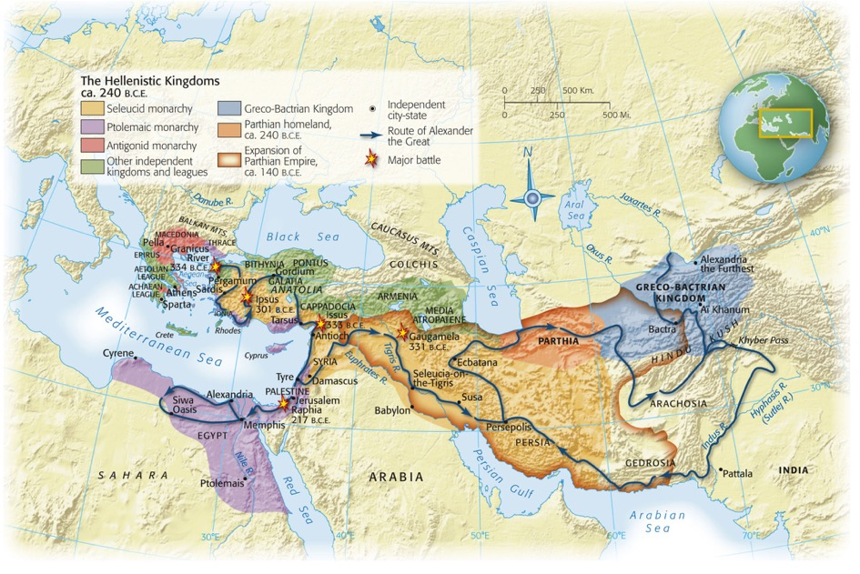
Map 5-3, p. 144
Notes:
Map 5.3: Hellenistic Civilization.
After the death of Alexander the Great in 323 B.C.E., his vast empire soon split apart into a number of large and small political entities. A Macedonian dynasty was established on each continent: the Antigonids ruled the Macedonian homeland and tried with varying success to extend their control over southern Greece; the Ptolemies ruled Egypt; and the Seleucids inherited the majority of Alexander’s conquests in Asia, though they lost control of the eastern portions because of the rise of the Parthians of Iran in the second century B.C.E. This period saw Greeks migrating in large numbers from their overcrowded homeland to serve as a privileged class of soldiers and administrators on the new frontiers, where they replicated the lifestyle of the city-state.

Slide 37
Hellenistic Kingdoms
Seleucids
Majority of Alexander’s lands
Mesopotamia, Syria, Anatolia
Many ethnic groups within the kingdom
Hard to control
Many threats from invasion
Persian administration
Antigonid
One main ethnic group
Macedonian homeland, northern Greece
Athens was a “museum” town
Ptolemies
One ethnic group
Easy to control
Pharaoh
Linked Egypt to the Mediterranean
Encouraged Greek immigration
Rule from Alexandria
Greek style polis
Alexandria
Body of Alexander “legitimized” the rule of the Ptolemies
Lighthouse of Alexandria
Library of Alexandria

Slide 38
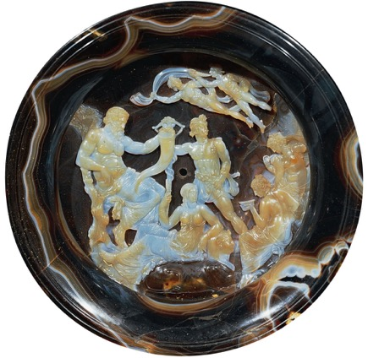
Syncretism
Diffusion
The spread of a culture, religion, idea WITHOUT changing the culture, religion, idea
EX: Spilled paint spreads out but doesn’t change colors
Syncretism
The spread of a culture, religion, idea and the changing of that culture, religion, idea into something new
EX: Two colors are spilled (blue and yellow) and make a new color (green)
Notes:
Hellenistic Cameo, Second Century B.C.E.
This sardonyx cameo is an allegory of the prosperity of Ptolemaic Egypt. At left, the bearded river-god Nile holds a horn of plenty while his wife, seated on a sphinx and dressed like the Egyptian goddess Isis, raises a stalk of grain. Their son, at center, carries a seed bag and the shaft of a plow. The Seasons are seated at right. Two wind-gods float overhead. The style is entirely Greek, but the motifs are a blending of Greek and Egyptian elements.

Slide 39
Early Rome
Founded in 753 BCE
Agricultural society
Land = power
Social status depended on owning land
Senate (Council of Elders)
Wealthy land-owners that “made the rules”
Monarchy (753 BCE – 507 BCE)
7 kings
1st = Romulus (founder)
Last = Tarquinius Superbus (tyrant)
Overthrown by Brutus the Liberator and the Senate

Slide 40
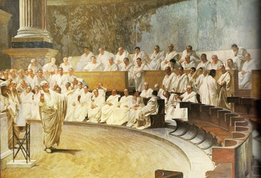
Roman Republic (507 BCE - 31 BCE)
NOT a modern democracy
The Assembly
Males only
Wealthy males had more voting power than poor males
Consuls
Elected for only one year
Presided over meetings
Military leader
The Senate
REAL power of Rome
Served for life

Slide 41
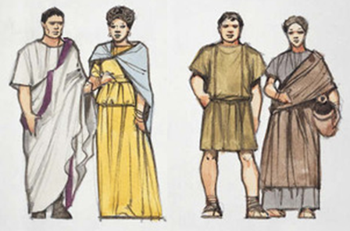
Conflict of the Orders
Order = social class
Patricians
elite, wealthy class
Plebeians
poorer class, majority of population
Plebeians refused to work, fight, etc in order to get more rights from the patricians

Slide 42
Roman Expansion
Roman army was key to expansion
Led by consuls seeking military victory
Similar to Greek hoplites
“Unified” (by conquering) the majority of the Italian peninsula by 290 BCE
Allowed conquered peoples full privileges of citizenship
Allowed an “inexhaustible” pool of soldiers
264 BCE – 202 BCE: Wars against Carthaginians
200 BCE – 146 BCE: Wars against Hellenistic kingdoms
Eventual takeover of Sicily, Sardinia, Spain
59 BCE – 51 BCE: Julius Caesar conquers Gaul (France)

Slide 43
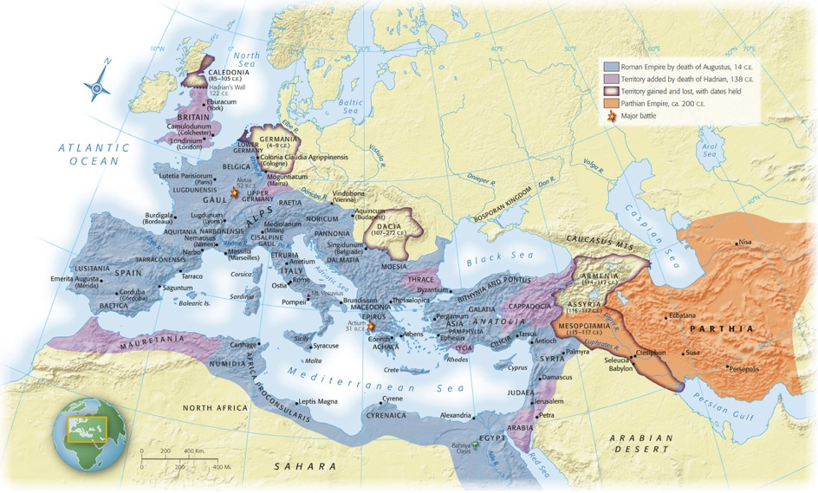
Map 6-1, p. 152
Notes:
Map 6.1: The Roman Empire.
The Roman Empire came to encompass all the lands surrounding the Mediterranean Sea, as well as parts of continental Europe. When Augustus died in 14 C.E., he left instructions to his successors not to expand beyond the limits he had set, but Claudius invaded southern Britain in the mid-first century and the soldier-emperor Trajan added Romania early in the second century. Deserts and seas provided solid natural boundaries, but the long and vulnerable river border in central and eastern Europe would eventually prove expensive to defend and vulnerable to invasion by Germanic and Central Asian peoples.

Slide 44
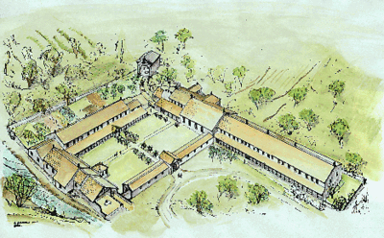
Fall of the Republic
Latifundia
Small farms taken over by wealthy estates/ranches
Cash crops rather than grains for food
Cattle, grapes for wine
Created dependence on foreign grain
Poor peasants couldn’t find work due to cheap POW labor
Movement into cities/urban areas
Lived in poverty
Decline in land owning men = decline in available soldiers

Slide 45
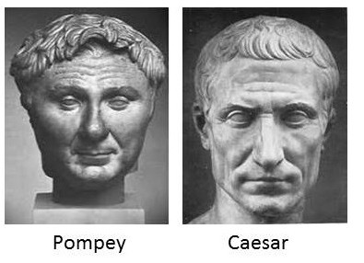
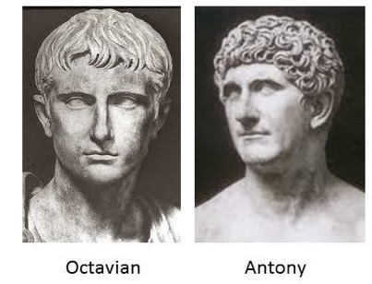
Ambition
Gaius Marius
NOT from the traditional ruling class
Allowed men in army without owning land
Promised land upon retirement
Elected consul 6x (ILLEGAL!!!!)
Armies became more loyal to their generals than to Rome
Julius Caesar, Mark Antony, Octavian
Generals used armies to further their personal power

Slide 46
The Principate/Roman Empire (31 BCE – 330 CE)
Established by Octavian (aka Augustus)
Kept the structure of the Republic
Ruled under the title of dictator
Those that ruled after him took the title “emperor”
Dead emperors viewed as gods
Law
Laws were studied and codified
Importance of individual rights

Slide 47
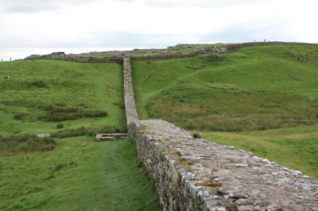
Defending the Empire
Defending the vast empire became very challenging and expensive
Army became defensive rather than offensive
Many borders protected by rivers, mountains, etc
Walls, forts built in areas without natural barriers
MOST surrounding neighbors were less technologically advanced

Slide 48
Third Century Crisis (235-284 CE)
Frequent change in rulers and administration
Reign for only a few months/years until overthrow or death
Outside threats
Germanic tribes began to raid towns deep into the empire
Cities began building their own walls for protection
Some regions broke away from the empire
Constant protection = draining of the treasury
Interruption in trade = no $ coming in
Emperors hoarded $
Value of coins was reduced and barter system resumed
Urban aristocracy disappeared
People moved out of the cities
Precursor to the Middle Ages

Slide 49
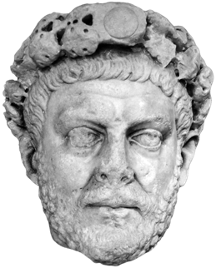
Diocletian (284-305 CE)
Eastern Europe; born a commoner
Divided the empire in half
Co-emperor was Marcus Aurelius
Diocletian ruled the west, Aurelius ruled the east
Radical reforms to help the flailing empire
Halted inflation
Issued edicts to set the maximum price for goods/services
Frozen professions
Did not allow people to change important professions
Made them hereditary
Creation of a black market
Death to those discovered
Reforms created distrust of the government
Too much government control

Slide 50
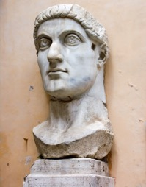
Constantine (306-337 CE)
Reunited the empire after end of Diocletian’s rule
Converted to Christianity after believing that the Christian God helped him win a battle
313: Edict of Milan
Ended persecution of Christians
Religious freedom to all
324: capital moved to Byzantium
Renamed Constantinople
Closer to invasion prone areas of the empire
Eastern half of empire in better shape than the western half
More Christians in eastern half
Seen as “end” of Roman Empire
Eastern half survived for another 1000 years as the Byzantine Empire

Slide 51
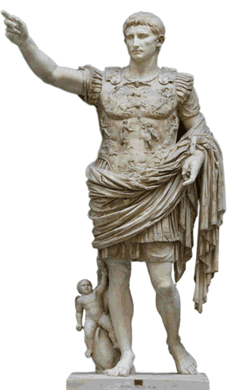
Pax Romana
“Roman Peace”
Height of empire
27 BCE – 180 CE
Begun with Augustus
200 years of peace and prosperity
Limited threat of invasion
Supported trade
Guaranteed safety along roads
Romanization

Slide 52
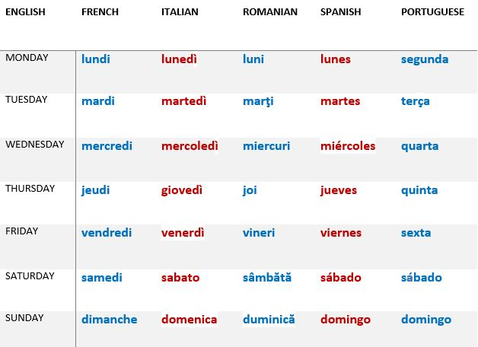
Romanization
The spread of Latin and the Roman way of life
Spanish, French, Italian, Romanian, Portuguese come from Latin
“Romance languages” comes from “Roman” not referring to love ☺
NOT forced in most places
Social and political advantages for conquered lands “converting” to Roman culture
Similar to the advantage of learning English today

Slide 53
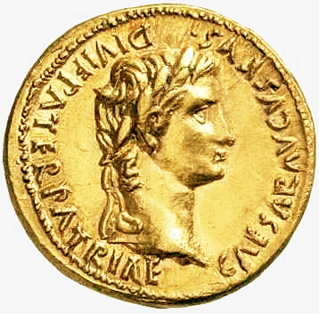
Economics
Agricultural based economy
Latifundia
Grain imported
Some long distance trade
Luxury goods
China-silk
India-spices
Africa-animals
Interior provinces (such as Gaul) supplied wealth to the central government
Taxes

Slide 54
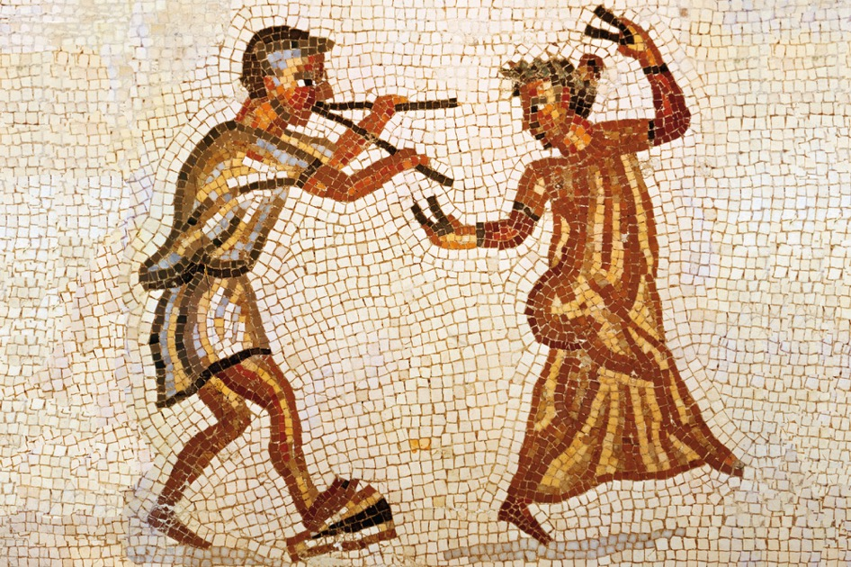
Notes:
Dancing Girl Wearing Silk Garment, Second–Third Century C.E.
This Roman mosaic depicts a musician accompanying a dancer who is wearing a sheer garment of silk imported from China.

Slide 55
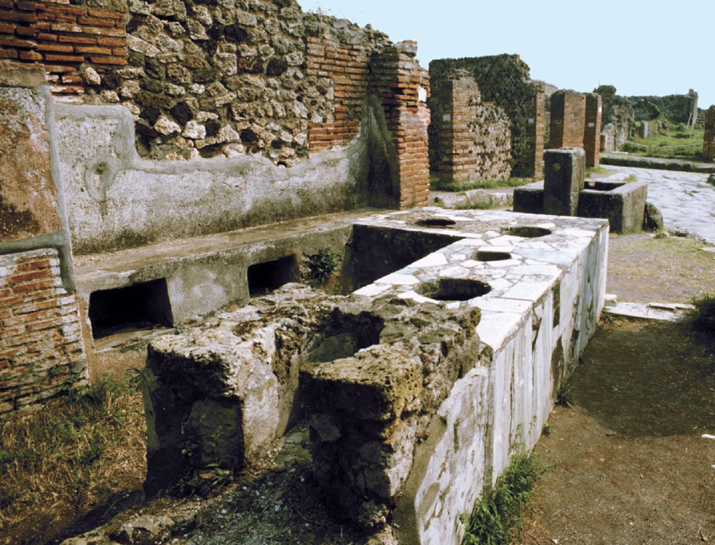
p. 158
Notes:
Roman Shop Selling Food and Drink.
The bustling town of Pompeii on the Bay of Naples was buried in ash by the eruption of Mt. Vesuvius in 79 C.E. Archaeologists have unearthed the streets, stores, and houses of this typical Roman town. Shops such as this sold hot food and drink served from clay vessels set into the counter. Shelves and niches behind the counter contained other items. In the background can be seen a well-paved street and a public fountain where the inhabitants could fetch water.

Slide 56
Society
Paterfamilias
Patriarchy
Several generations
Slaves
Patron/Client Relationship
Patrons (wealthy members of society) provided protection, loans, legal advice to those in the lower classes (clients)
Clients were obligated to follow patron into battle, work land
Women
Rights of a child
Under authority of males
Cannot own land
“Urban” empire
Administration centered in towns
Majority of population still living in rural/agricultural areas
Large city problems
Strained food/water supply
Sewage problems
Elite live lavishly
Poor live in slums

Slide 57
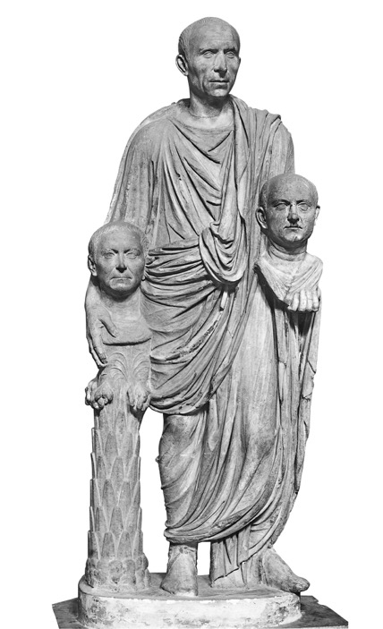
p. 153
Notes:
Statue of a Roman Carrying Busts of His Ancestors, First Century B.C.E.
Roman society was extremely conscious of status, and the status of an elite Roman family was determined in large part by the public achievements of ancestors and living members. A visitor to a Roman home found portraits of distinguished ancestors in the entry hall, along with labels listing the offices they held. Portrait heads were carried in funeral processions.

Slide 58
Religion
Numina: invisible forces that controlled the world (usually connected to nature)
Many gods stolen from Greek religion and renamed
Pax deorum: Peace of the gods
Agreement between the gods and the people
Sacrifices to honor/win favor of the gods
Gods reciprocate by favoring the Republic

Slide 59
Christianity
6 CE: Judaea (Jewish homeland/modern Israel) comes under Roman rule
Jews waited for the Messiah to drive out the oppressive Romans
Jesus
Offended Jewish officials
Accused of blasphemy by claiming to be the Messiah
Pontius Pilate (Roman governor) sentenced him to death by crucifixion
Paul
Jew from Tarsus (SE Anatolia)
Spoke Greek and Aramaic
Allowed him to travel easily between Greek, Roman, and Jewish traditions
Monotheistic
Caused dissention between Romans and believers
Christians refused to worship the emperor
Seen as not being loyal to the emperor/empire
First converts
“Disenfranchised groups” (women, children, poor)
These groups found acceptance in the new religion

Slide 60
Technology
Arches
Allowed for the distribution of enormous weight without thick supports
Concrete
Allowed the creation of domes and vaulted ceilings
Distinguished Roman architecture from the angular Greek architecture
The Roman Road
Allowed merchants to safely travel and sell products
Allowed Christianity to spread across the empire
Aqueducts
Use of gravity to move water to cities
Usually elevated above ground over long distances
Used arches

Slide 61
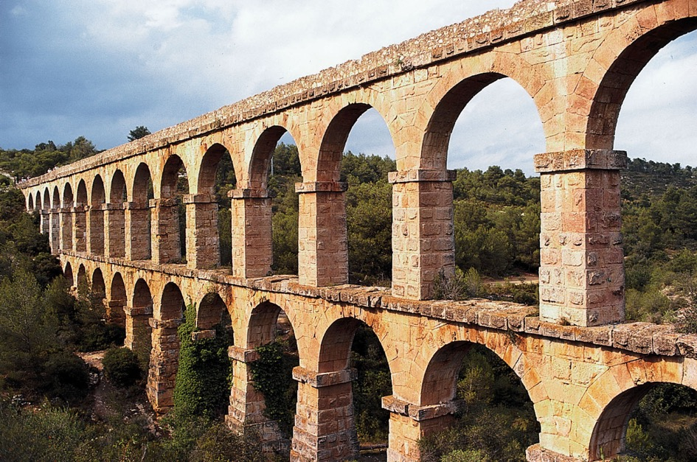
p. 161
Notes:
Roman Aqueduct Near Tarragona, Spain.
The growth of towns and cities challenged Roman officials to provide an adequate supply of water. Aqueducts channeled water from a source, sometimes many miles away, to an urban complex, using only the force of gravity. To bring an aqueduct from high ground into the city, Roman engineers designed long, continuous rows of arches that maintained a steady downhill slope. Scholars sometimes can roughly estimate the population of an ancient city by calculating the amount of water that was available to it.

Slide 62
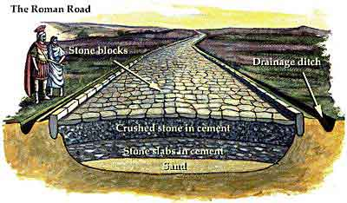

Slide 63
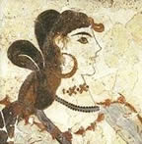
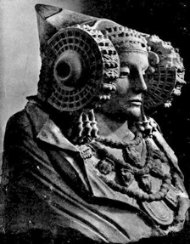
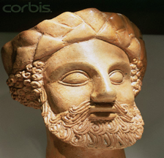
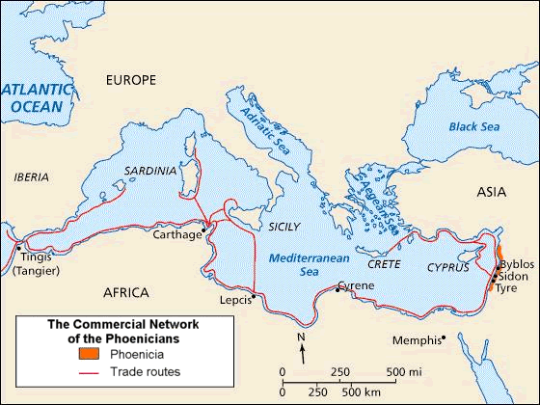
Phoenicians – Seafaring Traders

Slide 64
Phoenicians ~ 1100BCE
Area of modern day Lebanon
Developed City-states
Very wealthy
Important trade centers
Ship builders
Traded on Mediterranean Sea
May have traveled to Britain & Red Sea
Notes:
They were never a unified country but developed strong independent city-states.
They were the first traders to go beyond the Mediterranean. Herodotus even claimed that they sailed around Africa. This would not be attempted again for another 2000 years.
The most important trade centers were Sidon & Tyre. They also built colonies along the coasts of N. Africa, Spain, Sicily, & Sardinia.
Phoenician ships were rounded & wide on the bottom. This shape created a larger cargo space. They used jars with pointed ends called amphorae to hold oil and wine.

Slide 65
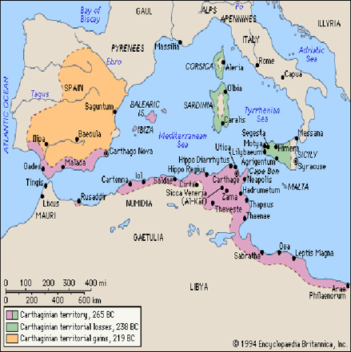
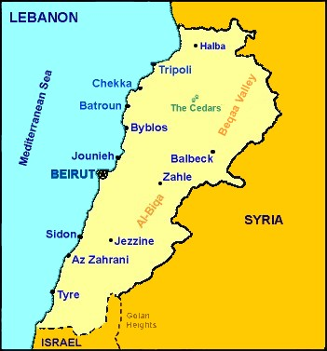
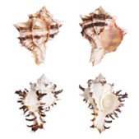
Colonies and Trade
Carthage – became
very powerful
Tyre - largest city-state
Red-purple dye from snails
Traders and business people
Notes:
Colony in N Africa
Famous for its purple fabric. Made from snails. It took 60,000 snails to produce one pound of dye. The purple fabric was so expensive that only royalty could afford it.

Slide 66
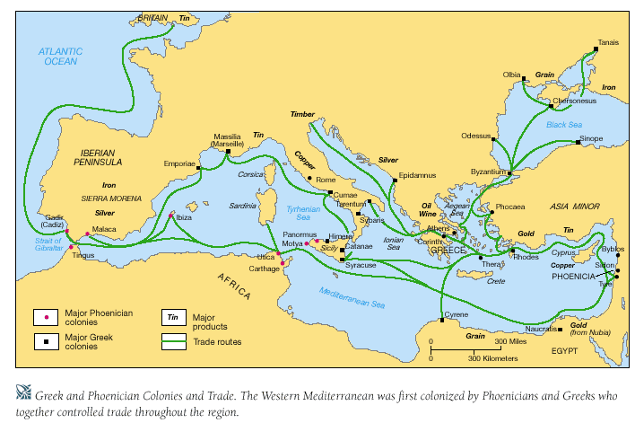
E. Phoenician Trade Routes

Slide 67
Phoenician Ship
Notes:
Created a wide bottom boat to hold lots of cargo.

Slide 68
The Phoenician Alphabet
Developed to record transactions
Symbols represent sounds
Phonetic
Easy to learn

Slide 69
Importance of Writing
Bills of sales
Contracts
Record events
Record history
Story telling
Recap of Writing:
Cuneiform – Sumerians (on stone and clay)
Hieroglyphics – Egyptians (on stone, clay and then papyrus)
Phoenician Alphabet – symbols = sounds - Phoenicians

