Slide 1
New Conflagrations: World War II and the Cold War
©2011, The McGraw-Hill Companies, Inc. All Rights Reserved.
*
Notes:
*

Slide 2
The Second World War
Allies vs. Axis powers
Italy, Germany and Japan form Axis
“Revisionists”: wished to revise post-World War I peace treaties
Allies initially follow policy of appeasement
War erupts 1939, global by 1941, over 1945
©2011, The McGraw-Hill Companies, Inc. All Rights Reserved.
*
Notes:
*

Slide 3
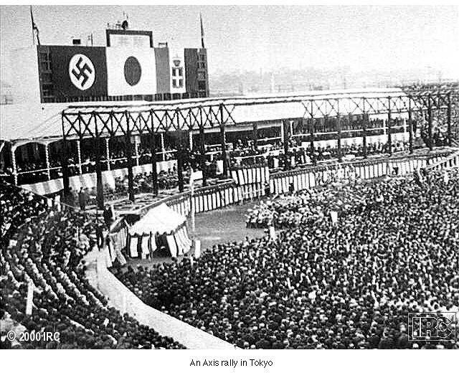
Axis Rally in Tokyo
©2011, The McGraw-Hill Companies, Inc. All Rights Reserved.
*
Notes:
*

Slide 4
Japan’s War in China
Conquest of Chinese Manchuria 1931-1932
Full-scale invasion in 1937
The Rape of Nanjing
Ariel bombing of urban center
400,000 Chinese used for bayonet practice, massacred
7,000 women raped
1/3 of all homes destroyed
Japan signs Tripartite Pact with Germany, Italy (1940); neutrality pact with Soviet Union (1941)
©2011, The McGraw-Hill Companies, Inc. All Rights Reserved.
*
Notes:
*

Slide 5
Chinese Resistance
Japanese aggression spurs “united front” policy between Chinese Communists and Nationalists
Guerilla warfare ties down half of the Japanese army
Yet continued clashes between Communists and Nationalists
Communists gain popular support, upper hand by end of the war
©2011, The McGraw-Hill Companies, Inc. All Rights Reserved.
*
Notes:
*

Slide 6
Italian Aggression
Benito Mussolini invades Ethiopia with overpowering force
2,000 Italian troops killed, 275,000 Ethiopians killed
Also takes Libya, Albania
©2011, The McGraw-Hill Companies, Inc. All Rights Reserved.
*
Notes:
*

Slide 7
Germany
Adolf Hitler (1889-1945) withdraws from League of Nations
Remilitarizes Germany
Anschluss (“Union”) with Austria, 1938
Pressure on Sudetenland (Czechoslovakia)
©2011, The McGraw-Hill Companies, Inc. All Rights Reserved.
*
Notes:
*

Slide 8
Munich Conference (1938)
Italy, France, Great Britain, Germany meet
Allies follow policy of appeasement
Hitler promises to halt expansionist efforts
British Prime Minister Neville Chamberlain (1869-1940) promises “peace for our time”
Hitler signs secret Russian-German Treaty of Nonaggression (August 1939)
©2011, The McGraw-Hill Companies, Inc. All Rights Reserved.
*
Notes:
*

Slide 9
Germany Conquers Europe
Invades Poland, September 1, 1939
Blitzkrieg: “lightning war” strategy
Air forces soften up target, armored divisions rush in
German U-boats (submarines) patrol Atlantic, threaten British shipping
©2011, The McGraw-Hill Companies, Inc. All Rights Reserved.
*
Notes:
*

Slide 10
The Fall of France
1940: Germany occupies Denmark, Norway, Belgium, France
Hitler forces French to sign armistice agreement in same railroad car used for the armistice imposed on Germany in 1918
©2011, The McGraw-Hill Companies, Inc. All Rights Reserved.
*
Notes:
*

Slide 11
The Battle of Britain
Air war conducted by the German Luftwaffe
“The Blitz”
40,000 British civilians killed in urban bombing raids
Especially London
Royal Air Force prevents Germans from invading
©2011, The McGraw-Hill Companies, Inc. All Rights Reserved.
*
Notes:
*

Slide 12
Operation Barbarossa
Lebensraum (“living space”)
June 22, 1941, Hitler double-crosses Stalin and invades Soviet Union
Stalin caught off-guard, rapid advance
But severe winter, long supply lines weakened German efforts
Soviets regroup and attack in spring 1942
Turning point: battle of Stalingrad (ends February 1943)
©2011, The McGraw-Hill Companies, Inc. All Rights Reserved.
*
Notes:
*

Slide 13
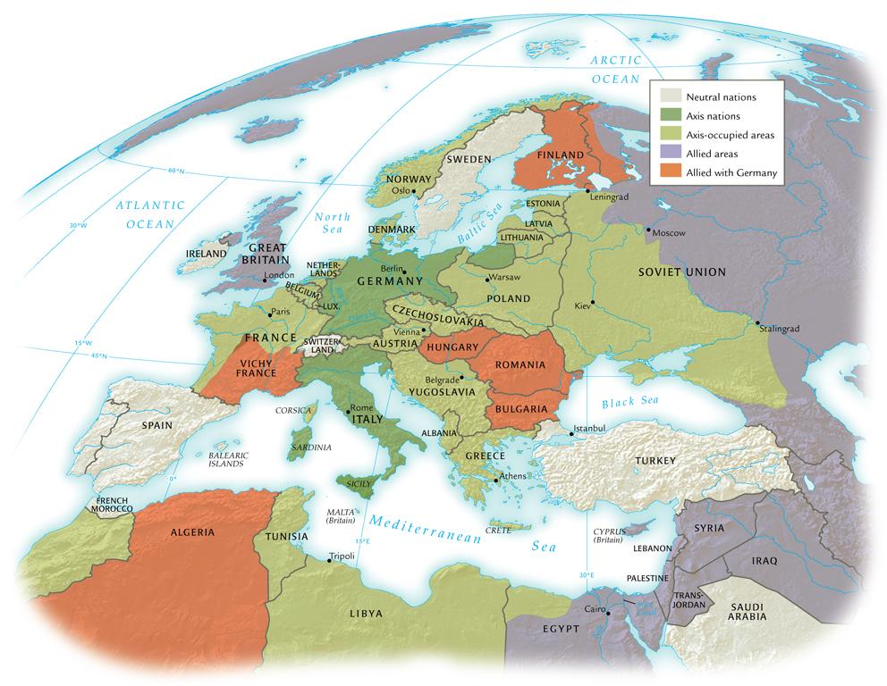
High Tide of Axis Expansion in Europe and North Africa, 1942-1943
©2011, The McGraw-Hill Companies, Inc. All Rights Reserved.
*
Notes:
*

Slide 14
U.S. Involvement in WWII before Pearl Harbor
U.S. initiates “cash and carry” policy to supply Allies with arms
“Lend-lease” program: U.S. lends war goods to Allies, leases naval bases in return
U.S. freezes Japanese assets in U.S.
U.S. places embargo on oil shipments to Japan
Japanese Defense Minister Tojo Hideki (1884-1948) plans for war with U.S.
©2011, The McGraw-Hill Companies, Inc. All Rights Reserved.
*
Notes:
*

Slide 15
Pearl Harbor (December 7, 1941)
FDR: “a date which will live in infamy”
Destroyed U.S. Navy in the Pacific
Hitler, Mussolini declare war on the U.S. on December 11
U.S. joins Great Britain and the Soviet Union
©2011, The McGraw-Hill Companies, Inc. All Rights Reserved.
*
Notes:
*

Slide 16
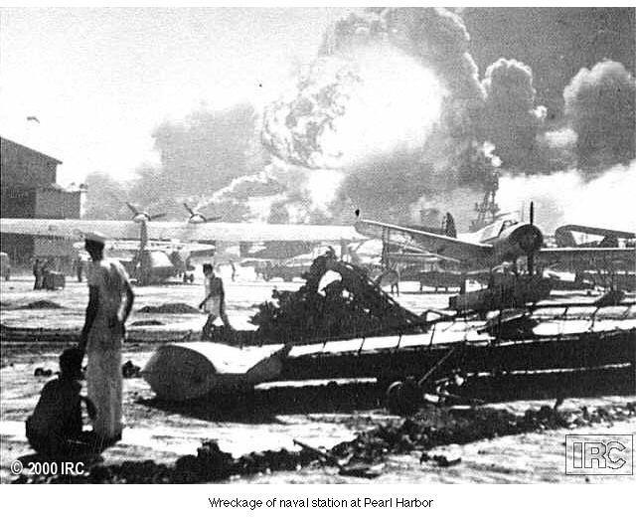
Wreckage from Pearl Harbor
©2011, The McGraw-Hill Companies, Inc. All Rights Reserved.
*
Notes:
*

Slide 17
Japanese Victories
Japan dominates southeast Asia, Pacific islands
Establishes “Greater East Asia Co-Prosperity Sphere”
©2011, The McGraw-Hill Companies, Inc. All Rights Reserved.
*
Notes:
*

Slide 18
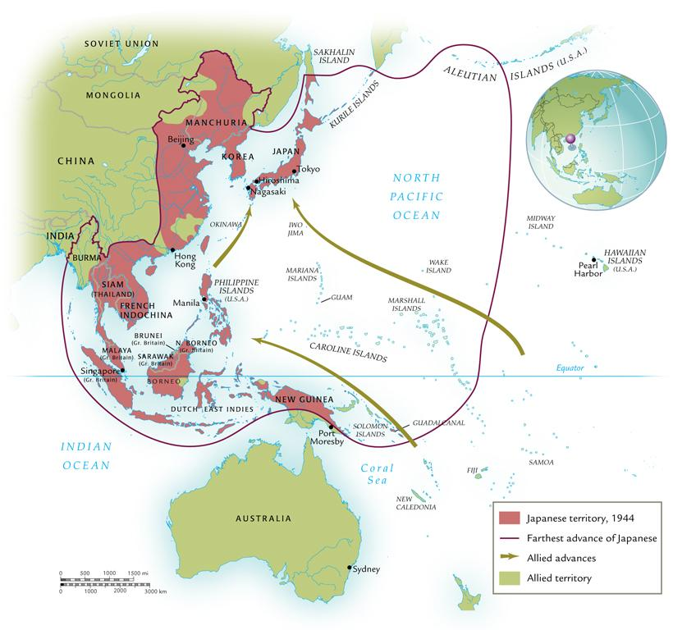
World War II in Asia and the Pacific
©2011, The McGraw-Hill Companies, Inc. All Rights Reserved.
*
Notes:
*

Slide 19
Defeat of the Axis Powers
Key factors: personnel reserves, industrial capacity
U.S. joining the war turned the tide
Shipbuilding, automotive production especially important
©2011, The McGraw-Hill Companies, Inc. All Rights Reserved.
*
Notes:
*

Slide 20
Allied Victory in Europe
Red Army (Soviet Union) gains offensive after Stalingrad (February 1943)
British, U.S. forces attack in north Africa, Italy
D-Day: June 6, 1944, British and U.S. forces land in France
U.S., Britain bomb German cities
Dresden, February 1945: 135,000 Germans killed in shelters
30 April 1945, Hitler commits suicide; 8 May, Germany surrenders
©2011, The McGraw-Hill Companies, Inc. All Rights Reserved.
*
Notes:
*

Slide 21
Turning the Tide in the Pacific
U.S. code breaking operation Magic discovers Japanese plans
Battle of Midway (June 4, 1942)
U.S. takes the offensive, engages in island-hopping strategy
Iwo Jima and Okinawa
Japanese kamikaze suicide bombers
Savage two-month battle for Okinawa
©2011, The McGraw-Hill Companies, Inc. All Rights Reserved.
*
Notes:
*

Slide 22
Japanese Surrender
U.S. firebombs Tokyo, March 1945
100,000 killed
25% of buildings destroyed
Atomic bombs dropped on Hiroshima and Nagasaki, August 1945
Emperor Hirohito (1901-1989) surrenders unconditionally September 2, 1945
©2011, The McGraw-Hill Companies, Inc. All Rights Reserved.
*
Notes:
*

Slide 23
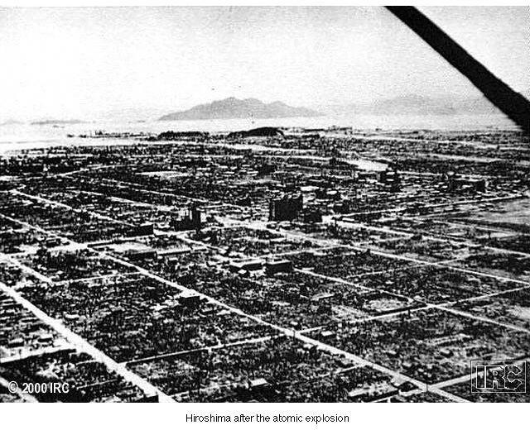
Hiroshima after the Bomb
©2011, The McGraw-Hill Companies, Inc. All Rights Reserved.
*
Notes:
*

Slide 24
Varieties of Wartime Occupation
Independent states with enforced alliances
Thailand, Denmark
Puppet states
Manchukuo, Vichy France
Military administration
Indochina, Poland
©2011, The McGraw-Hill Companies, Inc. All Rights Reserved.
*
Notes:
*

Slide 25
Collaboration
For some, opportunity for social mobility under conquerors
Sometimes considered a lesser evil than military administration
©2011, The McGraw-Hill Companies, Inc. All Rights Reserved.
*
Notes:
*

Slide 26
Resistance
Military forms of resistance
Intelligence gathering
Protecting refugees
Symbolic gestures
©2011, The McGraw-Hill Companies, Inc. All Rights Reserved.
*
Notes:
*

Slide 27
Nazi Genocide and the Jews
Jews primary target of Nazi genocidal efforts
Other groups also slated for destruction: Roma (Gypsies), homosexuals, Jehovah’s Witnesses
Nazis initially encouraged Jewish emigration
Few countries willing to accept Jewish refugees
Aborted plans to deport Jews to Madagascar, reservation in Poland
©2011, The McGraw-Hill Companies, Inc. All Rights Reserved.
*
Notes:
*

Slide 28
The Final Solution
Einsatzgruppen (mobile killing squads) follow German army into Soviet Union with Operation Barbarossa
Round up of Jews and others, machine-gun executions of 1.4 million
Later in 1941 decided on “final solution”: deportation of all European Jews to death camps
Plans solidified at Wannsee Conference, January 1942
©2011, The McGraw-Hill Companies, Inc. All Rights Reserved.
*
Notes:
*

Slide 29
The Holocaust
Jews deported from ghettos all over Europe in cattle cars, spring 1942
Destination: six specially-designed death camps in eastern Europe
Technologically advanced, assembly-line style of murder through poison gas (Zyklon B)
Corpses destroyed in crematoria
Estimated number of Jews killed: 5.7 million
©2011, The McGraw-Hill Companies, Inc. All Rights Reserved.
*
Notes:
*

Slide 30
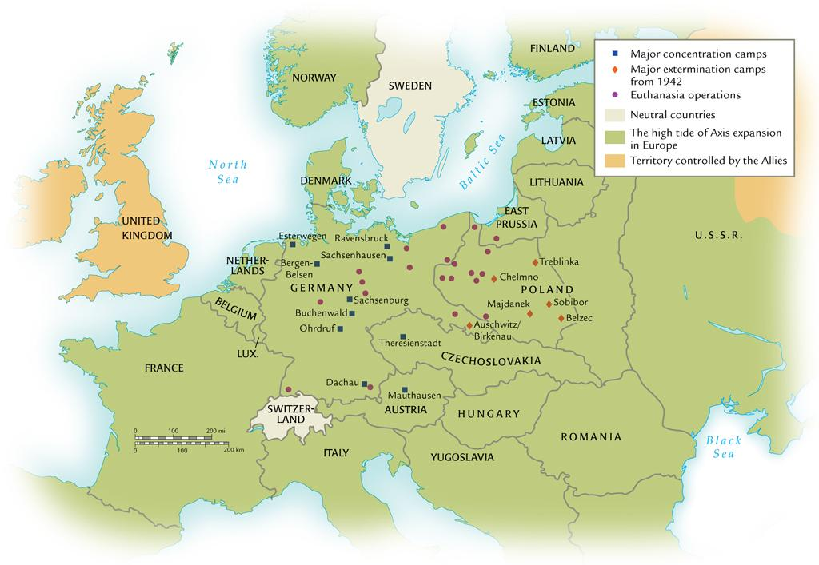
The Holocaust in Europe, 1933-1945
©2011, The McGraw-Hill Companies, Inc. All Rights Reserved.
*
Notes:
*

Slide 31
Jewish Resistance
German policy of collective punishment, generations of life as a minority hamper Jewish resistance efforts
Yet ghetto uprisings, armed conflict nevertheless
Warsaw ghetto uprising, spring 1943
Jews in partisan guerilla units
©2011, The McGraw-Hill Companies, Inc. All Rights Reserved.
*
Notes:
*

Slide 32
Women and the War
WAVES (Women Appointed for Volunteer Emergency Service)
U.S., Great Britain bar women from serving in combat units
Soviet, Chinese forces include women fighters
Women very active in resistance movements
©2011, The McGraw-Hill Companies, Inc. All Rights Reserved.
*
Notes:
*

Slide 33
Women’s Roles
Women occupy jobs of men away at war
Also take on “head of household” duties
Temporary: men returning from war displace women
Yet lasting impact on women’s movement
©2011, The McGraw-Hill Companies, Inc. All Rights Reserved.
*
Notes:
*

Slide 34
“Comfort Women”
Asian women forced into prostitution by Japanese forces
20-30 men per day, in war zones
“Comfort houses,” “consolation centers”
Killed when infected with venereal disease
Large-scale massacres at end of war to hide crimes
Social ostracism for survivors
©2011, The McGraw-Hill Companies, Inc. All Rights Reserved.
*
Notes:
*

Slide 35
Origins of the Cold War
Creation of United Nations, October 1945
Five permanent Security Council members: U.S., Great Britain, France, Soviet Union, China
Differences over future of Poland, eastern Europe
Soviets help bring communist governments to power, 1946-1947
Romania, Bulgaria, Hungary, Poland
Albania and Yugoslavia already communist-controlled
©2011, The McGraw-Hill Companies, Inc. All Rights Reserved.
*
Notes:
*

Slide 36
The Truman Doctrine (1947)
World divided into free and enslaved states
U.S. to support all movements for democracy; commits to interventionist foreign policy
“Containment” of communism
©2011, The McGraw-Hill Companies, Inc. All Rights Reserved.
*
Notes:
*

Slide 37
The Marshall Plan
Named for George C. Marshall (1880-1959), U.S. Secretary of State
Proposed in 1947, $13 billion to reconstruct western Europe
Soviet Union establishes Council for Mutual Economic Assistance (COMECON), 1949
©2011, The McGraw-Hill Companies, Inc. All Rights Reserved.
*
Notes:
*

Slide 38
Military Alliances
North Atlantic Treaty Organization (NATO), 1949
Collective defense
Warsaw Pact, 1955
Countermeasure consisting of seven communist European nations
©2011, The McGraw-Hill Companies, Inc. All Rights Reserved.
*
Notes:
*

Slide 39
A Divided Germany
Division of postwar Germany, especially Berlin
Western powers merge occupation zones
Soviet blockade of Berlin
©2011, The McGraw-Hill Companies, Inc. All Rights Reserved.
*
Notes:
*

Slide 40
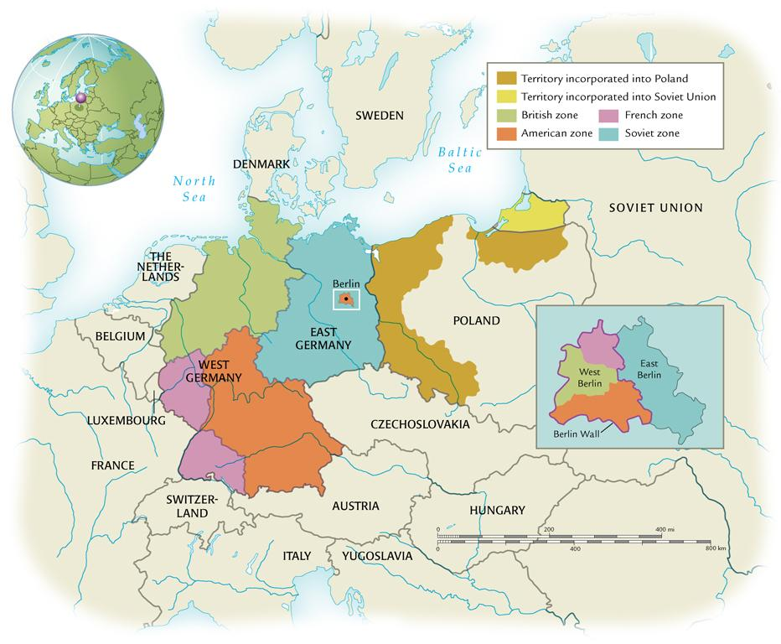
Occupied Germany, 1945-1949
©2011, The McGraw-Hill Companies, Inc. All Rights Reserved.
*
Notes:
*

Slide 41
Berlin Airlift
11 months of air shipments to Berlin, beginning June 1948
Cold war did not go “hot”
Soviets lift blockade in summer 1949
East Berlin capital of “German Democratic Republic”
Bonn capital of “Federal Republic of Germany”
©2011, The McGraw-Hill Companies, Inc. All Rights Reserved.
*
Notes:
*

Slide 42
Construction of the Berlin Wall
1949-1961: 3.5 million East Germans flee to West
Especially younger, highly-skilled workers
August 1961, construction of wall separating East and West
Symbol of the cold war
©2011, The McGraw-Hill Companies, Inc. All Rights Reserved.
*
Notes:
*

Slide 43
The People’s Republic of China
Civil war between Communists and Nationalists erupts after defeat of Japan
Jiang Jieshi (Chiang Kai-shek) forced to retreat to island of Taiwan with Nationalist forces
Takes most of China’s gold reserves
Mao Zedong proclaims People’s Republic of China, 1949
Begins dramatic transformation of Chinese society into communist mold
©2011, The McGraw-Hill Companies, Inc. All Rights Reserved.
*
Notes:
*

Slide 44
Beijing-Moscow Relations
Both felt threatened by U.S.
Mutual concern over U.S. rehabilitation of Japan
Beijing recognizes primacy of Moscow as communist leader
Receives military, economic aid in return
©2011, The McGraw-Hill Companies, Inc. All Rights Reserved.
*
Notes:
*

Slide 45
Division of Korea
Korea divided along 38th parallel after WWII
1948, two Koreas:
Republic of Korea (South, capital Seoul)
People’s Democratic Republic of Korea (North, capital Pyongyang)
©2011, The McGraw-Hill Companies, Inc. All Rights Reserved.
*
Notes:
*

Slide 46
Korean War
North Korea invades in 1950, captures Seoul
U.S. lands, drives North Koreans back to 38th parallel, then goes on to capture Pyongyang
Chinese invade, push U.S. back to 38th
3 million killed until ceasefire reached in summer 1953
No peace treaty signed; continued tensions
©2011, The McGraw-Hill Companies, Inc. All Rights Reserved.
*
Notes:
*

Slide 47
Containment
Southeast Asian Treaty Organization (SEATO), Asian version of NATO
“Domino theory” moves President Eisenhower (1890-1969) to consider nuclear weapon use in Korea
©2011, The McGraw-Hill Companies, Inc. All Rights Reserved.
*
Notes:
*

Slide 48
Soviet-Chinese Tensions
Chinese believe Soviet aid programs too modest, too many strings attached
Competing for influence in Africa, Asia
Successful nuclear testing in 1964 elevates Chinese prestige
©2011, The McGraw-Hill Companies, Inc. All Rights Reserved.
*
Notes:
*

Slide 49
Cuba
Fidel Castro Ruz (1926-), 1959 revolution
Accepts massive Soviet aid
Supports USSR’s foreign policy
©2011, The McGraw-Hill Companies, Inc. All Rights Reserved.
*
Notes:
*

Slide 50
The Bay of Pigs
Castro declares undying allegiance to Soviet foreign policy, 1960
Kennedy and CIA send 1,500 Cubans into Bay of Pigs to spur revolution
American air support does not appear; force destroyed in 3 days
U.S. embarrassment
©2011, The McGraw-Hill Companies, Inc. All Rights Reserved.
*
Notes:
*

Slide 51
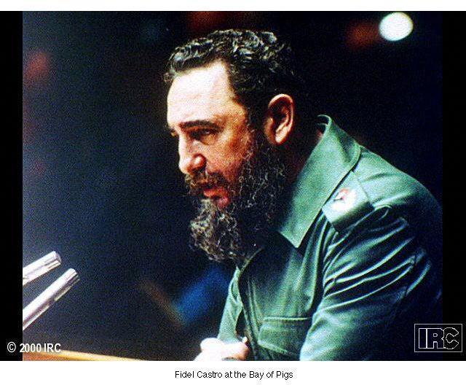
Fidel Castro at the Bay of Pigs
©2011, The McGraw-Hill Companies, Inc. All Rights Reserved.
*
Notes:
*

Slide 52
Cuban Missile Crisis
October 1962, Soviets begin assembling missiles in Cuba
Kennedy publicly challenges Soviet Union
Quarantines Cuba
Soviets concede, but U.S. guarantees noninterference with Castro regime
©2011, The McGraw-Hill Companies, Inc. All Rights Reserved.
*
Notes:
*

Slide 53
Soviet Intervention
De-Stalinization under Nikita Khrushchev (1894-1971)
Political thaw in governmental control
Emboldens experimentation by other communist leaders
Hungarian uprising; crushed by Soviets 1956
“Prague Spring”
Brezhnev doctrine (doctrine of limited sovereignty)
©2011, The McGraw-Hill Companies, Inc. All Rights Reserved.
*
Notes:
*

Slide 54
Détente
Reduction in hostility between nuclear superpowers
Strategic Arms Limitations Talks (SALT)
State visit by President Nixon (1913-1994) to China
©2011, The McGraw-Hill Companies, Inc. All Rights Reserved.
*
Notes:
*

