Slide 1
Classical Asian Empires
Maurya, Gupta, Zhou/Qin/Han

Slide 2
Classical India
Maurya and Gupta Empires

Slide 3
Mauryan Empire (324 BCE – 184 BCE)
India’s first centralized empire
Chandragupta Maurya
4th Century BCE
Control of Magadha
Kautilya
Brahmin advisor to Chandragupta
Arthashastra (treatise on government)
“My enemy’s enemy is my friend”
Tax collection
Spy “agency”
Economy
¼ harvest value tax to gov’t
Mining, liquor, weapon monopolies
Irrigation fees
Standard coinage
Armed Forces
Infantry, cavalry, chariot
War elephants
Pataliputra: capital
Height during/after Ashoka (see next slide)
Fall of Empire
$$$$$ of army/bureaucracy
External threats

Slide 4
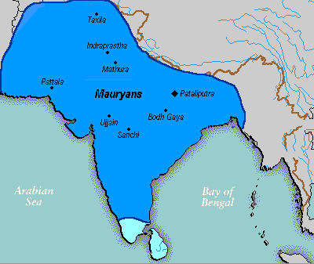

Slide 5
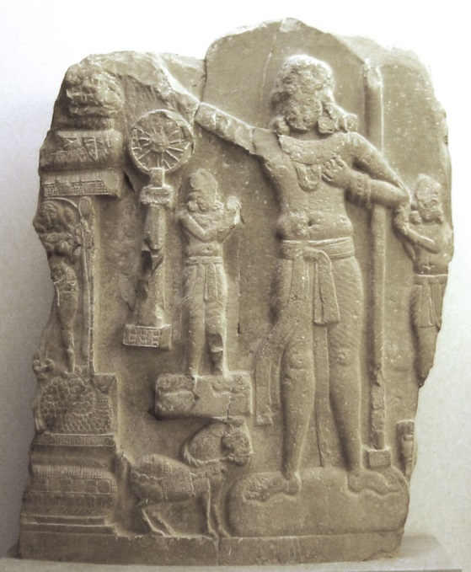
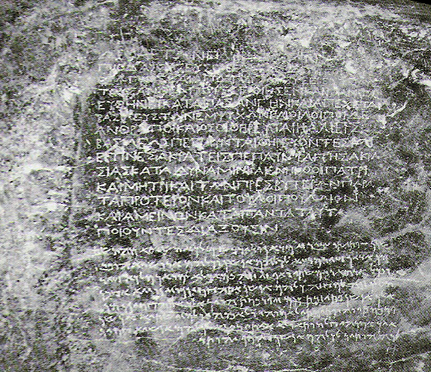
Ashoka
Chandrapgupta’s grandson
Conquest of Kalinga
Hundreds of thousands killed
Brutality caused Ashoka to convert to Buddhism
Nonviolence, morality, moderation , religious toleration
Pillars of Ashoka
40-50 ft tall / 50 tons
Earliest, decipherable Indian writing
Edicts of Ashoka for all to see
Emphasized morality, nonviolence
Reminded people of his ability to
punish those who did wrong

Slide 6
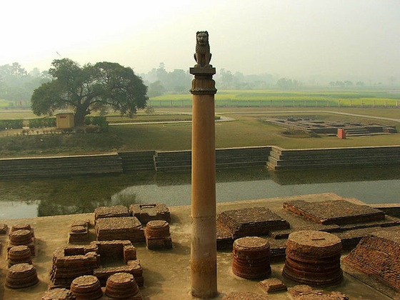

Slide 7
Political Fragmentation
500 years of foreign rule after fall of Mauryan Empire
Greco-Bactrian forces (Alexander the Great)
Central Asian groups
Kushans
Flourishing of economy and culture
India becomes center for international trade
Merchants and artisans become political powers
Ramayana and Mahabharata
Indian epics
Science and Technology
Herbal remedies
Standardization of Sanskrit into administrative language

Slide 8
Gupta Empire (320-550 CE)
Founded by Chandra Gupta
Named after Chandragupta Maurya
Smaller in territory size than Mauryan
Not as centralized as Mauryan
“Theater state”
Full of rituals and ceremonies
Invention of zero
Arabic numerals
Decline in women’s rights
Loss of right to own/inherit property
Barred from (some) religious ceremonies
Treated like the Shudra
Obey father, husband, sons
Sati: widow cremation
Escape to monasteries
Higher social status = more freedom

Slide 9
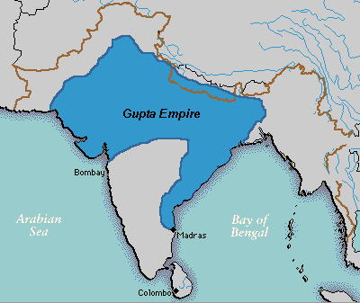

Slide 10
Religion and Fall of the Empire
Gupta monarchs were Hindu
Reestablishment of caste system
Brahmins receive land
Taxes go to priests
Practiced religious tolerance
Traditional temple style emerges
Raised platform and towers
Trade declines due to failing of Roman Empire
Begin trading with Malay Peninsula and Indonesia
Silk Roads still dangerous
Fall of Empire
5th century CE: Invasion of Huns
Exhaustion of treasury

Slide 11
Classical China
Zhou, Qin, and Han Dynasties

Slide 12
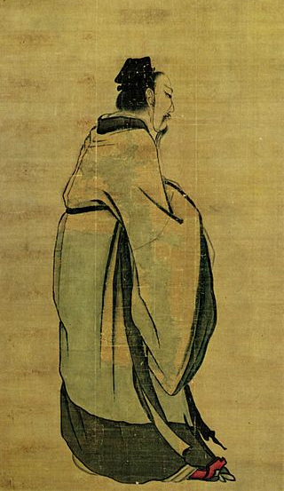
Rise of the Zhou
11th century BCE: overthrow of the Shang
Longest, most revered dynasty in Chinese history
Wen and Wu
Rebellion and attack of Shang capital
Wu is first ruler of dynasty →
Zhou Timeline:
Western Zhou (1045-771 BCE)
Eastern Zhou (771-221 BCE)
Spring and Autumn Period (771-481 BCE)
Warring States Period (481-221 BCE)

Slide 13
Mandate of Heaven
Use of religion to justify the rule of a king/emperor
Heaven gave authority to rulers
Authority could be taken away if the ruler did not look out for the well being of subjects
Proof of favor with the gods
Stability and prosperity of kingdom
Signs of disfavor of a ruler
Natural disasters
Invasion

Slide 14
Politics
Written texts
Book of Documents (letters, historical record)
Book of Songs (poems, songs—details the lives of all classes of citizens)
Xi’an: new capital city
Grid plan
Gates in walls opening at cardinal directions
Feng shui

Slide 15
Eastern Zhou (771-221 BCE)
Power of Zhou monarch is gradually reduced from 1045-771 BCE
771 BCE: attack of Xi’an
Capital moved east to Luoyang
(thus the name “Eastern Zhou)
Spring and Autumn Period
Spring and Autumn Annals are the historical record of the time period
Warring States Period

Slide 16
Spring and Autumn Period
771-481 BCE
Regional lords hold the power in China
Constant warfare between regions/states
Armies made up of farmers instead of the elite
Warriors on horseback
Bronze replaced by iron
First people in the world to forge steel
Development of a large and extensive bureaucracy
Government made up of appointed officials rather than elected ones
Development of philosophical systems of China

Slide 17
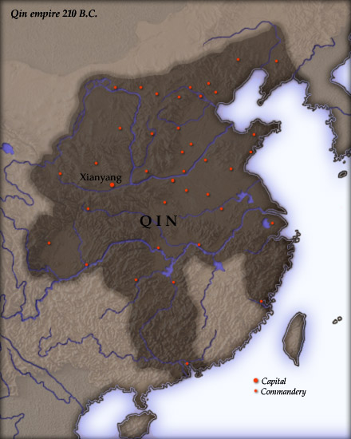
Unification of China – Qin Dynasty, 221-206 BCE
Qin = superior warring state from Warring States Period (see Ch 3)
Qin conquered various neighbors and rivals
By 221 BCE, all of northern/central China unified under Qin
Creation of the first Chinese Empire

Slide 18
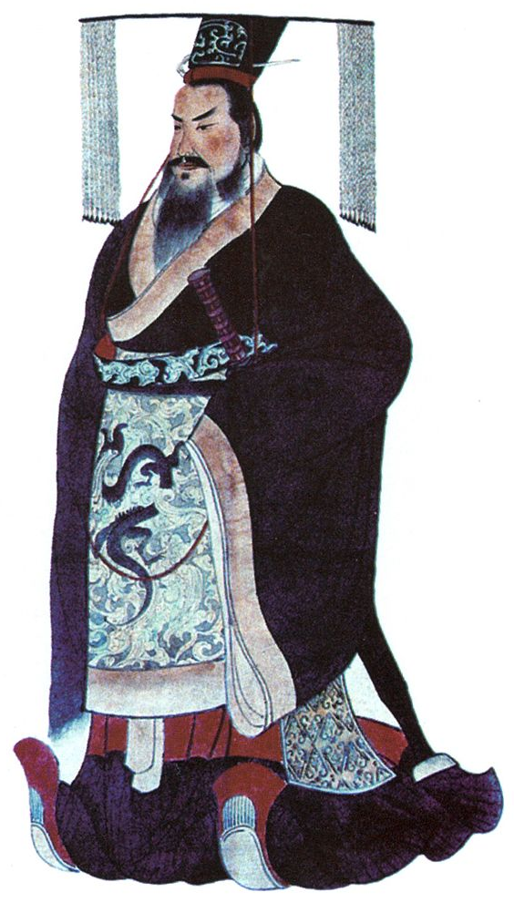
Qin Shi Huangdi
Ascended the throne in 246 BCE at age of 13 under the name Zheng
Shi Huangdi means “First Emperor”
Claimed his dynasty would last for 1000 years
Central administration of the empire with Legalist principles and policies
Reform
Abolition of primogeniture
Passing of all land to eldest son
New laws requiring land to be divided among several heirs
Standardization
Weights, measures, coinage, writing, law
Help unified diverse groups

Slide 19
LI Si and Legalism
Li Si = Prime Minister
Convinced Shi Huangdi that scholars were “subverting the goals of the regime”
Felt that the Confucian morals were in direct opposition of a ruler’s absolute power
Crackdown on Confucians and Confucian traditions
Burned Confucian books
Killed Confucian scholars

Slide 20
External Threats from Xiongnu
Nomads on the northern border of the empire
At times, peaceful trade between nomads and Chinese farmers
Other times, nomads raided villages
Chinese response
Began building walls to keep out invaders
Began training mounted soldiers (cavalry)
Shi Huangdi’s response
Send soldiers to drive nomads from empire
Connected/extended existing walls around empire
Precursor to Great Wall
Huangdi’s aggression caused nomads to band together and create the Xiongnu Confederacy
The Xiongnu would continue to cause problems for China for hundreds of years

Slide 21
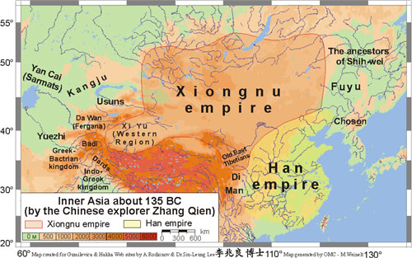

Slide 22
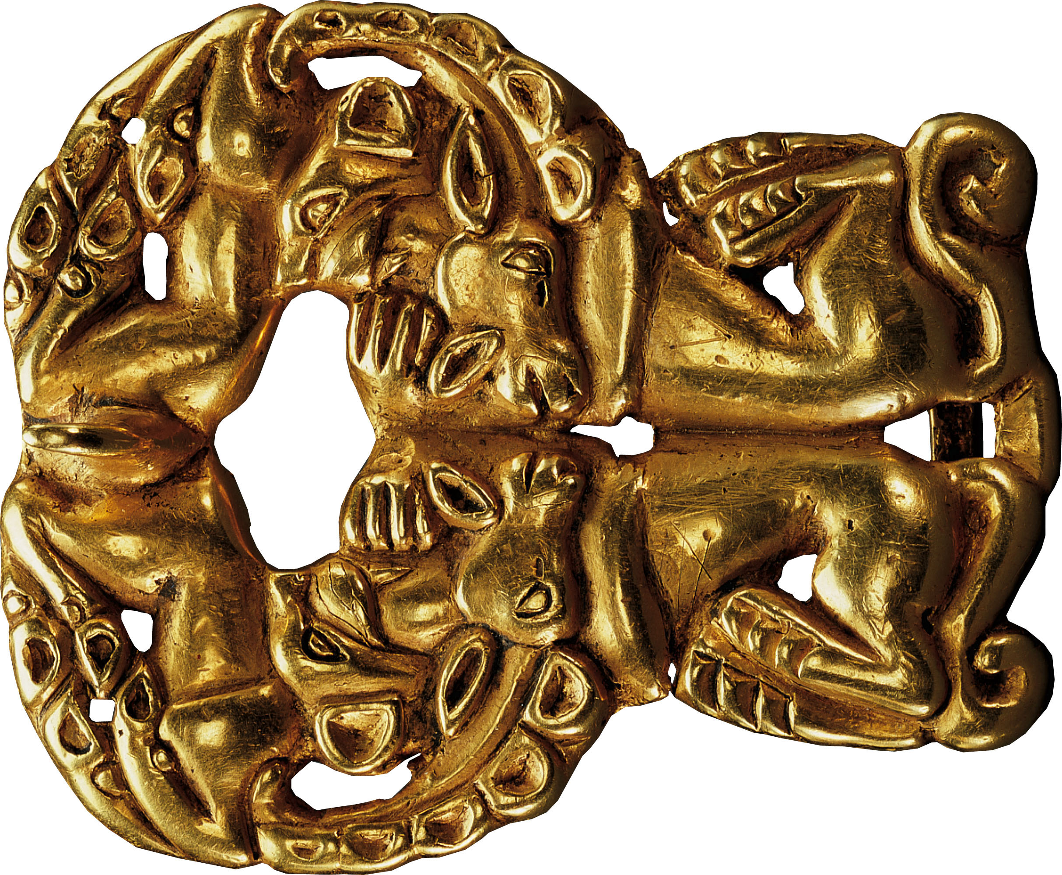
p. 168
Notes:
Gold Belt Buckle, Xiongnu, Second Century B.C.E.
The Xiongnu, herders in the lands north of China, shared the artistic conventions of nomadic peoples across the steppes of Asia and eastern Europe, such as this fluid, twisting representation of the animals on which they depended for their livelihood. Shi Huangdi’s military incursion into their pasturelands in the late third century B.C.E. catalyzed the formation of the Xiongnu Confederacy, whose horse-riding warriors challenged the Chinese for centuries.

Slide 23
Fall of the Qin
Oppressive policies
Mandatory military service
Forced labor for roads, walls, buildings
The Terra Cotta Army
Huangdi’s elaborate tomb that mimicked China’s geography
7000 life sized terra cotta soldiers to guard the afterlife
Huangdi’s successors were weak and the dynasty collapsed after only a few years

Slide 24
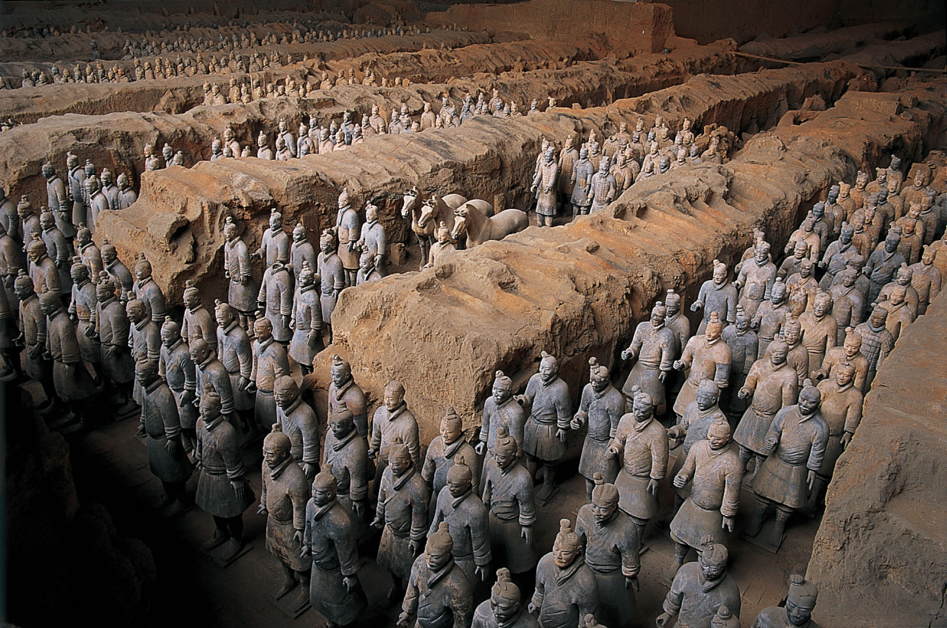
p. 167
Notes:
Terracotta Soldiers from the Tomb of Shi Huangdi, “First Emperor” of China, Late Third Century B.C.E.
Near the monumental tomb that he built for himself, the First Emperor filled a huge underground chamber with more than seven thousand life-sized baked-clay statues of soldiers. The terracotta army was unearthed in the 1970s.

Slide 25
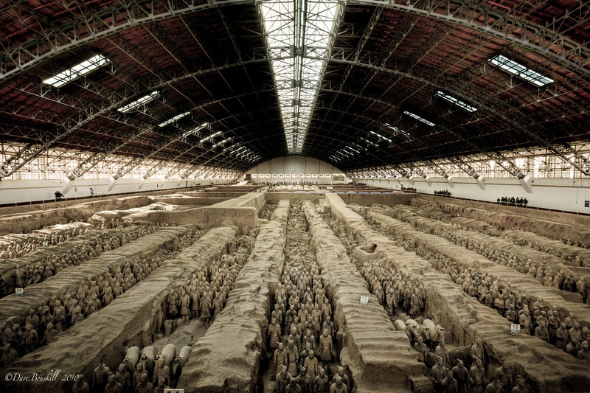

Slide 26
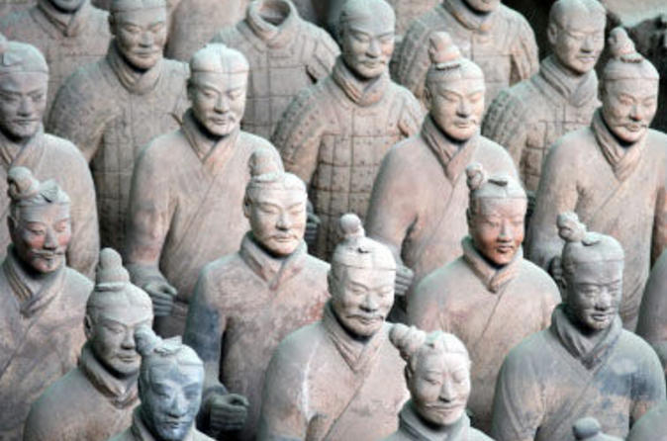

Slide 27
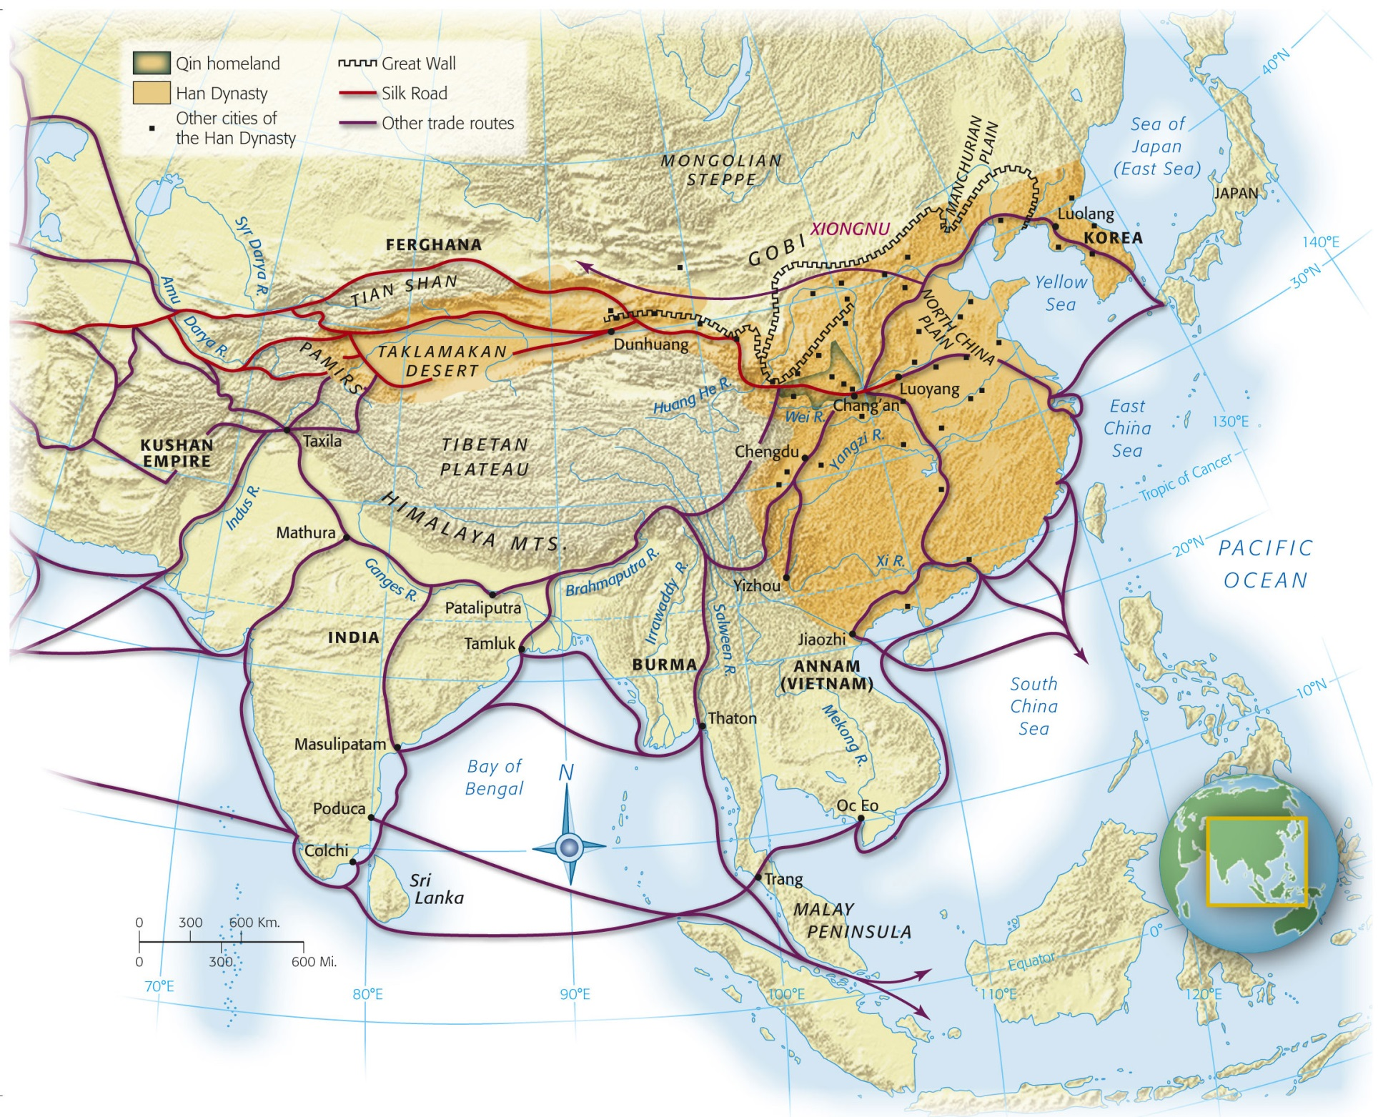
The Han Dynasty
202 BCE – 220 CE
Notes:
Map 6.2: Han China.
The Qin and Han rulers of northeast China extended their control over all of eastern China and extensive territories to the west. A series of walls in the north and northwest, built to check the incursions of nomadic peoples from the steppes, were joined together to form the ancestor of the present-day Great Wall of China. An extensive network of roads connecting towns, cities, and frontier forts promoted rapid communication and facilitated trade. The Silk Road carried China’s most treasured products to Central, South, and West Asia and the Mediterranean lands.

Slide 28
Early Emperors
Gaozu
Wu
First emperor of the Han Dynasty
Denounced extreme Qin policies, but retained Legalist institutions
Adopted an appeasement policy when dealing with Xiongnu
“gifts” (aka bribes) to buy safety
Substantially increased the power of the emperor
Increased size of empire
Abandoned Xiongnu appeasement
Built up Chinese military
By first century CE the Xiongnu had disbanded
Expensive wars caused Wu to establish monopolies on salt, iron, alcohol

Slide 29
Confucianism
Adopted by the Han as the “official ideology” of the empire
Confucian university
Chang’an (capital)
Confucian scholar exam for official positions

Slide 30
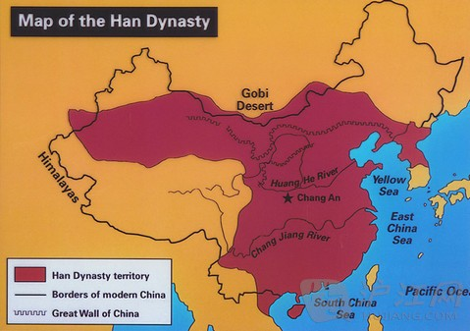
Chang’an
Modern Xi’an
Surrounded by a wall
Carefully planned with roads, imperial compound, homes/buildings
Model of urban planning
Dichotomy of elite and poor
Elite live in lavish homes
Poor live “as closely as the teeth of a comb”

Slide 31
Society
Patriarchal
Family = fundamental social unit
Included living AND ancestral spirits
Ancestor veneration
Sons favored over daughters
Filial piety (Confucianism)
Women
Cook, take care of family, make clothes
Submit to males
Arranged marriages
Ban Zhao
“Lessons for Women”

Slide 32
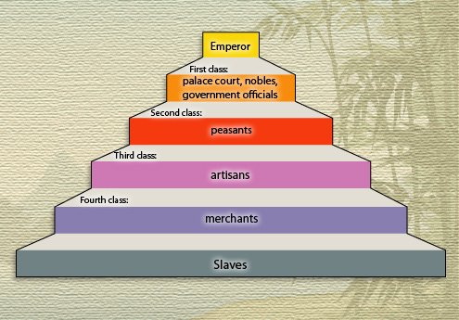
Social Classes
Gentry
Scholar offiials
Confucian
Exempt from taxes, military/labor service
Became a privileged class
Merchants
Some wealthy
Viewed as being greedy parasites
Blamed for China’s problems on occasion

Slide 33
Technology
Astrology/Observation of celestial bodies
Watermill
Horse collar
Heavier loads could be pulled by horses
Paper by 2nd century BCE
Crossbow trigger
Roads that traversed the empire
Similar to Roman Road
Canal system

Slide 34
Religion
Based in nature
Ghosts/spirits
Daoism
Alchemy
Turn common items into precious metals
Challenged Chinese tradition and led to uprisings
Buddhism
Originated in India in 5th century BCE
Arrival in China c. 1st century CE
Spread via Silk Road
Opposed traditional values of children and the family
Eventually changed to fit Chinese traditions

Slide 35
Fall of the Han (220 CE)
Yellow River
Flood caused river to change course
Many deaths
Economy destroyed
Widespread poverty
25 CE: capital moved to Luoyang
Corrupt officials, weak leaders, poverty

