Slide 1
The End of Empire
©2011, The McGraw-Hill Companies, Inc. All Rights Reserved.
*
Notes:
*

Slide 2
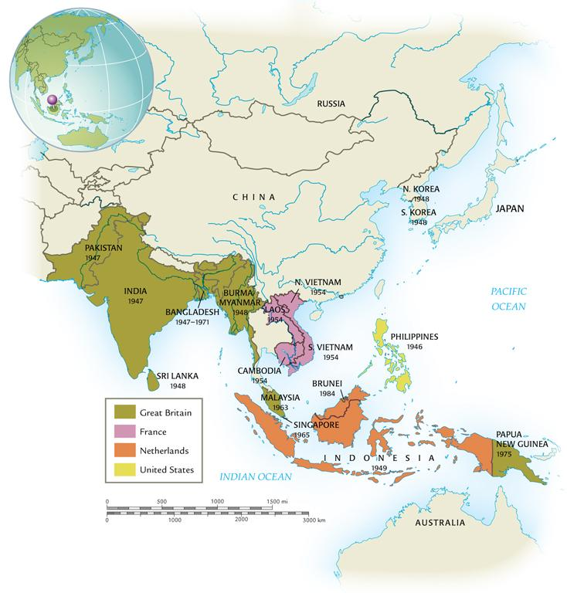
Decolonization in Asia
©2011, The McGraw-Hill Companies, Inc. All Rights Reserved.
*
Notes:
*

Slide 3
The Coming of Self-Rule
Home rule for India
Muslim separatism; communalism
Day of Direct Action
Great Calcutta Killing
©2011, The McGraw-Hill Companies, Inc. All Rights Reserved.
*
Notes:
*

Slide 4
Partition and Violence
Muhammad Ali Jinnah, Muslim League
Jawaharlal Nehru, Congress Party
1947 partition
500,000 killed
10 million refugees
India moves toward nonalignment position
The “third path”
©2011, The McGraw-Hill Companies, Inc. All Rights Reserved.
*
Notes:
*

Slide 5
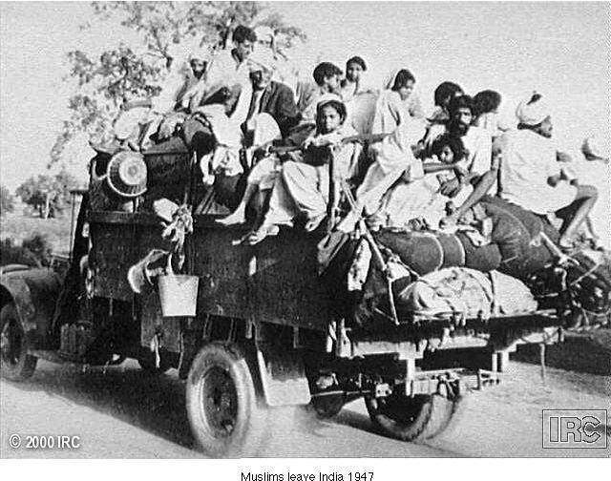
Muslims Leave India, 1947
©2011, The McGraw-Hill Companies, Inc. All Rights Reserved.
*
Notes:
*

Slide 6
Nationalist Struggles in Vietnam
French reassert control after WWII
Ho Chi Minh (1890-1969), communist leader, mounts guerilla war, defeats France in 1954
Vietnam divided at 17th parallel
Civil war between north (communist) and south
President Lyndon Johnson (1908-1973) begins increasing U.S. involvement
©2011, The McGraw-Hill Companies, Inc. All Rights Reserved.
*
Notes:
*

Slide 7
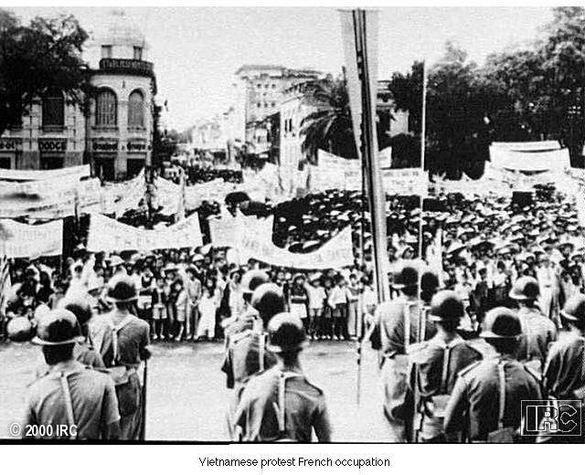
Vietnamese Protest French Occupation
©2011, The McGraw-Hill Companies, Inc. All Rights Reserved.
*
Notes:
*

Slide 8
The Issue of Palestine
After World War II, Arab states increasingly gain independence
Palestine ruled by Great Britain between the wars
Proclaims support for Jewish “homeland” in Palestine (Balfour Declaration, 1917)
British attempts to limit the growing Jewish migration
Pan-Arab nationalism; opposition to Jewish state
©2011, The McGraw-Hill Companies, Inc. All Rights Reserved.
*
Notes:
*

Slide 9
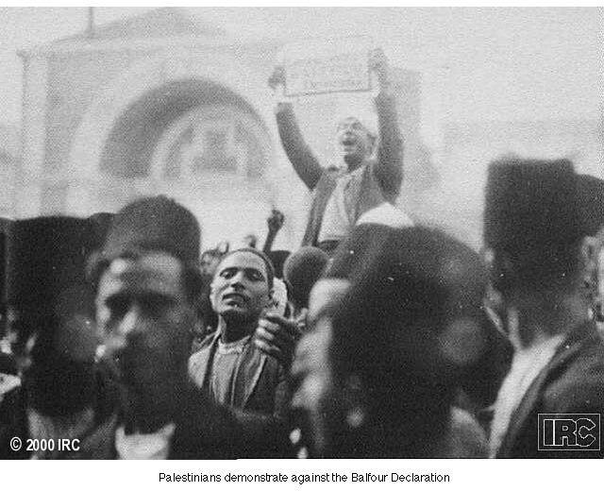
Demonstration against the Balfour Declaration
©2011, The McGraw-Hill Companies, Inc. All Rights Reserved.
*
Notes:
*

Slide 10
Creation of the State of Israel
Jewish, Arab pressure drives British to hand Palestine over to United Nations for a resolution
Partition plan of 1947 divides Palestine into two distinct states
May 1948, Jews declare independence of state of Israel
Sparks series of conflicts spanning five decades
Israel greatly expands territory
Intifada
©2011, The McGraw-Hill Companies, Inc. All Rights Reserved.
*
Notes:
*

Slide 11
Egypt and Arab Nationalism
Gamal Abdel Nasser (Egypt, 1918-1970) takes leadership position in Arab world
Nasser attempts to nationalize the Suez Canal (1956)
Gained international prestige
Confused cold war power politics
©2011, The McGraw-Hill Companies, Inc. All Rights Reserved.
*
Notes:
*

Slide 12
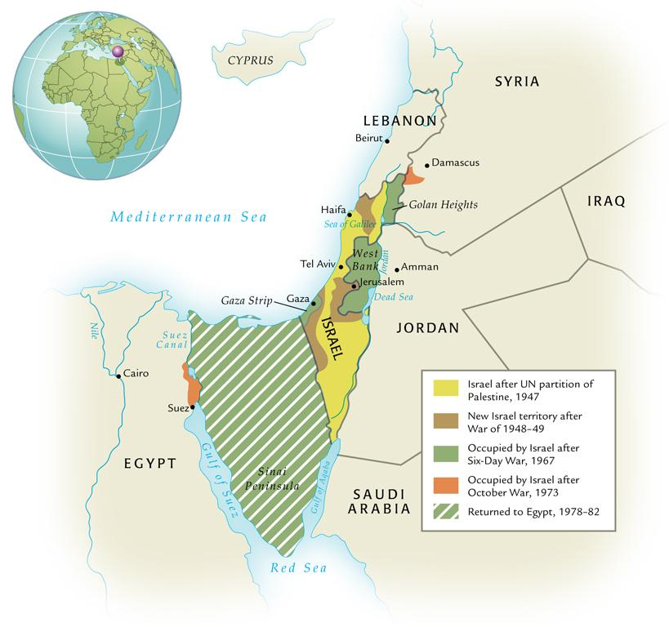
The Arab-Israeli Conflict, 1949-1982
©2011, The McGraw-Hill Companies, Inc. All Rights Reserved.
*
Notes:
*

Slide 13
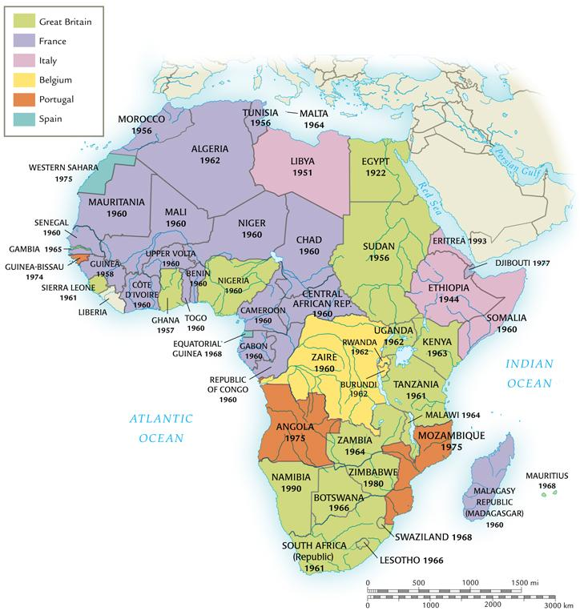
Decolonization in Africa
©2011, The McGraw-Hill Companies, Inc. All Rights Reserved.
*
Notes:
*

Slide 14
Decolonization in Africa
Legacy of colonial rule
Internal divisions
Tribal
Ethnic
Linguistic
Religious
©2011, The McGraw-Hill Companies, Inc. All Rights Reserved.
*
Notes:
*

Slide 15
France and North Africa
Abandonment of most territories
1956, Morocco and Tunisia gain independence, 13 other colonies in 1960
But determination to retain Algeria
Longer period of French colonization
Two million French citizens born or settled in Algeria by WWII
©2011, The McGraw-Hill Companies, Inc. All Rights Reserved.
*
Notes:
*

Slide 16
Algerian War of Liberation
1954 Front de Libération Nationale (FLN) begins guerilla warfare against France
Simmering conflict since French massacre in Sétif, 1945
500,000 French soldiers in war by 1958
War ends with Algerian independence in 1962
Frantz Fanon, The Wretched of the Earth (1961), manifesto against colonial rule
©2011, The McGraw-Hill Companies, Inc. All Rights Reserved.
*
Notes:
*

Slide 17
Négritude: “Blackness”
Influence of “black is beautiful” from U.S.
Revolt against white colonial values, reaffirmation of African civilization
Connection with socialism, communism
Geopolitical implications
©2011, The McGraw-Hill Companies, Inc. All Rights Reserved.
*
Notes:
*

Slide 18
Ghana
First sub-Saharan colony to achieve independence; 1957
Kwame Nkrumah (1909-1972), leader of Ghana
Celebrated visit of Queen Elizabeth II in 1961, affirmation of Ghana’s independence and equality
©2011, The McGraw-Hill Companies, Inc. All Rights Reserved.
*
Notes:
*

Slide 19
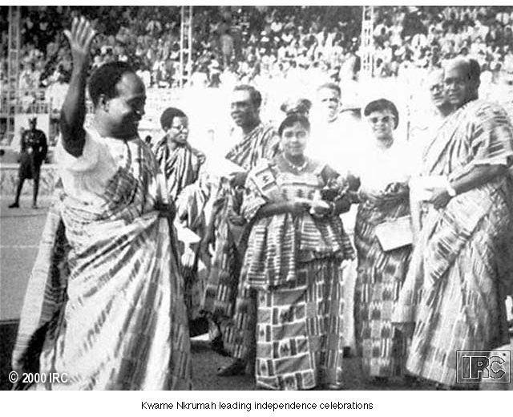
Kwame Nkrumah leading Independence Celebrations
©2011, The McGraw-Hill Companies, Inc. All Rights Reserved.
*
Notes:
*

Slide 20
Kenya
Kikuyu ethnic group begins attacks on British and “collaborationist” Africans, 1947
1952 state of emergency declared
Overwhelming British military response, 12,000 Africans killed vs. 100 Europeans
Bloody, but negotiated withdrawal, independence 1963
©2011, The McGraw-Hill Companies, Inc. All Rights Reserved.
*
Notes:
*

Slide 21
South Africa
Apartheid (1948)
87% of territory for whites
Division of Africans into tribes, settlement in “homelands”
African National Congress publishes Freedom Charter (1955)
Repression of ANC causes worldwide ostracism of South Africa
©2011, The McGraw-Hill Companies, Inc. All Rights Reserved.
*
Notes:
*

Slide 22
Dismantling of Apartheid
Release of Nelson Mandela, 1990
Negotiation of end of white minority rule
1994 elections bring ANC to power
Relatively calm transition to democratic society
©2011, The McGraw-Hill Companies, Inc. All Rights Reserved.
*
Notes:
*

Slide 23
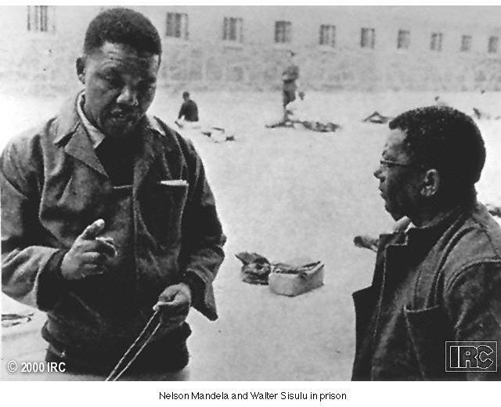
Nelson Mandela
©2011, The McGraw-Hill Companies, Inc. All Rights Reserved.
*
Notes:
*

Slide 24
Chinese Communism
Massive, pervasive policies of economic and cultural engineering
First Five-Year Plan (1955)
Great Leap Forward (1958-1961)
Great Proletarian Cultural Revolution (1966-1976)
Both huge failures
Deng Xiaoping (1904-1997) comes to power in 1981, moderates Maoism
Tiananmen Square pro-democracy rallies nevertheless subdued, 1989
©2011, The McGraw-Hill Companies, Inc. All Rights Reserved.
*
Notes:
*

Slide 25
Indian Democracy
Indian democracy flourishes under Indira Gandhi (1917-1984)
Daughter of Nehru, no relationship to Mohandas
“Green revolution” increases agricultural yields
Repressive policies to slow population growth, including forced sterilization
Assassinated by Sikh bodyguards after attack on Sikh extremists in Amritsar, 1984
©2011, The McGraw-Hill Companies, Inc. All Rights Reserved.
*
Notes:
*

Slide 26
Islamism
Muslims increasingly regard America in negative terms, move towards radicalism
Jihad: holy war
CIA support of Iranian Shah Mohammed Reza Pahlavi (1919-1980), overthrown in Iranian Revolution of 1979
Led by Ayatollah Ruhollah Khomeini
Held U.S. diplomats hostage for two years
Shut down U.S. facilities, confiscated economic ventures
©2011, The McGraw-Hill Companies, Inc. All Rights Reserved.
*
Notes:
*

Slide 27
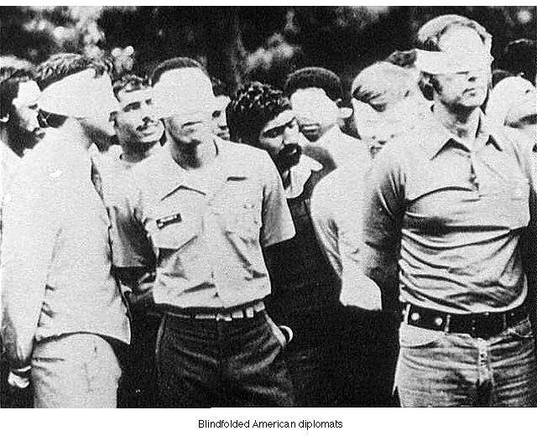
Blindfolded U.S. Diplomats
©2011, The McGraw-Hill Companies, Inc. All Rights Reserved.
*
Notes:
*

Slide 28
The Iran-Iraq War (1980-1988)
Saddam Hussein (Iraq, 1937-2006) uses oil, U.S. support to build huge military machine
Attacks Iran, 1980
Massive destruction, ends in stalemate
Hussein attacks Kuwait, provokes Gulf War (1991)
U.S.-led coalition drives him out, further hardships for Iraqi people
©2011, The McGraw-Hill Companies, Inc. All Rights Reserved.
*
Notes:
*

Slide 29
Colonial Legacies in Sub-Saharan Africa
Formed 1962
Declared boundaries permanent
Despite arbitrary nature, necessary to forestall conflicts
Promotion of pan-Africanism
Failure to prevent ethnic strife, even Nkrumah deposed 1966
Falling commodity prices; poverty
New International Economic Order
©2011, The McGraw-Hill Companies, Inc. All Rights Reserved.
*
Notes:
*

Slide 30
Developments in Latin America
Mexico: failed attempts to redistribute land
Argentina: military dominate politics
Juan Perón (1895-1974) elected president, 1946
Wife Eva (Evita) especially popular (1919-1952)
Guatemala and Nicaragua: U.S. intervention as local governments attempt to control U.S. economic interests
Under Reagan, U.S. supports anti-communist Contra forces
©2011, The McGraw-Hill Companies, Inc. All Rights Reserved.
*
Notes:
*

Slide 31
Revolutionary Ideologies
Liberation theology: mixture of Marxism and Catholicism
Agitation for women’s liberation
Search for economic equality
Dependency theory
©2011, The McGraw-Hill Companies, Inc. All Rights Reserved.
*
Notes:
*

