Slide 1
Monotheism
Christianity and Islam

Slide 2
Christianity
~30 CE

Slide 3
Roman Religion – based on Greek gods
Values, virtue and duty important
Showed gods proper respect
Fate was in hands of gods
Polytheistic – based on Greek gods
Anthropomorphic
All equal in eyes of gods (if citizens)
Examples:
Jupiter - god of the sky – rain
Mars - protected armies
Emperor = chief priest

Slide 4
Judea
3 wars fought for control of Jerusalem
Jews and Romans
Jews initially given religious autonomy
6 CE: Judaea (Jewish homeland/modern Israel) comes under Roman rule
Jews waited for the Messiah to drive out the oppressive Romans
Pontius Pilate - Rome had direct control over Jews
Crop failure, famine, plague, war
2 groups emerged:
1. Rid Judea of Romans
2. Messiah is coming

Slide 5
Christian Leaders
Jesus
Jew from Nazareth
Offended Jewish officials
Accused of blasphemy by claiming to be the Messiah
Pontius Pilate (Roman governor) sentenced him to death by crucifixion
Paul
Jew from Tarsus (SE Anatolia)
Spoke Greek and Aramaic
Allowed him to travel easily between Greek, Roman, and Jewish traditions

Slide 6
Jesus of Nazareth
A Jew; carpenter; parents were Joseph and Mary
Taught brotherly love, the love of God, kingdom in heaven, not on Earth
taught message of forgiveness – conquer evil w/ good
Claim to be the son of God
Apostles = followers
Crucified by Pontius Pilate
Disciples spread teachings
Romans felt threatened; Caused dissention between Romans and believers
Christians persecuted & illegal for 300 years
Christians refused to worship Roman gods OR the emperor
Seen as not being loyal to the emperor/empire
Created martyrs
Jesus carrying the cross - Michelangelo

Slide 7
Reasons for Diffusion of Christianity
Christianity taught all people were equal in sight of God
Promised rewards in afterlife for those who led a good life
Women were allowed to participate in ceremonies
Pagan ceremonies did not allow this (except in Ephesus)
First converts
“Disenfranchised groups” (women, children, poor)
These groups found acceptance in the new religion
Missionaries spread the teachings of Christ
Paul taught in Roman Empire
Emperor Constantine allowed Christianity to exist equally and legally with other religions
Theodosius commanded his subjects to become Christians in 380 CE

Slide 8
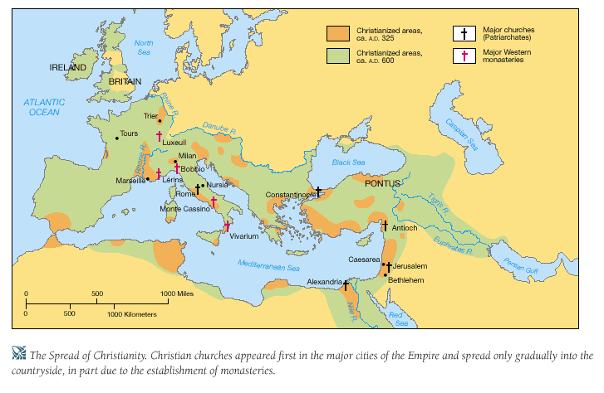

Slide 9
Romans Adopt Christianity
Constantine’s Edict of Milan - Christianity a legal religion in Empire
Encourage building of churches
Built Roman capital at Constantinople
Christian capital
By 391 CE - official religion of Rome

Slide 10
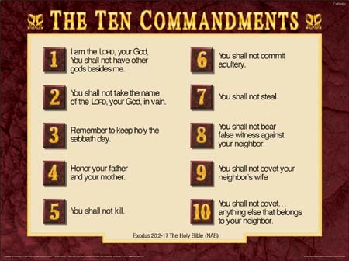
Main ideas of Christianity
One god
Equality of all people
Ten Commandments
Love of God above all else
Golden rule
Love and forgiveness

Slide 11
Church Structure and Sacraments
Pope
Bishops - several churches
Priests - one per church
The people
Canon law - church law
Heresy - going against church

Slide 12
Islam
ca. 630 CE

Slide 13
Muhammad (571-632 CE)
Born in Mecca; Orphan at 6; raised by grandfather
Had fits and seizures throughout life became unconscious and had visions
around age 40 angel Gabriel came to him with message to preach only one God… Allah
preached for 20+ years
wife and friends became followers
Khadijah was his first wife and first follower; she was older than him (25 and 40) and a successful business woman who ran caravans. He was her third husband (widowed) and she employed him to run her caravans. His honesty was very good for business and she proposed. They were married monogamously until her death right before the Hijrah.
followers attacked for beliefs
Notes:
At the time of Muhammad’s birth Mecca was a mixture of Christian, Jewish, and polytheistic beliefs. Caravan trader
Married an older woman for her business: Khadija, had four daughters
Muhammad began working for Khadija at 25 as her business manager. She was 40. Later they married.
Soon after this momentous event in the history of Arabia, Muhammad was born in Mecca. His father, ʿAbd Allāh, and his mother, Āminah, belonged to the family of the Banū Hāshim, a branch of the powerful Quraysh, the ruling tribe of Mecca, that also guarded its most sacred shrine, the Kaʿbah. Because ʿAbd Allāh died before Muhammad’s birth, Āminah placed all her hopes in the newborn child. Without a father, Muhammad experienced many hardships even though his grandfather ʿAbd al-Muṭṭalib was a leader in the Meccan community. The emphasis in Islamic society on generosity to orphans is related to the childhood experiences of Muhammad as well as to his subsequent love for orphans and the Qurʾānic injunctions concerning their treatment.
In order for Muhammad to master Arabic in its pure form and become well acquainted with Arab traditions, Āminah sent him as a baby into the desert, as was the custom of all great Arab families at that time. In the desert, it was believed, one learned the qualities of self-discipline, nobility, and freedom. A sojourn in the desert also offered escape from the domination of time and the corruption of the city. Moreover, it provided the opportunity to become a better speaker through exposure to the eloquent Arabic spoken by the Bedouin. In this way the bond with the desert and its purity and sobriety was renewed for city dwellers in every generation. Āminah chose a poor woman named Ḥalīmah from the tribe of Banū Saʿd, a branch of the Hawāzin, to suckle and nurture her son. And so the young Muhammad spent several years in the desert.
It was also at this time that, according to tradition, two angels appeared to Muhammad in the guise of men, opened his breast, and purified his heart with snow. This episode, which exemplifies the Islamic belief that God purified his prophet and protected him from sin, was also described by Muhammad: “There came unto me two men, clothed in white, with a gold basin full of snow. Then they laid upon me, and, splitting open my breast, they brought forth my heart. This likewise they split open and took from it a black clot which they cast away. Then they washed my heart and my breast with the snow” (Martin Lings, Muhammad: His Life, Based on the Earliest Sources, 1991). Muhammad then repeated the verse, found in the Hadith, “Satan toucheth every son of Adam the day his mother beareth him, save only Mary and her son.” Amazed by this event and also noticing a mole on Muhammad’s back (later identified in the traditional sources as the sign of prophecy), Ḥalīmah and her husband, Ḥārith, took the boy back to Mecca.
Muhammad’s mother died when he was six years old. Now completely orphaned, he was brought up by his grandfather ʿAbd al-Muṭṭalib, who also died two years later. He was then placed in the care of Abū Ṭālib, Muhammad’s uncle and the father of ʿAlī, Muhammad’s cousin. Later in life Muhammad would repay this kindness by taking ʿAlī into his household and giving his daughter Fāṭimah to him in marriage.
Islamic sources indicate that others recognized the mole as the sign of prophethood, including the Christian monk Baḥīrā, who met Muhammad when the Prophet joined Abū Ṭālib on a caravan trip to Syria.
When he was 25 years old, Muhammad received a marriage proposal from a wealthy Meccan woman, Khadījah bint al-Khuwaylid, whose affairs he was conducting. Despite the fact that she was 15 years older than he, Muhammad accepted the proposal, and he did not take another wife until after her death (though polygyny was permitted and common). She bore him two sons, both of whom died young. It is from the first son, Qāsim, that one of the names of the Prophet, Abūʾ al-Qāsim (“the Father of Qāsim”), derives. She also bore him four daughters, Zaynab, Ruqayyah, Umm Kulthūm, and Fāṭimah. The youngest, Fāṭimah, who is called the second Mary, had the greatest impact on history of all his children. Shīʿite imams and sayyids or sharifs are thought to be descendants of Muhammad, from the lineage of Fāṭimah and ʿAlī. Khadījah herself is considered one of the foremost female saints in Islam and, along with Fāṭimah, plays a very important role in Islamic piety and in eschatological events connected with the souls of women.
By age 35, Muhammad had become a very respected figure in Mecca and had taken ʿAlī into his household. When he was asked, according to Islamic tradition, to arbitrate a dispute concerning which tribe should place the holy black stone in the corner of the newly built Kaʿbah, Muhammad resolved the conflict by putting his cloak on the ground with the stone in the middle and having a representative of each tribe lift a corner of it until the stone reached the appropriate height to be set in the wall. His reputation stemmed, in part, from his deep religiosity and attention to prayer. He often would leave the city and retire to the desert for prayer and meditation. Moreover, before the advent of his prophecy, he received visions that he described as being like “the breaking of the light of dawn.” It was during one of these periods of retreat, when he was 40 years old and meditating in a cave called al-Ḥirāʾ in the Mountain of Light (Jabal al-Nūr) near Mecca, that Muhammad experienced the presence of the archangel Gabriel and the process of the Qurʾānic revelation began.
Muhammad. (2013). In Encyclopædia Britannica. Retrieved from http://www.britannica.com/EBchecked/topic/396226/Muhammad

Slide 14
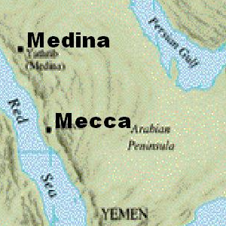
The Hijrah – 622 CE
When followers attacked Muhammad left Mecca for Yathrib (later Medina)
Muhammad’s leadership skills joined Arabs and Jews into one community
Muhammad Returned to Mecca in 630CE with 10,000 followers → Took over Mecca
Destroyed idols in Ka’aba
Most Meccans converted to Islam
Died two years later
Notes:
1. Migration known as hijrah (HIHJ*ruh)
“Even within his family there were skeptics. Although Muhammad gained the support of many of the Banū Hāshim, his uncle Abū Lahab, a major leader of the Quraysh, remained adamantly opposed to Islam and Muhammad’s mission. These naysayers feared that the new religion, based on the oneness of God and unequivocally opposed to idolatry, would destroy the favoured position of the Kaʿbah as the centre of the religious cults of various Arab tribes and hence jeopardize the commerce that accompanied the pilgrimage to Mecca to worship idols kept in or on the Kaʿbah.”
Muhammad. (2013). In Encyclopædia Britannica. Retrieved from http://www.britannica.com/EBchecked/topic/396226/Muhammad/251796/The-advent-of-the-revelation-and-the-Meccan-period
1. He became a political and religious leader and military leader b/t Mecca and Medina

Slide 15
Islamic Beliefs and Practices
One God - Allah
Good and evil
Followers called Muslims
Holy book called the Qur’an
House of worship called a mosque
Community of faith - Umma
Notes:
Islam means “submission to the will of Allah” Muslim means “one who has submitted”
Read excerpts from Muhammad’s Night Journey

Slide 16
5 Pillars of Islamic Faith
Faith – statement of faith in one God - Allah (Shahada)
Prayer - 5 times a day facing Mecca (Salat)
Alms/Charity - support less fortunate (Zakat)
Fasting - during holy month of Ramadan (Sawm)
Pilgrimage to holy city of Mecca (Hajj)

Slide 17
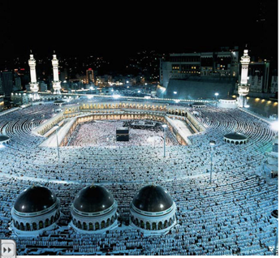
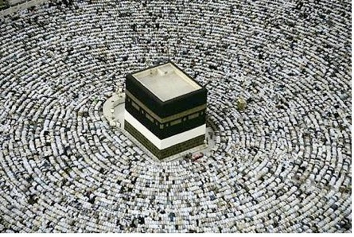
Mecca
All Muslims to take a Pilgrimage to Holy City
fighting never tolerated in city
Worship at shrine of Ka’aba
Housed relics of Abraham and other religions
Notes:
The cube-shaped structure is roughly 50 feet (15 metres) high, and it is about 35 by 40 feet (10 by 14 metres) at its base. Constructed of gray stone and marble, it is oriented so that its corners roughly correspond to the points of the compass. The interior contains nothing but the three pillars supporting the roof and a number of suspended silver and gold lamps. During most of the year the Kaʿbah is covered with an enormous cloth of black brocade, the kiswah.
Located in the eastern corner of the Kaʿbah is the Black Stone of Mecca, whose now-broken pieces are surrounded by a ring of stone and held together by a heavy silver band. According to tradition, this stone was given to Adam on his expulsion from paradise in order to obtain forgiveness of his sins. Legend has it that the stone was originally white but has become black by absorbing the sins of the countless thousands of pilgrims who have kissed and touched it.
Every Muslim who makes the pilgrimage is required to walk around the Kaʿbah seven times, during which he kisses and touches the Black Stone. When the month of pilgrimages (Dhuʾl-Hijja) is over, a ceremonial washing of the Kaʿbah takes place; religious officials as well as pilgrims take part.
The early history of the Kaʿbah is not well known, but it is certain that in the period before the rise of Islam it was a polytheist sanctuary and was a site of pilgrimage for people throughout the Arabian Peninsula. The Qurʾān says of Abraham and Ishmael that they “raised the foundations” of the Kaʿbah. The exact sense is ambiguous, but many Muslims have interpreted the phrase to mean that they rebuilt a shrine first erected by Adam of which only the foundations still existed. The Kaʿbah has been destroyed, damaged, and subsequently rebuilt several times since. In 930 the Black Stone itself was carried away by an extreme Shīʿite sect known as the Qarmatians and held almost 20 years for ransom. During Muhammad’s early ministry, the Kaʿbah was the qiblah, or direction of prayer, for the Muslim community. After the Muslim migration, or Hijrah, to Medinah, the qiblah briefly switched to Jerusalem before returning to the Kaʿbah. When Muhammad’s forces conquered Mecca in 630, he ordered the destruction of the pagan idols housed in the shrine and ordered it cleansed of all signs of polytheism. The Kaʿbah has since been the focal point of Muslim piety.
Ka'bah. (2013). In Encyclopædia Britannica. Retrieved from http://www.britannica.com/EBchecked/topic/309173/Kabah

Slide 18
Muslim Way of Life
No pork or alcohol – These are considered “haram” (forbidden). Non forbidden food are called “halal”
Friday - communal worship at the mosque
No priests or central religious authority (no equivalent to a Pope)
Scholar class called ulama
Leaders at local mosques are known as imams; the prayer callers are called muezzin.
Some communities and family will adopt certain clothing as part of expressing a cultural idea of modesty.

Slide 19
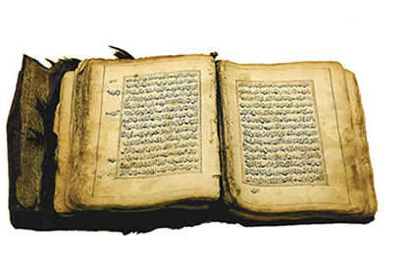
Islamic Religion and Law
Law code Shari’a covers all aspects of Muslim private and public life
made up of Qur’an (holy text) and Sunna - Muhammad’s example
Law cannot be separated from religion

Slide 20
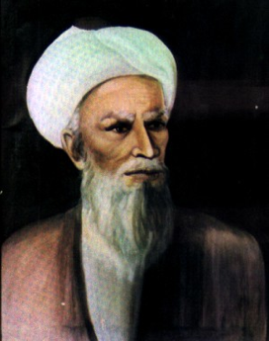
Muhammad’s Successors
Muhammad died 632 CE
Caliph means successor - to lead Muslims = Rightly Guided Caliph’s = first four after Muhammad
Abu-Bakr 1st Caliph
Umar, Uthman, and Ali next Caliphs had all known Muhammad
Abu-Bakr invoked jihad (holy war) against tribes that had abandoned Islam
By 750 the Muslim Empire covered 6,000 miles from Atlantic Ocean to Indus River
Notes:
The Caliphs saw victory in battle as approval from Allah. This encouraged them to continue to battle to spread Islam.

Slide 21
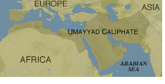
Two ruling families after Muhammad = Umayyad and Abbasid
First ruling family = Umayyad ca. 661-750 CE – capital = Damascus
united lands by having official language = Arabic
minted Arabic currency, built roads
established postal system & civil service
Jews and non-Greek Christians tolerated & protected (paid taxes). Jews and Christians were known as “People of the Book”. The tax was called jizyah
Notes:
The Qur’an forbade forced conversion. Christians & Jews were favored because they shared a common origin, Abraham. While Christians & Jews could not spread their religion they could be officials, scholars, and bureaucrats. Islam was a tolerant religion.

Slide 22
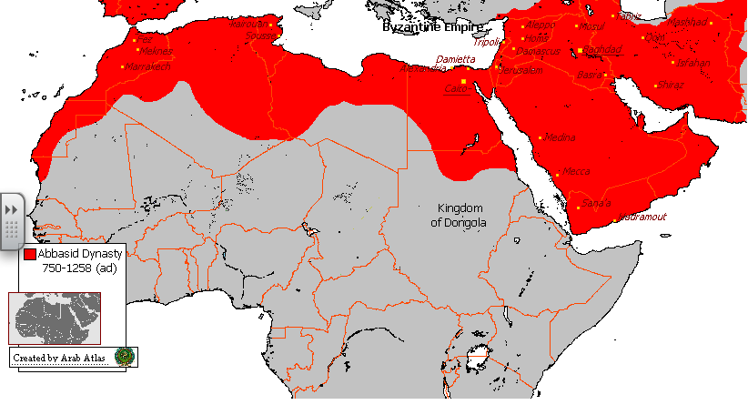
Second ruling family = Abbasid ca. 747-1258 CE – capital = Baghdad
Dissatisfied because of higher taxes, lower wages in army & government & social discrimination
Abu-al-Abbas “Bloodshedder” tried to kill off the Umayyad family
Overthrew Umayyad rule
Destroyed by Seljuk Turks and Mongols

Slide 23
Division Within Islam
Fight for position of Caliph
1. Sunni
“followers of the way”
Any devout Muslim can be caliph
Caliph a leader, not religious authority
90% of Muslims
2. Shia
Caliph must be a descendant of Muhammad
A spiritual leader, not a political leader
10% - Iraq, Iran, Lebanon

Slide 24
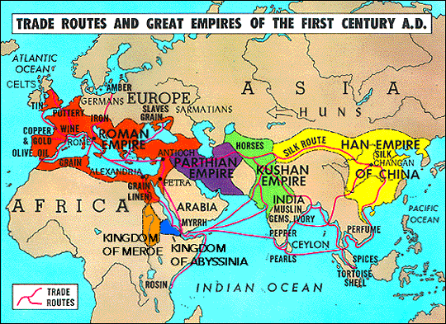
Economic Impact of Muslim Trade with India, China, Europe, and Africa
Trade networks
Land routes – including Silk Road (India, Europe, & Asia); Africa
Sea routes – Indian Ocean, Mediterranean Sea, Red Sea
Language and currency united traders
Banking system created
Sakk = checks – exchanged for currency
Cultural impact of trade = diffusion of cultures

Slide 25
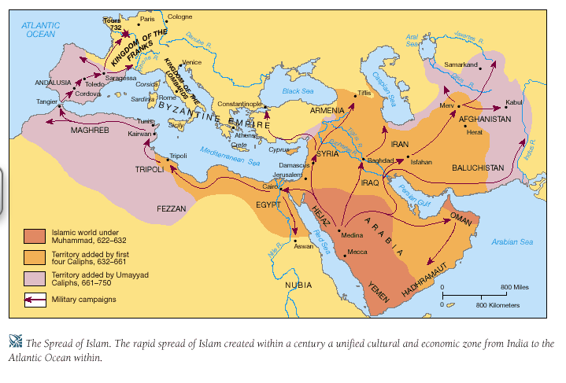
The Spread of Islam

Slide 26
Similarities Between Judaism, Christianity, and Islam
All are monotheistic
Jews and Muslims believe Jesus a prophet (of some kind)
All have holy books
All believe in Heaven, Hell, day of judgment; life after death
All traced ancestry to Abraham
Jews and Muslims forbidden to eat pork
Muslims and Christians specifically urged to practice charity and be generous to poor and weak – Jews also practice this.
Notes:
The Qur'an commands Muslims to believe in the revelations given to all of God's prophets. These prophets include Moses, David, and Jesus (peace be upon them). Muslims must believe in the revelations received by such prophets. Books associated with them are called by the names Torah, Psalms, and Gospel. Muslims, therefore believe in the original Torah, Psalms and Gospel.

Slide 27
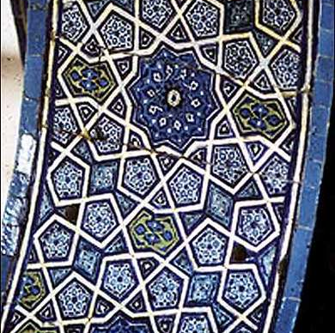
Social Classes
Upper class - Muslim at birth
Second class - Converts to Islam
Third class - Protected people = Jews & Christians
Lowest class - slaves

Slide 28
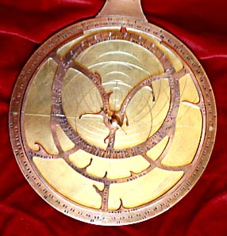
Extending Knowledge
Muhammad encouraged learning for men and women
Astrolabe - for time and direction of prayer
House of Wisdom - library, academy, translated texts
Medicine – Ibn Sina - Book of Healing - Father of modern medicine
Philosophy - goal - to find the truth
Notes:
2. Medical knowledge superior to west
3. Knowledge and experience in anatomy and
pharmaceutical prescriptions further advanced

Slide 29
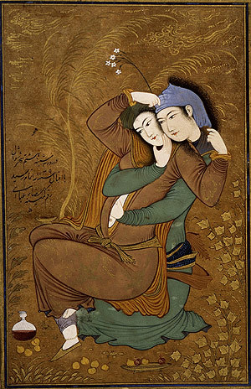
Position of Women
Women were wives, mothers
Female infanticide forbidden by Muhammad
Limited polygamy (fairness)
Women had control over their own property; could inherit and operate their own businesses
Could remarry
Were often educated and advised leaders and some became rulers
Aisha led troops into battle
Notes:
(could
only have 4 wives and all
must be treated equally…
must have $$ to support
them equally)

Slide 30
Muslim Cultural Influences
Arabic influence illustrated in the words that came into English and Spanish from Arabic
Alcohol, admiral, algebra, almanac; almohada, alfombra
Candy, coffee, damask, lemon, orange, sherbet, zero

Slide 31
The Golden Age of Muslim Civilization
Learning
Translate writings of Greek philosophers at the research center called House of Wisdom (CE 830)
Develop algebra, trigonometry, place value
Observe Earth turning and measure its circumference
Earth round, but believed all revolved around the earth
Produce first accurate maps of the earth CE 1100s
Improved the astrolabe
Art
Use beautiful writing and patterns to decorate buildings and art
Adapt Byzantine domes and arches
Paint people and animals in nonreligious art
Use calligraphy and arabesques, not human forms in religious art
Literature
Consider Qur’an most important piece of Arabic literature
Chant oral poetry
Collect stories from other people
The Arabian Nights by Omar Khayyam
Medicine
Require doctors to pass difficult tests
Set up hospitals and emergency rooms
Study diseases and write medical books
Canon of Medicine by Ibn Sina (or Avicenna)
Al-Razi develops a medical encyclopedia

