Slide 1
Polytheism and Philosophy
Daoism, Confucianism, Legalism, Vedic traditions, Hinduism, Buddhism, Shintoism

Slide 2
Zhou Dynasty
China – Daoism, Confucianism, Legalism

Slide 3
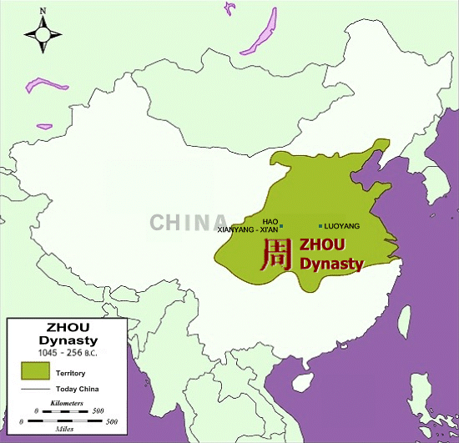

Slide 4
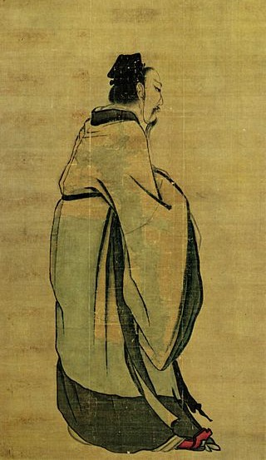
Rise of the Zhou
11th century BCE: overthrow of the Shang
Longest, most revered dynasty in Chinese history
Wen and Wu
Rebellion and attack of Shang capital
Wu is first ruler of dynasty →

Slide 5
Zhou Timeline
Western Zhou (1045-771 BCE)
Eastern Zhou (771-221 BCE)
Spring and Autumn Period (771-481 BCE)
Warring States Period (481-221 BCE)

Slide 6
Mandate of Heaven
Use of religion to justify the rule of a king/emperor
Heaven gave authority to rulers
Authority could be taken away if the ruler did not look out for the well being of subjects
Proof of favor with the gods
Stability and prosperity of kingdom
Signs of disfavor of a ruler
Natural disasters
Invasion

Slide 7
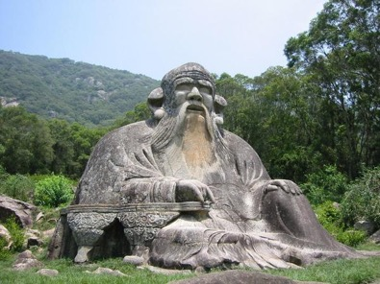
Daoism/Taoism
The teachings of the Way (Dao/Tao)
Laozi (604-517 BCE )
AKA Lao Zi, Lao Tsu
Real person?
Legend?
Composite of both?
Urged people to leave behind empty formalities, rituals, hierarchies, etc of society
*Note*
There are many different spellings of people, philosophies, etc in China. I have placed several different forms of the names in the PPT to help you become familiar with them.

Slide 8
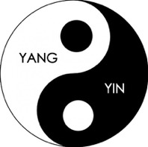
Dao
“The Way” cannot be defined with words
To obtain the dao, one must “wu wei”
Wu wei: do not tamper with nature/life—act naturally and things will work out
Yin-Yang
Balance in life
Yin: female, passive, shaded, reflective (moon)
Yang: male, active, bright, shining (sun)

Slide 9
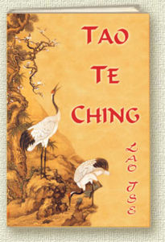
Dao Dejing
Means “Classic of the Way of Virtue”
Written by Laozi
Questions if the world is real or a dream
Education, knowledge are obstacles to understanding
Cultivate intuition
Avoid struggles

Slide 10
Dao Dejing
“ The Dao produces all things and nourishes them; it produces them and does not claim them as its own; it does all, and yet does not boast of it; it presides over all, and yet does not control them. This is what is called “The mysterious quality” of the Dao.”
“If we could renounce our sageness and discard our wisdom, it would be better for the people a hundredfold…if we could renounce our artful contrivances and discard our scheming for gain, there would be no thieves nor robbers.”

Slide 11
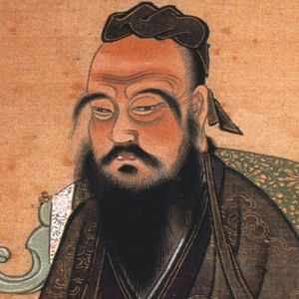
Confucianism
Kongzi=Confucius (551-479 BCE)
The Analects: Compilation of Confucius’ sayings
Society is broken and needs to return to the “Golden Age” of the early Zhou
NOT a religion
Emphasized family obligations
Everyone has a “place” in society
“filial piety”
Obedience to and love of parents
Devotion to ruler
Benevolence and compassion

Slide 12
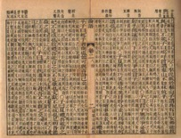
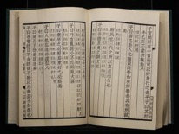
The Analects
"The superior man bends his attention to what is radical. That being established, all practical courses naturally grow up. Filial piety and fraternal submission,-are they not the root of all benevolent actions?"
“…Conduct yourself with respect; perform your duties with reverence; treat others with wholehearted sincerity…you cannot abandon these.”

Slide 13
Society
Many officials were Confucian in work, but Daoist in private life
Family = fundamental social unit
3 generation unit (grandparents, parents, children)
Patriarchy: fathers have complete authority and control over family and women

Slide 14
The Warring States Period
481-221 BCE
Warfare between Chinese states intensified
Smaller states taken over by larger, more powerful states
Build up of larger armies
Fortified walls built to protect state borders
Military innovations
Qin: most innovative state
First to use Legalism

Slide 15
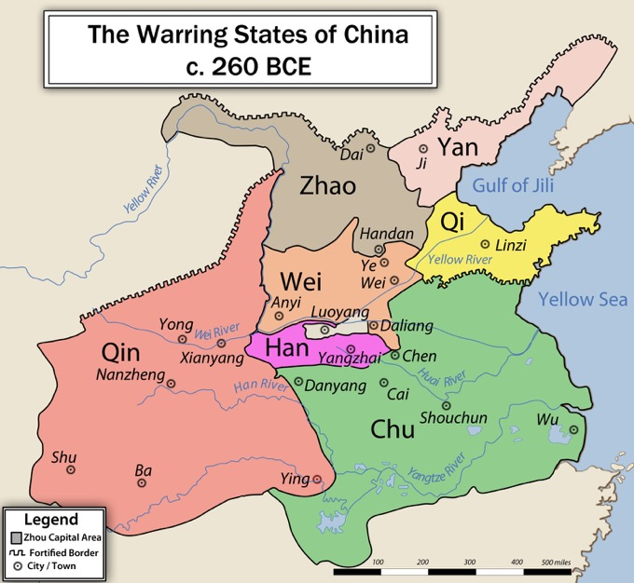

Slide 16
Legalism
Rejected both Confucianism and Daoism
Unconcerned with ethics and morals (Confucianism)
Unconcerned with nature and humans’ place in the world (Daoism)
Emphasized the law and a restructuring of society
Strengthen and expand the state no matter what the cost
Sacrifice freedom of individuals in order to aid/prosper the state

Slide 17
Legalism
Emphasized work in agriculture or military
Discouraged work that did not directly advance state interests (merchants, artists, etc)
Strict laws, severe punishments
Amputation of hand/foot for dumping ashes in street
Ruthless, but helped unify China and end Warring States Period

Slide 18
Legalist Leaders
Lord Shang Yang
Han Feizi
390-338 BCE
Minister to duke of Qin
Ruthless leader-murdered
The Book of Lord Shang
Confucians are wrong that a ruler should worry about his subjects
A ruler should us whatever necessary to obtain good behavior from subjects
Included weakening the power and privileges of the nobles
280-233 BCE
AKA Han Fei
Qin advisor
Forced suicide
Trained in Confucian thought
Realism needed to end chaos
Wrote essays on how to create a peaceful and stable state

Slide 19
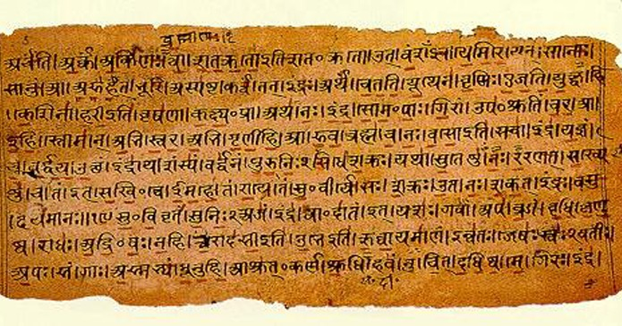
Vedic Age
1500-500 BCE
Vedas: religious texts; main source of information of the time
1000 BCE: New peoples migrate into India
Aryas: lighter skinned, Indo-European language speakers
Settled in the North
Dasas: dark skinned, Dravidian language speakers
Settled in the South
New technologies
Iron allowed for stronger/harder tools
Ability to clear land, plow fields
Monsoon rains allowed for multiple crops per year
Led to increase in food production and ultimately an increase in population

Slide 20
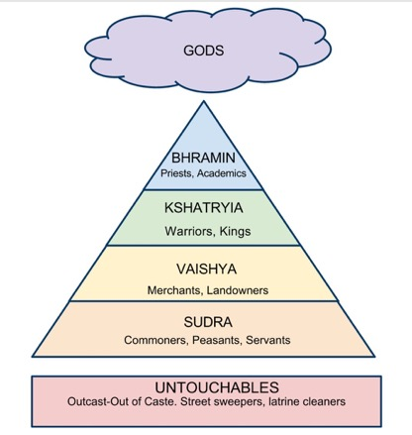
The Caste System
Varna: “Color” (class)
People are born into a varna
Jati: sub-caste/birth group
Each jati has specific duties to perform
Interact/marry ONLY within your jati/varna
Reincarnation
Karma: deeds from this life influence your reincarnate life
Can be re-born to a higher jati
“You are where you deserve to be”

Slide 21
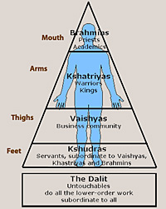
Castes
Brahmin: priests, scholars
Mouth of Purusha
Intellect and knowledge
Kshatriya: warriors, officials
Arms of Purusha
Vaishya: merchants, artisans, landowners
Thighs of Purusha
Shudra: peasants, laborers
Feet of Purusha
Untouchables: excluded from caste system
AKA “pariah” or “harijan”
Leather tanning, cremations, garbage disposal
Touching of dead bodies/animals

Slide 22
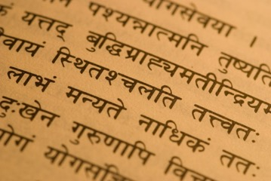
Vedic Religion/Sacred Texts
Male deities
Indra: war, thunderbolt
Varuna: sky, justice, order
Agni: fire, sacrifice
Brahmin priests = only ones who know prayers/rituals
Did not want lower classes to be able to read/write
Brahmanas: descriptions of rituals
Rig Veda: 1000 hymns to various deities
Bhagavad-Gita: The most sacred of Indian texts
Dialogue between Krishna (god) and Arjuna (warrior)
Krishna allows Arjuna to see with a “divine eye”
Sanskrit: Aryan upper class language

Slide 23
Opposition to Vedic Religion
700 BCE
Reactions against power of the Brahmin
Retreat to wilderness
Individuals attracted “cult” followings
Abandonment of towns and the caste system
Question the exclusivity of the priestly class
Gave alternate paths to salvation
Yoga: pursuit of insight to nature through physical and metal discipline
Special diets
Meditation
Moksha: liberation through distancing oneself from worldly desires
Upanishads
100+ dialogues between teachers and students
Questioning of the Vedic religion

Slide 24
Jainism
Mahavira (540-468 BCE)
AKA Jina (the Conqueror)
Holiness of all life
Extreme non-violence
Masks to prevent inhaling insects
Asceticism
“Severe self-discipline and avoidance of all forms of indulgence, typically for religious reasons”
Nudity (clothing comes from killing something)
Eventual starvation

Slide 25
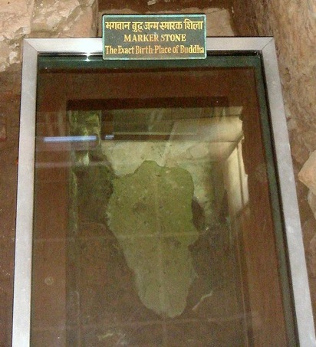
Siddhartha Gautama (563-483 BCE)
Kshatriya family in the Himalayan mountains
Abandoned family for life of asceticism
6 years of meditation
Determined that asceticism did nothing for a life of spiritual insight
Adopted “Middle Path” of moderation
Gained insight while sitting under a tree on the Ganges River
The Buddha (Enlightened One)
Four Noble Truths
Eightfold Path

Slide 26
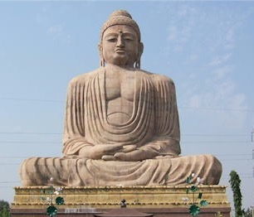
The Four Noble Truths
Life is suffering
Suffering arises from desire
The solution to suffering lies in the curbing of those desires
Desire can be curbed by following the Eightfold Path
Aka “dharma” (law)

Slide 27
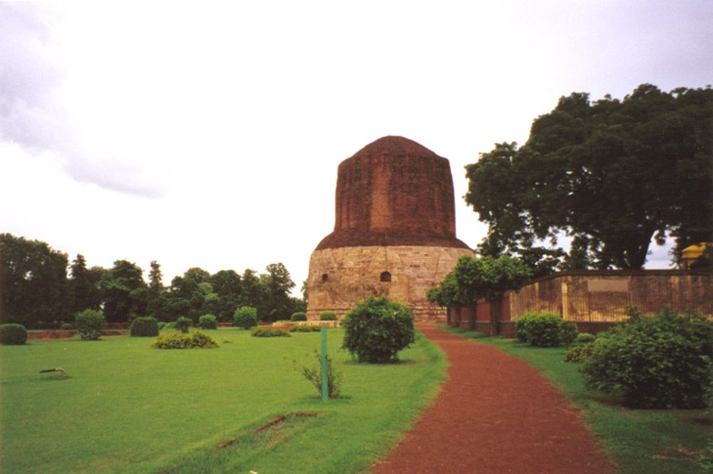
Site of the First Sermon where Buddha preached on the
Four Noble Truths

Slide 28
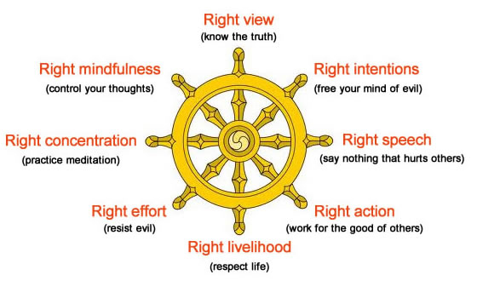
The Eightfold Path

Slide 29
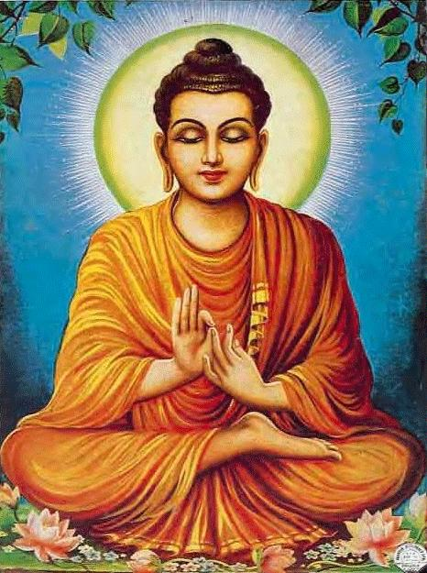
Buddhism
Emphasis on the individual
People are composite beings with out a “soul” that exists in the afterlife
Denial of the usefulness of gods
Live in moderation
Minimize desires in order to end suffering
Search for spiritual truth through meditation and self discipline
Nirvana: ultimate reward (“snuffing out the flame”)
Release from reincarnation cycles
Achievement of tranquility

Slide 30
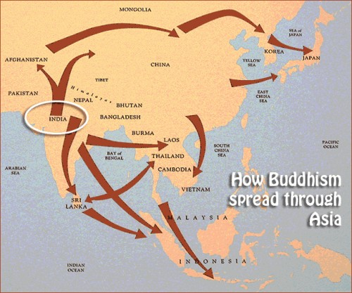
Spread of Buddhism
Buddha’s death
No instructions for followers— “Be your own lamp”
India, Central Asia, Southeast Asia, East Asia
Monasteries established
Hierarchies of monks and nuns
Stupas
Buddhist temples erected
Symbolized the universe
Remains of Buddha

Slide 31
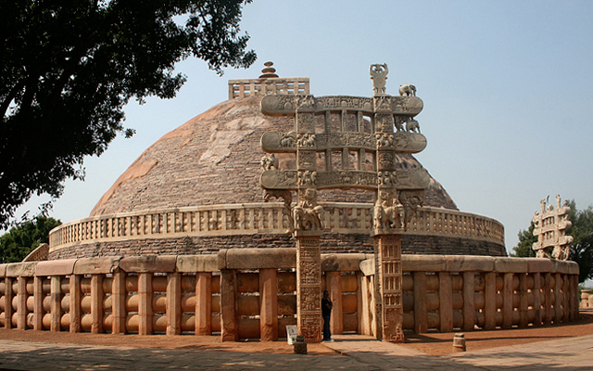
The Great Stupa
The Great Stupa
Built at the birthplace of Ashoka’s wife (India)

Slide 32
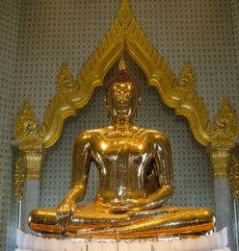
Transformation of Buddhism
Buddha began to be worshipped as a god
Bodhisattvas
Men/women who achieve nirvana but choose to be reincarnated in human bodies in order to help others
Art
Early art portrayed symbols rather than the Buddha himself
2nd century CE: statues of Buddha appear
Syncretism of Buddhist and Greek styles
Mahayana Buddhism (Great Vehicle)
Embraced “modern” aspects of the religion
Theraveda Buddhism (Teachings of the Elders)
Closest to original teachings

Slide 33
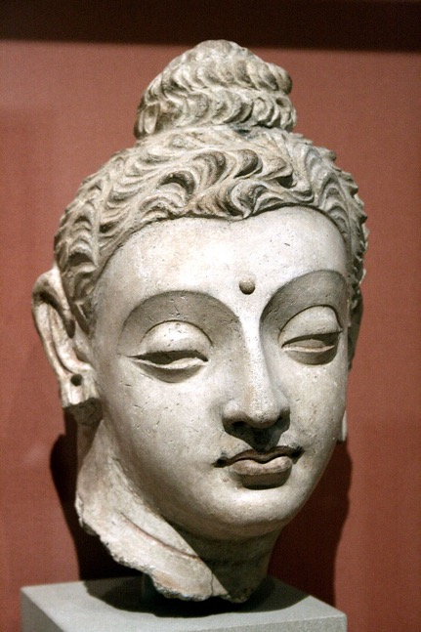
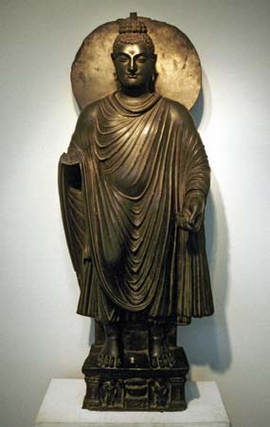
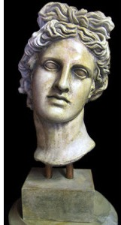
Gandharan Art

Slide 34
Hinduism
Result of Vedic religion adjusting to Jainism and Buddhism
Vedic transformed by 4th century CE
Includes aspects of Buddhism, fertility rituals, other religions
Emphasis of individual devotion to a single god
330 million gods (?)
All gods are manifestations of a single divine force
Vishnu: the preserver
Appears as avataras (incarnations)
Rama (hero)
Krishna (cow herd god)
Buddha (rival religion)
Shiva: creation and destruction
Devi: fertility

Slide 35
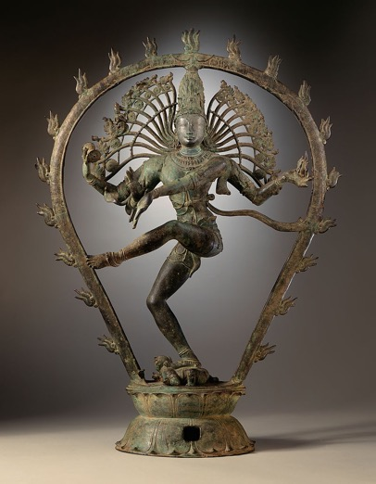
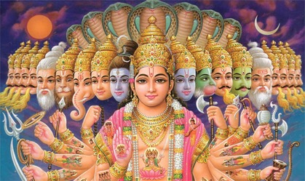

Slide 36
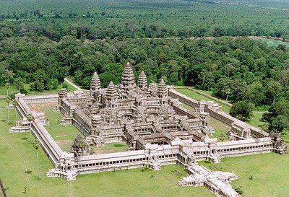
Hindu Worship
Gave the people a personal deity with whom they could make divine and direct connections
Direct opposition to Theraveda Buddhism
Temples
“plain” and elaborate
Statues
Embodied by gods
Puja: service to deity
Bathing, clothing, feeding statues
Pilgrimages
Temples, shrines, sacred locations
Ganges River

Slide 37
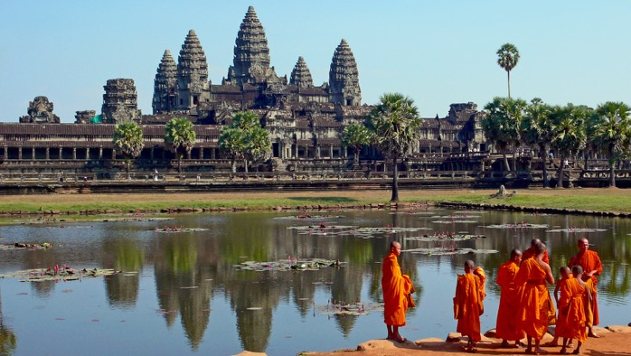
Angkor Wat
Built as a temple to honor Vishnu in 12th century
Eventually transformed to Buddhist temple
Largest religious temple in the world

Slide 38
Shinto
Shintō, indigenous religious beliefs and practices of Japan. The word Shintō, which literally means “the way of kami” (generally sacred or divine power, specifically the various gods or deities), came into use in order to distinguish indigenous Japanese beliefs from Buddhism, which had been introduced into Japan in the 6th century CE. Shintō has no founder, no official sacred scriptures in the strict sense, and no fixed dogmas, but it has preserved its guiding beliefs throughout the ages.
Shinto has been influenced throughout history by Buddhism and Confucianism as well as by other surrounding religions.

Slide 39
Shinto
Shintō can be roughly classified into the following three major types: Shrine Shintō, Sect Shintō, and Folk Shintō. Shrine Shintō, which has been in existence from the beginning of Japanese history to the present day, constitutes a main current of Shintō tradition. Shrine Shintō includes within its structure the now defunct State Shintō —based on the total identity of religion and state—and has close relations with the Japanese Imperial family. Sect Shintō is a relatively new movement consisting of 13 major sects that originated in Japan around the 19th century and of several others that emerged after World War II. Each sect was organized into a religious body by either a founder or a systematizer. Folk Shintō is an aspect of Japanese folk belief that is closely connected with the other types of Shintō. It has no formal organizational structure nor doctrinal formulation but is centered in the veneration of small roadside images and in the agricultural rites of rural families.

