Slide 1
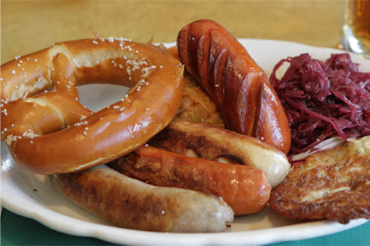
AP World History: The Rise of Nationalism in Italy and Germany

Slide 2
I What is Nationalism?
A) Nationalism is the belief that one’s greatest loyalty should not be to a king or an empire but to a nation of people who share a common culture and history. When the nation also has its own independent government, it becomes a nation-state.
B) Bonds that create a nation-state:
NATIONALITY: A belief in a common ethnic ancestry – real or imagined.
LANGUAGE: Different dialects (forms) of one language; one dialect chosen as the “national language”.
CULTURE: A shared way of life (food, dress, behavior, ideals).
HISTORY: A common past, common experiences (real or imagined).
RELIGION: A religion shared by all or most of the people.
TERRITORY: A certain territory that belongs to the ethnic groups; its “land”.

Slide 3
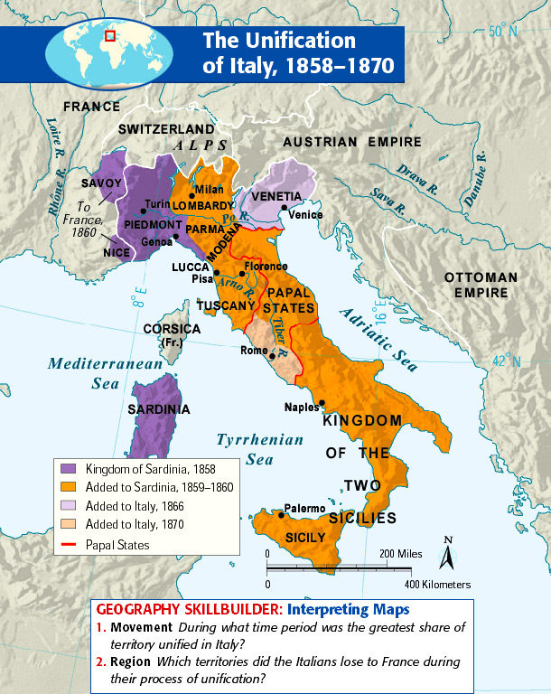

Slide 4
II The Creation of Italy
A) After the Congress of Vienna (1815, following the collapse of Napoleon’s empire), the Italian peninsula was still divided.
Austria ruled the Italian provinces of Venetia and Lombardy.
The Spanish Bourbon family ruled the Kingdom of the Two Sicilies.
Pope controlled the Papal States (under French protection since 1848).
B) Soon after, Italian nationalist movements formed.
1. Mazzini formed a nationalist group known as “Young Italy” in 1832. He called for an end to foreign rule and the unification of Italy based on the common language and culture of the people. In 1848 former rulers of Italian states drove Mazzini into exile.
2. Cavour was the Prime Minister of the Kingdom of Piedmont-Sardinia. He used diplomacy and alliances to increase Piedmont-Sardinian power, and unified the North.
3. Garibaldi was the leader of the Red Shirts (an Italian nationalist group that gained control of Sicily in 1860). He unified the South and merged with the North under pressure.

Slide 6
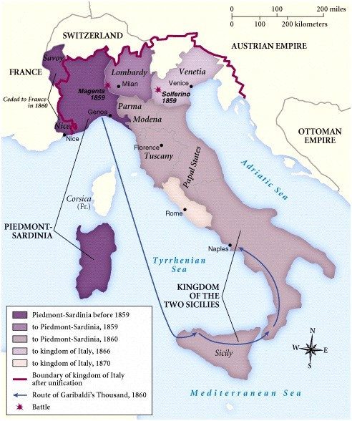
The Creation of Italy Continued…
C) An agreement was reached between Cavour and Napoleon III of France at Plombieres in 1858. Napoleon agreed to help drive Austria out of the northern provinces of Lombardy and Venetia.
D) In 1859 Cavour provoked a war with Austria. They drove Austria out of Lombardia but failed to drive them out of Venetia. France was given Savoy and Nice in exchange for their help.

Slide 7
The Creation of Italy Continued…
E) The victory over Austria awoke nationalist feelings among the states of Central Italy. A plebiscite held in 1860 determined the incorporation into the kingdom of Sardinia of the states of Parma, Modena and Tuscany.

Slide 8
The Creation of Italy Continued…
F) In May 1860 1000 Red Shirts (led by Giuseppe Garibaldi), sailed from Genoa and aided the Sicilian revolts, forcing the Bourbon army out of Sicily. From Sicily, Garibaldi crossed to the Italian mainland and successfully marched north to Naples. After Garibaldi took complete control and became leader of Southern Italy the people voted in a second plebiscite to unite with the north. (Because Garibaldi received an ultimatum from King Victor Emmanuel II – unify or go to war against us.)

Slide 9
The Creation of Italy Continued…
G) In March 1861, a parliament of all of Italy except Rome and Venetia, agreed on unifying Italy with Victor Emmanuel II as its first king. Turin was the first capital,1861. Three months later Cavour died. Before dying, Cavour purportedly said: "Italy is made. All is safe."
H) In 1864 Victor Emmanuel II met with Napoleon III and negotiated the withdrawal of French troops within 2 years. Florence became the new Italian capital.
I) In 1866, Italy joined Prussia in a war against Austria. When the Prussians won, Italy’s reward was Venetia.

Slide 10
The Creation of Italy Continued…
N) When in 1870 French troops withdrew from Rome so they could fight in the Franco-Prussian War; the Italian forces seized Rome. Rome was declared the capital of Italy, in 1871, after final unification. However, Pope Pius IX refused to acknowledge the Italian State and it was not until Mussolini came to power that Rome/Vatican finally “accepted” Italy.

Slide 11
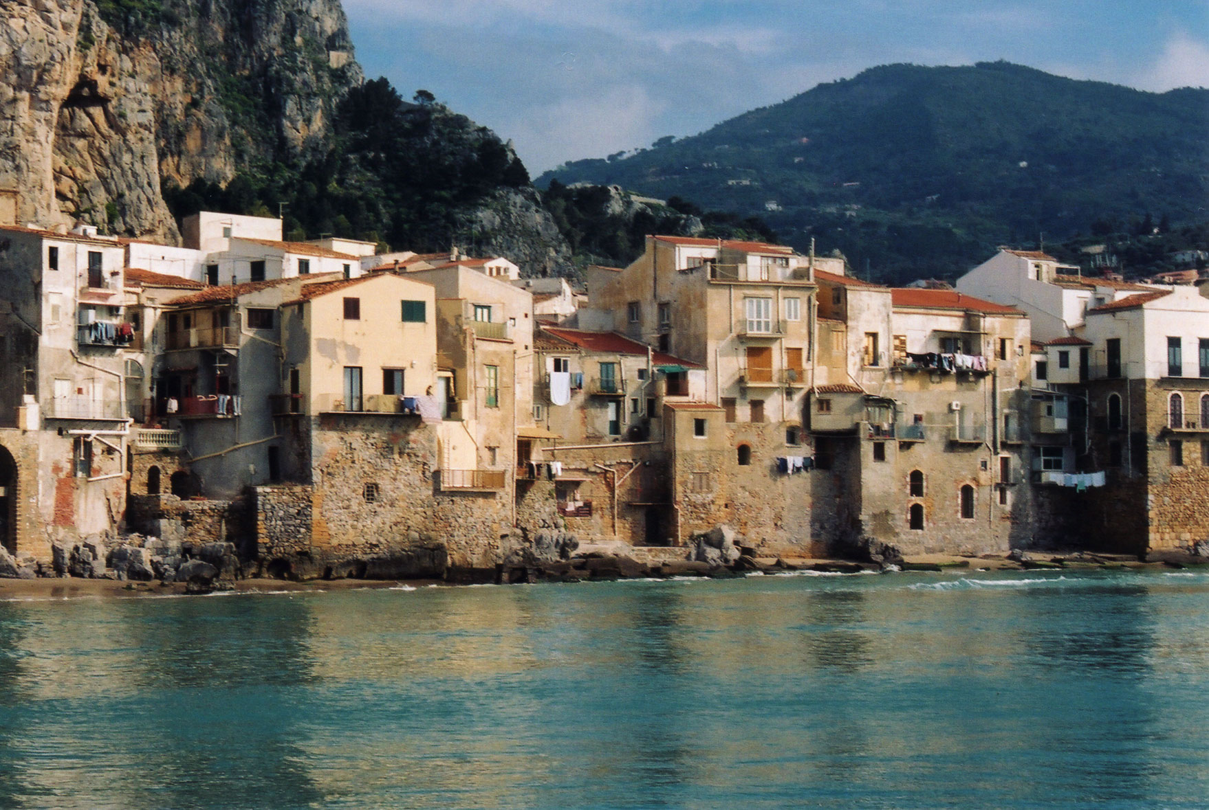
Sicily

Slide 12
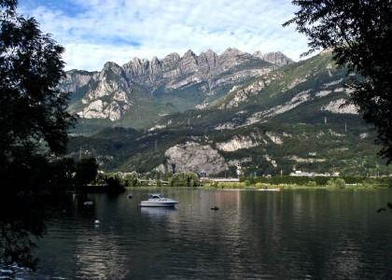
Lombardy, Italy

Slide 13
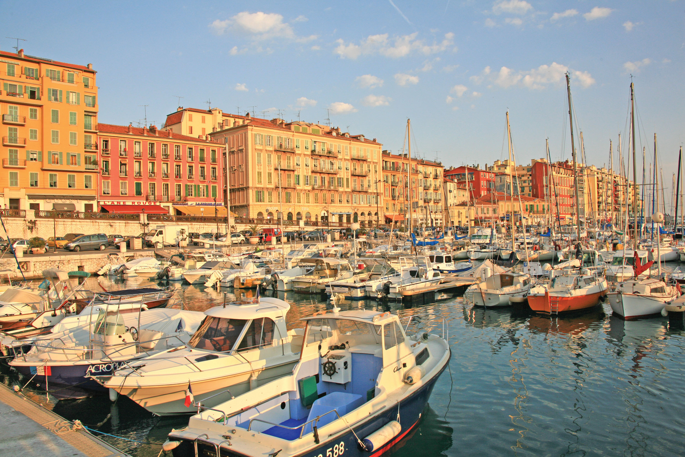
Nice, France

Slide 14
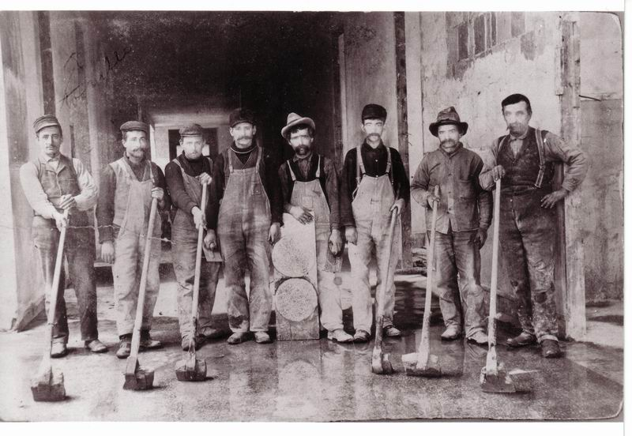
III After the Unification of Italy
A) Tension between the industrial north and agricultural south due to cultural differences and different dialects of Italian.
B) Disorganized political parties caused an unstable parliament. Led to strikes and riots in the south.
C) Italy entered the 20th century as a poor country.
Venetian laborers, circa 1900

Slide 15
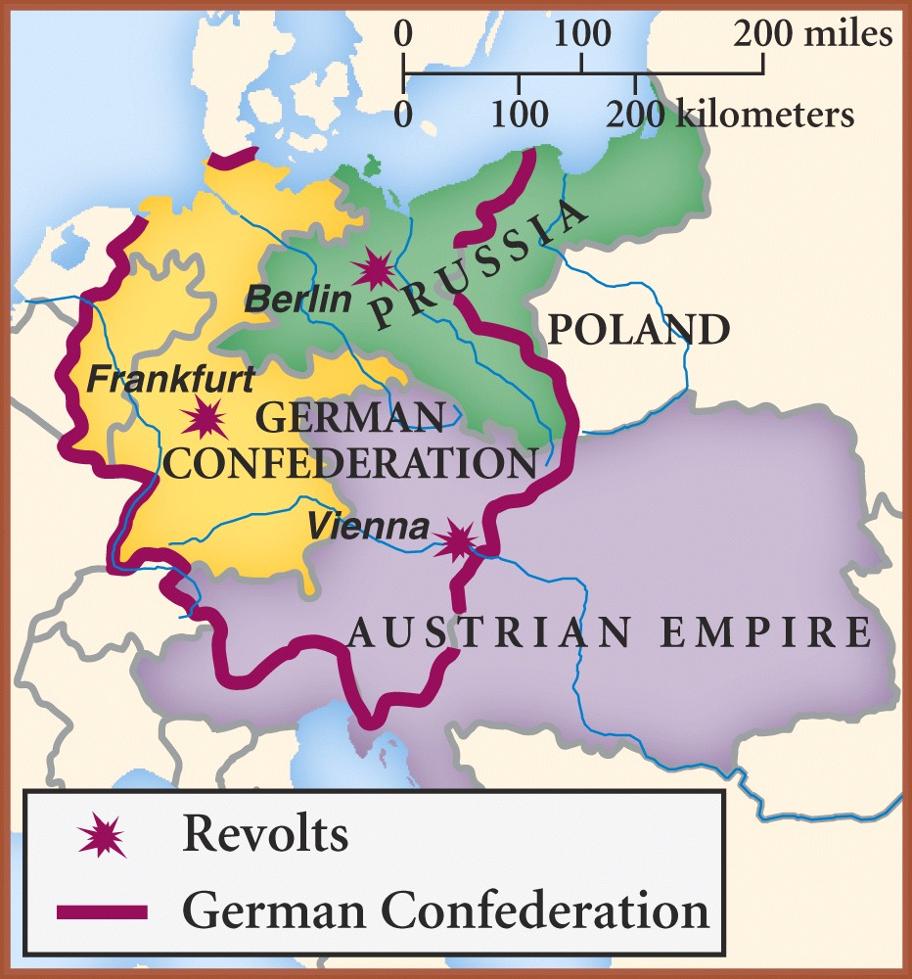
III The Creation of Germany
A) Following the Congress of Vienna, 39 German States formed the German Confederation. Austria and Prussia dominated the Confederation.

Slide 16
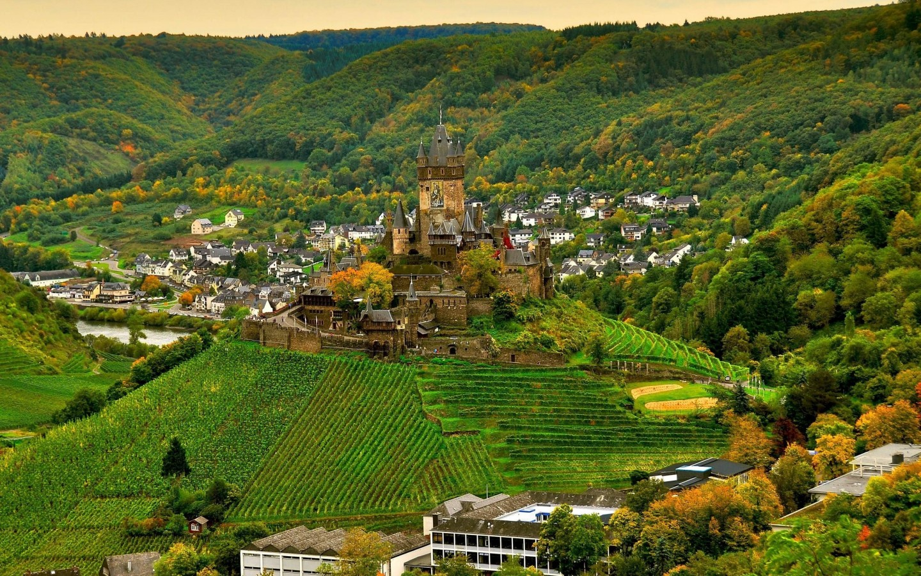
The Creation of Germany Continued…
B) Prussian advantages:
Mainly German population
Most powerful army in Europe (emerging)
Industrialized faster than other German states
Rich resources in the Rhineland
C) Friendship between the two German states would turn to conflict in an attempt to unify Germany.
The Rhineland

Slide 17
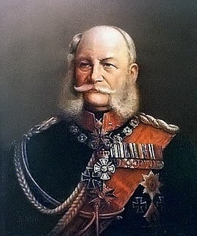
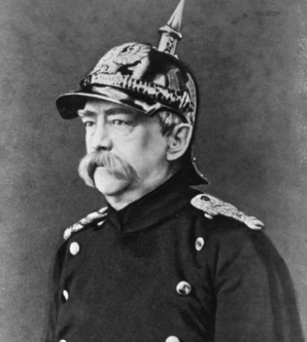
The Creation of Germany Continued…
C) King Wilhelm I became the King of Prussia in 1861. He was supported by the Junkers (members of the wealthy landowning class and strongly conservative). He wanted to increase the size and strength of the military (Parliament refused to give him the money). He picked a new Prime Minister in order to get what he wanted.
D) Otto von Bismarck (a conservative Junker) became Prime Minister in 1862. Known as the “Iron Chancellor” for his realpolitik and his powerful rule.
King Wilhelm I
“Not by speeches and votes of the majority, are the great questions of the time decided — that was the error of 1848 and 1849 — but by iron and blood.” –his first speech to Parliament
Otto von Bismarck
Realpolitik (“the politics of reality”): politics than leave no room for idealism.

Slide 18
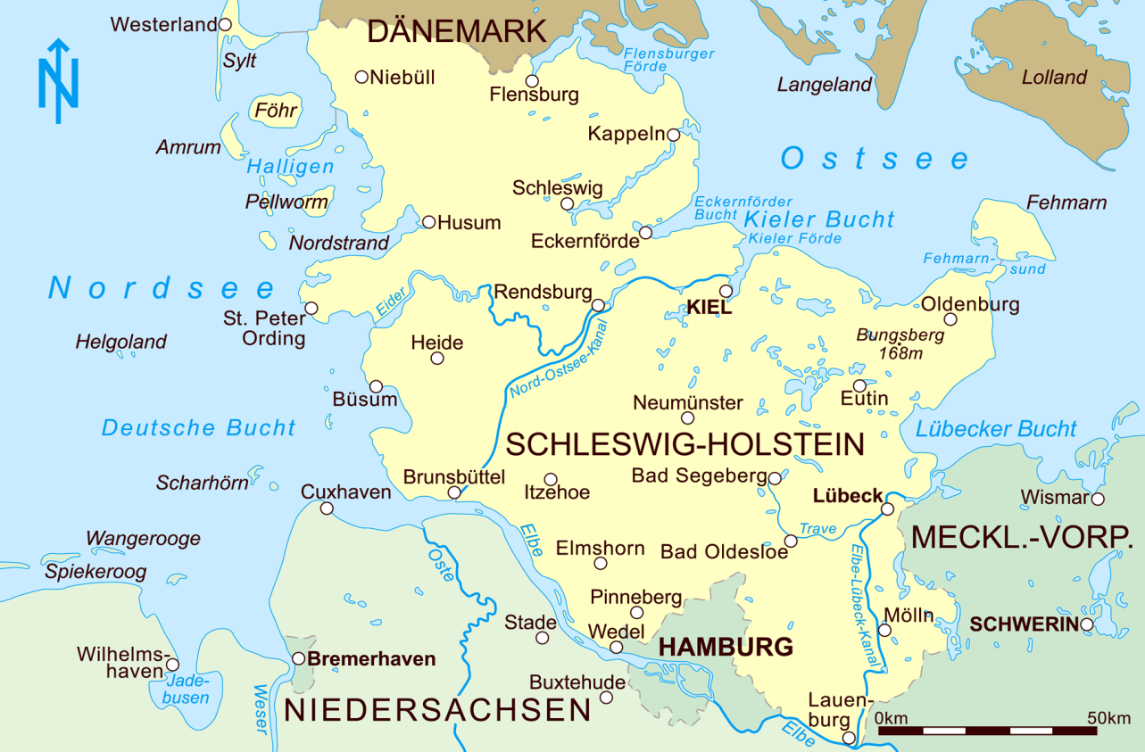
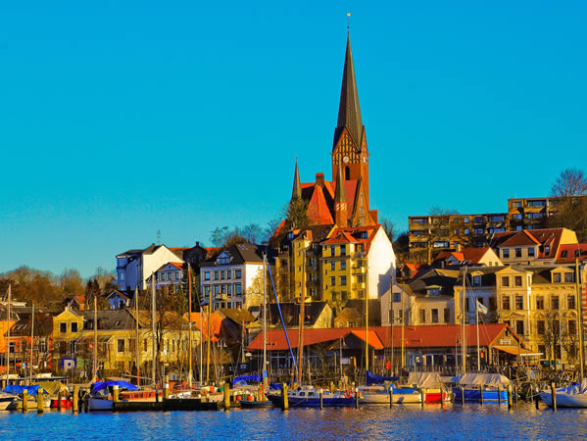
The Creation of Germany Continued…
D) In 1864 Bismarck began the series of wars that would establish Prussian power in Europe. He attacked Denmark to gain the German-speaking territories of Schleswig-Holstein and two years later provoked Emperor Franz-Josef I into starting the Austro-Prussian War (1866)…

Slide 19
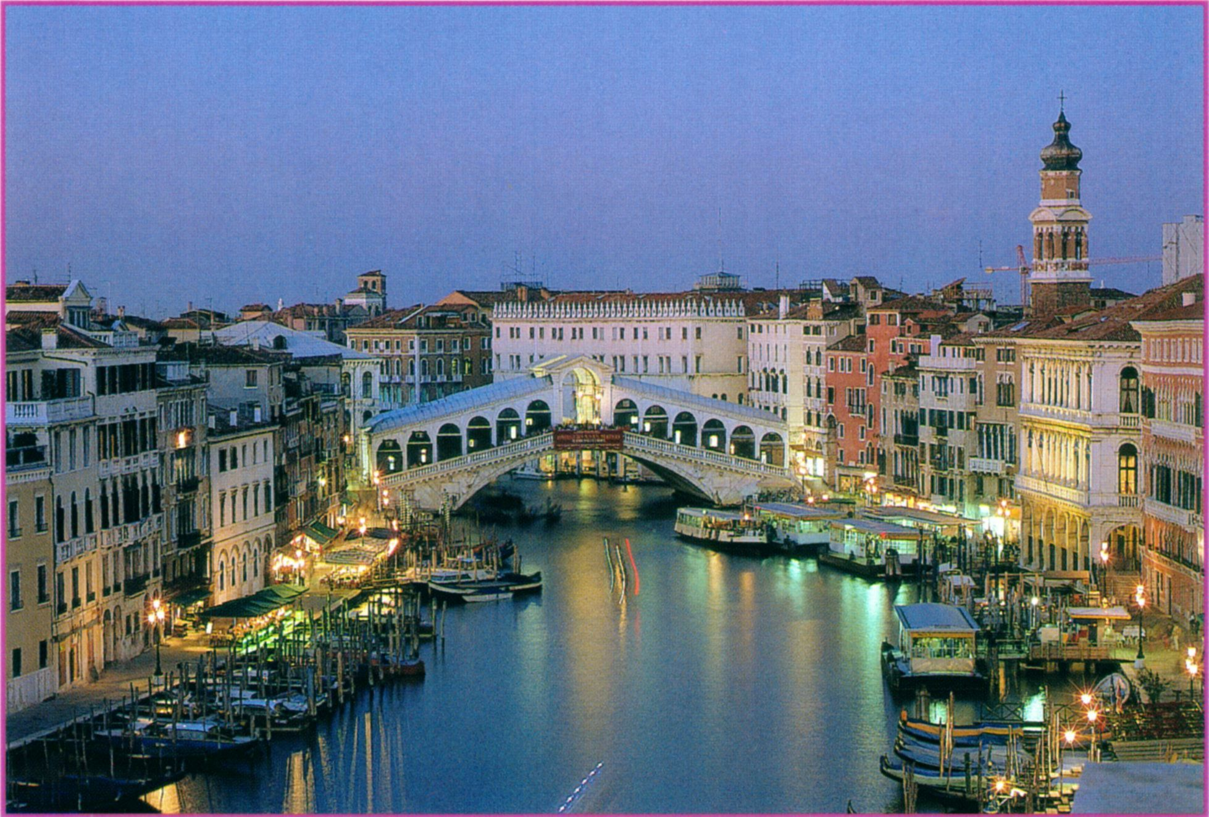
Venice, Italy

Slide 20
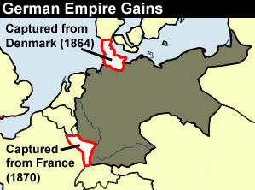
The Creation of Germany Continued…
The Franco-Prussian War (1870-1871) By 1867, a few southern German states remained independent of Prussia. Bismarck felt he could win the support of Southerners if they faced a threat from outside (like a war with France!). He published an altered version of a diplomatic telegram he had received from France (the Ems telegram). Wilhelm seemed to insult the French. Reacting to the insult, France declared war on Prussia on July 19, 1870. The Prussian army poured into northern France, and in September, they surrounded the main French force in Sedan. They took 80,000 French prisoners (even Napoleon III). After 4 months, hunger forced the French to surrender. The Franco-Prussian War was the final stage in German unification.

Slide 21
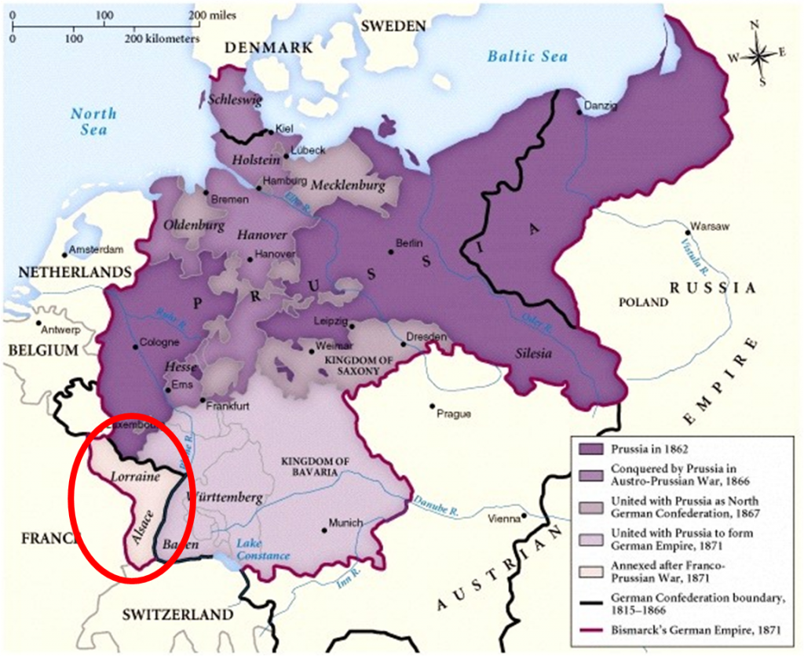

Slide 22
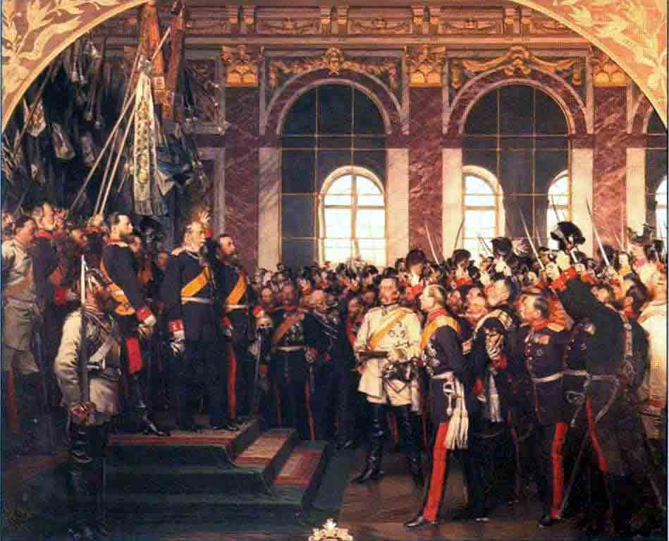
The Creation of Germany Continued…
E) On January 18, 1871 Wilhelm I was crowned Kaiser (Emperor) at the Palace of Versailles. The new German Empire was coined the Second Reich.
So what was the First Reich? Hmmmm…

Slide 24
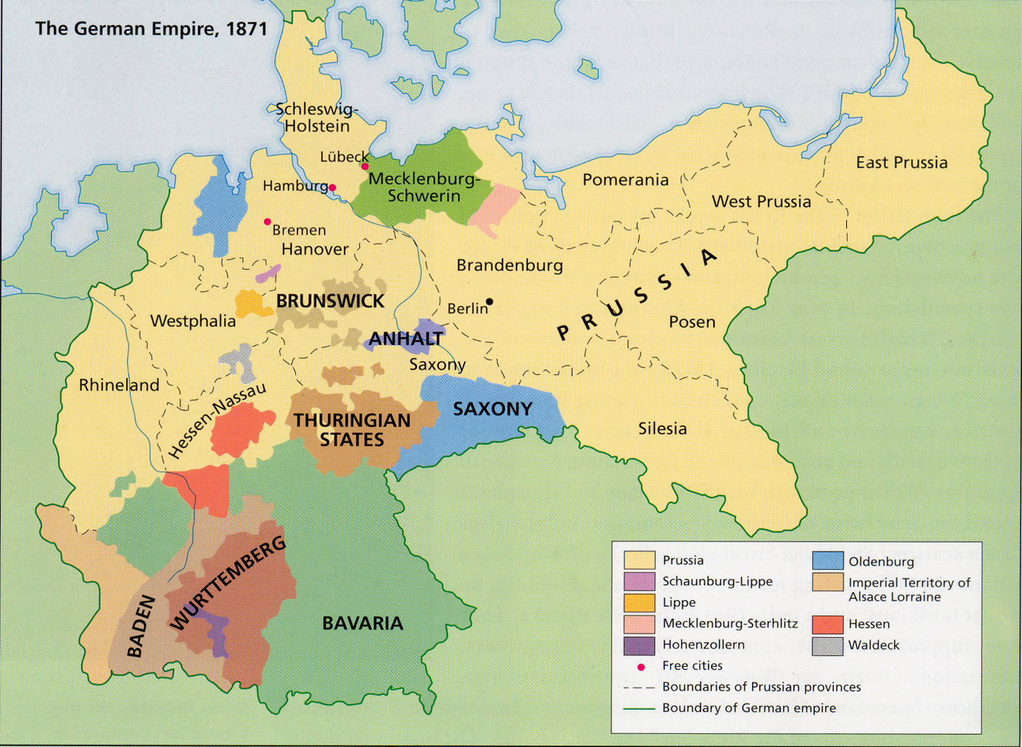
The Second Reich, 1871

Slide 25
IV THE BALANCE OF POWER SHIFTS
A) The Congress of Vienna had established five Great Powers in Europe: Britain, France, Austria, Prussia and Russia.
B) By 1871, however, Britain and Germany were clearly the most powerful. The European balance of power had broken down.

Slide 26
Italy’s National Anthem
Germany’s National Anthem
Brothers of Italy, Italy has awakened… because slave of Rome God created her. Let us unite! We are ready to die; Italy called. We have been for centuries stamped on, and laughed at, because we are not one people, because we are divided. Let's unite under one flag, one dream; To melt together Already the time has come.
Germany, Germany above all, Above all in the world, When, for protection and defense, it always takes a brotherly stand together…. Unity and justice and freedom For the German fatherland! For these let us all strive Brotherly with heart and hand! Unity and justice and freedom Are the pledge of fortune;

