Slide 1
Revolutions and National States in the Atlantic World
©2011, The McGraw-Hill Companies, Inc. All Rights Reserved.
*
Notes:
*

Slide 2
Popular Sovereignty
Ancient and medieval notions of kingship: “mandate of heaven,” “divine right of kings”
Impact of Enlightenment ideas
Kings to be made responsible to subject populations
John Locke (1632-1704)
Second Treatise of Civil Government (1690)
Argues that rulers derive power from consent of ruled
Individuals retain personal rights, give political rights to rulers
©2011, The McGraw-Hill Companies, Inc. All Rights Reserved.
*
Notes:
*

Slide 3
Individual Freedoms
Voltaire (pen name of François-Marie Arouet, 1694-1778)
Écrasez l’infame, “erase the infamy:” criticism of Roman Catholic church
Jean-Jacques Rousseau (1712-1778)
Argues for equality of all individuals, regardless of class, before the law
The Social Contract (1762), argues that society is collectively the sovereign
©2011, The McGraw-Hill Companies, Inc. All Rights Reserved.
*
Notes:
*

Slide 4
Revolution in America
Little indication of forthcoming revolution in mid-eighteenth century
Thirteen colonies regarded themselves as British subjects
Long cultural and personal connections with England
Mutually profitable military and economic relationship
©2011, The McGraw-Hill Companies, Inc. All Rights Reserved.
*
Notes:
*

Slide 5
French and Indian War, 1754-1763
Expensive, extensive
Overlapped with Seven Years’ War (1756-1763)
Conflict in Europe, India
British victory ensured global dominance, North American prosperity
©2011, The McGraw-Hill Companies, Inc. All Rights Reserved.
*
Notes:
*
Washington in French and Indian War

Slide 6
Increased Taxation in 1760s
Bills come due from the Seven Years’ War
Tax burden falls to the colonies
Sugar Act (1764)
Stamp Act (1765)
Quartering Act (1765) (housing of British troops)
Tea Act (1773)
©2011, The McGraw-Hill Companies, Inc. All Rights Reserved.
*
Notes:
*

Slide 7
The Declaration of Independence
British products boycotted, officials attacked
Protests
Boston Tea Party (1773), tea dumped into Boston harbor in protest against Tea Act
“No taxation without representation”
Continental Congress formed (1774), coordinates colonists’ resistance to British policies
July 4, 1776, adopts Declaration of Independence
Influence of Locke: retention of individual rights, sovereignty based on consent of the ruled
©2011, The McGraw-Hill Companies, Inc. All Rights Reserved.
*
Notes:
*

Slide 8
Divided Loyalties
Patriots
Those who supported revolution, in majority
Loyalists (Tories)
Estimated 20% of white population that remained loyal to British monarchy
Neutrals
Quakers
Divided
Native Americans, African-Americans
©2011, The McGraw-Hill Companies, Inc. All Rights Reserved.
*
Notes:
*

Slide 9
Revolutionary War
Colonies:
Logistic advantage
Popular support
Support of British rivals
George Washington (1732-1799) provides imaginative military leadership
Britain:
Strong central government
Navy, army
Loyalist population
©2011, The McGraw-Hill Companies, Inc. All Rights Reserved.
*
Notes:
*

Slide 10
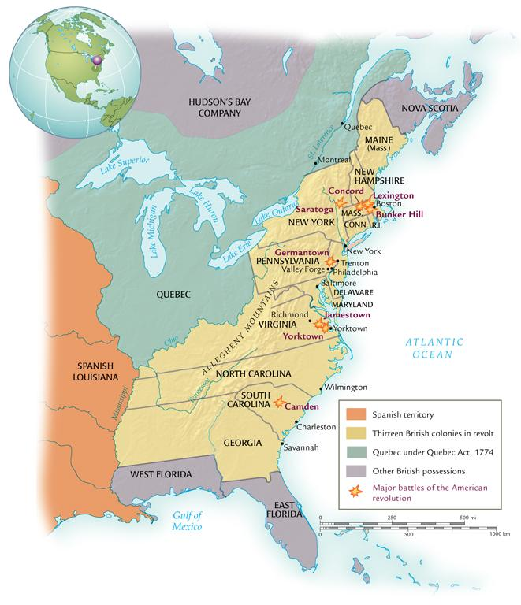
The American Revolution
©2011, The McGraw-Hill Companies, Inc. All Rights Reserved.
*
Notes:
*

Slide 11
Building an Independent State
War-weariness sets in by 1780
British forces surrounded at Yorktown, Virginia
Surrender in October 1781
Military conflict ceases, treaty at Peace of Paris, 1783
Recognition of American independence
1787 Constitution of the United States drafted
Political and legal equality for men of property
©2011, The McGraw-Hill Companies, Inc. All Rights Reserved.
*
Notes:
*

Slide 12
The French Revolution
Serious fiscal problems in France
War debts, 1780s
50% of tax revenues to war debts
25% of tax revenues to military
Leads to revolution more radical than the American
Repudiation of many aspects of the ancien régime
©2011, The McGraw-Hill Companies, Inc. All Rights Reserved.
*
Notes:
*

Slide 13
The Estates General
Three Estates
First estate: Roman Catholic clergy
100,000
Second estate: nobles
400,000
Third estate: everyone else
24,000,000 serfs, free peasants, urban residents
Estates General founded 1303, had not met since 1614
One vote per estate
©2011, The McGraw-Hill Companies, Inc. All Rights Reserved.
*
Notes:
*

Slide 14
1789
Protest of nobility forces King Louis to call Estates General for new taxes, May 1789
Third estate demands greater social change
June, third estate secedes
Renamed “National Assembly”
July, mob attacks Bastille, bloody battle won by mob
©2011, The McGraw-Hill Companies, Inc. All Rights Reserved.
*
Notes:
*

Slide 15
Declaration of the Rights of Man and the Citizen
August 1789
American influence
Equality of men
Women not included: Olympe de Gouges (Marie Gouze) unsuccessfully attempts to redress this in 1791
Sovereignty resides in the people
Individual rights
©2011, The McGraw-Hill Companies, Inc. All Rights Reserved.
*
Notes:
*

Slide 16
Radicalization of Revolution
“Liberty, equality, fraternity”
National Assembly abolishes old social order
Seizes church lands, redefines clergy as civilians
New constitution retains king, but subject to legislative authority
Convention: elected by universal male suffrage
Levée en masse: conscription for war
1793: King Louis and Queen Marie Antoinette found guilty of treason and sent to guillotine
©2011, The McGraw-Hill Companies, Inc. All Rights Reserved.
*
Notes:
*

Slide 17
Maximilien Robespierre (1758-1794)
“The Incorruptible,” leader of Committee of Public Safety
Leader of Jacobin party
Dominated Convention, 1793-1794
Churches closed, priests forced to marry
Promoted “cult of reason” as secular alternative to Christianity
Calendar reorganized: Ten-day weeks, proclaimed Year I
Executed 40,000; imprisoned 300,000
©2011, The McGraw-Hill Companies, Inc. All Rights Reserved.
*
Notes:
*

Slide 18
The Directory (1795-1799)
Revolutionary enemies of the Jacobins
1794 Robespierre arrested, sent to guillotine
Men of property take power in the form of the Directory
Unable to solve economic and military problems of revolutionary France
©2011, The McGraw-Hill Companies, Inc. All Rights Reserved.
*
Notes:
*

Slide 19
Napoleon Bonaparte (1769-1821)
From minor Corsican noble family
Army officer under King Louis XIV, general at age 24
Brilliant military strategist
Overthrew Directory in 1799
Established new government, the Consulate
Crowned himself emperor in 1802
©2011, The McGraw-Hill Companies, Inc. All Rights Reserved.
*
Notes:
*

Slide 20
Napoleonic France
Agreement with Pope: Concordat (1801)
France retains church lands, but pay salaries to clergy
Freedom of religion, also for Protestants, Jews
1804 promulgates Napoleonic Code
Patriarchal authority
Became model for many civil codes
Tight control on newspapers, use of secret police
©2011, The McGraw-Hill Companies, Inc. All Rights Reserved.
*
Notes:
*

Slide 21
Napoleon’s Empire
Conquered Iberian, Italian peninsulas, Netherlands
Forced Austria and Prussia to enter into alliance
Disastrous invasion of Russia in 1812
Burned Moscow, but defeated by Russian weather
British, Austrian, Prussian, and Russian armies force Napoleon to abdicate, 1814
Exiled to Island of Elba, escaped to take power again for 100 days
Defeated by British at Waterloo, exiled to St. Helena, dies 1821
©2011, The McGraw-Hill Companies, Inc. All Rights Reserved.
*
Notes:
*

Slide 22
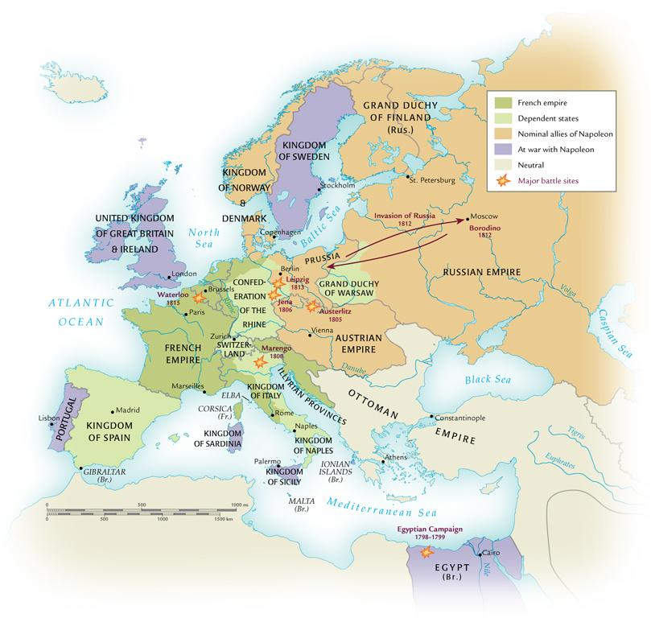
Napoleon’s Empire in 1812
©2011, The McGraw-Hill Companies, Inc. All Rights Reserved.
*
Notes:
*

Slide 23
The Revolution in Haiti
Only successful slave revolt
Island of Hispaniola
Spanish colony Santo Domingo in east (now Dominican Republic)
French colony of Saint-Domingue in west (now Haiti)
Rich Caribbean colony
Sugar, coffee, cotton
Almost one-third of France’s foreign trade
©2011, The McGraw-Hill Companies, Inc. All Rights Reserved.
*
Notes:
*

Slide 24
Society in Saint-Domingue
40,000 white French settlers
Dominated social structure
28,000 gens de couleur (free people of color, i.e. mixed-race, freed slaves)
Holders of small plots
500,000 slaves
High mortality rate, many flee to mountains
“Maroons,” escaped slaves
©2011, The McGraw-Hill Companies, Inc. All Rights Reserved.
*
Notes:
*

Slide 25
The Revolt
Inspired by American and French revolutions
500 gens de couleur sent to fight British in American War of Independence
1789 white settlers demand self-rule, but with no equality for gens de couleur
1791 civil war breaks out
Slaves revolt under Vodou priest named Boukman
French, British, Spanish forces attempt to intervene
©2011, The McGraw-Hill Companies, Inc. All Rights Reserved.
*
Notes:
*

Slide 26
François-Dominique Toussaint (1744-1803)
Renames self Louverture (“the opening”), 1791
Descendant of slaves, freed in 1776
Helped his original owners escape, then joined rebel forces
Built army of 20,000, eventually dominated Saint-Domingue
1801 promulgated constitution of equality
1802 arrested by Napoleon’s forces, died in jail
French troops driven out, 1804 Haiti declares independence
©2011, The McGraw-Hill Companies, Inc. All Rights Reserved.
*
Notes:
*

Slide 27
Latin American Society
30,000 peninsulares, colonial officials from Iberian peninsula
3.5 million criollos (creoles), born in the Americas of Spanish or Portuguese descent
Privileged class, but grievances with peninsulares
1810-1825 led movements for creole-dominated republics
10 million others
African slaves, mixed-race populations
©2011, The McGraw-Hill Companies, Inc. All Rights Reserved.
*
Notes:
*

Slide 28
Mexican Independence
Napoleon’s invasion of Spain and Portugal (1807) weakens royal authority in colonies
Priest Miguel de Hidalgo (1753-1811) leads revolt
Hidalgo captured and executed, but rebellion continues
Creole general Augustín de Iturbide (1783-1824) declares independence in 1821
Installs self as emperor, deposed in 1823, republic established
Southern regions form federation, then divide into Guatemala, El Salvador, Honduras, Nicaragua, Costa Rica
©2011, The McGraw-Hill Companies, Inc. All Rights Reserved.
*
Notes:
*

Slide 29
Simón Bolívar (1783-1830)
Led independence movement in South America
Native of Caracas (Venezuela), influenced by Enlightenment, George Washington
Rebels against Spanish rule 1811, forced into hiding
Forms alliances with many creole leaders
José de San Martín (Argentina, 1778-1850)
Bernardo O’Higgins (Chile, 1778-1842)
Spanish rule destroyed in South America by 1825
©2011, The McGraw-Hill Companies, Inc. All Rights Reserved.
*
Notes:
*

Slide 30
Gran Colombia
Bolívar hoped to form U.S.-style federation
Venezuela, Columbia, Ecuador form Gran Colombia
Attempts to bring in Peru and Bolivia
Strong political differences, Gran Colombia disintegrates
Bolívar goes into self-imposed exile, dies of tuberculosis
©2011, The McGraw-Hill Companies, Inc. All Rights Reserved.
*
Notes:
*

Slide 31
Brazilian Independence
Napoleon’s invasion sends Portuguese royal court to exile in Rio de Janeiro
1821, king returns, son Pedro left behind as regent
Pedro negotiates with creoles, declares independence of Brazil
Becomes Emperor Pedro I (r. 1822-1834)
Social structure remains largely intact
©2011, The McGraw-Hill Companies, Inc. All Rights Reserved.
*
Notes:
*

Slide 32
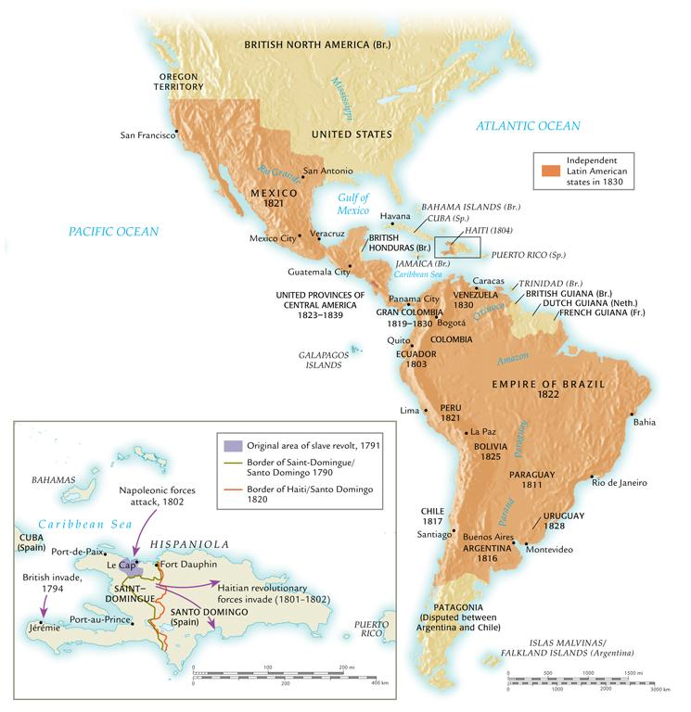
Latin America in 1830
©2011, The McGraw-Hill Companies, Inc. All Rights Reserved.
*
Notes:
*

Slide 33
Emergence of Ideologies
Conservatism
Edmund Burke (England, 1729-1797)
Disavowed rapid revolutionary change
Favored slow evolution of society
Liberalism
Viewed conservatives as defenders of illegitimate status quo
Manage, not stifle, social change
John Stuart Mill (England, 1806-1873)
©2011, The McGraw-Hill Companies, Inc. All Rights Reserved.
*
Notes:
*

Slide 34
The End of the Slave Trade
Campaign to end slavery begins in eighteenth century
Olaudah Equiano (1745-1797)
Gains momentum after American, French and Haitian revolutions
William Wilberforce (England, 1759-1833), philanthropist, succeeds in having Parliament outlaw slave trade, 1807
Other states follow suit, but illegal trade continues until 1867
©2011, The McGraw-Hill Companies, Inc. All Rights Reserved.
*
Notes:
*

Slide 35
End of the Institution of Slavery
Haiti: slavery ends with revolution
Mexico slavery abolished 1829
Partially to stop U.S. development of slave-based cotton industry in Mexico
1833 Britain abolishes slavery, offers compensation to former owners
Other states follow, but offer freedom without equality
Property requirements, literacy tests, etc. block voting
©2011, The McGraw-Hill Companies, Inc. All Rights Reserved.
*
Notes:
*

Slide 36
Enlightenment Ideals and Women
Enlightenment thinkers remained conservative regarding women’s rights
Rousseau argues women should receive education to prepare for lives as wives and mothers
Mary Astell (England, 1666-1731) argues that women essentially born into slavery
Mary Wollstonecraft (England, 1759-1797)
A Vindication of the Rights of Woman (1792)
©2011, The McGraw-Hill Companies, Inc. All Rights Reserved.
*
Notes:
*

Slide 37
Women and Revolution
Women active in all phases of French revolution
Women storm Versailles in 1789, demands for food
Republican Revolutionary Women patrol streets of Paris with firearms
Yet hold few official positions of authority
Revolution grants equality in education, property, legalized divorce
Yet women not allowed to vote, major task of nineteenth century
Elizabeth Cady Stanton (U.S., 1815-1902)
©2011, The McGraw-Hill Companies, Inc. All Rights Reserved.
*
Notes:
*

Slide 38
Nations and Nationalism
“Nation” a type of community, especially prominent in nineteenth century
Distinct from clan, religious, regional identities
Usually based on shared language, customs, values, historical experience
Sometimes common religion
Idea of nation has immediate relationship with political boundaries
©2011, The McGraw-Hill Companies, Inc. All Rights Reserved.
*
Notes:
*

Slide 39
Types of Nationalism
Cultural nationalism
Johann Gottfried von Herder (1744-1803) praises the Volk (“people”)
Literature, folklore, music as expressions of Volksgeist: “spirit of the people”
Political nationalism
Movement for political independence of nation from other authorities
Unification of national lands
Giuseppe Mazzini (1805-1872), “Young Italy”
©2011, The McGraw-Hill Companies, Inc. All Rights Reserved.
*
Notes:
*

Slide 40
Nationalism and Anti-Semitism
Nationalist ideologies distrustful of indigenous minorities
Pogroms, violent attacks on Jewish communities in Russian empire beginning 1881
Anti-Semitism rallying cry of many European nationalists
French military Captain Alfred Dreyfus framed for selling military secrets to Germany
Eventually exonerated, but great debate on loyalty of Jews in European societies
©2011, The McGraw-Hill Companies, Inc. All Rights Reserved.
*
Notes:
*

Slide 41
Zionism
Theodor Herzl (Austria, 1860-1904) journalist at Dreyfus trial
Observed intense mob anti-Semitism, concluded that Enlightenment and revolution could not solve this human ill
Worked to create refuge for Jews by re-establishing Jewish state in Palestine
Zion synonymous with Jerusalem
1897 convened first World Zionist Organization
©2011, The McGraw-Hill Companies, Inc. All Rights Reserved.
*
Notes:
*

Slide 42
The Congress of Vienna (1814-1815)
Meeting after defeat of Napoleon
Prince Klemens von Metternich (Austria, 1773-1859) supervises dismantling of Napoleon’s empire
Established balance of power
Worked to suppress development of nationalism among multi-national empires like the Austrian
©2011, The McGraw-Hill Companies, Inc. All Rights Reserved.
*
Notes:
*

Slide 43
Nationalist Rebellions
Greeks in Balkan peninsula seek independence from Ottoman Turks, 1821
With European help, Greece achieves independence in 1830
Rebellions all over Europe, especially in 1848
Rebels take Vienna, Metternich resigns and flees
But rebellions put down by 1849
©2011, The McGraw-Hill Companies, Inc. All Rights Reserved.
*
Notes:
*

Slide 44
Unifications of Italy and Germany
Italy and Germany formerly disunited groups of regional kingdoms, city-states, ecclesiastical states
Germany: over three hundred semiautonomous jurisdictions
Nationalist sentiment develops idea of unification
Count Camillo di Cavour (1810-1861) and Giuseppe Garibaldi (1807-1882) unify Italy under King Vittore Emmanuele II
©2011, The McGraw-Hill Companies, Inc. All Rights Reserved.
*
Notes:
*

Slide 45
Unifications of Italy and Germany
Otto von Bismarck (1815-1898) advances Realpolitik (“the politics of reality”), uses wars with neighbors to unify Germany
Second Reich proclaimed in 1871 (Holy Roman Empire the first), King Wilhelm I named emperor
©2011, The McGraw-Hill Companies, Inc. All Rights Reserved.
*
Notes:
*

Slide 46
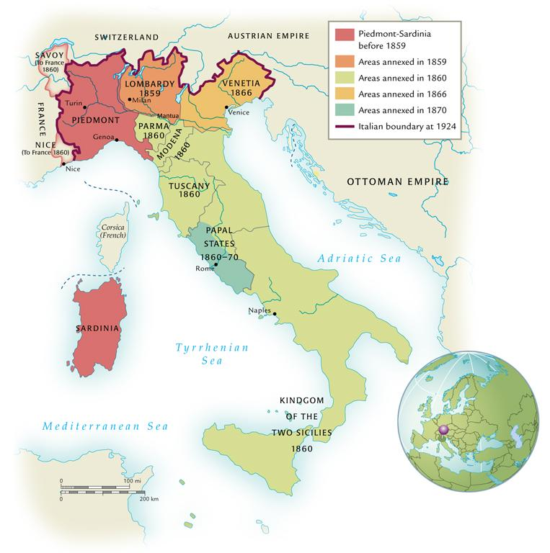
The Unification of Italy and Germany
©2011, The McGraw-Hill Companies, Inc. All Rights Reserved.
*
Notes:
*

