Slide 1
The Industrial Revolution
1760-1851
“The most profound transformation in human life since the beginnings of agriculture”

Slide 2
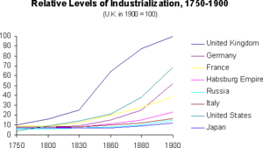

Slide 3
Causes
Population Growth
Resistance to disease
Reliable food supply
Potato
Maize
Enclosure Acts
Early marriage
More kids
Child labor
Migration/immigration
Trade/Inventions
Improved roads
Rural cottage industry
Sugar
Electricity
Hot air balloon
Telegraph

Slide 4
The Rise of Industry: England
Increase in living standards
Leading exporter
Tools
Guns
Craft goods
Society
Aristocracy / court
Social classes
Transportation / commerce
Access to water

Slide 5
The Rise of Industry: Europe
Slower pace than England
High transportation cost
Social structures
Canals
Revolution / war
Britons began training Europeans after revolutions
Ability to mine ore

Slide 6
Innovations
Mass production
Division of labor
Mechanization
New machines
Iron
Steam engine
Electric telegraph

Slide 7
Mass Production
The making of many identical items by breaking the process into simple repetitive tasks
1759: Josiah Wedgwood and pottery
Measure temperature inside kilns
Division of labor (subdivided work into repetitive tasks)
Molds vs. potter’s wheel
Lowered cost of porcelain
1782: steam engine

Slide 8
Mechanization
The use of machines to do work previously done by hand
Cotton industry was largest in GB
Parliament forbids imported cloth
Creates need for domestic cloth
Cotton becomes America’s most valuable crop
Increased productivity
Lowered prices
Fewer skilled workers
Child labor

Slide 9
Cotton Innovations: GB
Spinning Jenny (1764)
Created thread mechanically
Soft; must be used with linen
Richard Arkwright: water frame (1769)
Stronger thread (no linen)
“cotton mill”
Samuel Crompton: mule (1785)
Combined spinning jenny and water frame
Muslin
Other inventions
Chlorine bleach
Printed fabrics

Slide 10
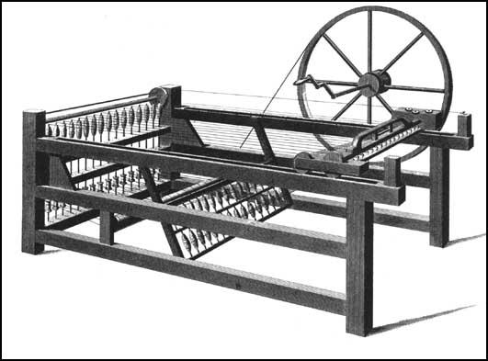
Spinning Jenny

Slide 11
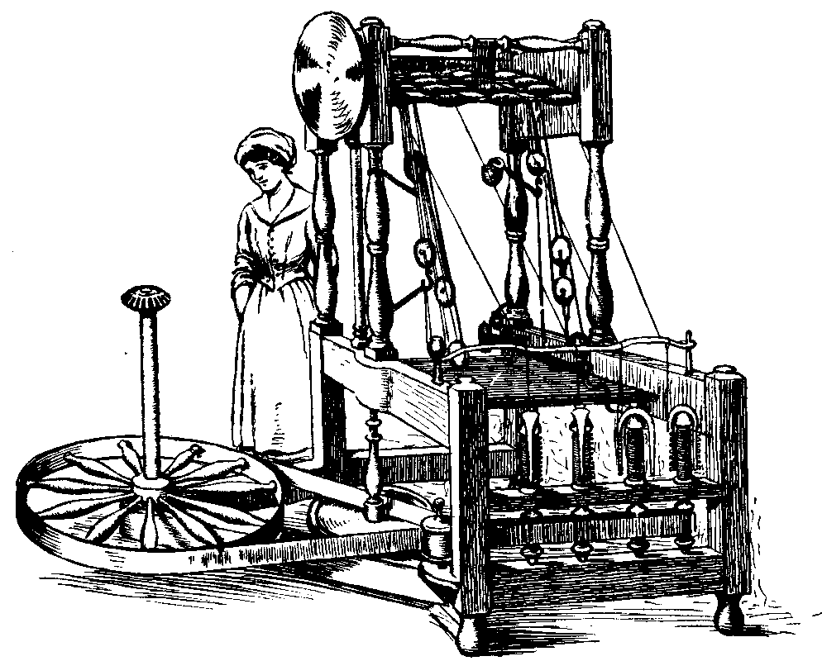
Water Frame

Slide 12
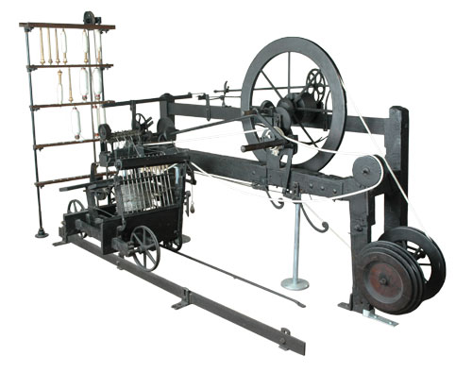
Mule

Slide 13
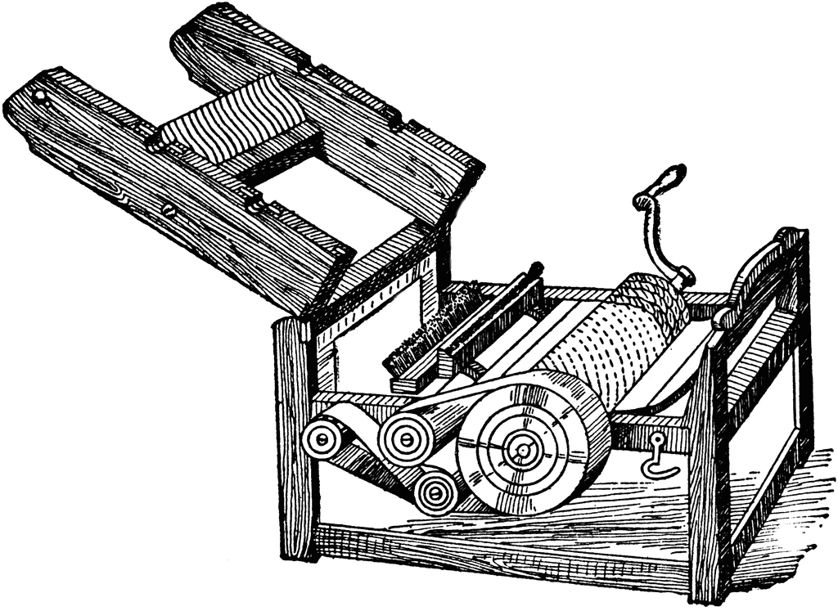
Cotton Innovations :US
Eli Whitney: cotton gin (1793)
Separated bolls from fiber
Allowed for spread of cotton across the South
slavery

Slide 14
Iron
Song China
Cast iron produced in large quantities
Production declined but iron products remained cheap
OUTSIDE of China, iron was expensive
Deforestation
Charcoal costs rise (smelting process)
Abraham Darby (1709)
Use of coke instead of charcoal
Wrought iron
Bridges
Crystal Palace (1851)
Great Exhibition
Show off GB’s innovations
Interchangeable parts
“American system of manufactures”

Slide 15
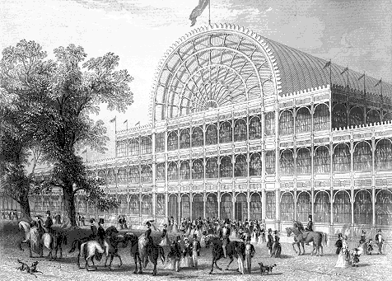
Iron

Slide 16
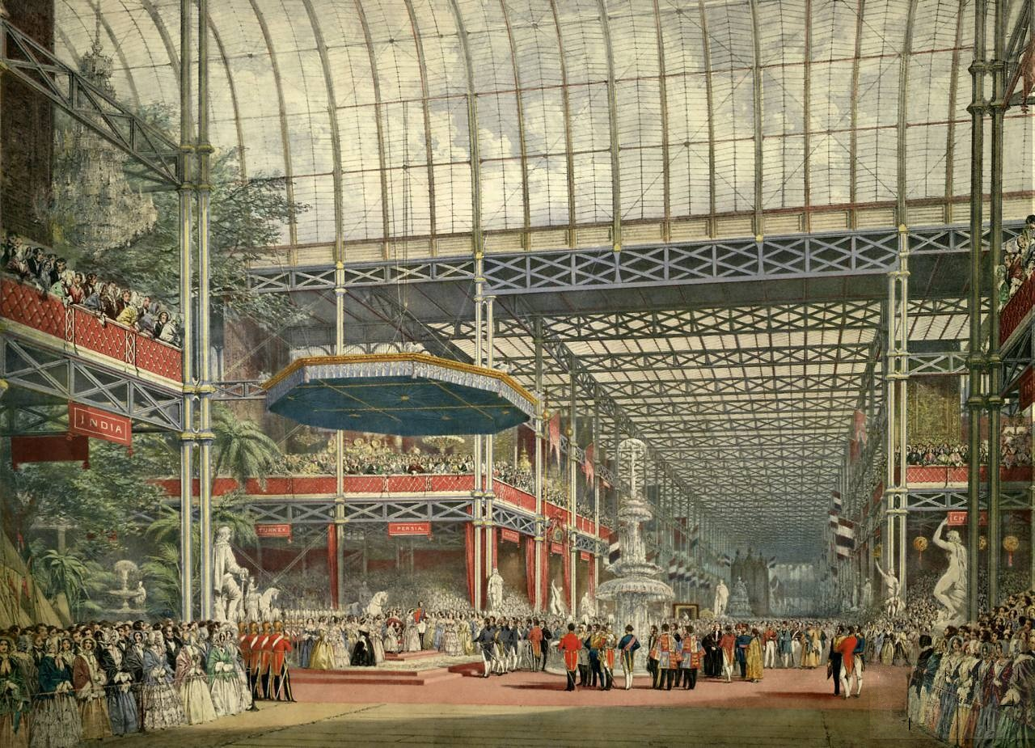

Slide 17
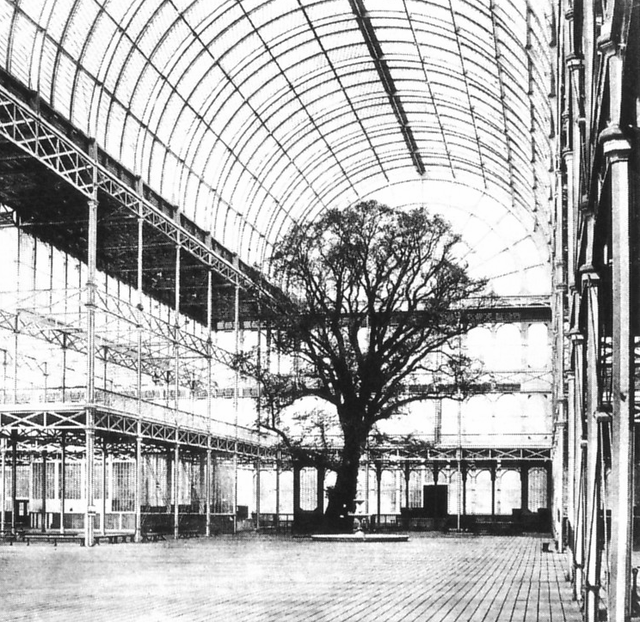

Slide 18
Steam
Steam engine
Fossil fuel → mechanical energy
Distinguished Industrial Revolution from other growth/innovation periods
Thomas Newcomen
First practical steam engine
Water pump for mines
Very expensive for other uses
James Watt
Repair of Newcomen engine
Improved design
More affordable for industry (flour, cotton, pottery)

Slide 19
Steamboats
Robert Fulton and the North River (1807)
Frist commercial steamboat
Hudson River in NY
Erie Canal (1820s)
Connected Atlantic to the Great Lakes
New settlements
Steamboats on the MS
Great Western and Sirius (1838)
First steam boats to cross Atlantic on steam power

Slide 20
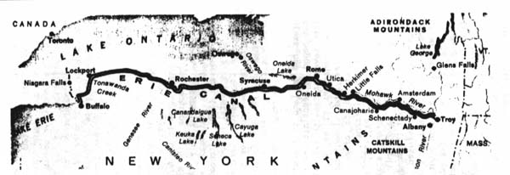
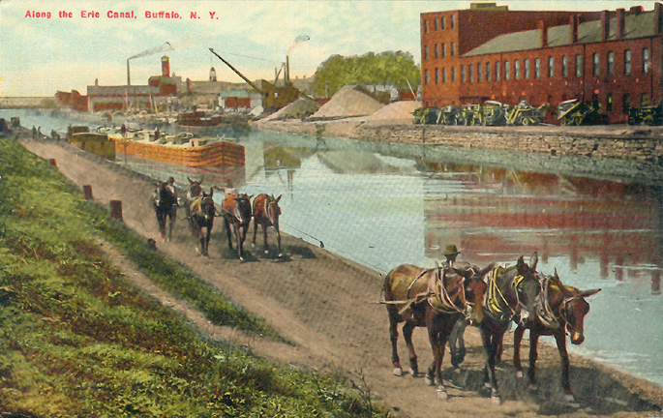

Slide 21
Railroads
Richard Trevithick (1804)
Engine that uses less coal than Newcomen or Watt
Steam powered vehicles (road and rail)
George and Robert Stephenson (1829)
Liverpool and Manchester Railway
Competition between steam powered locomotive and horse drawn wagon
The Rocket: 30 mph
Cheap, fast, comfy
Need for iron, machinery, construction

Slide 22
US Railroads
De Witt Clinton (1835)
First US steam locomotive
1840s: 6,000 miles of track
1850s: 21,000 miles of track laid
Connect East to Memphis, St. Louis, Chicago
Prairie land connected to the East

Slide 23
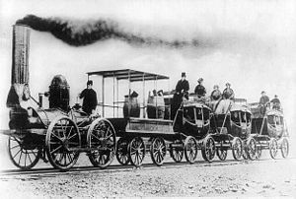

Slide 24
Telegraph
Alessandro Volta: battery (1800)
Made production of electric current possible
Charles Wheatstone and William Cooke
England
Five wire telegraph
Samuel Morse
US
Dots and dashes (single wire)
1851: first submarine telegraph cable
English Channel

Slide 25
Impacts of the Industrial Revolution

Slide 26
Urban Life
FAST growth
London
1700: population of 500,000
1850: population of 2,363,000
Towns merge
“Development” in poor neighborhoods
Quick builds
Shoddy work
Pollution
Air pollution
Coal
Trains
Sewage and trash in street/river
Drinking water
City livestock
Noise
Disease
Rickets
Cholera (from India)

Slide 27
Rural Life
Deforestation
Ships
Homes
Charcoal
Manufacturing

Slide 28
Working Conditions
Long, repetitive days
Unskilled workers
Few breaks
Gas lighting
Allowed workers to continue working at night
1806: National Light and Heat Company
Produce and distribute in London
1816: 26 miles of gas lines

Slide 29
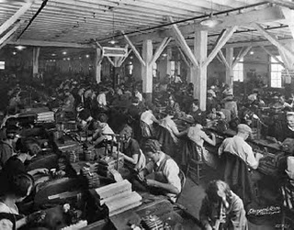

Slide 30
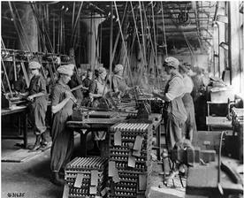

Slide 31
Women and Children
Rural areas: family/household work
Urban areas
Domestic servants
Laundry, Millinery, Sewing
Textile factories
Unmarried??
Lowell mills in Massachusetts
½ to ¹/₃ pay of men
Children contribute at early age
5-6 years old in mills
Smaller, less likely to cause problems
Beaten if mistakes/asleep
14-16 hour days

Slide 32
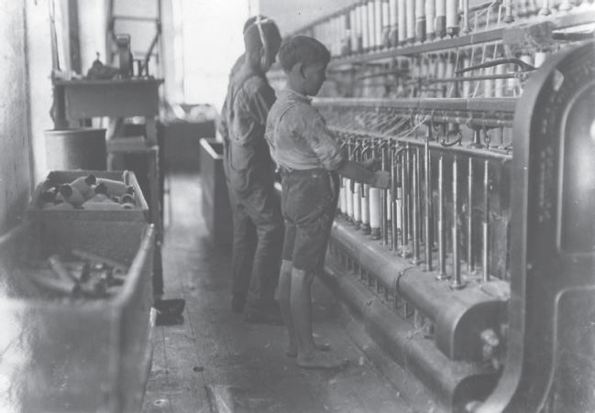

Slide 33
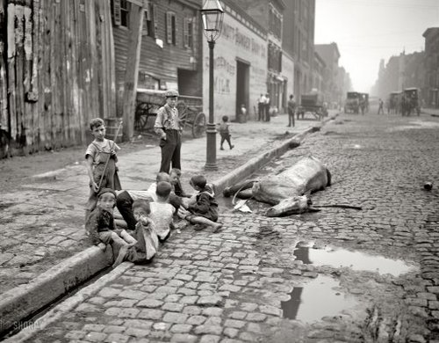

Slide 34
Women
Pre-Industrial Revolution
Wives participate in business
Widows manage businesses alone
Post Industrial Revolution
“Cult of domesticity”
Removal of women from business world
Mary Wollstonecraft
Vindication of the Rights of Woman (1792)
First feminist manifesto

Slide 35
Economics and the People
Destitute
Those that clung to “old ways”
Factory workers
1792-1815: Food prices rose quicker than wages
1847-1848: potato famine in Ireland
¼ population died
¼ emigrated to England/North America

Slide 36
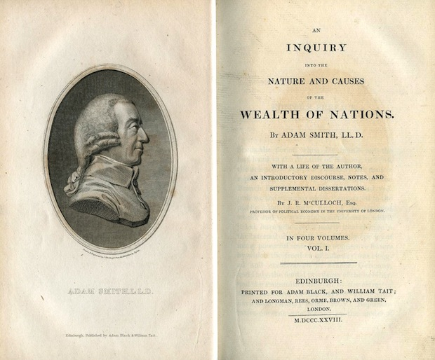
Economics
Laissez faire
“let them do” (little/no government intervention in business)
Mercantilism
Governments should regulate trade
Adam Smith (British)
Scottish economist
Wealth of Nations
Challenged mercantilism
Allow free trade with foreign countries
Allow individuals to seek personal gain
Result will be increase in general welfare

Slide 37
Economics
Thomas Malthus and David Ricardo (British)
Worker’s problems brought about by population boom
Poverty is a result of “natural law”
Outside Great Britain
Friedrich List (German)
Zollverein
Positivism (France)
Saint Simon, Auguste Comte
Scientific method can solve social problems
Workers unions

Slide 38
Worker Demands
Universal male suffrage
Shorter work days
Workers unions
Factory Act of 1833
Prohibits children under age 9 from working in mills
Limit working hours
9-13 yrs = 8 hours
14-18 = 12 hours
Mines Act of 1842
Prohibit women and boys under 10
Corn Laws
Taxes on imported grain

Slide 39
The World Outside the Industrialized West

Slide 40
Egypt
1798: French invasion
Brings European influence
Muhammad Ali
Less dependence on Ottoman Empire
Imports advisers from Europe to build mills, etc
Britain and “free trade”
Becomes dependent on Britain

Slide 41
India
Pre-Industrial Revolution
World leader in producing/exporting cotton textiles
British East India Company
Takes over parts of India
Allows cheap, British made cloth to flood market
Becomes dependent on Britain

Slide 42
China
Conservative elite class stands in the way of change
Does not grow with Europe, America
Britain sends iron, steam powered ships to defeat China

