Slide 1
Imperialism

Slide 2
Land Empires
1800-1870

Slide 3
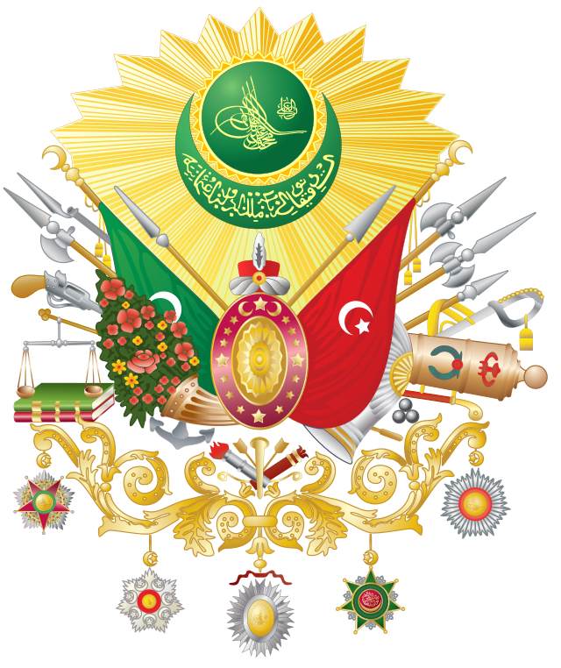
The Ottoman Empire

Slide 4
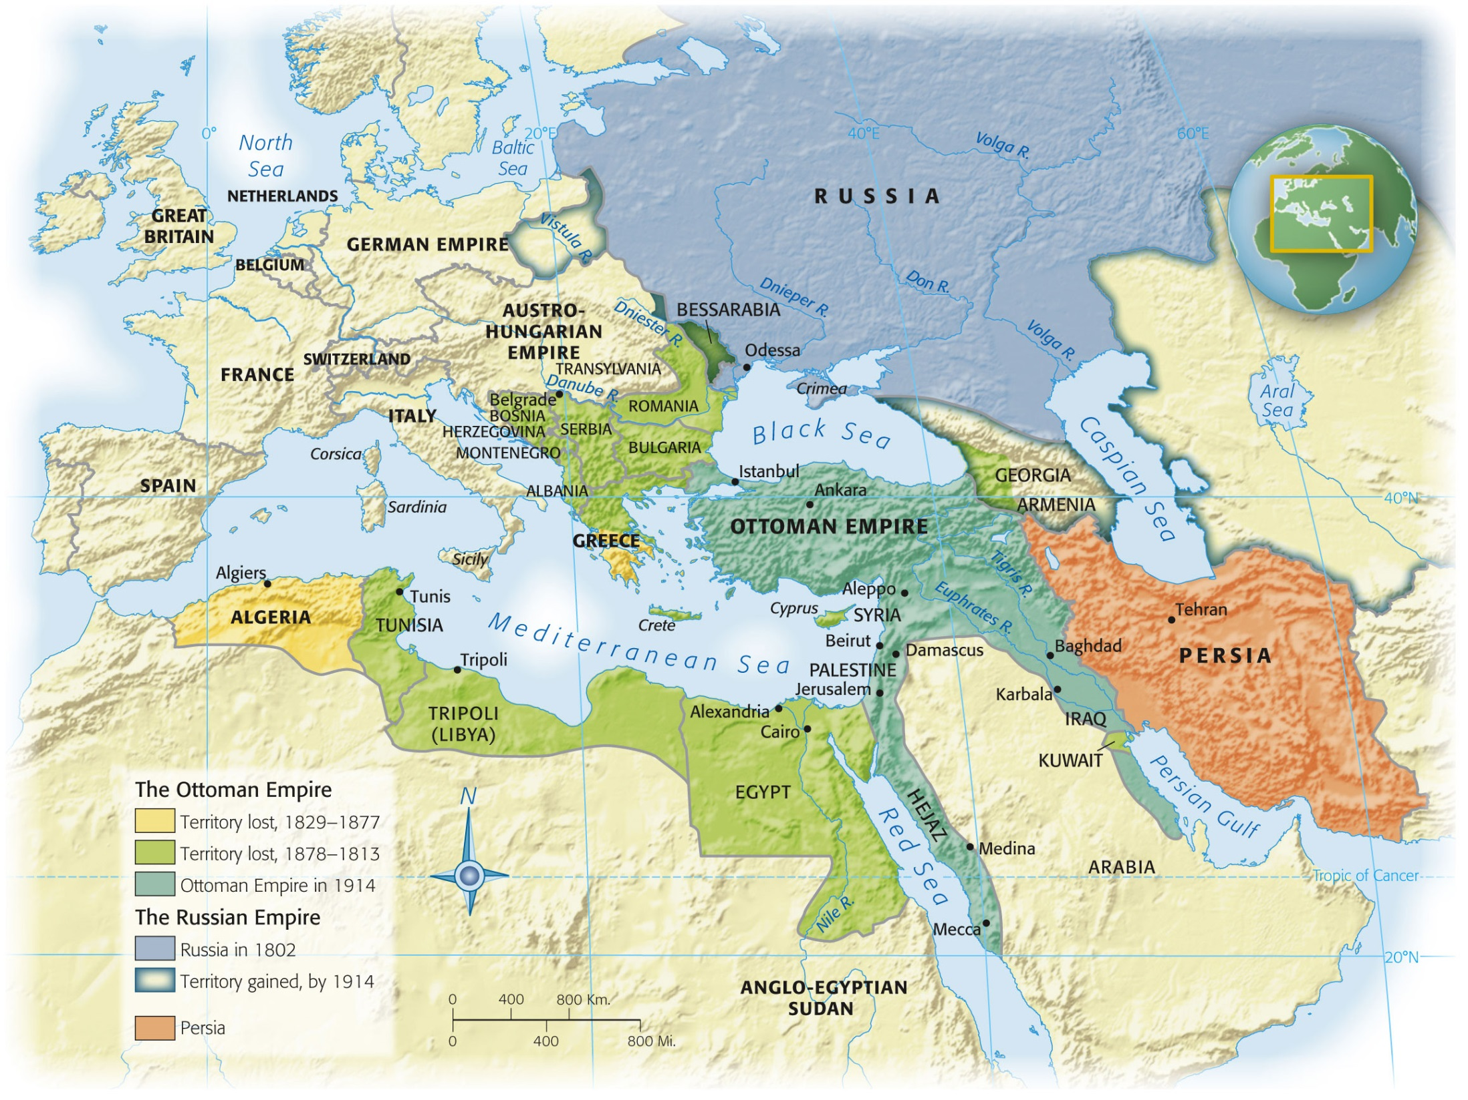

Slide 5
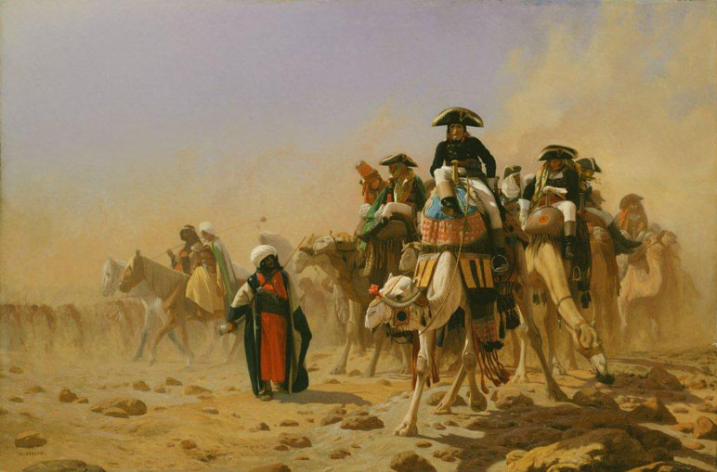
Napoleon and Egypt
1798: Napoleonic invasion
Defeat of Mamluk forces
Napoleon returns to France
Withdraw in 1801
Cut off from France by Mediterranean
Incompetent generals
Creates power struggle
Notes:
Muhammad Ali: Albanian soldier sent by sultan to restore control

Slide 6
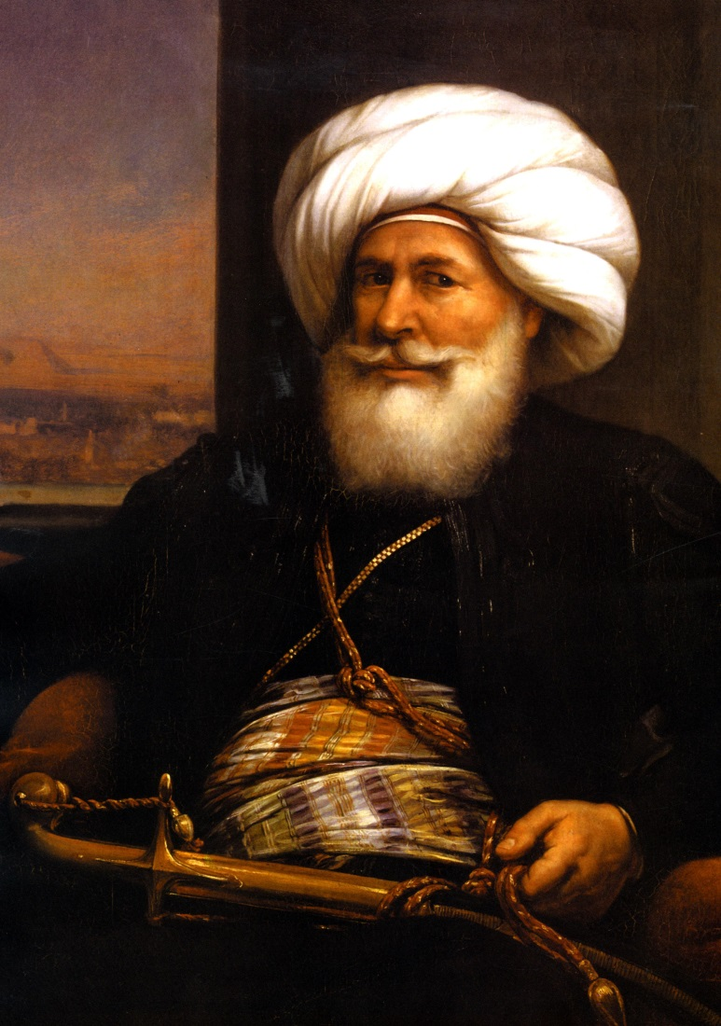
Muhammad Ali
Sent by sultan to restore order in Eypt
1805: replaced official Ottoman governor
1811: gets rid of privileges of mamluks
1830s: Head of the strongest Islamic state
Ottoman Empire no longer has true control of Egypt

Slide 7
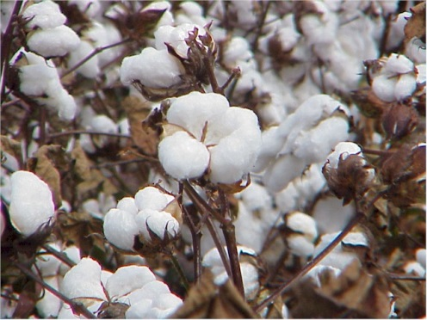
Muhammad Ali
Father of Modern Europe
Adopts French/European methods, etc
Industry
Wanted to rival Europe’s textile industry
Factories to supply weapons
Military schools
Printing Industry
First newspaper in Islamic world
Revival of Arabic literature
Population doubles
Trade with Europe increases by 600%
At the expense of peasants

Slide 8
Ismail
Muhammad Ali’s grandson
“My country is no longer in Africa…[I]t is in Europe.”
1870
Canals
Railroads
Postal service
Cairo
American Civil War
Collapse of cotton market
In debt to Great Britain and France
Occupation

Slide 9
The Janissary Problem
Violent opposition to reforms in Ottoman Empire
Resist creation of new military units
Afraid that the sultan would take their power and “perks”
1805: massacre of Serbian Christians
Ottoman ruler unable to focus on unrest in Serbia due to Russian threats
Serbia becomes independent
Mahmud II creates new artillery unit
Janissaries revolt
Bombardment and destruction by new unit

Slide 10
Tanzimat (“reorganization”)
“Dawn of modern thought and enlightened government in the Middle East”
Reforms enacted by Abdul Mejid
Son of Mahmud II
Public trials/equal protection under the law for all
Privacy rights
Equality in military conscription
Non-Muslims liable for service

Slide 11
Education
1830s: Imperial School of Military Sciences
Chemistry, engineering, math, physics
Model for other reform
1838: First med school
French becomes the preferred language for universities
Cadets sent to France to train
Foreign teachers
Books expensive to reprint in Turkish

Slide 12
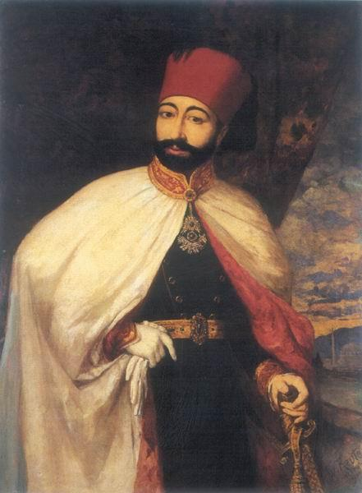
Military Reform
European changes to military
Beards are unhygienic
Modern weapons and dress
Modern headgear (cap with bill)
Fez
Alternative to billed cap for Muslims
European dress becomes common in everyday life

Slide 13
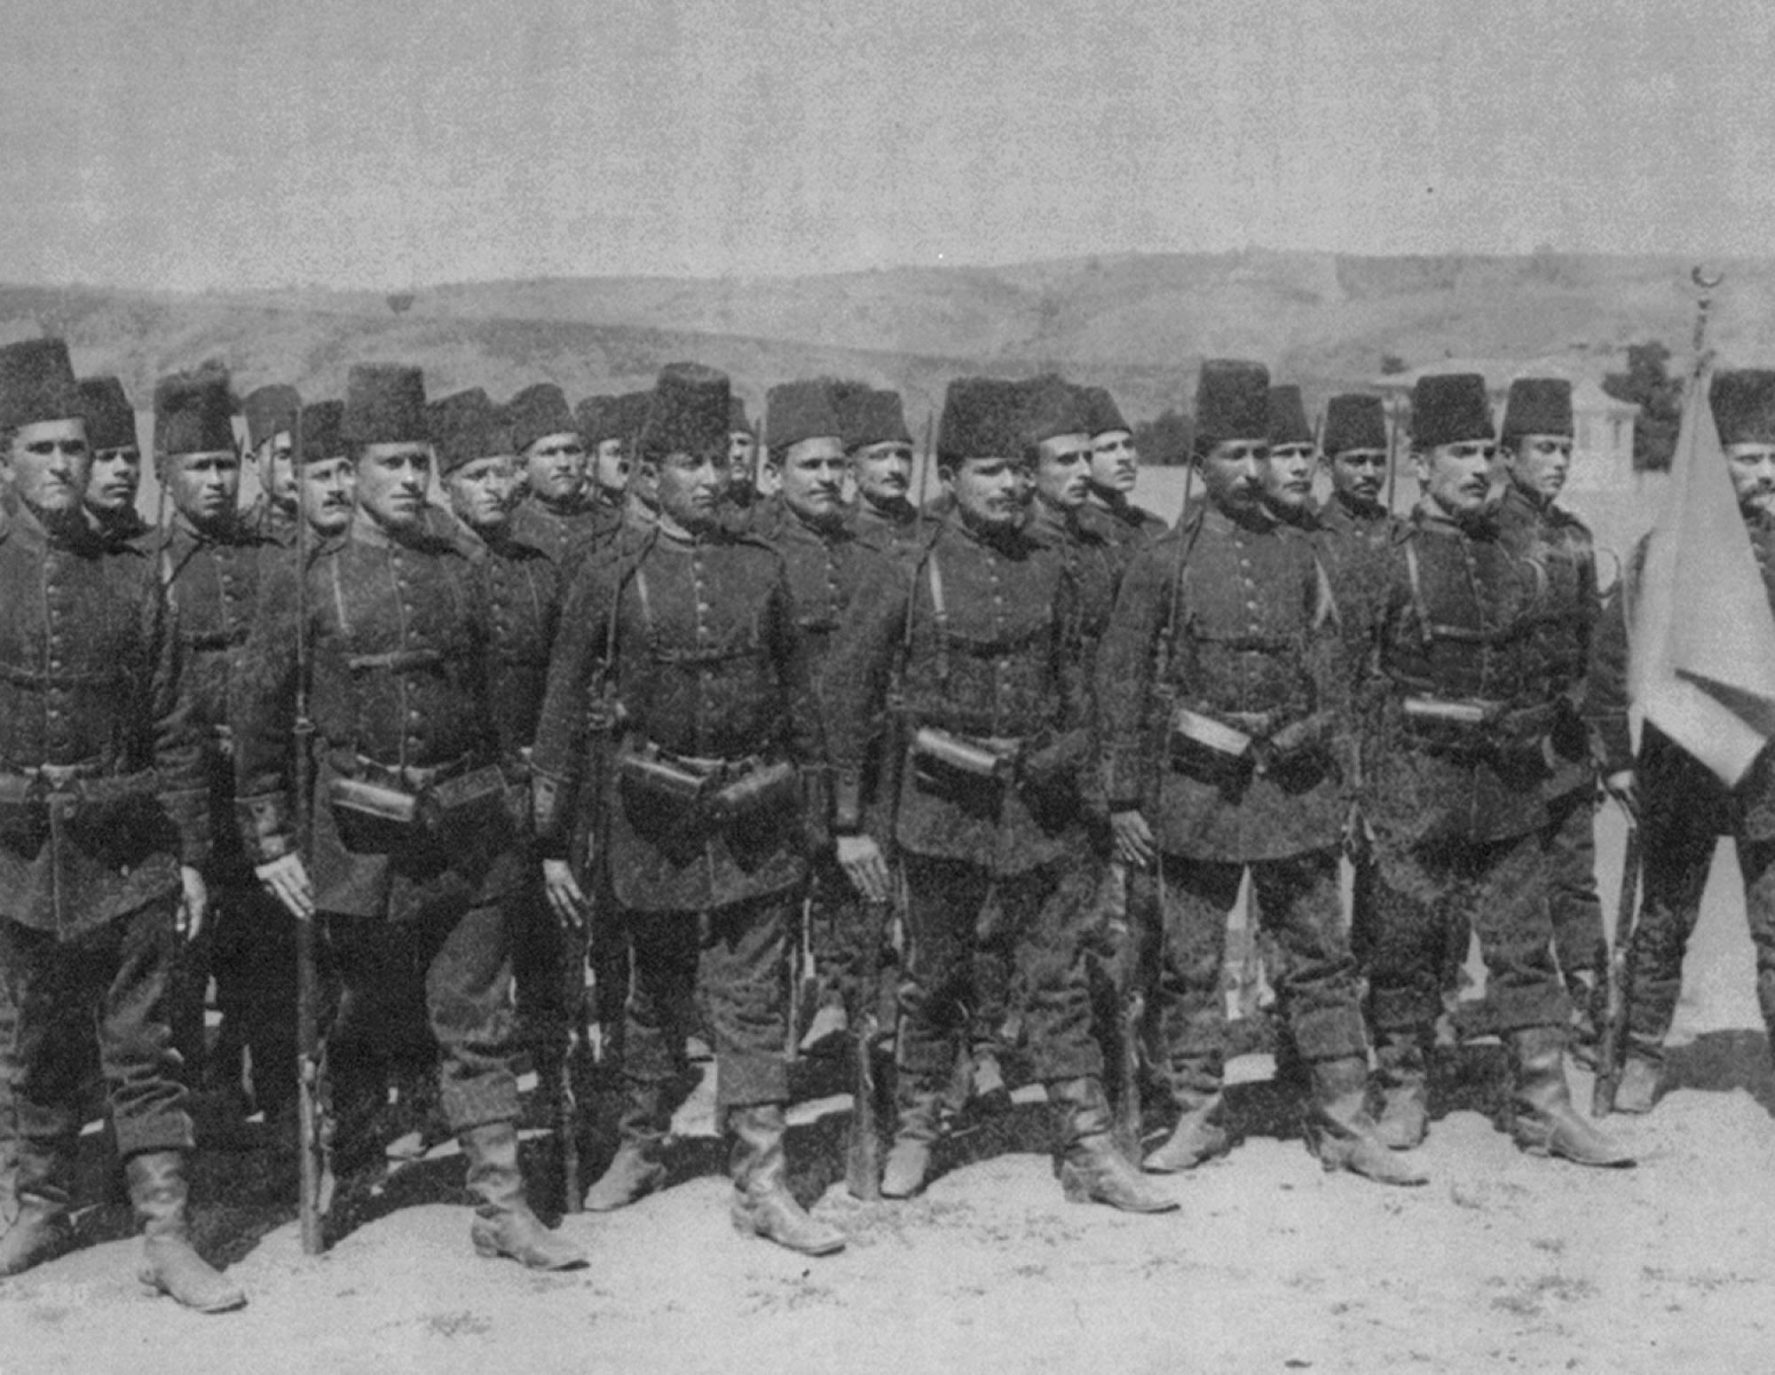
Notes:
Modernized Ottoman Troops.
This photograph of a contingent of Imperial Guards in the late nineteenth century shows them equipped and uniformed much like any other European army of the time. The only distinctive feature is the fez, a brimless hat adopted earlier in the century as a symbol of reform. Comparison with the soldiers in the funeral procession of Suleiman the Magnificent (page 530) shows the degree of change from the traditional military uniforms that were still being worn in the eighteenth century.

Slide 14
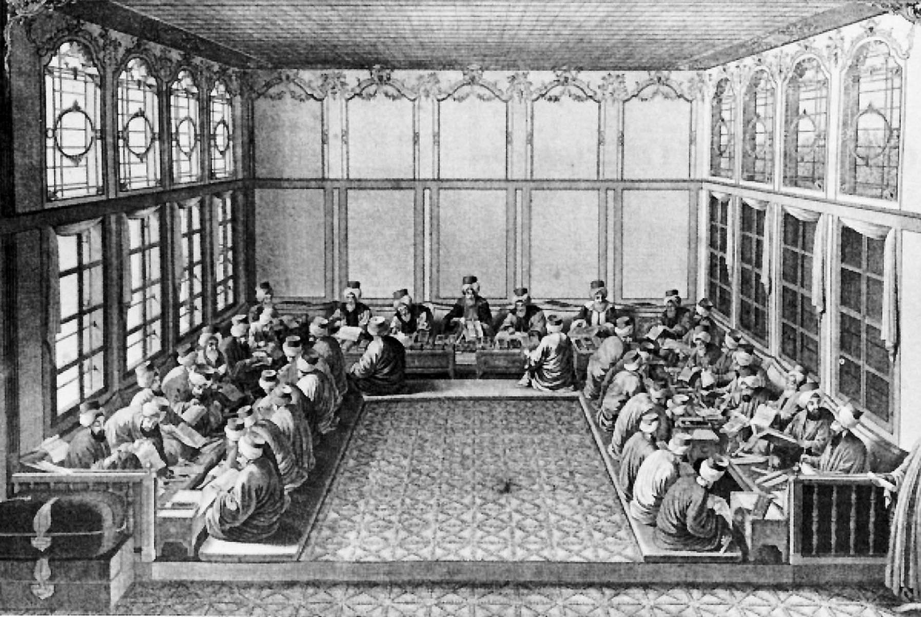
Notes:
Interior of the Ottoman Financial Bureau.
This engraving from the eighteenth century depicts the governing style of the Ottoman Empire before the era of westernizing reforms. By the end of the Tanzimat period in 1876, government offices and the costumes of officials looked much more like those in contemporary European capitals.

Slide 15
Legal Reform
Taxes
Ended tax farming
Ended non-Muslim head tax
Legal codes developed
Commercial
Criminal
Civil
Shari’a
Localized to family law
Marriage, etc
Women
Pre-Tanzimat
Ability to manage their own property
Post Tanzimat
Ability transferred to civil courts and to male family members

Slide 16
The Crimean War
1833
Muhammad Ali invades Syria
Russia supports Ottomans
Ottomans agree that Russia is the “protector” of Ottoman Orthodox subjects
1852
Sultan names France “protector”
Russia invades Ottoman Empire
France and Britain support Ottomans
Creates suspicion of Russia in Europe

Slide 17
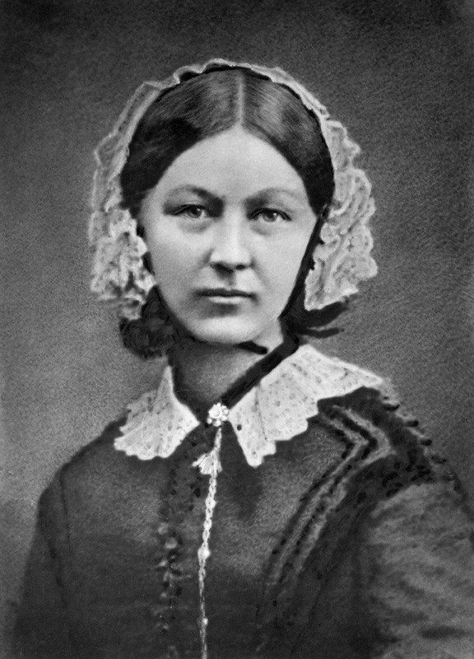
The Crimean War
Transition to modern warfare
Cavalry destroyed by modern weapons
International career soldiers
1st time newspapers garnered support from public
Created war celebrities
Florence Nightingale
Sanitary hospitals
Wash bed linens and hands
Decreased the number of deaths due to infection and bleeding

Slide 18
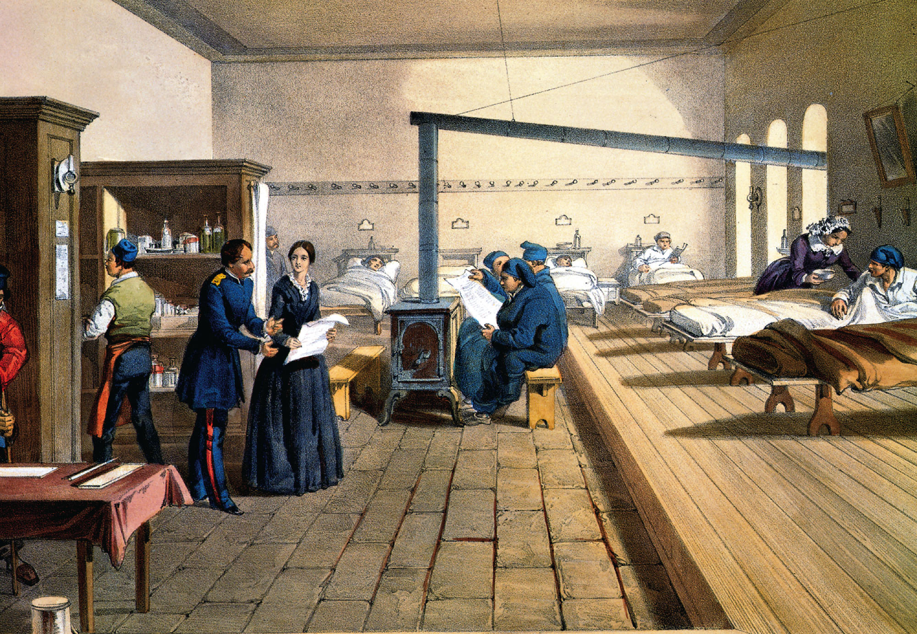
Notes:
Florence Nightingale During Crimean War.
This 1856 lithograph shows Florence Nightingale supervising nursing care in a hospital in Scutari (Uskudar) across the Bosphorus strait from Istanbul. Though the artist may have exaggerated the neatness and cleanliness of the ward, sanitary measures proved the key to Nightingale’s raising of the survival rate of sick and wounded soldiers.

Slide 19
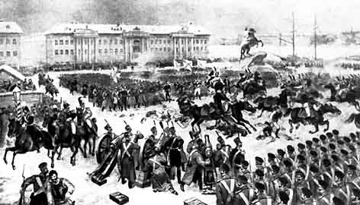
Russian Empire

Slide 20
“Industry”
Agriculturally based
No middle class
Tsar
Elite
Unfree serfs
Majority live in rural areas
1817: better roads appear
1843: steam transportation
1837: first RR
Connect St. Petersburg w/ summer palace of Nicholas I
Finally connects to Moscow
Limited interest in industry
Nicholas I fears rebellion
Military technology
Obsolete weapons
No transportation

Slide 21
Russophobia
Russia looks more like Europe than Ottoman Empire
West fears Russia is a competitor for power in the East
Threat to British India
Slavophiles
Opposed reform
Foundation of Russian society
Orthodox faith
Peasant life
Absolute rule of tsar
Pan-Slavism
Militant political doctrine
Unity of Slavic peoples

Slide 22
Russian Expansion
18th Century: expand east to Pacific Ocean
19th Century: expand south
Southern lands not technologically advanced
Vladivostok established as military outpost and naval port
Georgia, Azerbaijan, Armenia, Chechnya, Abkhazia, Dagestan conquered

Slide 23
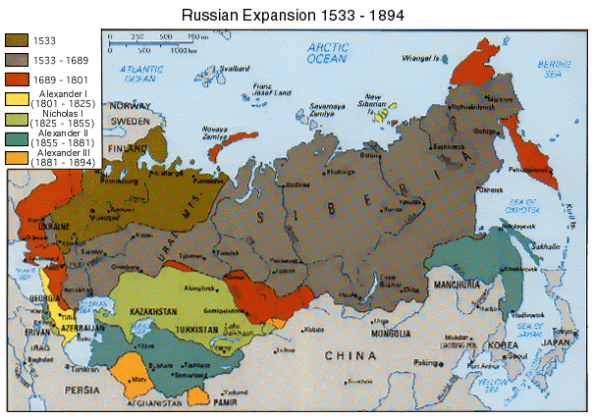

Slide 24
Decembrist Revolt
December 1825: Alexander I dies
Names younger son, Nicholas, as heir
Reformist military officers attempt to take over government
Protesters are killed by gunfire
Nicholas I ignores call for reform

Slide 25
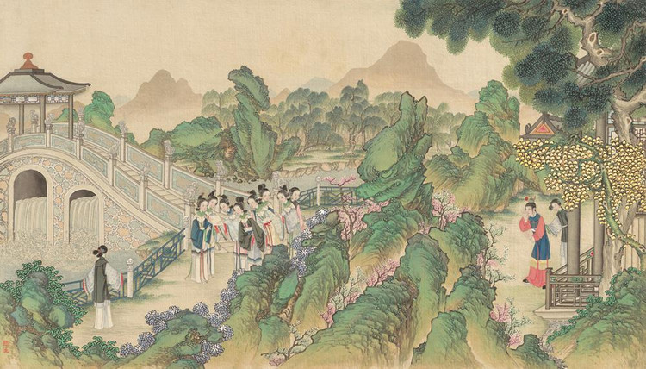
Qing Empire

Slide 26
Unrest
Population strain
Government take over of land
Localized policing due to corrupt officials
White Lotus Rebellion
1794-1804
Wanted to overthrow the Manchu Qing Dynasty
Return of the Ming and Buddha

Slide 27
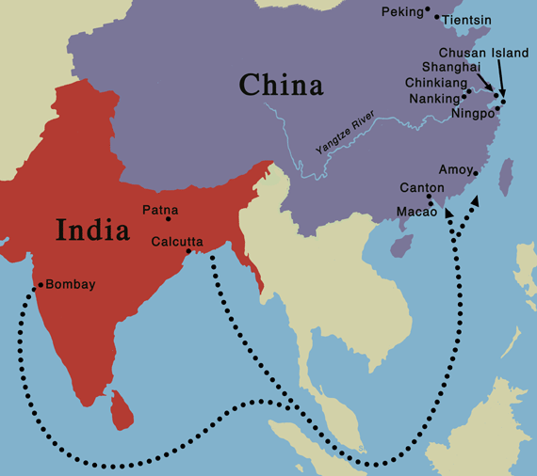
Opium War
Highly addictive drug (poppy seeds)
1729: Qing passed laws banning opium
1800: Amount of smuggled opium reaches 4000 chests
British India
Silver acquired fuels Industrial Revolution
Entire population affected by opium addiction by 1830s

Slide 28
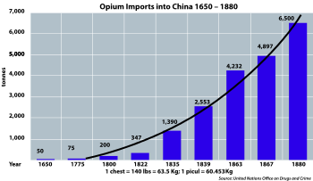

Slide 29
Opium Response
China
England
Government: tax it and create a government monopoly or ban it?
Li Tse-Hsu
Sent to end opium trade
1838-1839
Canton (Guangzhou)
Arrests addicts and dealers
Forces foreign merchants to end trade
Refusal to accept ban
Affected England’s economic well-being
Sent navy to China for war
Superiority of British military
Modern weapons
Chinese Bannermen were hereditary soldiers similar to Ottoman Janissaries
No Chinese navy

Slide 30
Treaty of Nanking
Ended Canton system
Britain can only trade at Canton (Guangzhou)
Opened four more Chinese ports to British
Extraterritorial rights
Hong Kong becomes British colony
British in China are not subject to Chinese law
Russia and France eventually gain land
European Zones
Chinese not permitted to live, eat, etc in certain areas
Christian missionaries “subvert” Confucian beliefs

Slide 31
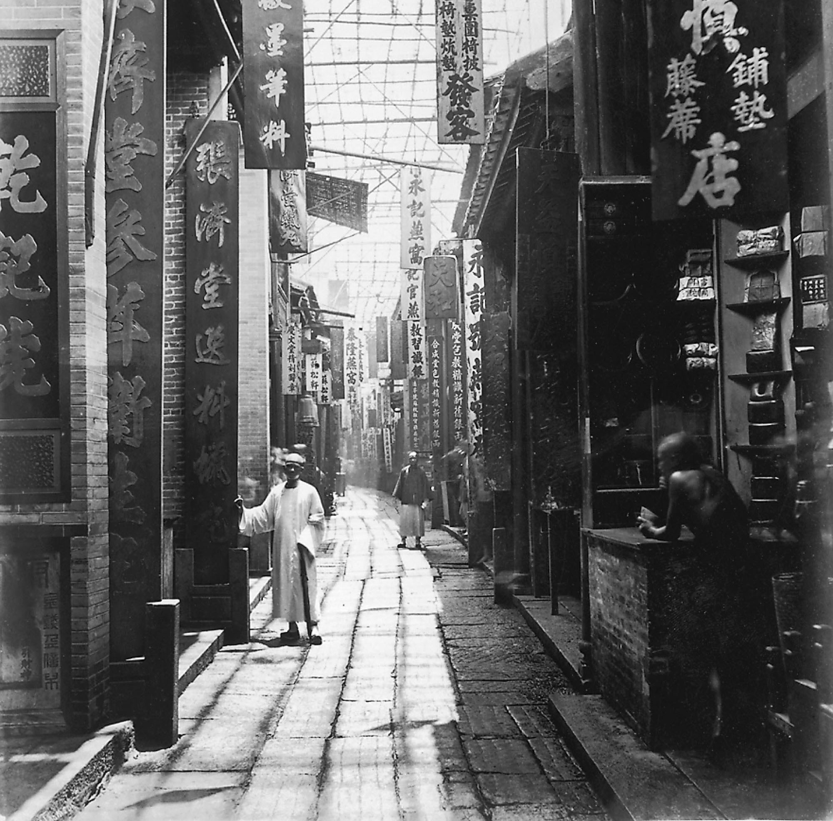
p. 678
Notes:
Street Scene in Guangzhou.
This photograph taken in the 1860s by an Englishman shows a comparatively wide market street with signs advertising drugs, cushions, seals, ink, etc. The engraving of a Cairo street scene (page 668) shows a much more exotic stereotype of the orient, complete with young girl displaying her body while covering her face.

Slide 32
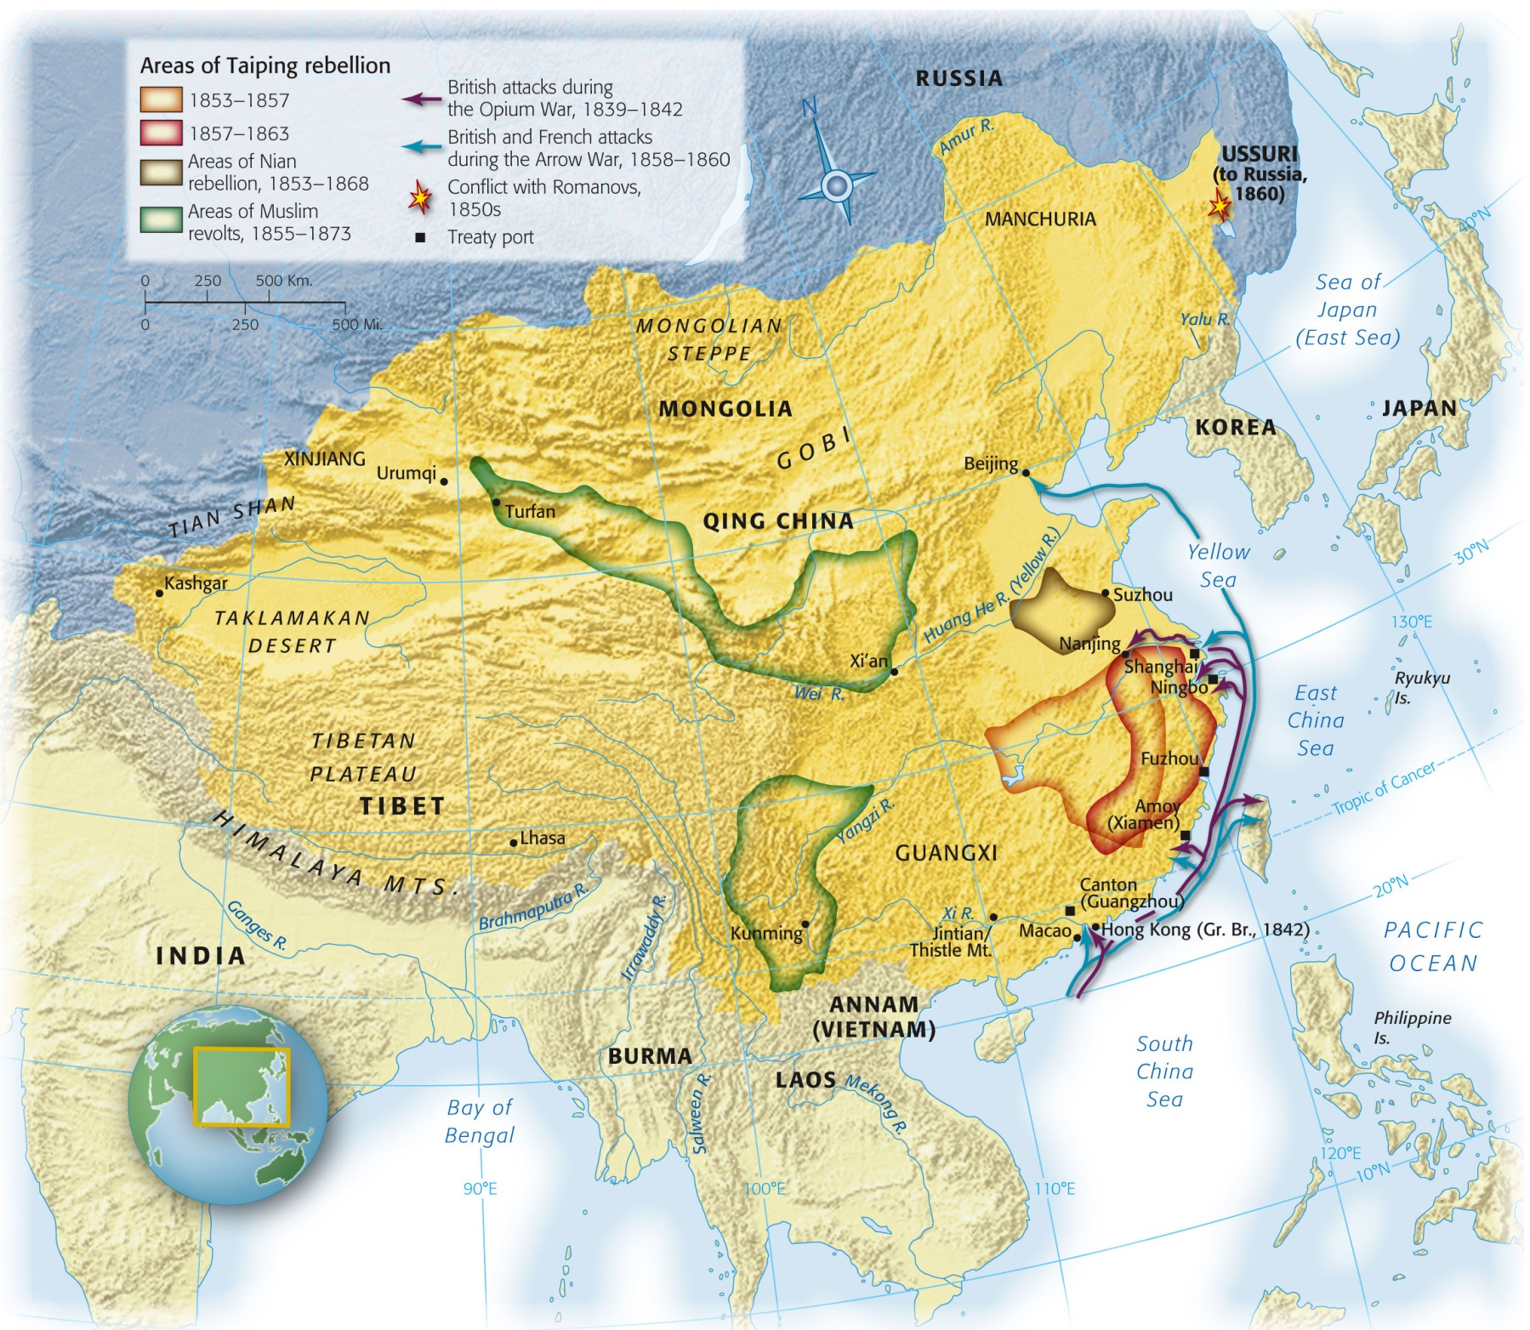
Map 25-2, p. 676
Notes:
Map 25.2: Conflicts in the Qing Empire, 1839–1870.
In both the Opium War of 1839–1842 and the Arrow War of 1856–1860, the seacoasts saw most of the action. Since the Qing had no imperial navy, the well-armed British ships encountered little resistance as they shelled the southern coasts. In inland conflicts, such as the Taiping Rebellion, the opposing armies were massive and slow moving. Battles on land were often prolonged attempts by one side to starve out the other side before making a major assault.

Slide 33
Hong Xiuquan
Failed civil service exam 3 times
Nervous breakdown
Saw himself as Jesus’ younger brother
Sent by God to drive the Manchu (Qing) out of China
“Taiping Tianguo”:Heavenly Kingdom of Great Peace
Taiping Rebellion

Slide 34
Taiping Rebellion
Forced loyalty of small villages
Segregation of men and women
Women to participate in farming and battle
Offended Confucian ideals
1853: Conquered Nanjing
Qing surrounded new Taiping capital
Taiping well supplied and fortified
Not enough to topple Qing

Slide 35
Arrow War
Second Opium War
China doesn’t “hold up their end of the deal” after First Opium War
British and France vs. China
Invasion of Beijing
After Chinese defeat, GB and France join forces against Taipings

Slide 36
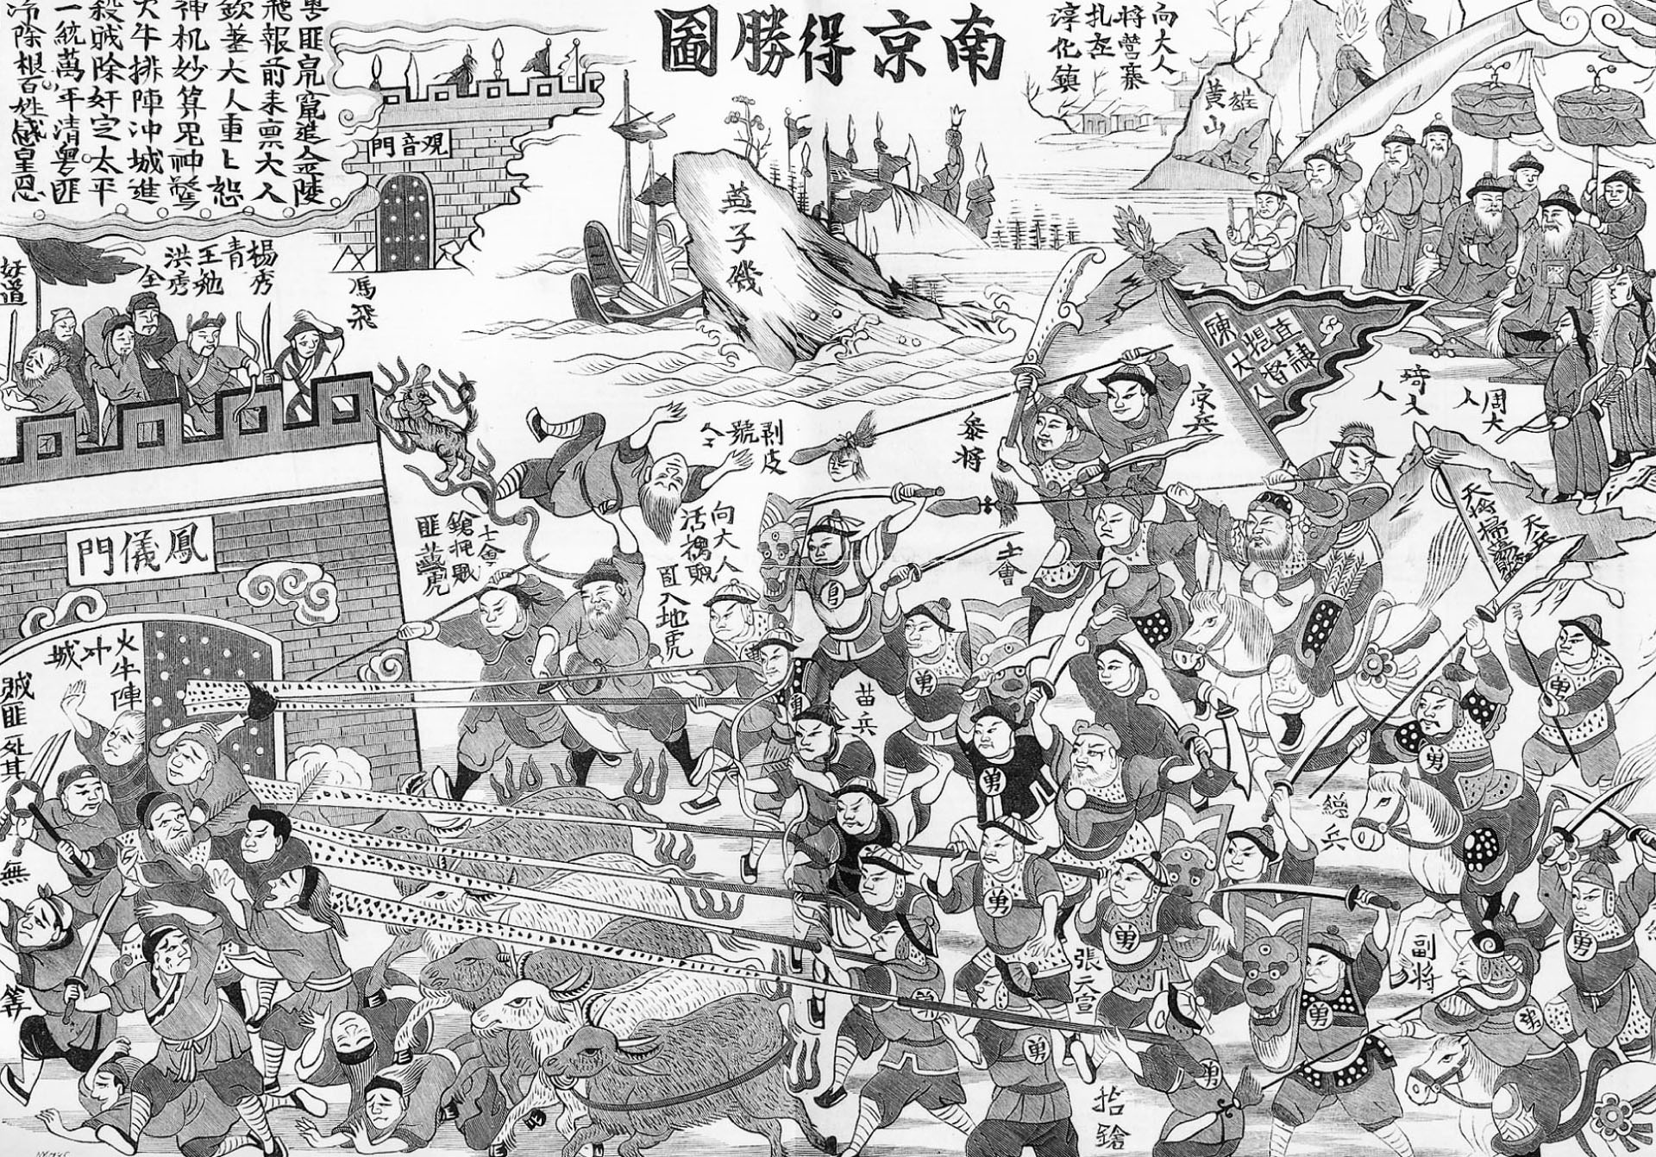
p. 677
Notes:
Nanjing Encircled.
For a decade the Taipings held the city of Nanjing as their capital. For years Qing and international troops attempted to break the Taiping hold. By the summer of 1864, Qing forces had built tunnels leading to the foundations of Nanjing’s city walls and had planted explosives. The detonation of the explosives signaled the final Qing assault on the rebel capital. As shown here, the common people of the city, along with their starving livestock, were caught in the crossfire. Many of the Taiping leaders escaped the debacle at Nanjing, but nearly all were hunted down and executed.

Slide 37
After the Taiping
Bubonic Plague
Taiping followers spread plague to Singapore, San Francisco, Calcutta, London
Chinese Exclusion Acts (US)
Destruction
Agricultural land (depopulation)
Art, architecture, literature destroyed
Yellow River
Changes course
Flooding and drought

Slide 38
Fall of Qing
Decentralization
Provincial governors
Dowager Empress Cixi
Supported reform and provincial governors
Zeng Guofan
Looked to model of US
Emphasis on education
American advisors

Slide 39
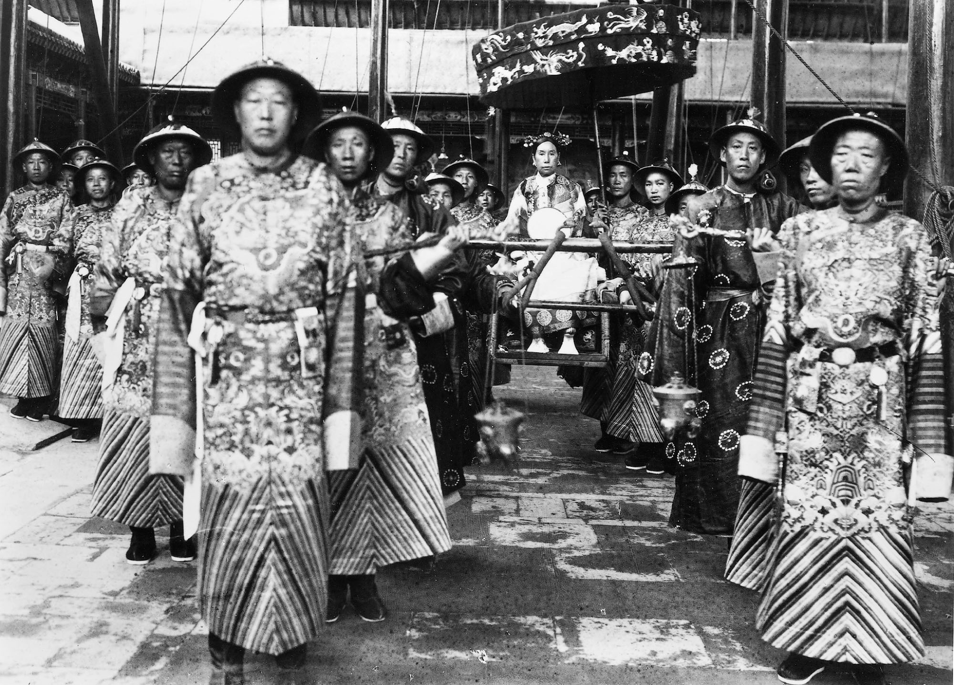
p. 679
Notes:
Cixi’s Allies.
In the 1860s and 1870s, Cixi was a supporter of reform (see page 682). In later years she was widely regarded as corrupt and self-centered and as an obstacle to reform. Her greatest allies were the court eunuchs. Introduced to palace life in early China as managers of the imperial harems, eunuchs became powerful political parties at court. The first Qing emperors refused to allow the eunuchs any political influence, but by Cixi’s time the eunuchs once again were a political factor.

