Slide 1
Africa, India, and the New British Empire
1750-1870

Slide 2
Imperial Policies
Emphasis on trade rather than territory
Colonies were to serve as ports
Emphasis on free trade rather than mercantilism
Mercantilism: government regulation of trade
Laissez faire: no / little government intervention in trade
African exports
Oils, ivory, coffee, cocoa, tea, sugar, cotton
Received cheap manufactured goods in return
Clipper ships
Faster, larger ships constructed with iron and wood
Lowered shipping costs

Slide 3
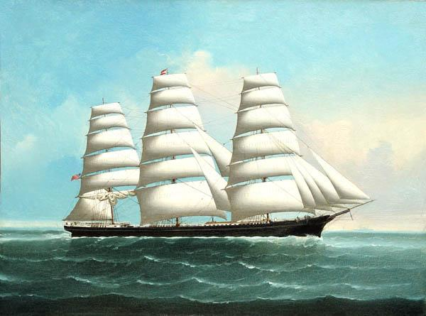

Slide 4
Africa

Slide 5
Independent African Regions
Zulu
Sokoto Caliphate
1818: Shaka gains control of area
Military genius
Powerful and feared across southern Africa
Raided neighboring countries
Lesotho and Swaziland created to protect themselves from Zulu
Created national identity
Largest Muslim state in West Africa
Muslim reform movement
Usuman dan Fodio
Housa (Nigerian) kings were not truly Muslim
Jihad to overthrow rulers
Center of learning and reform
Participated in trans-Saharan slave trade

Slide 6
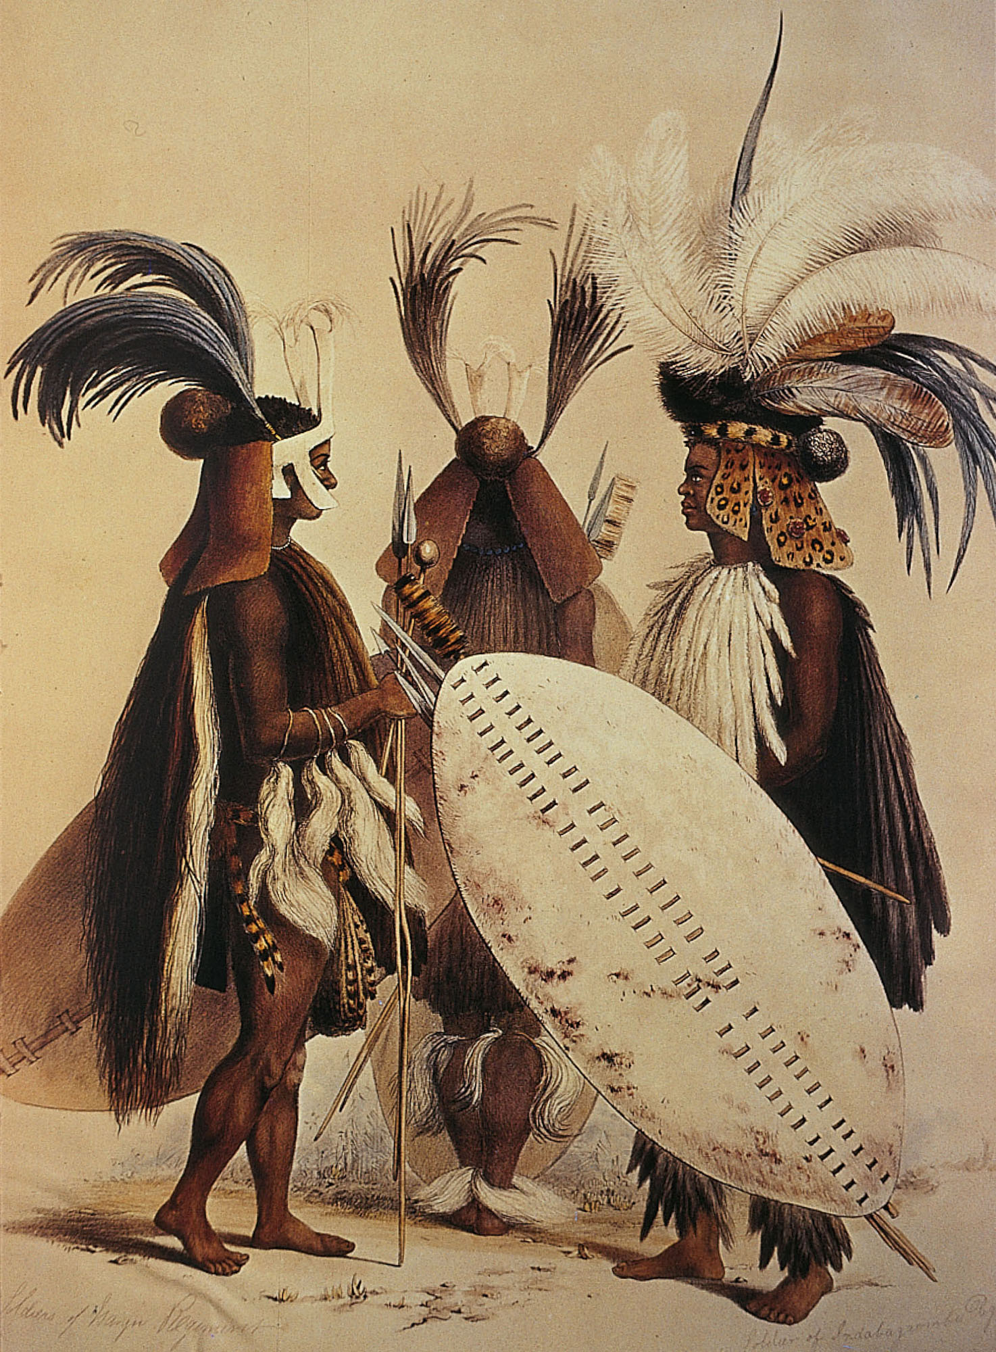
p. 686
Notes:
Zulu in Battle Dress, 1838.
Elaborate costumes helped impress opponents with the Zulus’ strength. Shown here are long-handled spears and thick leather shields.

Slide 7
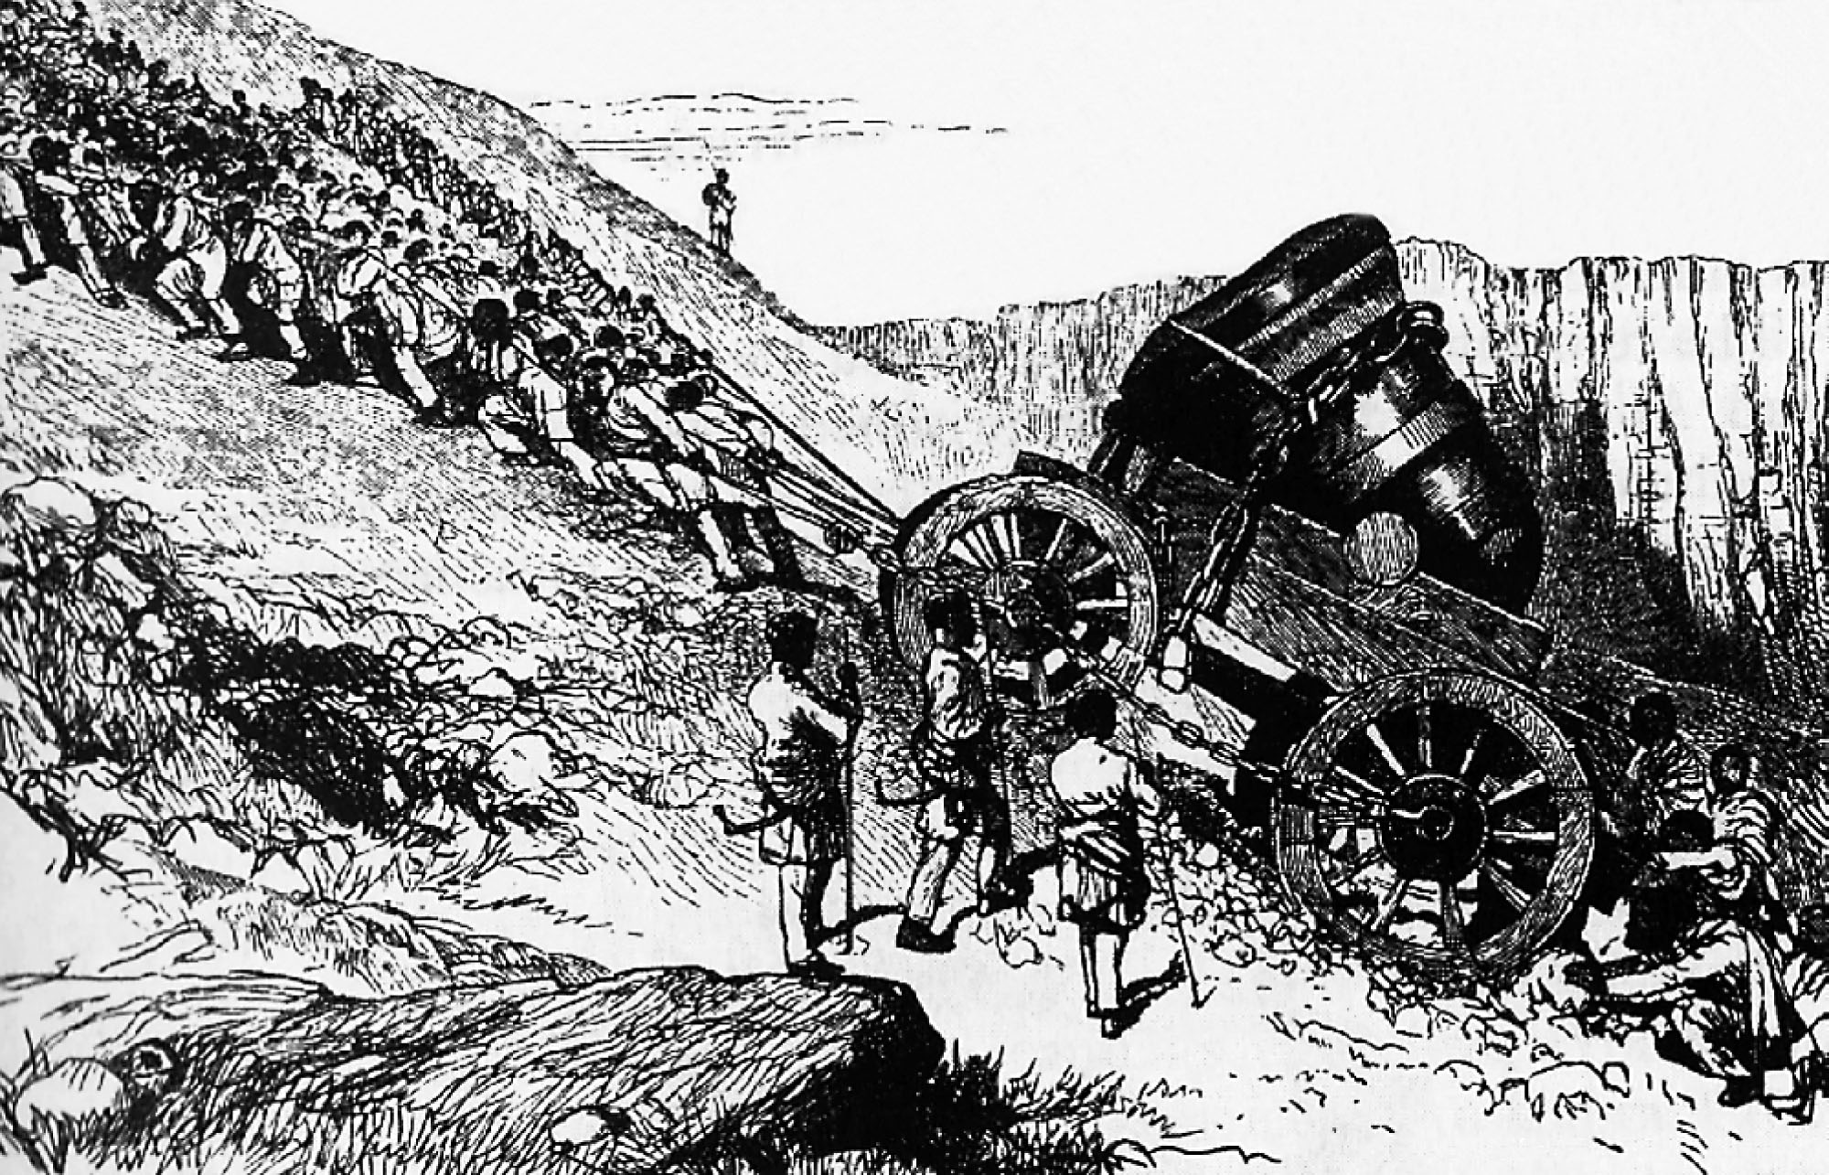
p. 688
Notes:
Téwodros’s Mighty Cannon.
Like other modernizers in the nineteenth century, Emperor Téwodros of Ethiopia sought to reform his military forces. In 1861 he forced resident European missionaries and craftsmen to build guns and cannon, including this 7-ton behemoth. It took five hundred men to haul it across Ethiopia’s hilly terrain.

Slide 8
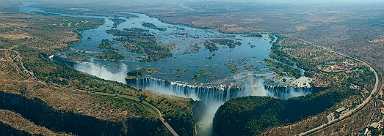
European Exploration
Algeria
Supplied Napoleon with grain during Egyptian conquest
France fails to re-pay the debt
France attacks in 1830
Nationalism
Easy target
Inner Africa
1770-1870
Niger River
David Livingstone
Zambezi River
Victoria Falls
Missionaries
Scramble for Africa

Slide 9
Slave Trade
Trans-Atlantic
Eastern Africa
1807: GB and US make importing slaves illegal
GB becomes “Slave Police”
Established a base in Sierra Leone to police the Atlantic
Captured 1,635 slave ships / liberated 160,000 slaves
“Recaptured” slaves populate the capital of Freetown
Brazil and Cuba continue to import slaves
1867:Trans-Atlantic slave trade finally ends
Zanzibar Island
Center of slave and ivory trade
Ivory sent to India
Clove plantations
Secondary Empires
“Empire” established through the supply of weapons, etc from Europe
Tippu Tip
Zanzibar trader
Personal empire along Congo River

Slide 10
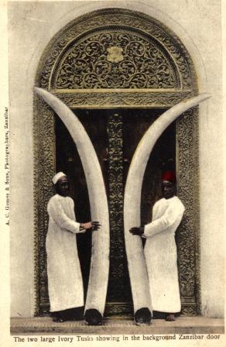
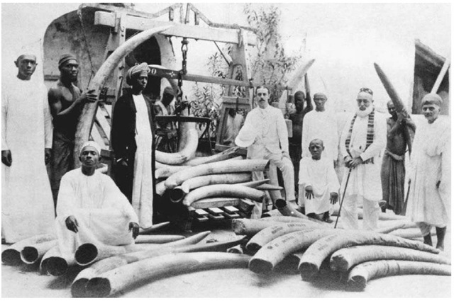
Ivory in Zanzibar

Slide 11
Legitimate Trade
Needed exports other than slaves to continue to get cloth, metal, etc from Europe
Palm Oil
Candles
Soap
Coastal trading
Canoes used to transport palm oil from inner Africa to the coast
Slaves bought to work canoes
Male slaves could control entire canoe houses

Slide 12
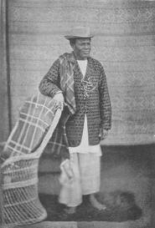
Niger Delta
Becomes leading exporter of palm oil
Brutal conditions for slaves BUT ability for wealth and power
Jaja of Opobo
Canoe slave rose to head of canoe house (palm oil company)
Established his own port of Opobo
Became king of Opobo

Slide 13
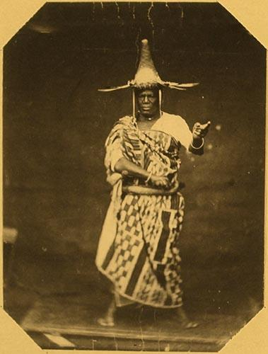
Recaptives
Republic of Liberia (1821)
Free black American settlement
1865: Emancipation of US slaves
Slaves return to Africa and Liberia
Emma White
Kentucky slave
Liberia to Opobo
Secretary to Jaja
Free blacks from Brazil and Cuba
Roman Catholicism
Architecture
Clothing

Slide 14
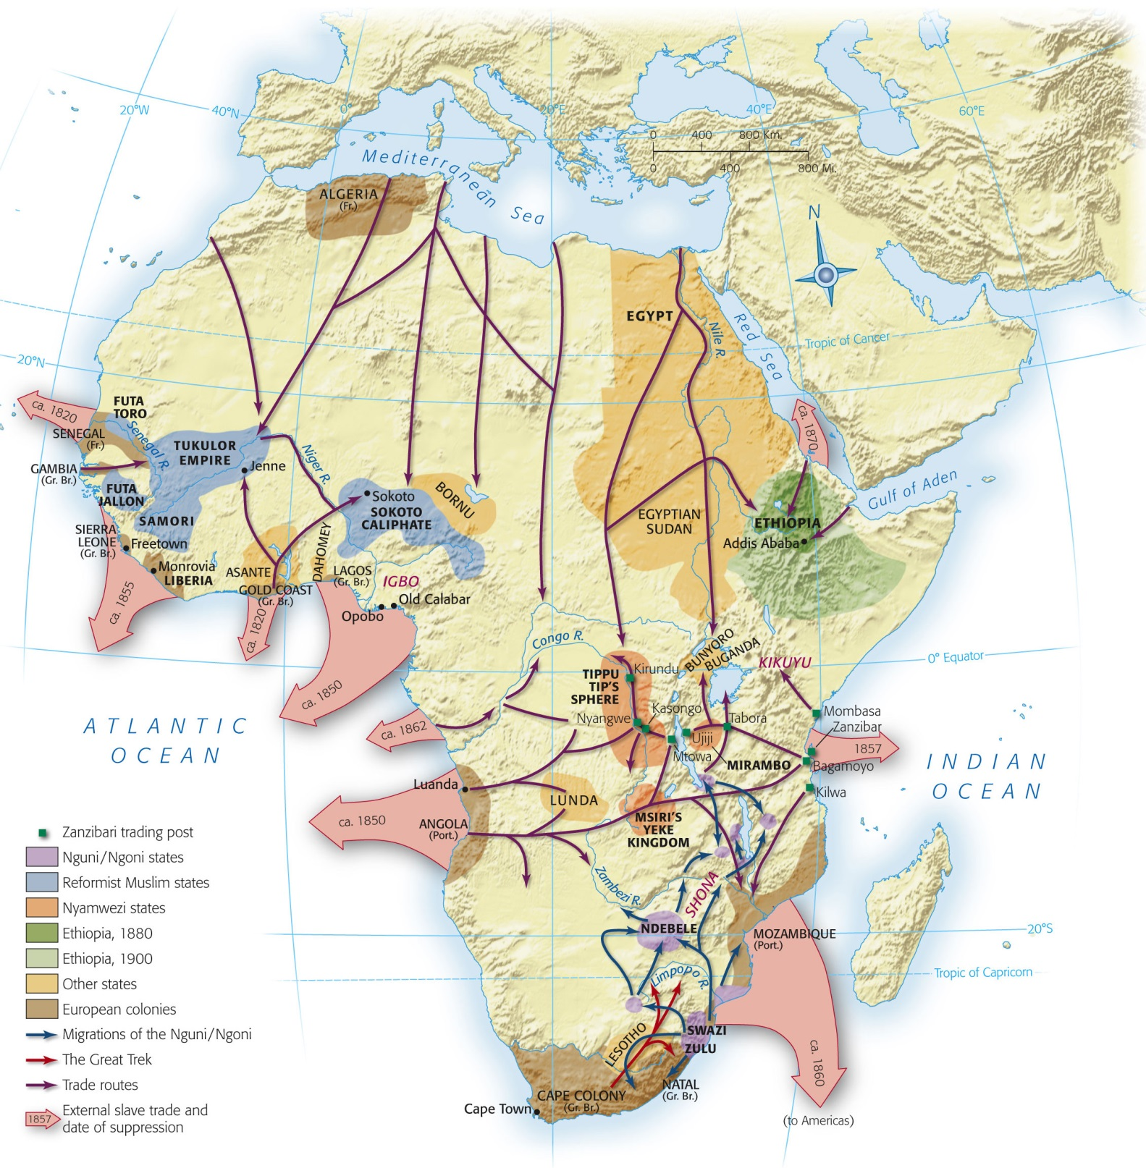
Map 26-1, p. 689
Notes:
Map 26.1: Africa in the Nineteenth Century.
Expanding trade drew much of Africa into global networks, but foreign colonies in 1870 were largely confined to Algeria and southern Africa. Growing trade, Islamic reform movements, and other internal forces created important new states throughout the continent.

Slide 15
India

Slide 16
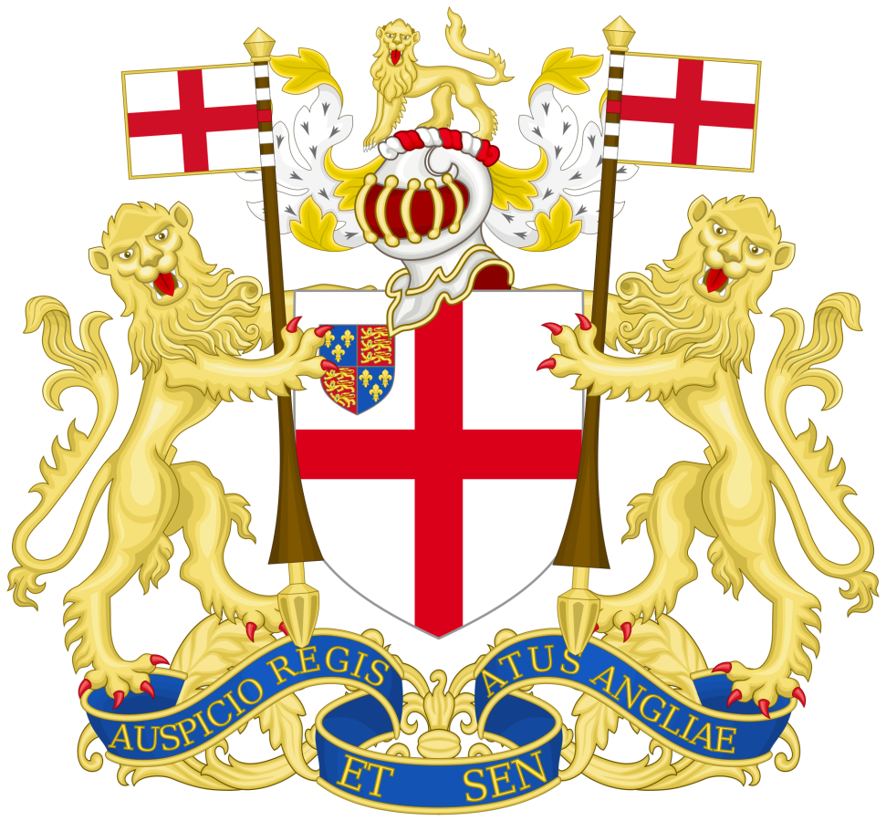
British East India Company
1691: EIC establishes fort in Calcutta, India
Nawab of Bengal agrees
Muslim deputy prince of Mughal emperor
1756: Black Hole of Calcutta
New nawab imprisons EIC men
Many die of suffocation
Robert Clive avenges death and overthrows nawab
1765: Mughal emperor recognizes EIC right to rule Bengal

Slide 17
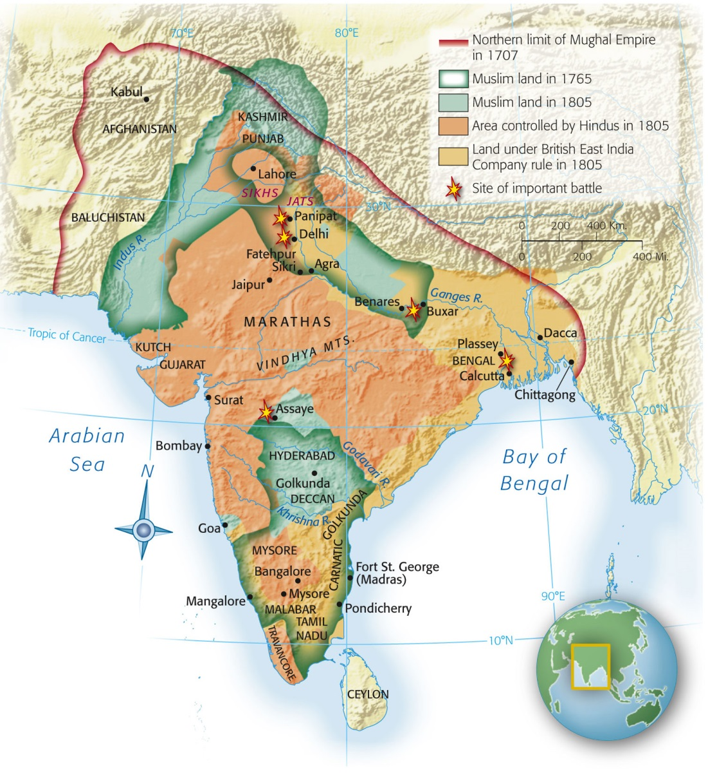
British East India Company
Madras
Southern India
Clive ensures that nawab is sympathetic to EIC
Gain advantage over the French
Bombay
3rd major power center for Britain in India
Bombay Presidency
Nawabs accept control of EIC
Notes:
Map 26.2: India, 1707–1805.
As Mughal power weakened during the eighteenth century, other Indian states and the East India Company expanded their territories.

Slide 18
British Raj (1818)
More people than all of Western Europe
50x population of American colonies
Create a new Britain in India
Social, economic, technology
Military power
“Traditions” (new and old)
Indian princes got greater power than ever before under Mughals
Elaborate parades that showcased the splendor of the empire
Oppression and new jobs
Bengal: opium
Ceylon: coffee
Assam: tea
Death of Indian textile industry

Slide 19
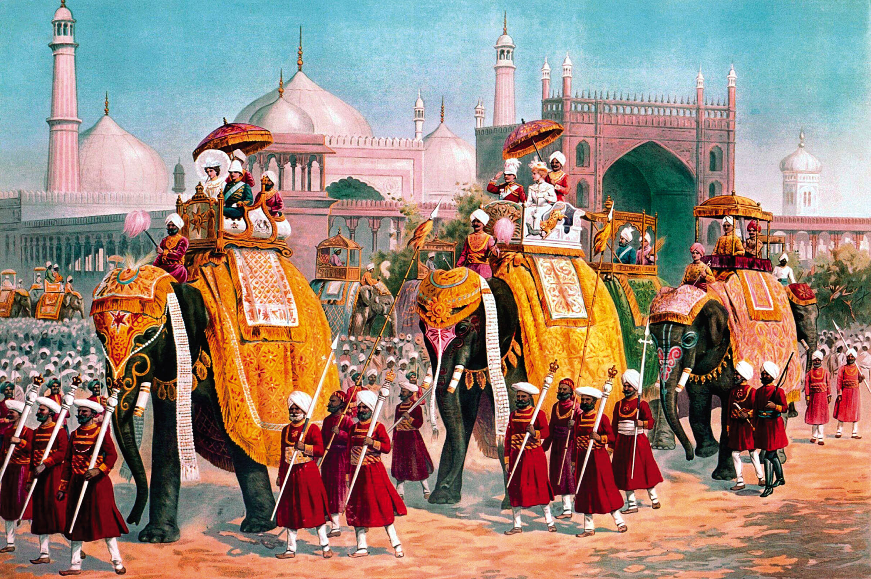
p. 698
Notes:
Delhi Durbar, January 1, 1903.
The parade of Indian princes on ornately decorated elephants and accompanied by retainers fostered their sense of belonging to the vast empire of India that British rule had created.

Slide 20
Indian Civil Service and Nationalism
Civil Service
Nationalism
Powerful bureaucracy
Recruitment by open examination
BUT exam given in England
1870: only one member of ICS was Indian
Pan-Indian nationalism
Rammohun Roy
Reconcile West with Indian/Hindu traditions
Caste system reform
Sati outlawed
Established schools
Indian National Congress
“It is this consciousness of the inherent superiority of the European which had won for us India. However well educated…a native may be…no rank we can bestow on him would cause him to be…an equal of the British officer”
-Lord Kitchener, Commander in Chief of Indian Army (1892)

Slide 21
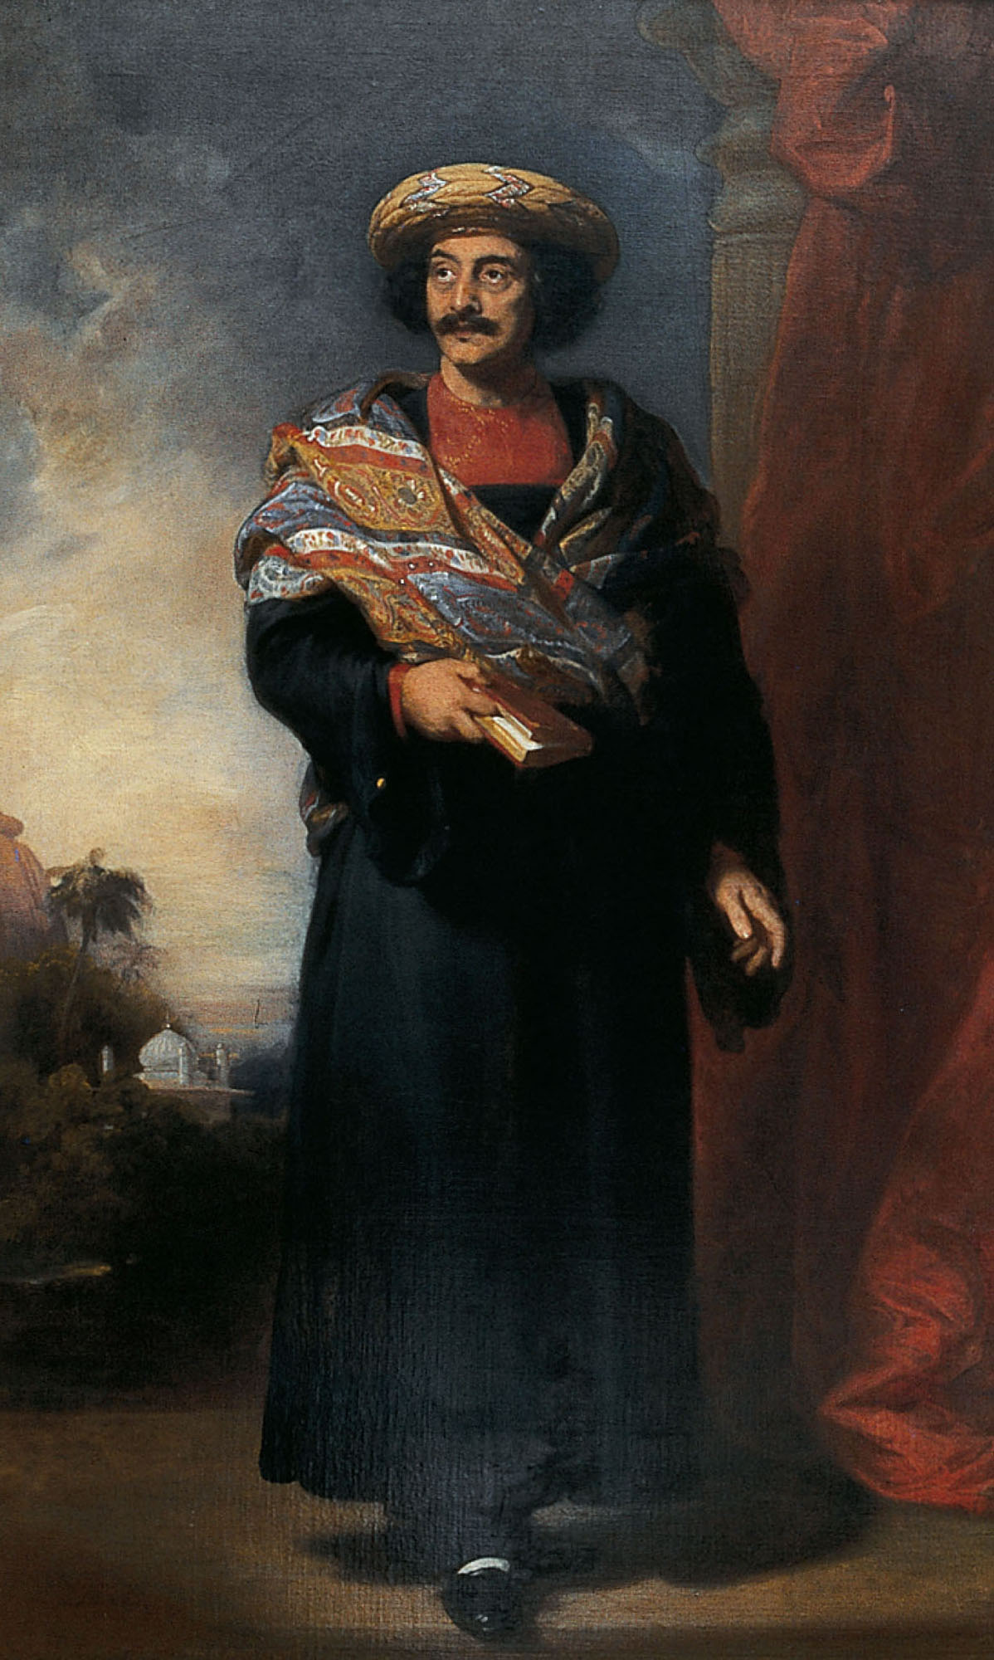
Sepoy Rebellion
Sepoy: trained Indian troops
Used by the British to protect warehouses from attack
Modern weapons and fighting techniques
Most came from Bengal
1848: other ethnicities added to ranks
Resentment of Indians
Hindus and Muslims offended
Ocean travel
Animal fat greased ammo cartridges
Hindus, Muslims, peasants, elites rise against the British Empire
Notes:
Rammohun Roy.
This portrait of the Indian reformer emphasizes his scholarly accomplishments and India’s traditional architecture and natural beauty.

Slide 22
Railroads
1840s: first national transportation network
Owned by British companies
Opposition: Mixing of castes, races, genders
Cholera
Spread by contaminated water
Kala mari (black death)
Punishment from being conquered by British
New sewage system and water filtration system by 1860s

Slide 23
Eastern British Empire

Slide 24
British Domination (Indian Ocean)
Destruction of former dominance
France
French Revolution
Napoleon
Mauritius and Reunion*
Netherlands
Allowed GB to take over to keep out of French hands
Dutch Guiana and Trinidad
Java* (Center of Dutch empire)
*eventually returned to France/Netherlands

Slide 25
Afrikaners
Settlers of European descent / permanent residents of Africa
Cape Colony
Cape Town
Important port for travel to India
Prohibition for whites to settle past Cape (fear of war)
Great Trek (1836-1839)
Afrikaners leave Cape for fertile lands to the north
Orange Free State
Transvaal
Natal

Slide 26
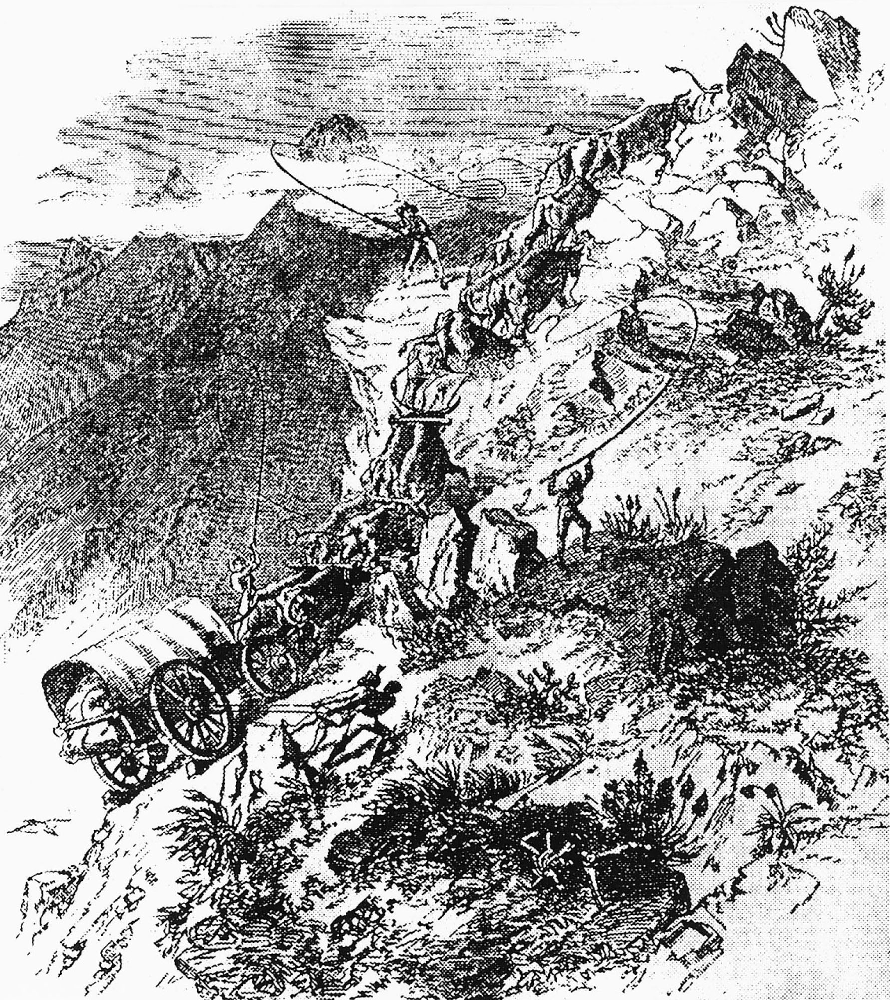
p. 701
Notes:
Great Trek.
Aided by African servants, the ox-drawn wagons of the Afrikaners struggled over the Drakensberg Mountains to the high plains in an effort to escape British control.

Slide 27
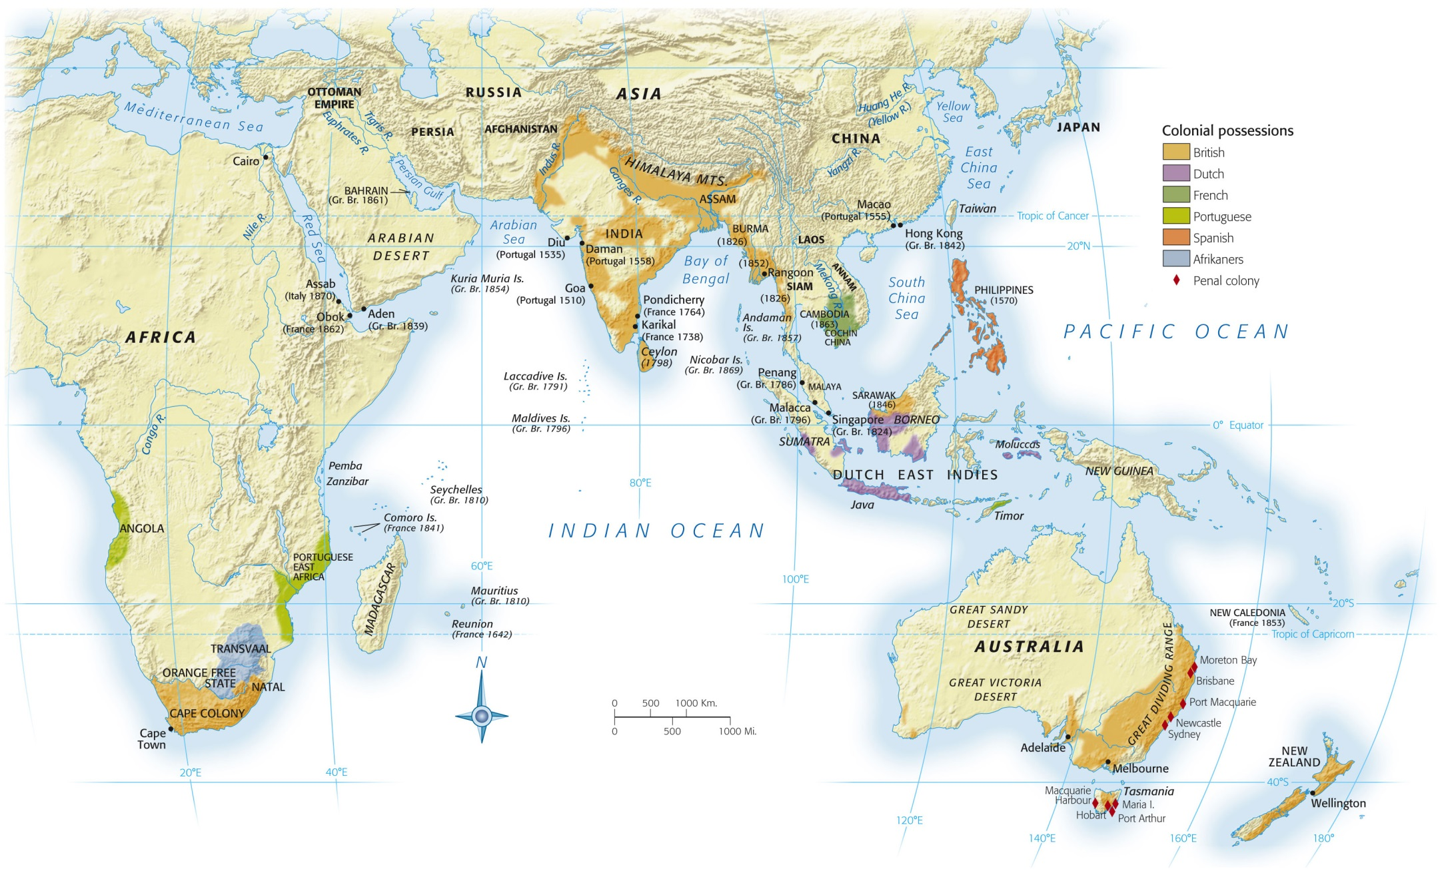
Map 26-3, p. 702
Notes:
Map 26.3: European Possessions in the Indian Ocean and South Pacific, 1870.
By 1870 the British controlled much of India, were settling Australia and New Zealand, and possessed important trading enclaves throughout the region.

Slide 28
Australia and New Zealand
Islands inhabited by Melanesian descendants
Vulnerable to diseases of Europeans
Called “aborigines” by the British
Captain James Cook
Explored/discovered New Zealand
Australia
First permanent British settlers = 736 exiled convicts
1851: GOLD!
Free settlers come to find fortunes
New Zealand
Longer to settle
Seal/whaling trade

Slide 29
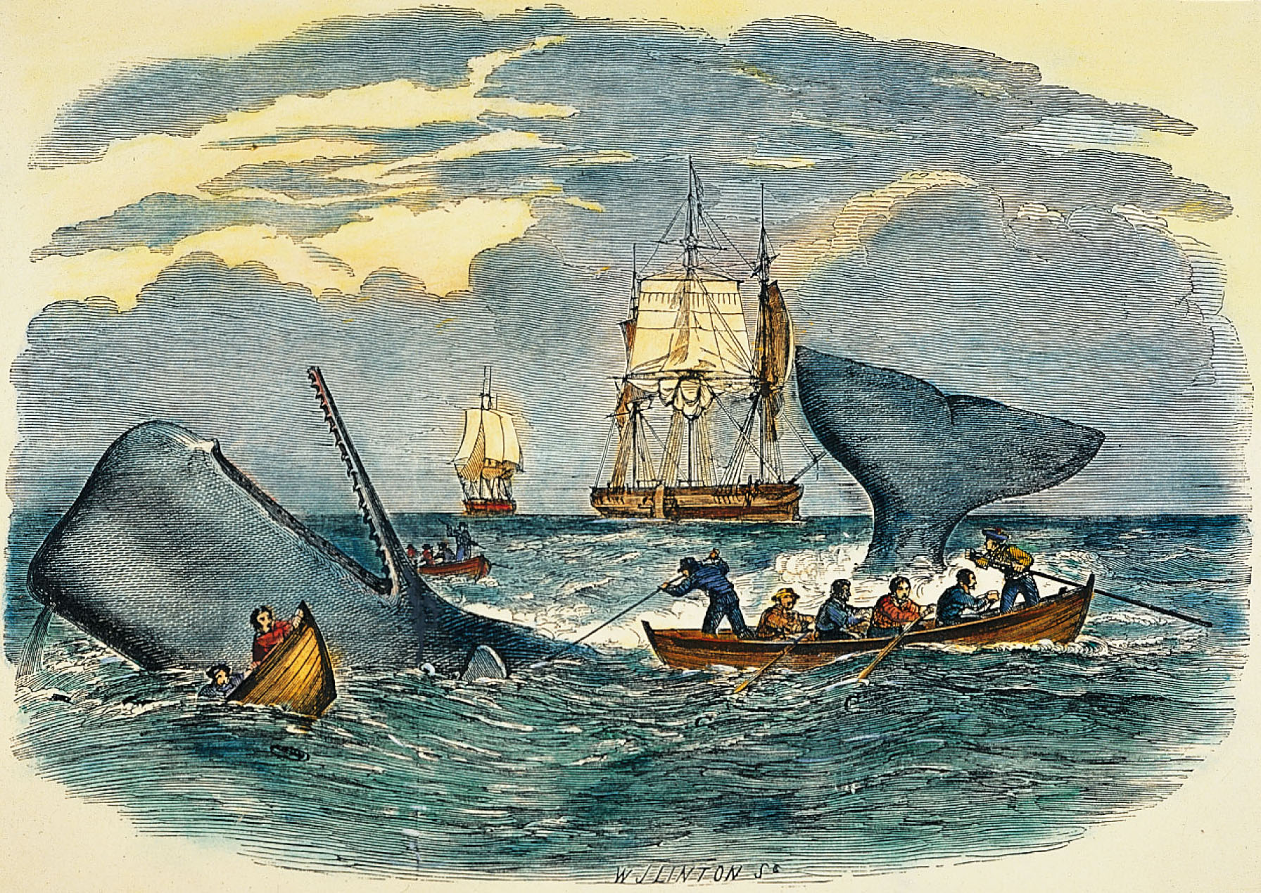
p. 705
Notes:
South Pacific Whaling.
One boat was swamped, but the hunters killed the huge whale.

Slide 30
Review
India feels impact of European expansion more profoundly than Africa

