Slide 1
The New Imperialism
1869-1914

Slide 2
New imperialism
Explosion of TERRITORIAL conquest
1869-1914
10 million mi²
150 million people
More/quicker than Spanish conquistadores
Brought dependent countries into world economy
Producer of raw materials/food

Slide 3
Motives
Political
France: reestablish prestige of nation
GB: protect India and large empire
Germany: important countries need overseas empires
Cultural
Westernize and convert the heathens
Racism
Superiority of Western ideas, customs, culture, race
Social Darwinism (ch 27)
Economic
Industrialization required raw materials
Copper, coal, gold, diamonds

Slide 4
Imperialist TOols
Canals
Steamboats
Industrial Revolution
Quinine
Prevented death from malaria
Superior firearms
Battle of Omdurman (Sudan)
40,000 Sudanese
Spears, single shot muskets
British
20 machine guns and 4 artillery
Killed 11,000 Sudanese
Only 48 British dead

Slide 5
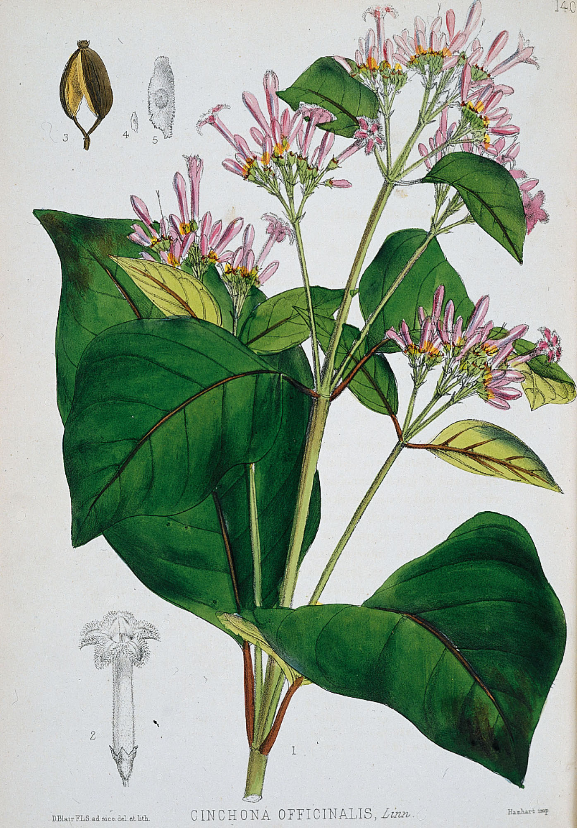
Branch of a Cinchona Tree
The bark of the cinchona tree was the source of quinine, the only antimalarial drug known before the 1940s. Quinine made it much safer for Europeans to live in the tropics.

Slide 6
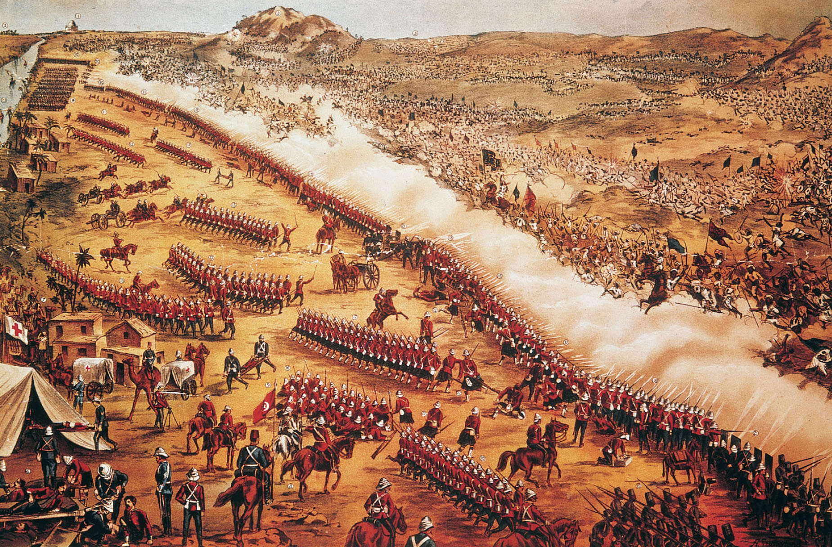
p. 743
Notes:
The Battle of Omdurman.
In the late nineteenth century, most battles between European-led troops and African forces were one-sided encounters because of the disparity in the opponents’ firearms and tactics. The Battle of Omdurman in Sudan in 1898 is a dramatic example. The forces of the Mahdi, some on horseback, were armed with spears and single-shot muskets. The British troops and their Egyptian allies, lined up in the foreground, used repeating rifles and machine guns able to shoot much farther than the Sudanese weapons. As a result, there were many Sudanese casualties but very few British and Egyptian casualties.

Slide 7
The Scramble for AFrica

Slide 8
European Intervention
1879: Africans rule more than 90% of Africa
1889: European powers control the majority of Africa
1914: only Ethiopia and Liberia are free from European control

Slide 9
Suez canal
1869: Ismail, khedive of Egypt
Invites world dignitaries to the opening of the canal
Wanted to emphasize equality and harmony of world powers
Stimulated shipping and ship building

Slide 10
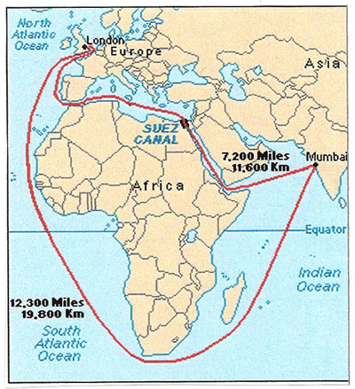
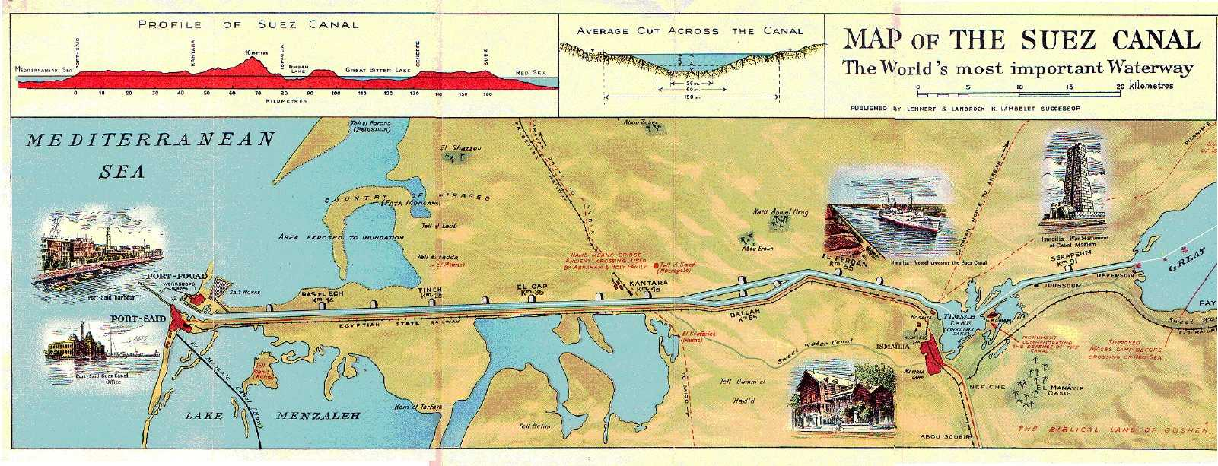

Slide 11
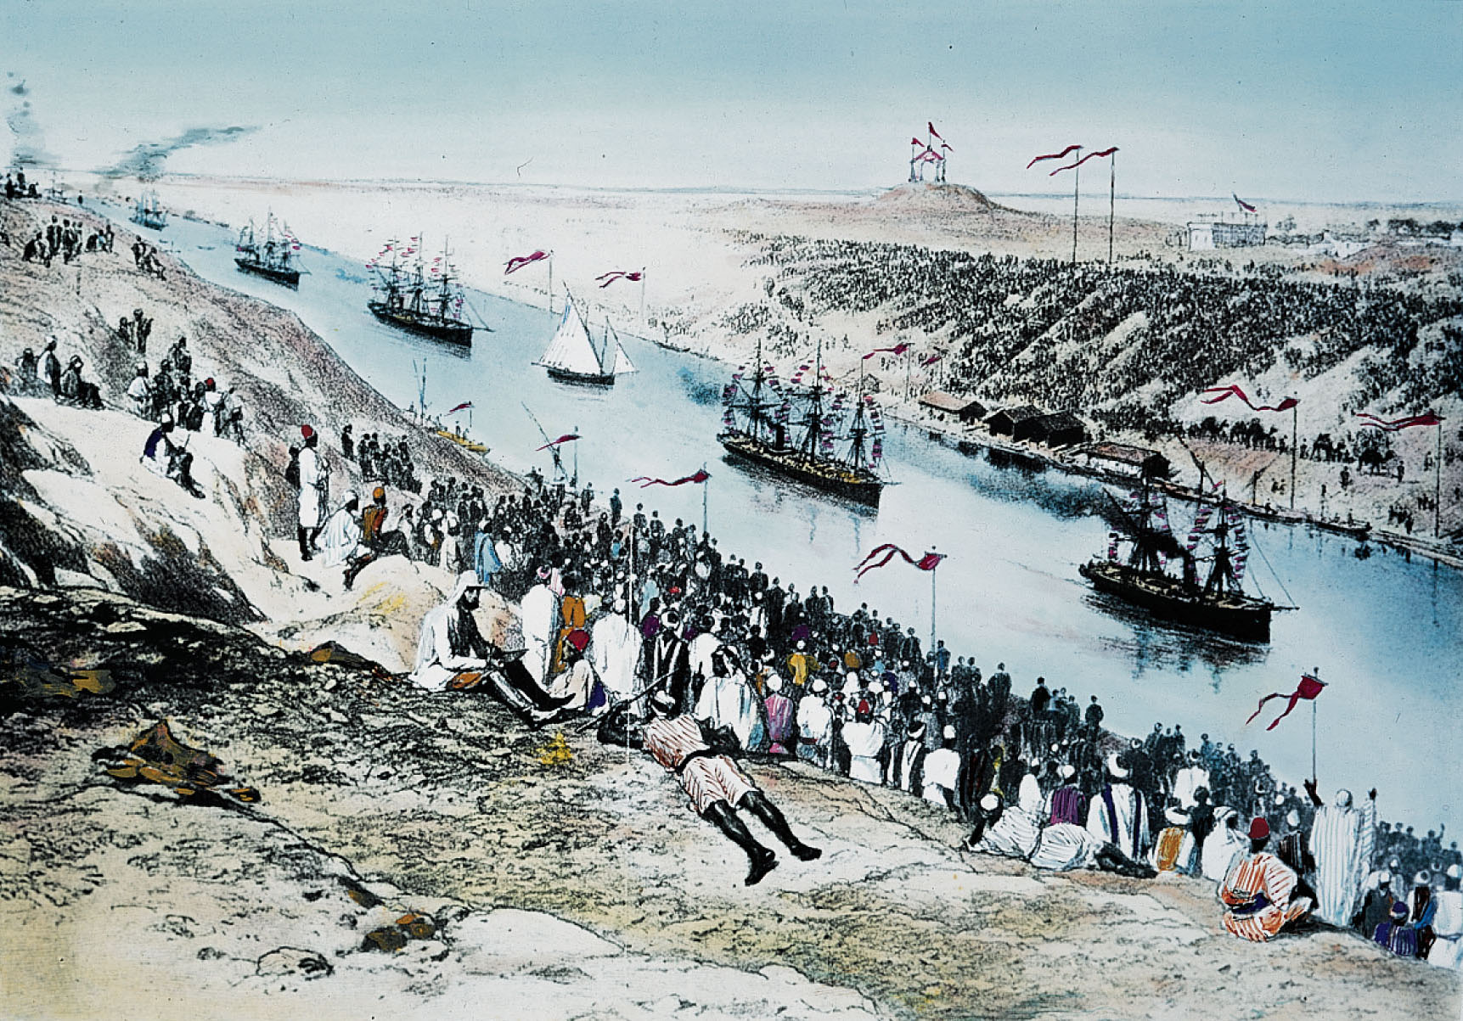
Notes:
Opening the Suez Canal.
When the canal opened in 1869, thousands of dignitaries and ordinary people gathered to watch the ships go by.

Slide 12
Egypt
European involvement stems from Egyptian wishes to free itself from Ottoman Empire
Modernization = $$$$$$$$$$
Loans from Europe
Sells Suez Canal shares to GB
British rule indirectly
Build dam across Nile at Aswan
Cotton production
Egyptians view British rule as worse than Ottoman rule

Slide 13
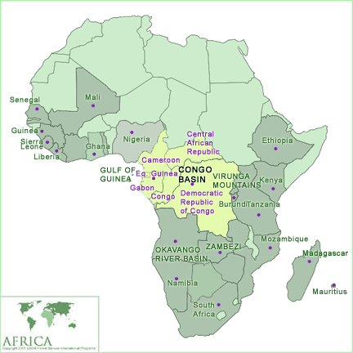
Congo Basin
Henry Morton Stanley (US) and King Leopold II (Belgium)
Want to open up interior of equatorial Africa
Trading posts on Congo River
Savorgnan de Brazza (Italian in French army)
Obtains treaty that places area under French protectorate

Slide 14
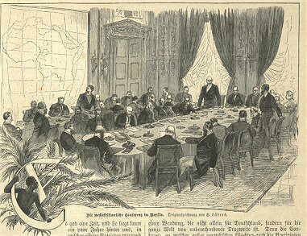
Notes:
Berlin Conference

Slide 15
Berlin Conference
Called by Bismarck
Major powers agreed to “effective occupation”
Replaces old treaties between European powers and African nations
Countries with “colonial ambitions”
MUST send troops to Africa to participate in division
Leopold receives Congo Free State

Slide 16
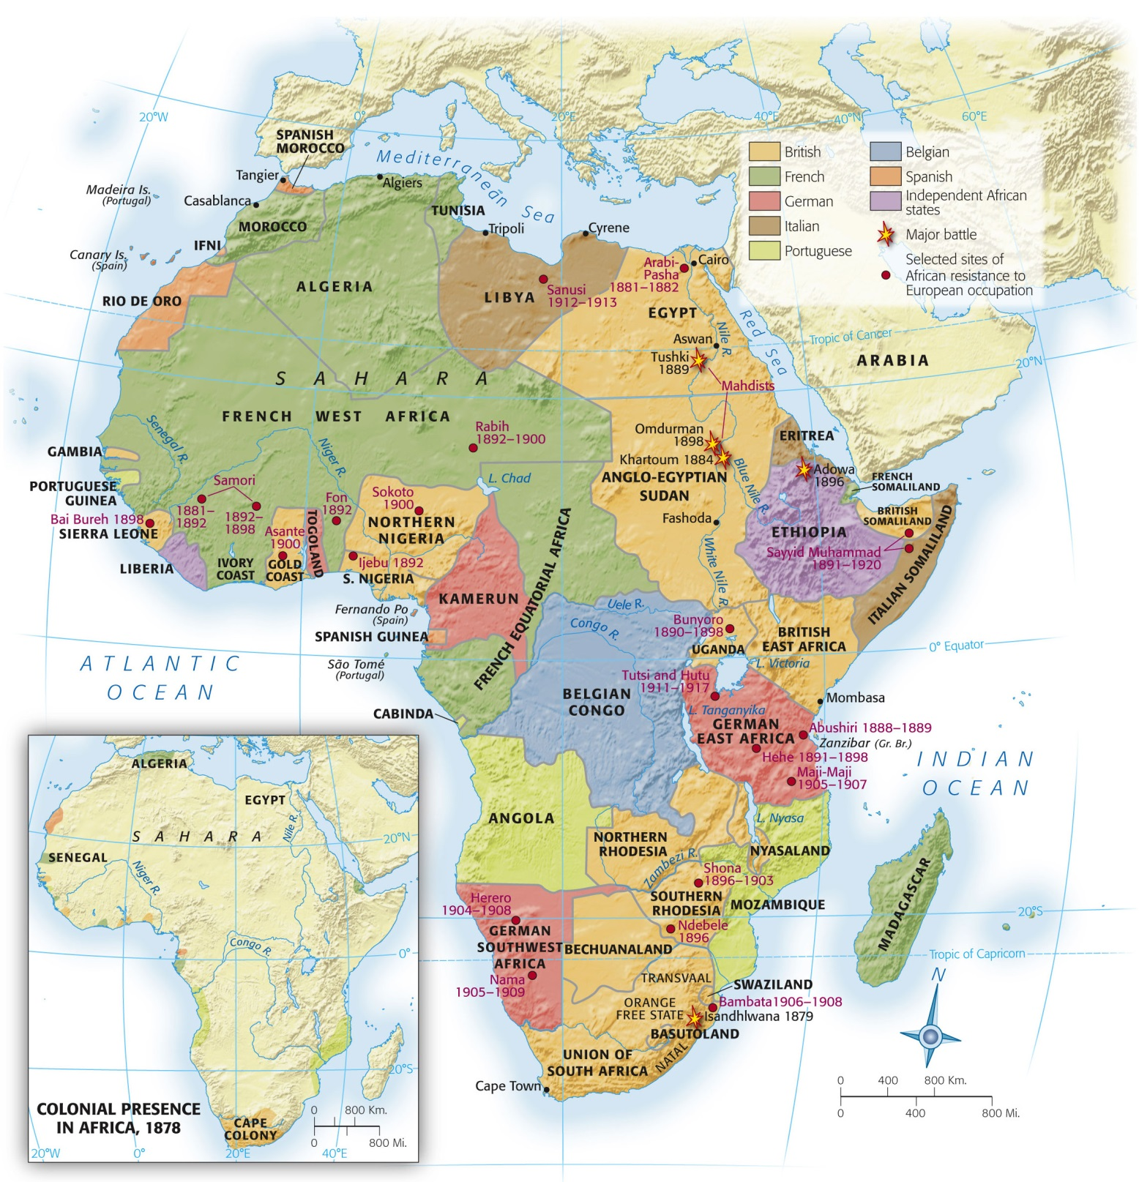
Map 28.1: Africa in 1878 and 1914.
In 1878 the European colonial presence was limited to a few coastal enclaves, plus portions of Algeria and South Africa. By 1914, Europeans had taken over all of Africa except Ethiopia and Liberia.

Slide 17
Trade
West Africa
Equatorial Africa
Existing trade networks
Taxing of merchants/farmers
Gold Coast (GB) cocoa
Little existing trade
Congo Free State, French Congo, Portuguese Mozambique/Angola
Private companies given land
Free from outside intervention
HORRIBLE treatment of natives

Slide 18
DIAMONDS
Southern Africa = El Dorado of Africa
1868: Kimberley annexed by GB
Angered Afrikaans
Confronted and defeated Xhosa and Zulu
Transvaal and Orange Free State
South African War
GB crushed Afrikaans
Cecil Rhodes
Wanted to “annex the stars”
Founded De Beers Consolidated
STILL leading producer of diamonds
Northern and Southern Rhodesia (Zambia and Zimbabwe)
Notes:
Afrikaans ultimately become leaders of the new Union of South Africa
Natives Land Act-moves Africans to reservations

Slide 19
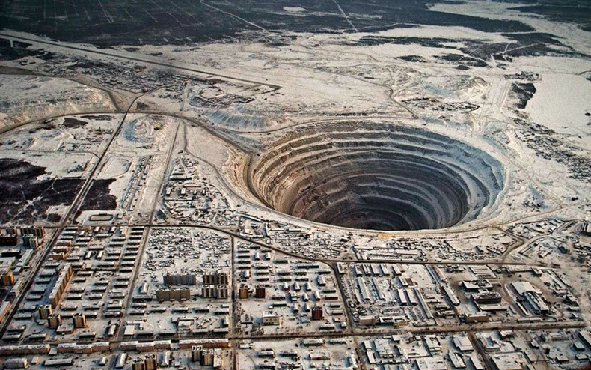

Slide 20
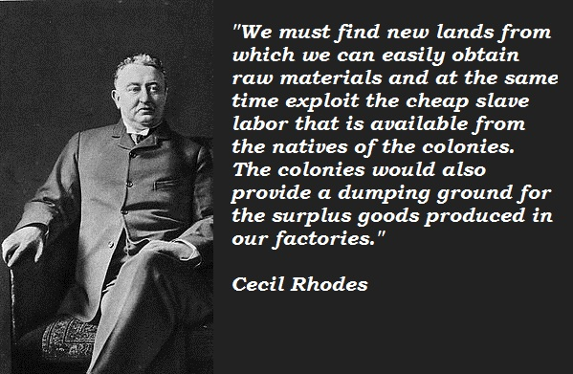
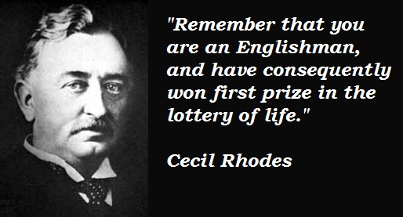

Slide 21
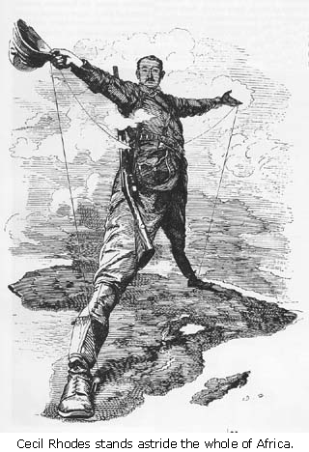

Slide 22
Response
Welcome of European powers as allies against traditional enemies
Zulu and Herero
Traditional warrior nations
Fought against invaders
Ethiopia
Menelik
Modern weapons and trained armies

Slide 23
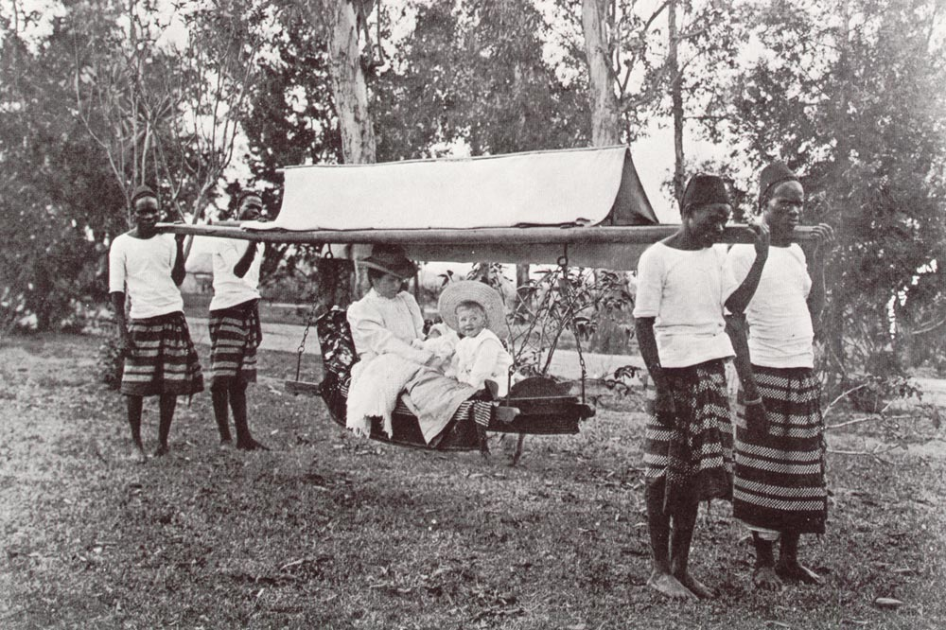
Land and Labor
White settlers force Africans from land
Reservations
LOW payment for labor
High taxes
Migrants
Men
Women/children stayed home
Divisions in family unit
Prostitution and STDs

Slide 24
Asia and the Pacific

Slide 25
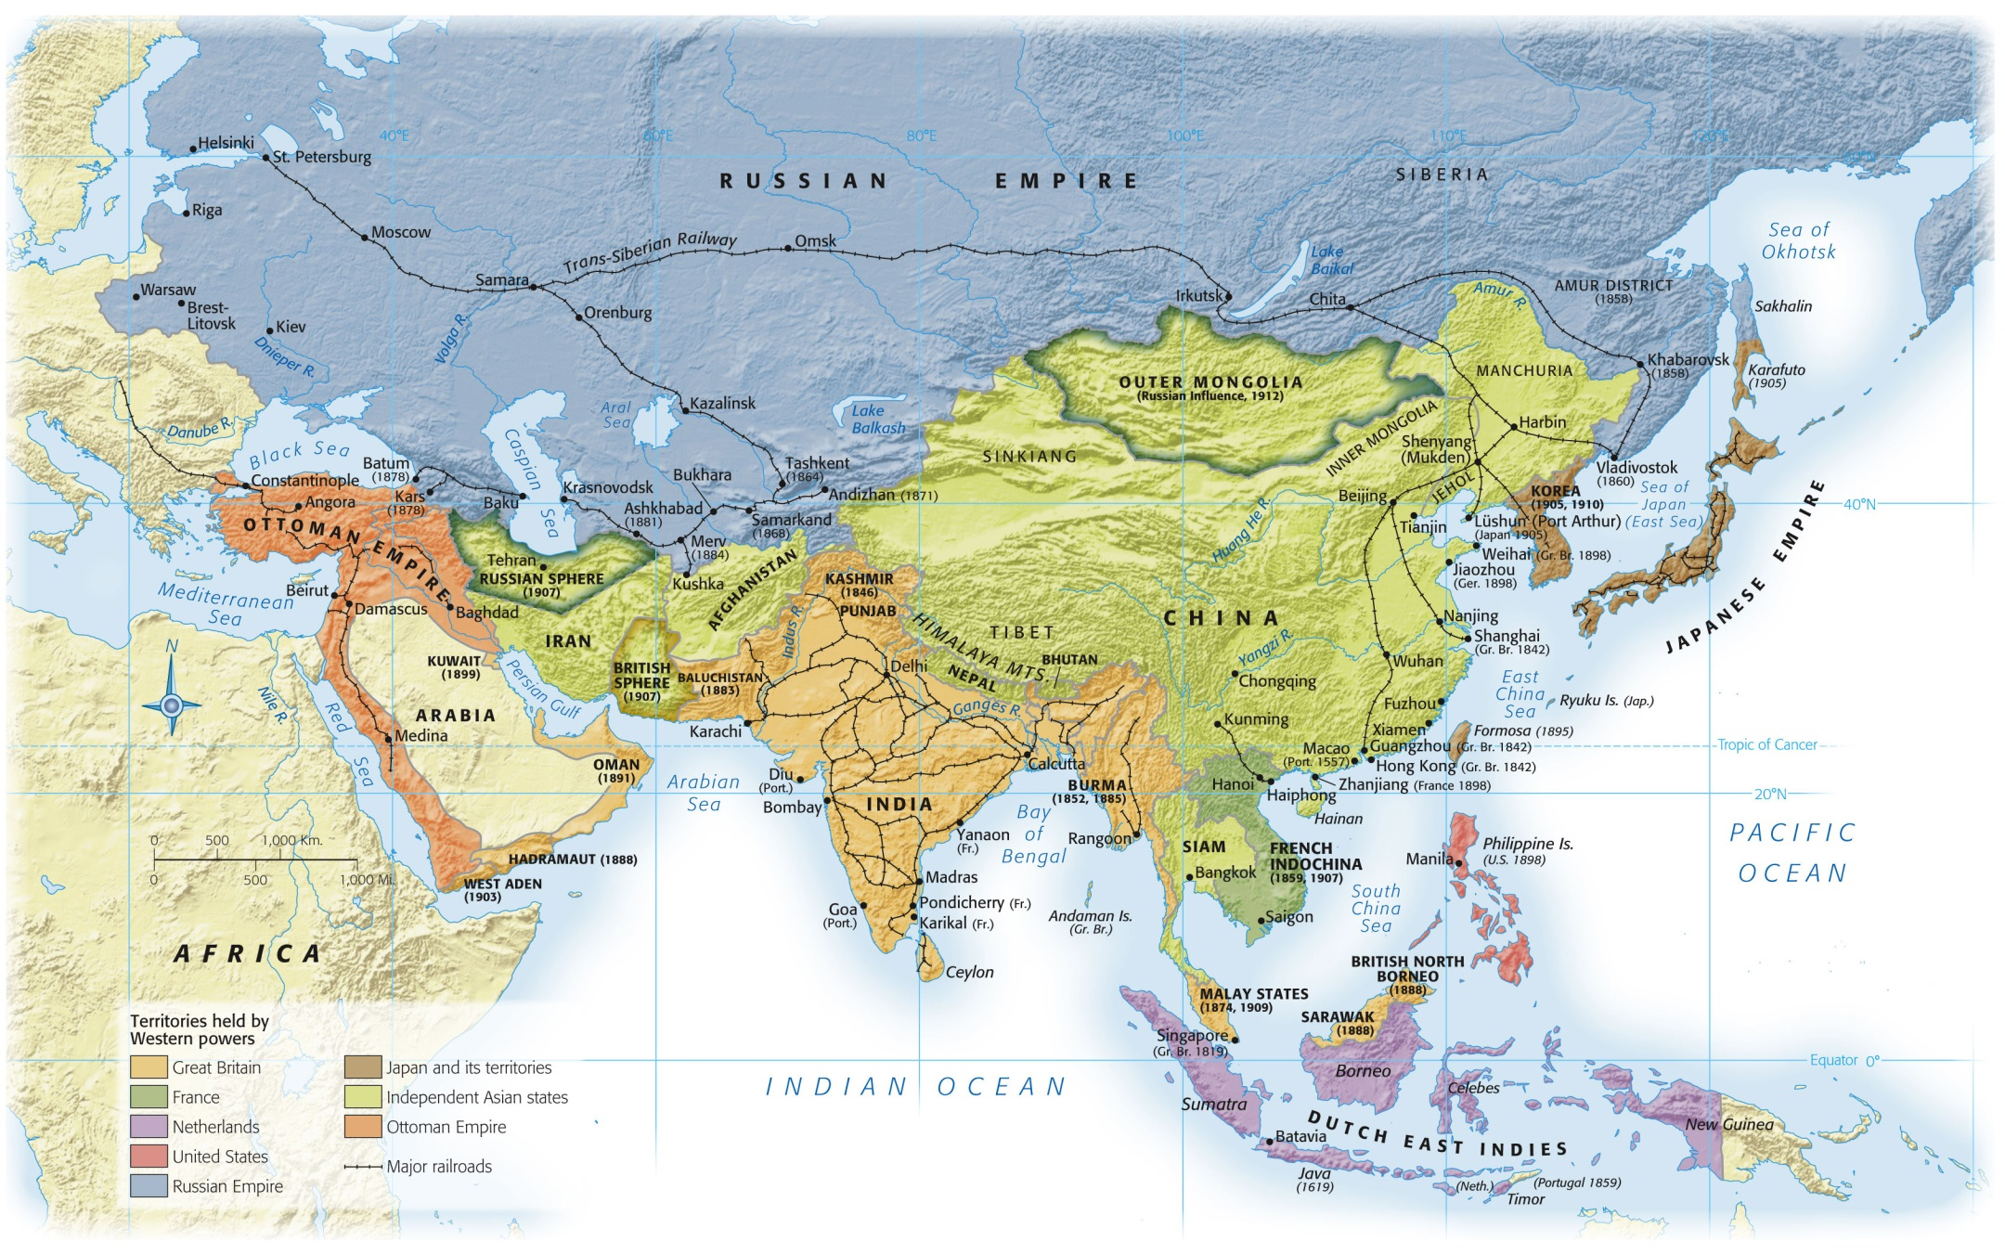
Notes:
Map 28.2: Asia in 1914.
By 1914, much of Asia was claimed by colonial powers. The southern rim, from the Persian Gulf to the Pacific, was occupied by Great Britain, France, the Netherlands, and the United States. Central Asia had been incorporated into the Russian Empire. Japan, now industrialized, had joined the Western imperialist powers in expanding its territory and influence at the expense of China.

Slide 26
Central Asia and Russia
1865-1876
Russia takes over Kazakhs
Turned communal grazing land into permanent farms for Russians
Starvation
“International rights cannot be taken into account when dealing with semi-barbarous peoples”

Slide 27
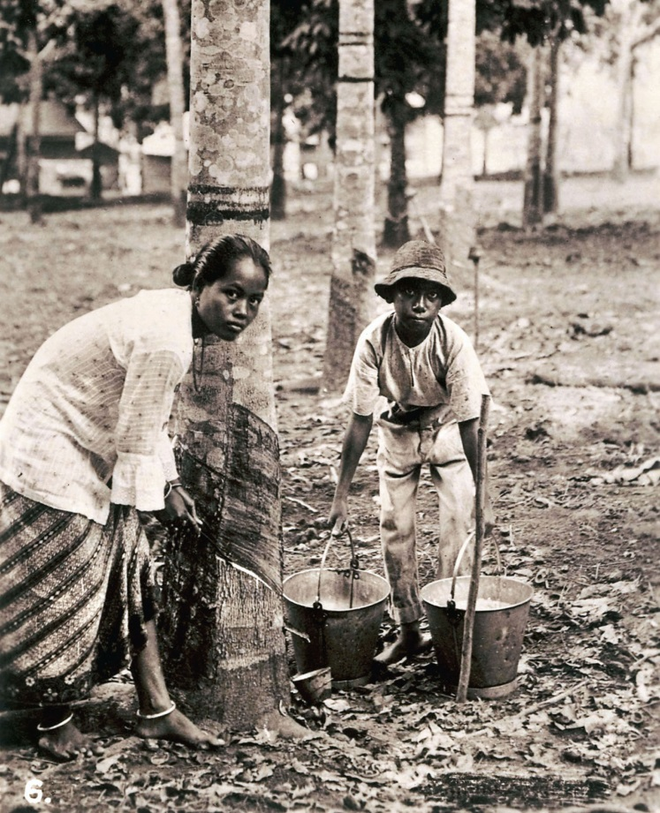
SE Asian Agriculture
Fertile soil, warm climate, heavy rain
Easily imported laborers (China and India)
Valuable crops imported
Tobacco, manioc, maize, rubber
Sugar, tea, coffee, palm oil
1914: majority of these products exported from SE Asia and Indonesia
Migrations of workers
Hunter/gatherers displaced by plantations
Notes:
A Rubber Plantation.
As bicycles and automobiles proliferated in the early twentieth century, the demand for rubber outstripped the supply available from wild rubber trees in the Amazon forest. Rubber grown on plantations in Southeast Asia came on the market from 1910 on. The rubber trees had to be tapped very carefully and on a regular schedule to obtain the latex or sap from which rubber was extracted. In this picture a woman and a boy perform this operation on a plantation in British Malaya.

Slide 28
US Imperialism
Too many manufactured goods for population
Pago Pago, Samoa
US naval base
Pearl Harbor, Hawaii
US naval base
Spanish American War
Panama Canal

Slide 29
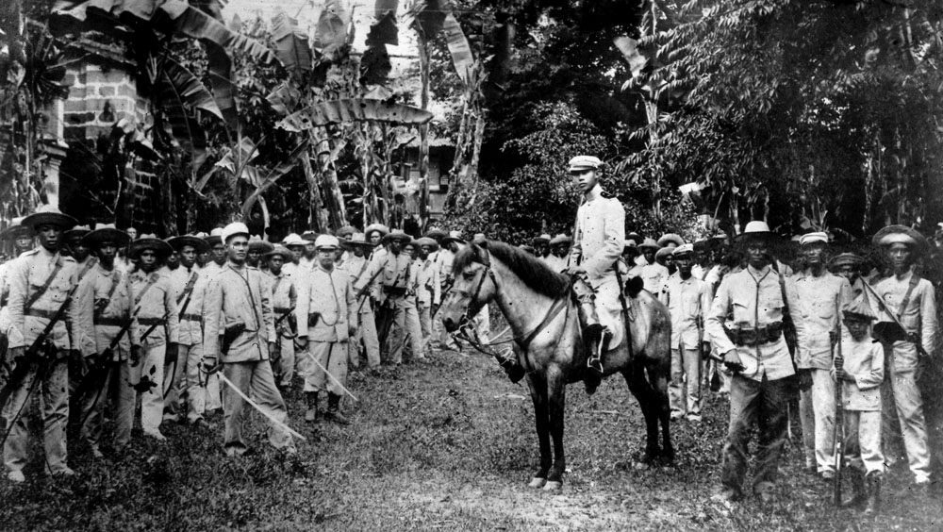
Emilio Aguinaldo
In 1896, a revolt led by Emilio Aguinaldo attempted to expel Spaniards from the Philippines. When the United States purchased the Philippines from Spain two years later, the Filipino people were not consulted. Aguinaldo continued his campaign, this time against the American occupation forces, until his capture in 1901. In this picture, he appears on horseback, surrounded by some of his troops.

Slide 30
Spanish American War
USS Maine
Havana harbor
Ship explodes
Yellow journalism
Ultimatum to Spain
Leave Cuba
Defeat of Spanish navy at Manila, Philippines
Philippines become US territory
Liberation of Cuba from Spain
Platt Amendment
Gave US “right to intervene”

Slide 31
Global Economy and ENVIRONMENT
economy
Environment
Nonindustrial countries
Dependent on manufactured imports
Export of natural resources
Canals
Lowered transportation costs ant times
Railroads
Tropical forests
Destroyed for plantations
Irrigation
Mining

