Slide 1
Africa in the Early Colonial Period
What happens when you take the strongest members of an entire continent away?

Slide 2
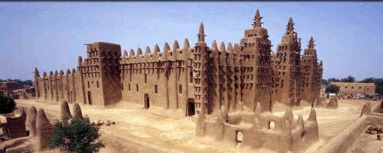
Songhay Empire
Sunni Ali became the ruler in 1464 and expanded his territory
Took over Timbuktu and instituted repressive policies against some of the scholars there
Would be later conquered by Moroccan forces with firearms… unheard of in Sub-Saharan Africa at that time

Slide 3
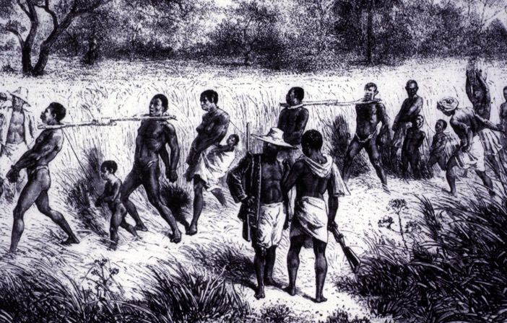
Europeans Arrive
With cooperation of local rulers, first Portuguese and other European traders set up trading posts along Africa’s coasts, some rulers traded slaves for gunpowder
In Central Africa, Portuguese explorers, traders, and missionaries visited Kongo and Benin kingdoms
Finally Vasco da Gama invaded Swahili city-states like Kilwa and took over trade throwing the region into devastating decline

Slide 4
Developments in Literature
Works | Country | Dates | Significance
Collected works of Wiliam Shakespeare | England | 1564-1616 | Set the precedent for European style in prose, poetry, and drama
Don Quixote by Cervantes | Spain | 1547-1616 | Was the first great novel in European Literature
Epic of Sundiata | Mali Empire in West Africa | 1210-1260 | Spread the story orally of the founder of the Mali Empire for generations before being written down
Journey to the West | China | 1592 | Used Buddhist, Taoist, and Confucian symbolism in the format of a novel
Kabuki Theater | Japan | 17th Century | Dramatized love stories, conflicts, and other aspects of Japanese culture in a highly stylized and flashy form

Slide 5
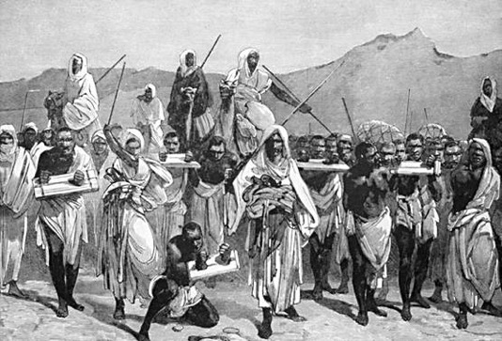
Africans and the Atlantic Slave Trade
Slavery was around before the Europeans, just ask the Muslim traders in the north and on the Indian Ocean, but why Africa?
Native Americans kept dying and Europeans didn’t want to work the fields, so Africans fit the bill
Also, slave labor was for life unlike indentured servants

Slide 6
Triangular Trade

Slide 7
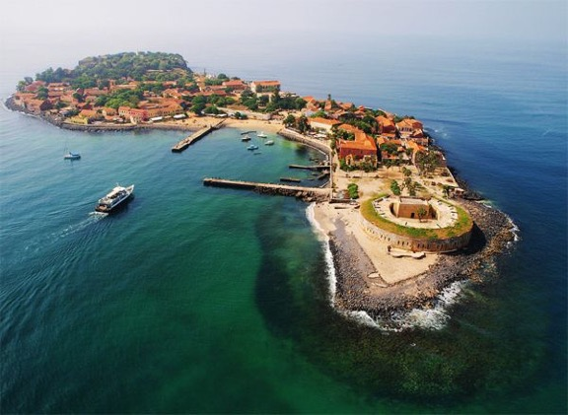
Capture and Shipment of Slaves to the Americas
African leaders along the coast invaded neighboring societies to take slaves to the coast
Transferred to holding pens in West Africa known as barraoons, or Slave Castles such as the “House of Slave” on Goree Island
From there they took them across the Middle Passage on slave ships where 25% of all slaves died on the trip, and slave ships planned for this

Slide 8
African Presence in the Americas
With few exceptions Africans were not able to transplant their languages to the Americas
Most lost their languages after a generation since Europeans refused to speak it
As discussed in a earlier chapter, religious syncretism, happened between the different African religions, and Christianity

Slide 9
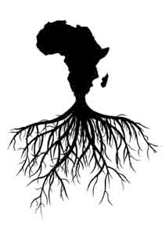
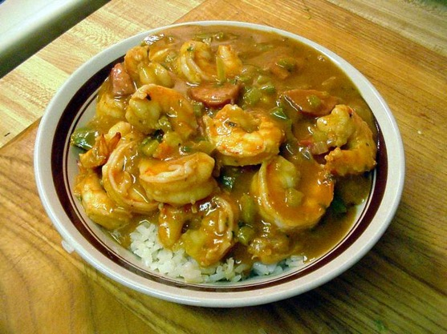
African Music and Food in the Americas
Jazz, gospel, blues rock-n-roll, hip-hop, samba, reggae, and country music are all influenced by African music
Blended Christian music with their own religious songs to sing to get through the day
Brought rice and okra to the Americas, and the dish known as Gumbo, popular in the southern US traces it’s roots to Africa

Slide 10
Effects of the Slave Trade on Africa
Gender distributions in Ghana and Benin became imbalanced since two-thirds taken were men, leading to the practice of polygyny
Economically those with firearms became wealthy and led to more fighting between the tribes
Slowed the development of societies in Africa
It did, however spur population growth and improve their diet through the Columbian Exchange

Slide 11
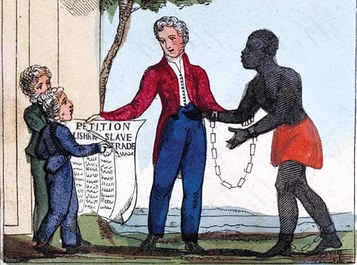
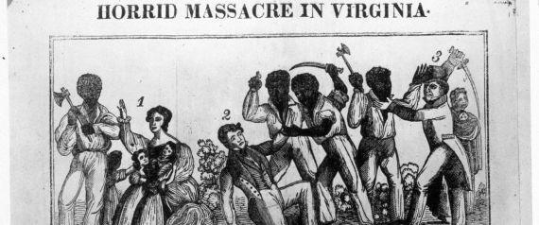
The End of the Atlantic Slave Trade
Over time, the drive for abolition of the slave trade thanks to the Enlightenment philosophers led to the end of the slave trade
Slave revolts began to be common such as the French colony of Saint Domingue by Toussaint L’Ouventure
By 1888, slavery in the Americas was abolished, in Haiti and the US by full-scale war

