Slide 1
The Industrial Revolution Game

Slide 2
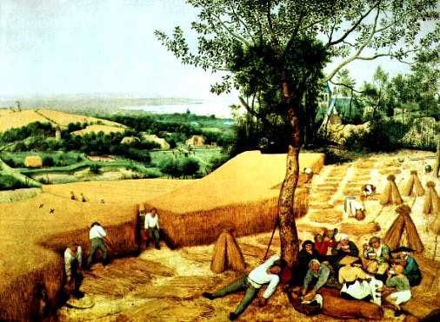
Round 1 1700
1. Draw a river across your paper connecting east to west. The river should be about half an inch wide.
2. Draw a simple wooden bridge crossing the river.
3. Draw two roads: one running north to south and crossing the river at the bridge, and one running from east to west.
Neither road need be a straight line.
4. Draw 10 houses, 1 church, 1 cemetery, 1 store, 1 pub, 1 coalmine and 50 trees.

Slide 3
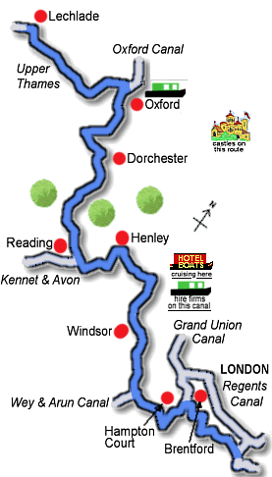
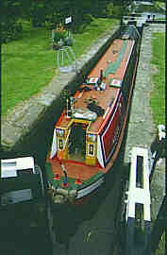
Round 1 Part 2 1745 Oxford Canal
Draw a canal. It must connect the coal mine to the river.

Slide 4
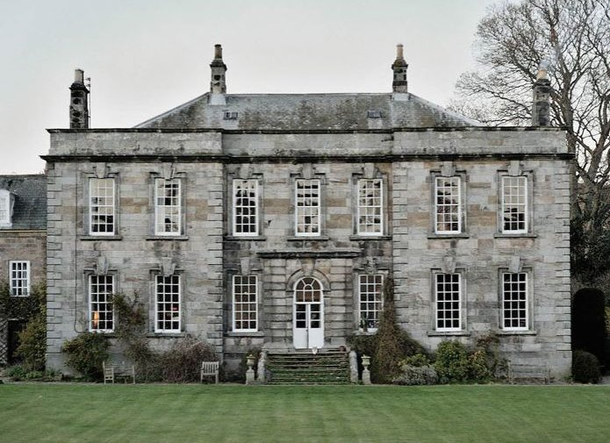
Round 1 – Part 3
Draw one nice house. Label it 1745.

Slide 5
Round 2 Population Explosion
Add 5 regular houses Label them 1750.

Slide 6
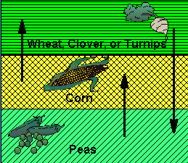
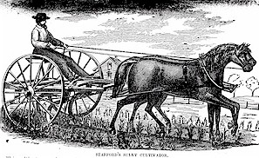
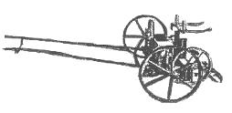
Round 3
Draw your Commons. Fence off a 3x3 inch square of land for community use in the middle of your town.
Add 5 more houses. Build 1 more nice house.
Three Field System
Crop Rotation

Slide 7
Round 4
Add one factory beside the river. Label it 1773. Add 5 more regular houses.

Slide 8
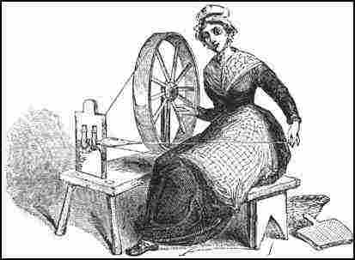
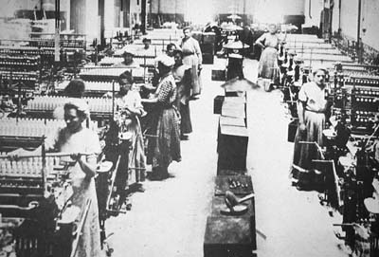
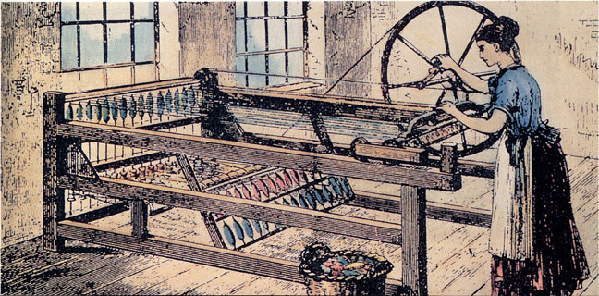
Round 5
Draw 15 regular houses (total of 40). Draw 1 church, 1 pub, and 1 store. Draw a road leading to the factory from the part of the village with the most houses.

Slide 9
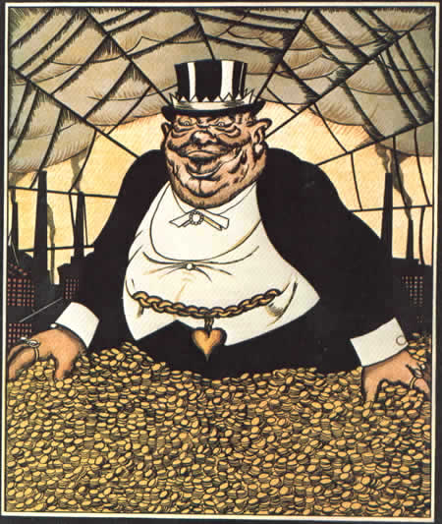
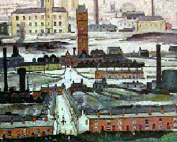
Round 6
Add 5 new factories along the river bank as they need water power. Add a circle for a water wheel to each factory. Add 5 new houses.

Slide 10
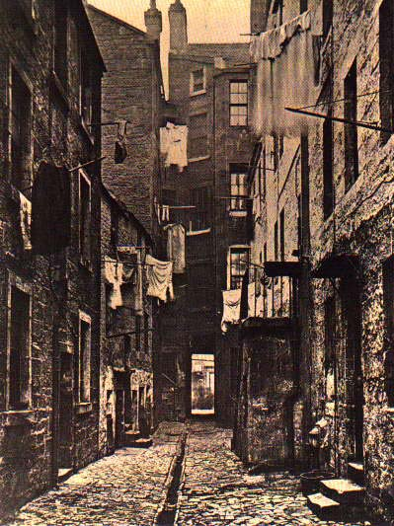
Round 7
Add 5 tenements. Label them 1780
Tenements

Slide 11
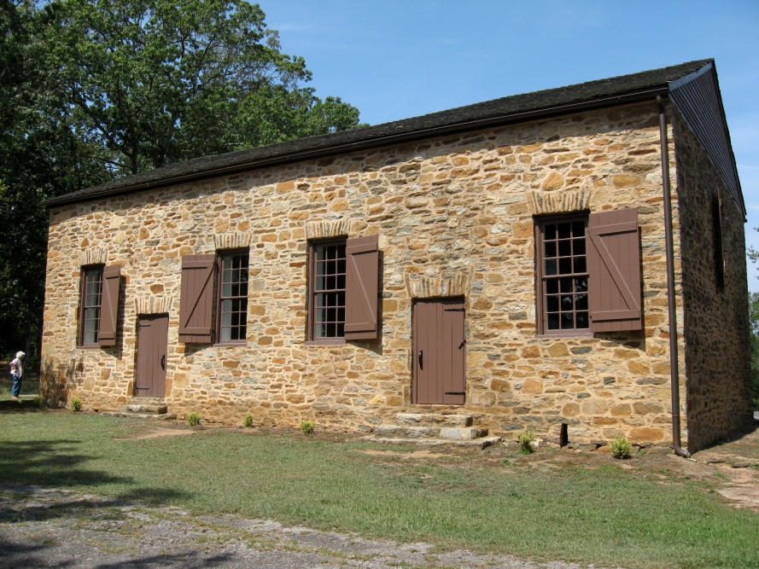
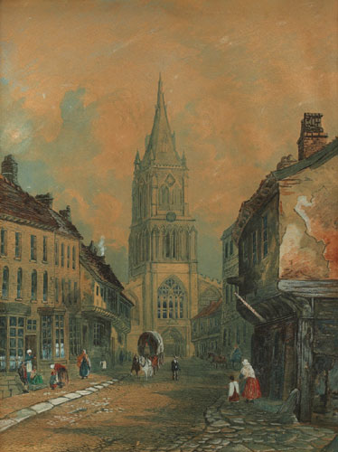
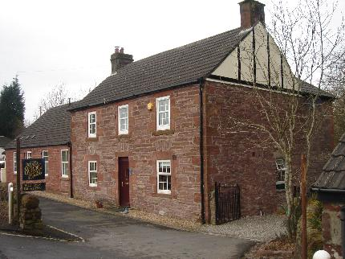
Round 8
Add 1 store, 1 pub, 1 church and 1 school for rich boys.

Slide 12
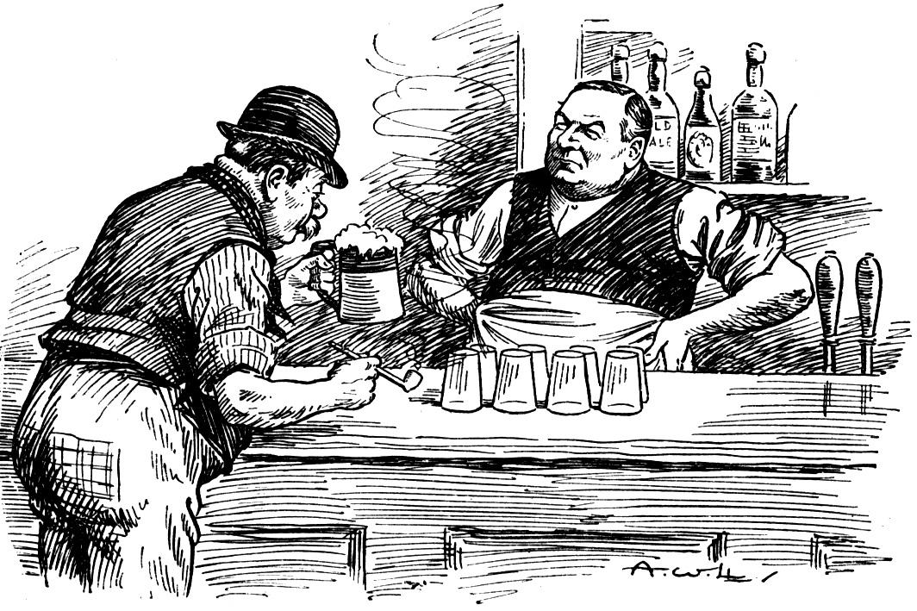
Round 9
Add 5 pubs. Destroy 5 houses and add 4 tenements. Totals: 40 houses, 9 tenements, 6 factories (no smoke), 3 churches, 8 pubs, 3 stores, 1 school, 1 coal mine, 50 trees and 1 commons (3x3 box).

Slide 13
Round 10
Add 2 special homes. Add 1 factory. Add 15 houses for management personnel. You may get rid of your trees.

Slide 14
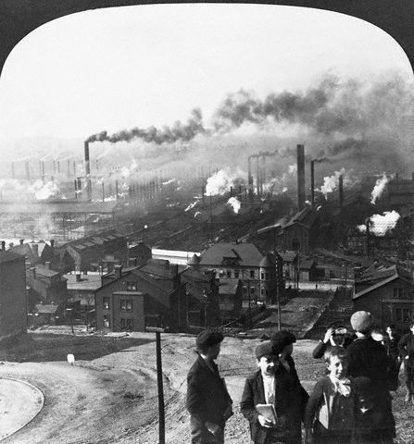
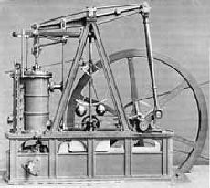
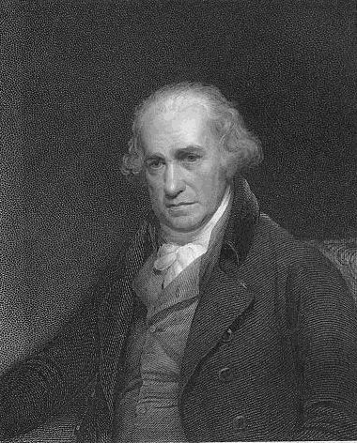
Round 11
Add 10 factories with smoke anywhere on the map. Add smoke to all the other factories (Total of 17 factories). Add 1 nice house , 5 regular houses, and 1 tenement.
James Watt
Notes:
Thomas Newcomen was a famous engineer from Dartmouth. He built a steam engine to pump water from the Cornish tin mines. His engines were also used in the 18th century to increase the supply of drinking water.

Slide 15
Round 12
Add 1 new coal mine and a new iron bridge to replace the old wooden one. Add 5 houses.
This makes a total of 65 houses, 17 factories with smoke, 2 coal mines, 10 tenements, 8 pubs, 5 large homes, 3 churches, 3 stores, 1 school, 1 cemetery, 1 commons (3x3).

Slide 16
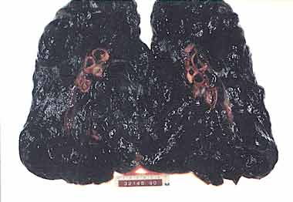
Round 13
Add one cemetery and a third coal mine. Label them 1815.

Slide 17
Round 14
Add 5 houses. Add 1 major railroad connecting all your factories and your coal mines.

Slide 18
Round 15
Add 1 jail, 2 pubs and 2 tenements. Label these 1827.

Slide 19
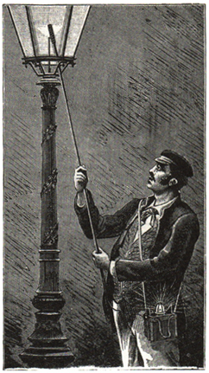
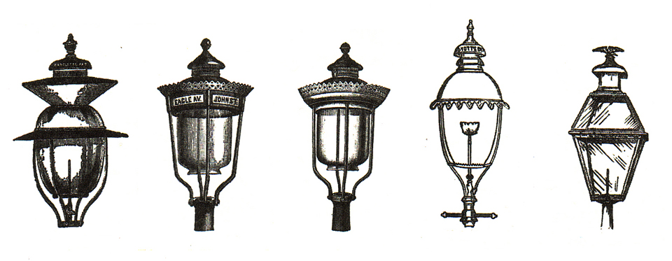
Round 16
Add 20 street lamps along your main streets

Slide 20
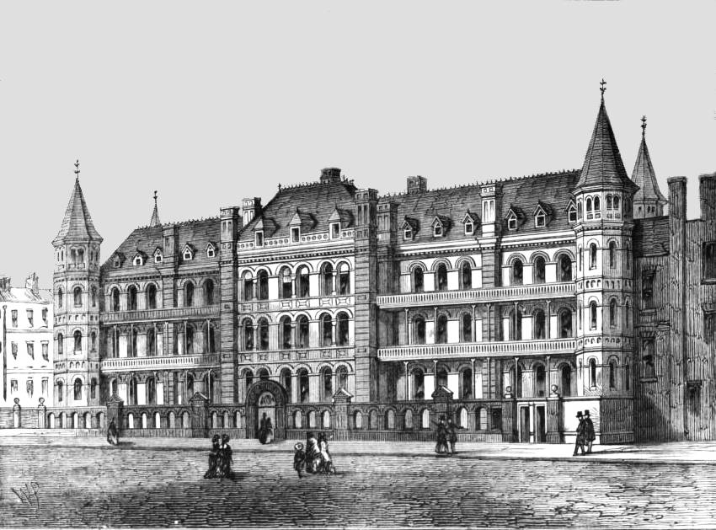
Round 17
Add two hospitals and 1 more cemetery. Below is a hospital built for children in London.

Slide 21
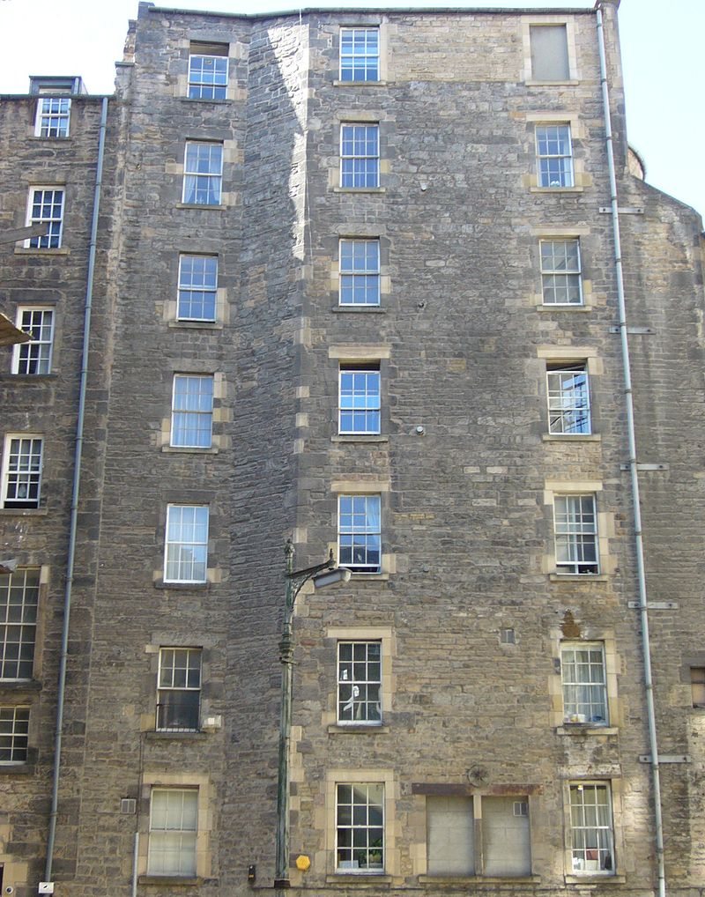
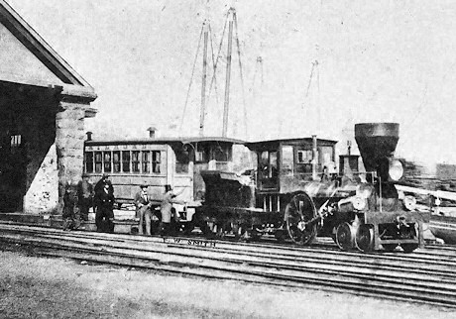
Round 18
Add 5 houses and 1 tenement for the new workers. Add 1 more railroad line going north to south.
Totals: 75 houses, 17 factories, 3 coal mines, 13 tenements, 10 pubs, 5 large homes, 3 churches, 3 stores, 3 cemeteries, 2 hospitals,1 school, 1 jail Below: 1840 railway & 1840 Edinburgh Tenement

Slide 22
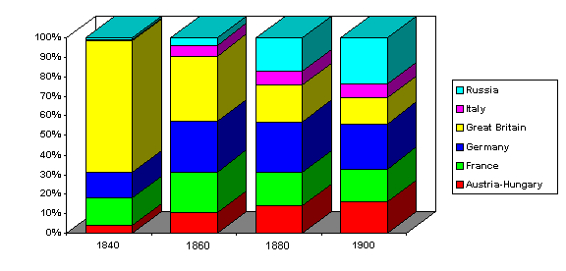
Round 18 % of Europe’s Railroads by Country
Notes:
Visually this version of the table can be presented as follows. In this version the percentage of total European railways belonging to each country in particular years is shown. Great Britain, a small island, had well over 60 percent of railroads in Europe in 1840, but a much smaller percentage, even though its absolute amount of track increased tenfold, by 1900.

Slide 23
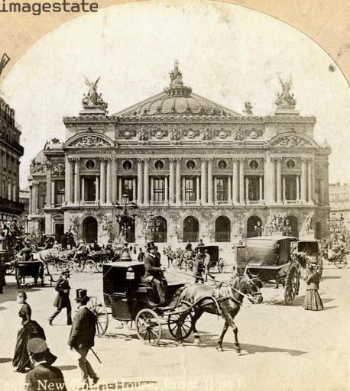
Round 19
Add 1 theater and 1 museum. Add 2 private schools, and 1 normal school. Add one nice house and 10 more houses.
Opera House

Slide 24
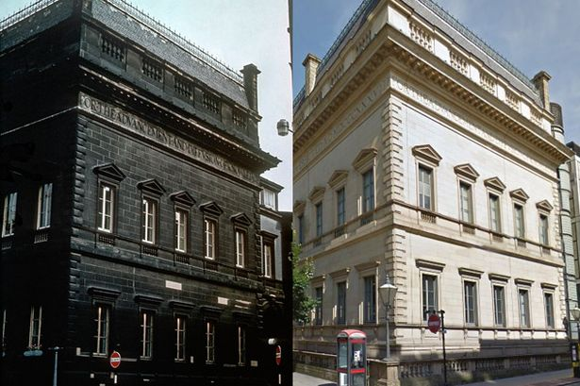
Round 20
Add 2 cemeteries, 1 jail, 1 hospital.
Below: Manchester England

Slide 25
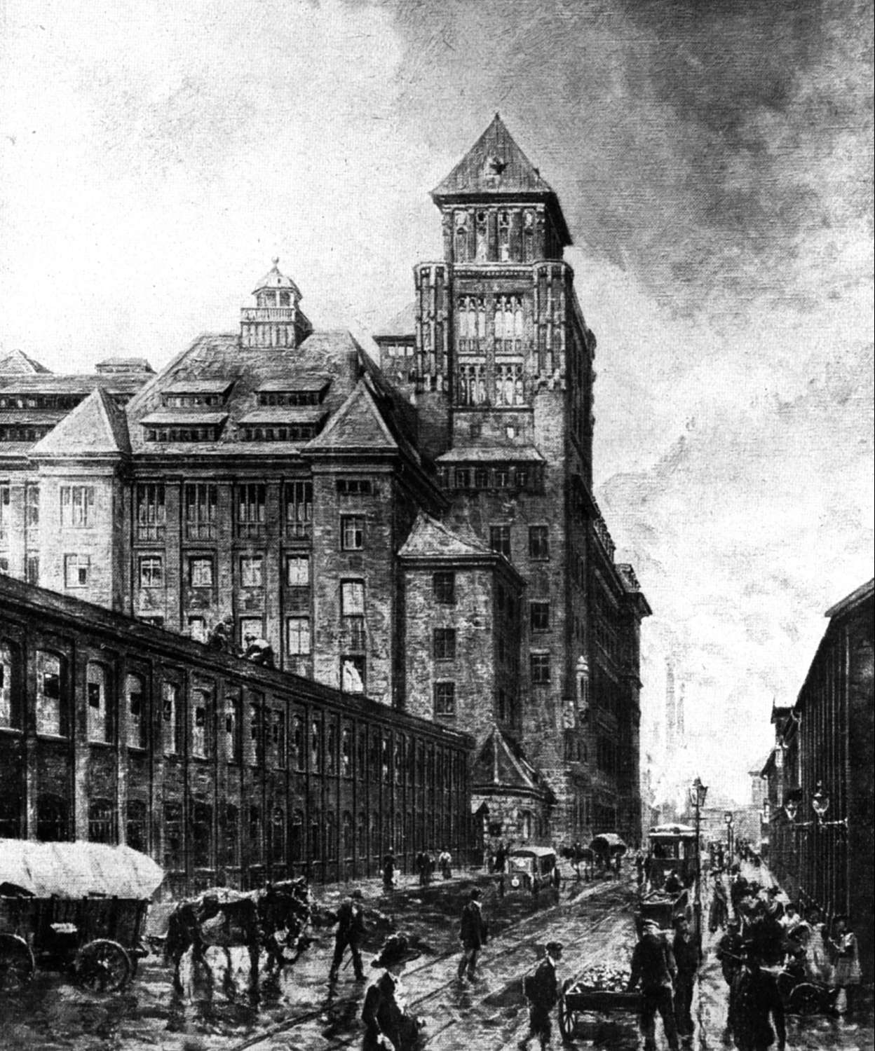
Round 21
Add 15 houses, 4 more nice homes, 2 stores, 7 tenements, 2 churches, 8 factories, 1 school, and 5 pubs. Build 1 City Hall for the mayor.

Slide 26
Totals: 100 houses, 25 factories, 20 tenements, 10 wealthy homes, 10 pubs, 5 cemeteries, 5 stores, 4 schools, 3 hospitals, 2 railroads (N-S, E-W), 3 coal mines, 3 canals, 2 jails, 2 theaters, 1 city hall, 1 museum, and up to 5 bridges

Slide 27
Exit Ticket:
With the Industrial Revolution – how was your village changed? Can it even be called a village any more? Why or why not? What do you believe the impact of the Industrial Revolution to be? Knowing what you know now, what would you do differently in building a city?
Write in complete sentences to earn credit for the day!

